Slide 1
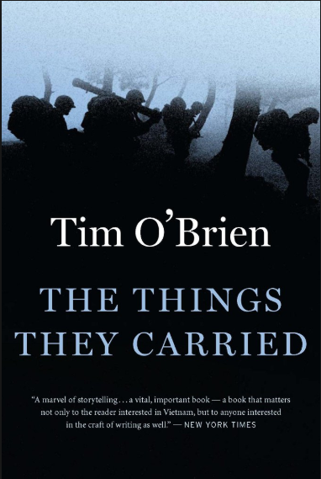
The Things They Carried
Tim O’Brien

Slide 2
“This book is essentially different from any other that has been published concerning the ‘late war’ or any of its incidents. Those who have had any such experience as the author will see its truthfulness at once, and to all other readers it is commended as a statement of actual things by one who experienced them to the fullest.”
(TTTC epigraph)
- John Ransom’s Andersonville Diary
**Metafiction
**Intertextuality: Shaping of texts' meanings by other texts, borrowing from other texts to create meaning Poiomena: Story about the process of writing; Challenges fiction and reality
POSTMODERNISM: Emphasize idealism, constructivism, relativism, pluralism and skepticism in its approaches to knowledge and understanding

Slide 3
Key Details about the book
Full Title: The Things They Carried
When Written: 1980s http://www.cnn.com/2013/07/01/world/vietnam-war-fast-facts/
Where Written: The United States
When Published: 1990
Literary Period: Post-modern, Contemporary
Genre: War Novel
Setting: Vietnam; Minnesota; central Iowa

Slide 4
Tim O'Brien
Tim O'Brien moved with his family to Worthington, Minnesota when he was twelve, a place which has served as the setting in many of his stories in The Things They Carried as well as his other works.
He got his BA from Macalester College in Political Science in 1968.
In 1968 he was drafted by the Army and sent to Vietnam, where he served from 1968 to 1970.

Slide 5
Tim O'Brien
When he returned from the war, he went to graduate school at Harvard University.
In 1973, he published his first book, a memoir entitled: If I Die in a Combat Zone, Box Me Up and Ship Me Home.
In 1979, O'Brien won the National Book Award for his novel Going After Cacciato, but he is perhaps best known for his collection of semi-autobiographical stories The Things They Carried.
He has written many additional novels, many focused around the Vietnam war and its aftermath upon those who served in it.

Slide 6
Overview of novel
The Things They Carried is a collection of linked short stories by American novelist Tim O'Brien, about a platoon of American soldiers fighting on the ground in the Vietnam War. Meet some of the boys as he characterizes them by group and then again as individuals. Closely examine the effects of his style choices and then apply them in your own writing.

Slide 7
overview
POV: mostly 1st, 3rd sometimes for distancing or other character POV
Tone: introspective, self-conscious
Narrator: unreliable, blurs fiction w truth
22 short stories/chapters/vignettes
Independent, but expand on each other for meaning
Non-linear
Repetition - cyclical - foreshadowing - flashback
Time - memory - truth

Slide 8
Overview
Tense: past - late 60s war & narrator’s immediate past in late 80s
Protagonist: “Tim O’Brien”
Conflict: short/long-term effects of war
Climax: coping w loss of men of Alpha & guilt

Slide 9
themes
Morality and Death
Social Obligation
Storytelling and Memory
Shame and Guilt

Slide 10
Chapter 1
Ch. 1:
Built around central question: Why people carry the things they do?
Physical - abstract - physical...
Group - individual - group...
Cataloging of minutiae continues to expand and connect...
Imagination - reality - imagination…
Syntax - parallelism (anaphora, epistrophe/epiphora, polysyndeton, asyndeton)

