Slide 1
Transcendentalism
Goodman, Russell, "Transcendentalism", The Stanford Encyclopedia of Philosophy (Spring 2011 Edition), Edward N. Zalta (ed.), URL = <http://plato.stanford.edu/archives/spr2011/entries/transcendentalism/>.

Slide 2
Romantics vs. Dark Romantics
American Romantic authors celebrated and portrayed nature and individual reflection as a rejuvenating departure from the evils of overcrowded urban life.
William Bryant’s “Thanatopsis”
TRANSCENDENTALISTS: Thoreau, Emerson
American Dark Romantic authors condemned and portrayed the evil darkness inherent in both people’s souls to show that man and the world contain evil.
Poe’s The Masque of Red Death, The Tell-Tale Heart
Burton’s Batman Returns

Slide 3
From Movement to Philosophy
Movement: a group of people working together to advance their shared political, social, or artistic ideas (Romanticism)
Philosophy: the study of the fundamental nature of knowledge, reality, and existence, especially when considered as an academic discipline. (Transcendentalism)

Slide 4
“We will walk on our own feet; we will work with our own hands; we will speak our own minds ... A nation of men will for the first time exist, because each believes himself inspired by the Divine Soul which also inspires all men.”
-Ralph Waldo Emerson

Slide 5
Transcendentalists
Well educated people who lived in the decades before the American Civil War and national division
Mostly New Englanders (Boston, New England Congregationalists), were attempting to create a uniquely American body of literature
Had a sense that a new era was at hand
Were critics of their society for its unthinking conformity, and urged that each person find, in Emerson's words, “an original relation to the universe.”
They believed in the importance and efficacy of human striving, as opposed to the bleaker Puritan picture of complete and inescapable human damnation
Efficacy: ability to produce a desired effect

Slide 6
Historical Context
Popular politics were generally concerned with keeping the status quo and adding as much territory as possible
Jacksonian era
Confrontation of the rights of slaves/women/Indians was definitely NOT on the agenda
Class differences were widening rapidly
Reform movements were therefore generated by small groups of individuals

Slide 7
Core Beliefs & Values *
Largely believed in peaceful revolution, spurred by example
The belief that the way one lived, thought, and interacted with the world would become a model for others
An exemplary life would inspire others to live in a new way
Emphasis on education and self-culture
Both reflected and exacerbated national division

Slide 8
Transcendental Beliefs *
Action — along with nature and “the mind of the Past” is essential to human education
Men and women are gods “in ruins” (Emerson from Nature)
Religion is based not on testimony but on a “perception” that produces a “religious sentiment”
The European Christian establishment is injurious but Jesus is a “friend of man”

Slide 9
Transcendentalists
Emerson and Thoreau sought this in relation in solitude amidst nature, and in their writing.
By the 1840s they, along with other transcendentalists, were engaged in the social experiments of Brook Farm, Fruitlands, and Walden
By the 1850s communicated increasingly urgent critique of American slavery

Slide 10
Characteristics of Transcendentalism *
In Nature, we are able to "transcend" the truths we know in the Natural world.
In other words, Transcendentalists believe in things they cannot see or touch or feel. Nature is our source to experience these truths. So things like meditation can bring us to truths that we never would have experienced using only our five senses.
Materialism is bad.
Striving for material goods was seen as worthless and an unhealthy pursuit. It was totally superficial and can only lead to corruption.

Slide 11
Characteristics of Transcendentalism *
Society is the source of corruption.
If we are all to follow our own free will and listen to our hearts, we would be much better off. Societal/governmental norms and rules are counterintuitive.
Our intuition and natural instincts guide us to do the right things.
In nature, we are uncorrupted. It is only when we let society in that we start to conform and hence, be corrupted.

Slide 12
Characteristics of Transcendentalism *
Conformity is wrong.
We should NOT follow the crowd. We should make our own way and our own decisions in this world in order to truly embrace our uncorrupted intuition.
The nature of human beings is good.
Again, it is society that corrupts us. Human beings left to their own devices are good.

Slide 13
Characteristics of Transcendentalism *
Knowledge comes from experience.
The knowledge is not derived from reading books or studying or any of the other things we do in schools. It comes from living.
God is everywhere and in everything.
The Transcendentalists did not need organized religion because they wanted that direct relationship with God, not one through a pastor or a priest.
All things are interconnected.
The LIFEFORCE or OVERSOUL that exists everywhere also connects everything

Slide 14
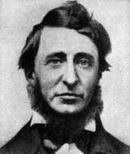
Henry David Thoreau
1817-1862
American author, philosopher, abolitionist, tax resister, etc.
Book: Walden
Literary style: weaves natural observation, personal experience, symbolic meanings, historical lore
Heavily influenced other leaders that came after him
Political writings had less of an impact during his lifetime, not seen as a radical by his contemporaries

Slide 15
Ralph Waldo Emerson
Attended Harvard School of Divinity & became a minister in 1826. His wife died from Tuberculosis in 1831, causing him to leave the church & experience a crisis of faith.
He traveled to Europe, which inspired lectures on the personal nature of the spiritual experience and ethical living.
He found a following of like minded people, such as Margaret Fuller, Henry David Thoreau, and Amos Bronson Alcott.
His lectures, like “Nature” became published essays. He encouraged American authors to find their own style of writing.
Emerson favored a more moderate balance between individual nonconformity and broader societal concerns.
He advocated for the abolition of slavery and continued to lecture until he died in 1882.

Slide 16
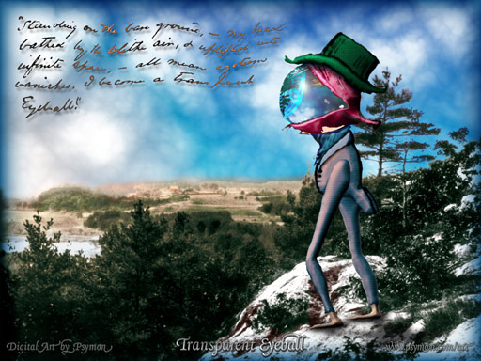
Ralph Waldo Emerson
Nature, Self Reliance
transparent eye-ball
nature as a way to reach God

Slide 17
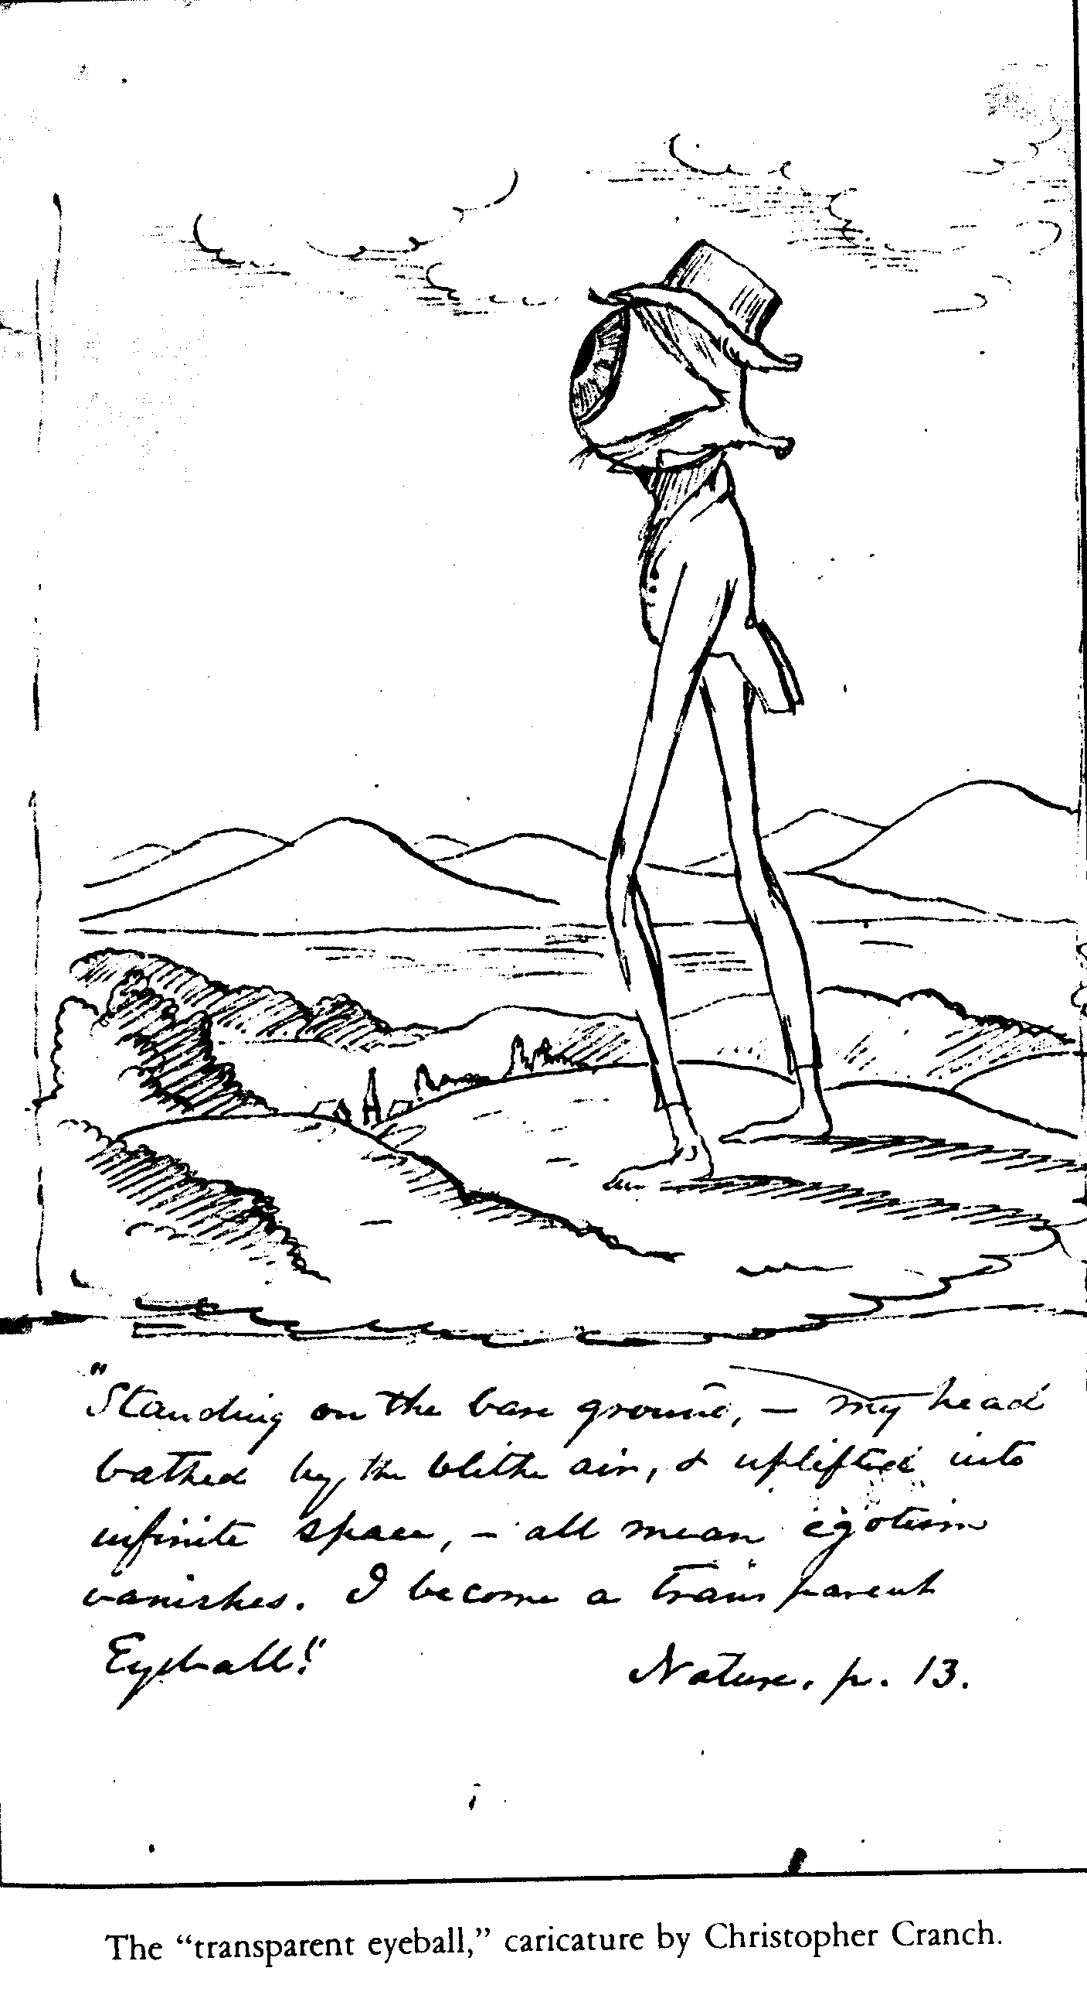
“I become a transparent eyeball. I am nothing; I see all; The currents of the universal being circulate through me.” (Emerson from Nature)

Slide 18
“Nature”
What is Emerson saying about solitude in the first paragraph?
Explain his use of the viewing of the stars as an illustration: what is his point?
What is the ideal relationship between man and nature?
What is Emerson talking about in paragraph 3, where he discusses the role of the poet?
What point is Emerson making about children vs. adults, and what does he say about wisdom?
“I become a transparent eye-ball; I am nothing; I see all…” What is going on in this sentence.
What effect does nature have on man in how he perceives/relates to it properly?

Slide 19
Thursday Prep Work
Reading:
Self-Reliance (Emerson)
Civil Disobedience (Thoreau)

Slide 20
Individual Prep Work
Each response should have direct evidence from the readings:
Summary of main ideas/point/message
Determine the authors views on humanity and human kind.
Explain the advice the author offers humans.
Conclude if there are any connections to abolition/rights movements.
Based on your reading, define what it means to be a Transcendentalist. What do they value?

Slide 21
Civil Disobedience
The active, professed refusal to obey certain laws, demands, and commands of a government, or of an occupying international power. (Usually non-violent)

Slide 22
Transcendentalist Recruitment Posters
Create a piece of recruitment to persuade others to believe in the Transcendentalist philosophy.
Incorporate the following:
Ideas from both readings (including quotes)
Images
Characteristics of Transcendentalism
Write all of your names on the front of the poster!

Slide 23
Group Reflection (other side of white paper)
How could these Transcendentalist have inspired the abolitionist movement?
What current aspects in American culture reflect Transcendentalist ideals/ideas?
What lessons can 2019 Americans learn from Transcendentalist?

Slide 24
Older Files

Slide 25
Your turn: Be the transparent eye-ball!
In true transcendentalist fashion, we are going to go outside! ☺
Bring only a pen or pencil and something to write on.
Use your 5 senses, and write about whatever comes to mind. What do you see? Feel? Hear? Smell?

Slide 26
Group Image (one side of white paper)
Once you have shared your individual questions/answers, grab a white piece of printer paper.
You need to visually represent the ideas of transcendentalists, especially Thoreau and Emerson
Think metaphor and not literal representation

Slide 27
Imagination
Imagination was emphasized over “reason.”
This was a backlash against the rationalism characterized by the Neoclassical period or “Age of Reason.”
Imagination was considered necessary for creating all art.
British writer Samuel Taylor Coleridge called it “intellectual intuition.”

Slide 28
Intuition
Romantics placed value on “intuition,” or feeling and instincts, over reason.
Emotions were important in Romantic art.
Transcendentalist, Henry David Thoreau, prolifically focused on the intuition man can identify through communing with nature.

Slide 29
Idealism
Idealism is the concept that we can make the world a better place.
Idealism refers to any theory that emphasizes the spirit, the mind, or language over matter – thought has a crucial role in making the world the way it is.
Transcendentalist will clash with American Dark Romantics on this point.

Slide 30
Inspiration
The Romantic artist, musician, or writer, is an “inspired creator” rather than a “technical master.”
What this means is “going with the moment” or being spontaneous, rather than “getting it precise.”
The work of Edgar Allan Poe will represent this idea well.

Slide 31
Individualism
Romantics celebrated the individual.
During this time period, Women’s Rights and Abolitionism were taking root as major movements which is grounded in individualism.
Walt Whitman, a later Romantic writer, would write a poem entitled “Song of Myself”: it begins, “I celebrate myself…”

Slide 32
Find & explain a quote in Civil Disobedience or Self-Reliance that fits each of these four tenets of Transcendentalism:
Idealization of nature and the natural world
Developing a “mind of the Past” is essential to human education
Men and women are gods “in ruins”
The importance and efficacy of human striving, as opposed to the bleaker Puritan picture of complete and inescapable human damnation
Efficacy: ability to produce a desired effect

