Slide 1
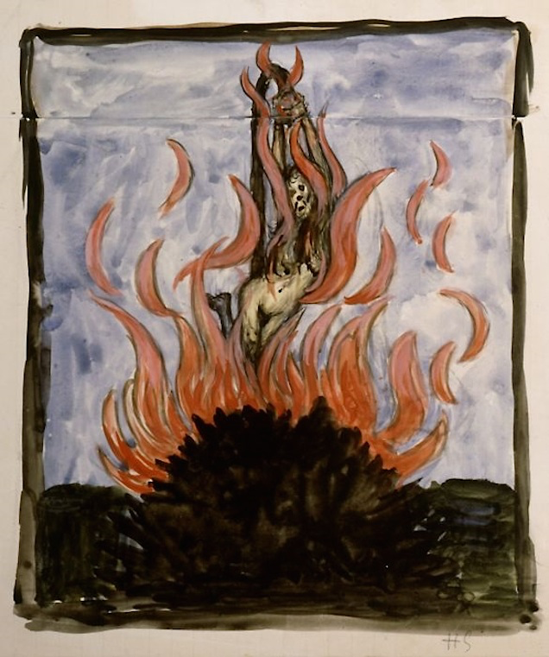
The Salem Witch Trials

Slide 2
How to Spot a Witch
Is the suspect a woman?
Does she have a pet?
Does she have a wart? (Or a mole, ‘Devil’s mark’?)
Is she middle aged?
Is she independent?
Has she stopped going to church?
Has she threatened you?
Have you seen her spirit?
Has she confessed?

Slide 3
Witch Tests
Swimming Test
Prayer Test
Touch Test
Witch Cakes
Witch’s Marks
Pricking & Scratching Tests

Slide 4
Witch
Comes from the Old English word wicca, derived from the Germanic root wic
Means to bend or turn
By using magic, a witch can bend or turn events
Can be applied to a man or a woman

Slide 5
Witchcraft
Also known as: Wicca, the Craft, Wisecraft, the Old Religion
Belief in witchcraft exists around the world and varies from culture to culture
Historically associated with evil

Slide 6
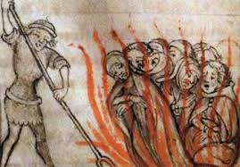
Heresy
Belief or opinion contrary to orthodox religious doctrine

Slide 7
Early Origins
In Europe beginning in the 700s CE witchcraft was associated with heresy
The Christian church began a long crusade to stamp out heresy
Especially in the 1500s people were brought before secular courts and accused of human sacrifice and worshiping with the Devil
Such stories created a mood of fear and anxiety

Slide 8
The 1500 and 1600s were a time of scarcity, and much witchcraft hysteria has to do with goods and services
Also with relationships
Many of the accused were midwives or nurses
The stereotype about women in the 1600 and 1700s was that women were wonton and naturally lustful, in need of male guidance, in order to protect them from natural inclination to sin (kind of like Eve)

Slide 9
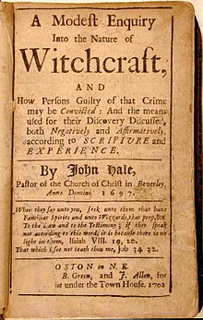
Salem Witches
Colonial Massachusetts, 1692-1693
Incredibly Puritan village, devoutly religious and conservative in values
Resulted in the execution of 20 people, most women
1 man, Giles Corey, was pressed to death by stones

Slide 10
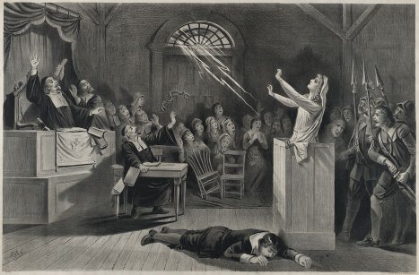
Legacy
Numerous references throughout popular culture
Cautionary tale about the dangers of isolationism, religious extremism, false accusations, lack of due process

Slide 11
What is hysteria?

Slide 12
The Church’s Take
During the late Middle Ages, the church took up the position that witches were in fact real. This began with the shift in perceptions of Satan, and with the testimony of Thomas Aquinas.
Witches were essentially vessels or puppets that demons worked through to do Satan’s dirty work.
One of the primary beliefs was that demonic possession was spread through sexual interactions.
Another common belief was that witches knowingly engaged in a deal with Satan in exchange for these powers. Of course they didn’t really possess the powers, the demons did.

Slide 13
Church’s take cont.…
Witches were believed to cause / spread disease, cause crop failure, be a source of impotence, and be guilty of idolatry (worship of Satan)
One common belief was that witches would go on night flights on brooms or animals, and that they would meet with demons in the woods. These were known as “Sabats”

Slide 14
Important thought…
The church acknowledged there were demons throughout the world, and that it was the churches job to seek out and destroy these demons.
-Problem: You can’t see demons
However: if you identify a witch or a person possessed, you can physically see/fight them.
Conclusion: The belief and attack on witches gave the Church something real to point at, and served as a way of reinforcing their power. Not only were people afraid to speak against the church for fear of persecution, but those who were accused of withcraft, acted as visible symbols that demons were real and among us!

Slide 15
Corruptions
What taboos / corruptions can we identify with the “witch monster”?
Oppose God
Oppose the natural order of reproduction
Murder babies / Barrenness
Cause infidelity
Sleeping with a demon / non-human
Look like ordinary people
Crop Failures
Cause involuntary physical behaviors

Slide 16
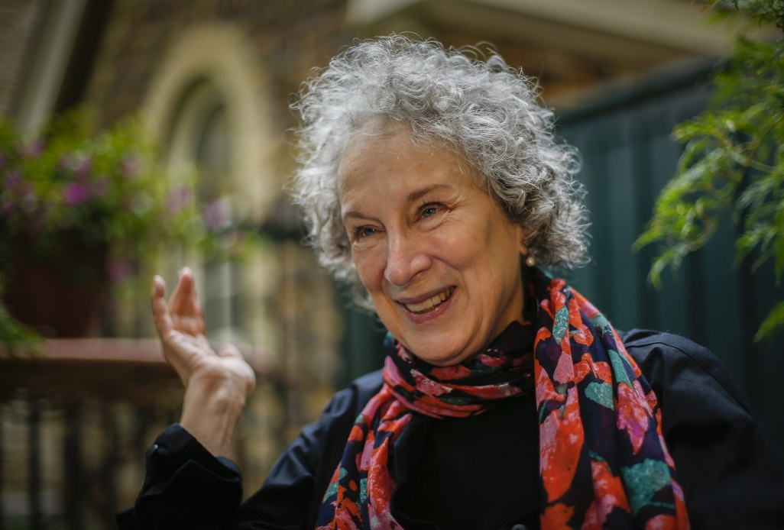
Margaret Atwood
Canadian novelist, poet, essayist, critic
Born 1939
Genres: historical fiction, speculative fiction, science fiction, and dystopian
Related to a woman who was hanged in Puritan Massachusetts for being a witch

Slide 17
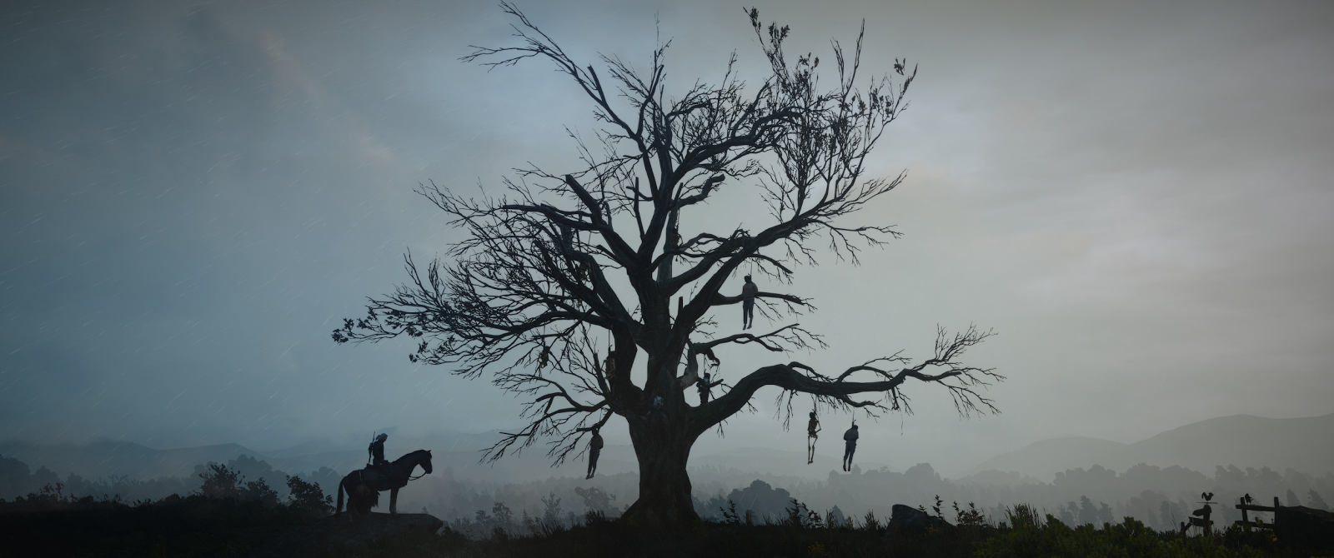
Half Hanged Mary by Margaret Atwood

Slide 18
Half Hanged Mary
As a group, answer the discussion questions about “Half Hanged Mary”
Create an original stanza that would follow next in this poem… it does not have to be directly chronological, but it must address what you think this woman’s next thoughts/feelings might be…

Slide 19
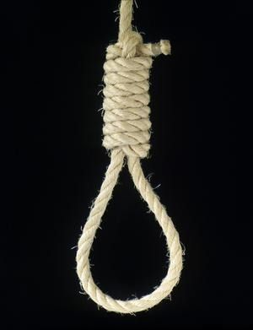
Half Hanged Mary Discussion
How does the structure of the poem affect our reading?
This poem tells the tale of witch hunts, what does this tell us about the people involved and how they were impacted?

Slide 20
Homework
Read the Overture on pages 138-141 (up until “ Reverend Parris is praying…”)
Be prepared to answer/discuss:
What did you learn about Salem?
Who did you meet?

