Slide 1
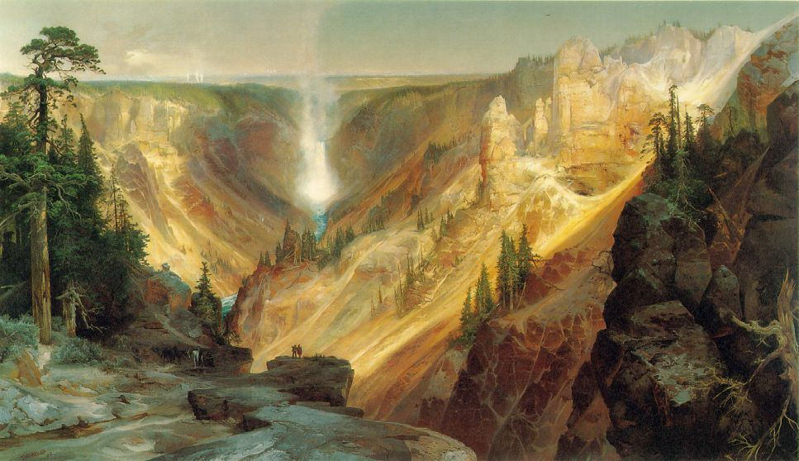
American Romanticism
(Early- Mid 1800s)

Slide 2
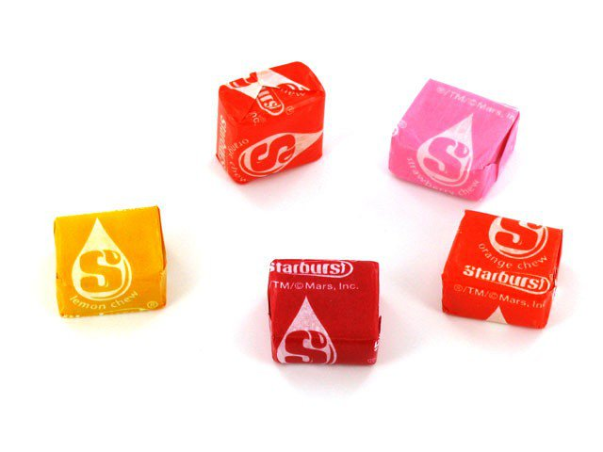
Discuss in your table groups…
Imagine that you have in front of you a Starburst…
What is logical thing to do with it?
What creative thing can you do with it?
Realism vs. Romanticism

Slide 3
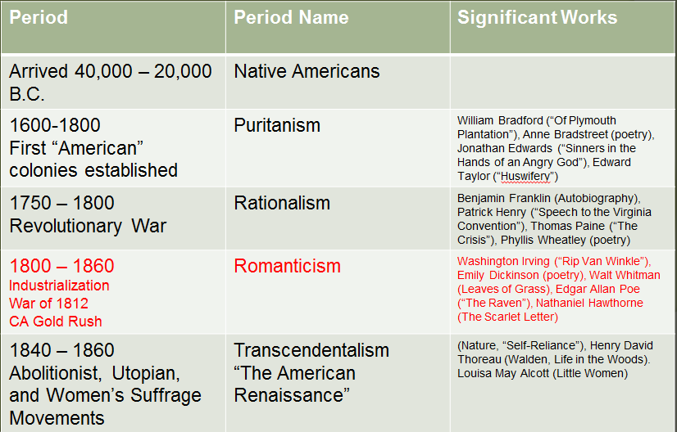
American Literary Movements

Slide 4
Historical Context: Early 1800s
Louisiana Purchase (1803) doubles size of nation and speeds up western expansion
Huge influx of immigrants (Irish, German, other N. Europeans) fleeing famine and war
Cities boom
  Industrial Revolution
  Massive urbanization of population
  Crime, disease rampant
Notes:
Urbanization: the rapid and massive growth of, and migration to large cities.

Slide 5
Romantic Philosophy
City is site of corruption, moral decay, and death
Countryside and nature are sites of renewal and rebirth
Valued feeling and intuition over reason
  Horrors of industrialized society, etc.
  Intuition capable of understanding truths that reason can’t reach
  “Felt” experience valued over theory

Slide 6
Characteristics of American Romanticism
values feeling and intuition over reason
places faith in inner experience and the power of the imagination
despises the artificiality of civilization and seeks unspoiled nature
prefers youthful innocence to educated sophistication
finds inspiration in myth, legend, and folk culture
supporters of individual freedom and the worth of the individual
looks to the wisdom of the past and distrusts progress
finds beauty and truth in exotic locales, the supernatural realm, and the inner world of the imagination
sees poetry as the highest expression of the imagination

Slide 7
5 I’s of Romanticism
Romanticism refers to a movement in art, literature, and music during the 19th century.
1.Imagination
2.Intuition
3.Idealism
4.Inspiration
5.Individuality

Slide 8
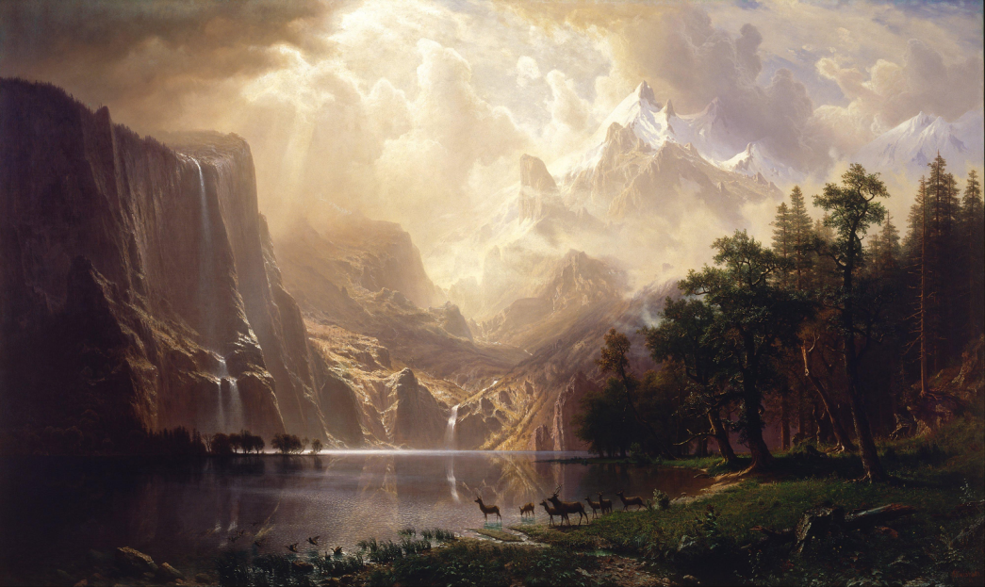
Imagination
Imagination was emphasized over “reason.”
This was a backlash against the rationalism characterized by the classical period or “Age of Reason.”
Imagination was considered necessary for creating all art.
Bierstadt’s “Among the Sierra Nevada Mountains, California”

Slide 9
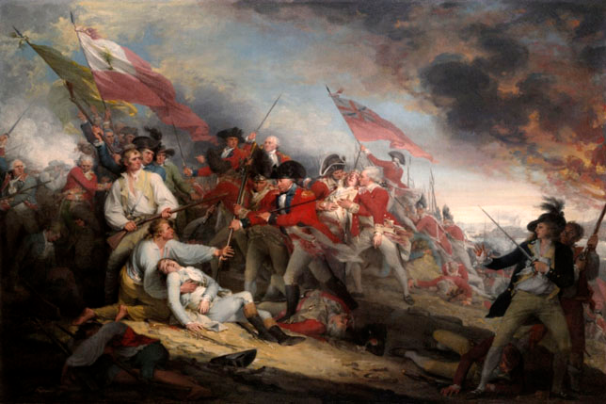
Intuition
Romantics placed value on “intuition,” or feeling and instincts, over reason.
Emotions were important in Romantic art.
Trumbull’s “The Battle of Bunker Hill June 17, 1775”

Slide 10
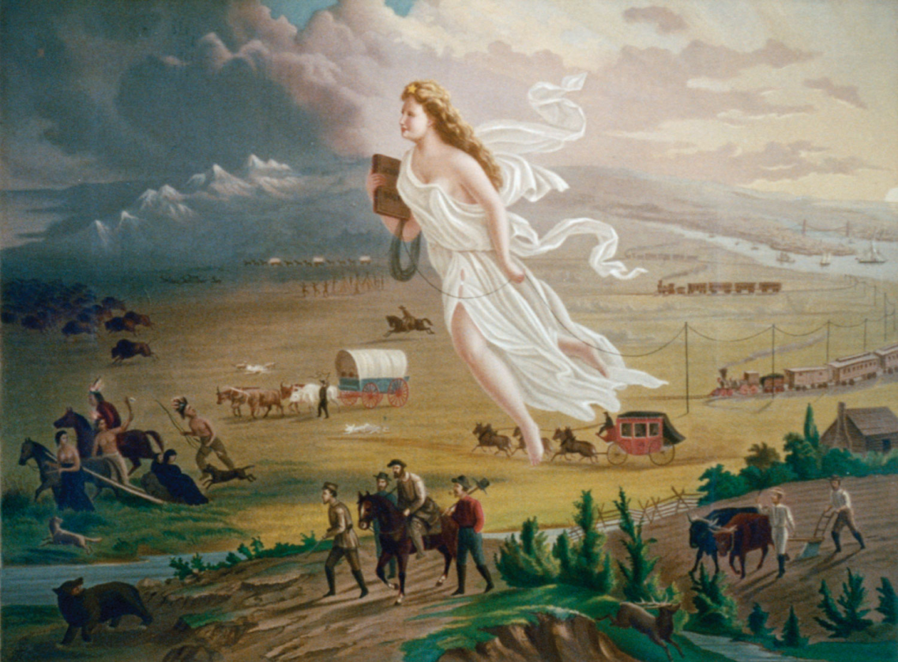
Idealism
Idealism is the concept that we can make the world a better place.
Idealism refers to any theory that emphasizes the spirit, the mind, or language over matter – thought has a crucial role in making the world the way it is.
Gast’s “American Progress”

Slide 11
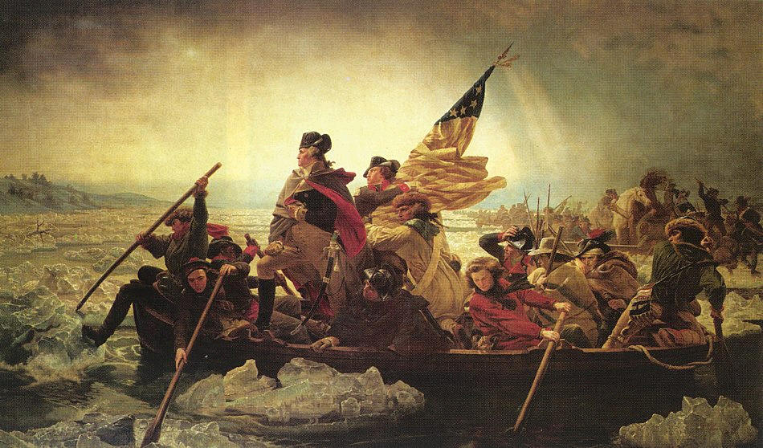
Inspiration
The Romantic artist, musician, or writer, is an “inspired creator” rather than a “technical master.”
What this means is “going with the moment” or being spontaneous, rather than “getting it precise.”
Luetze’s “Washington Crossing the Delaware”

Slide 12
Romantic Literature
Poetry thought to be highest form of expression
Traditionalist- Looks back to Europe
Self-consciously literate- lots of big words, obscure references, and complex sentences
Very emotional: goal is to give reader a feeling, not realistically depict character, setting, etc.
About frontier (not present in Europe)
Celebrates experience over stuffy sophistication

Slide 13
The Romantic Hero
    Youthful and innocent instead experienced and sophisticated
    Intuitive (Heart) over Rational (Brain)
    Action more important than Words
    Close to nature & uncomfortable in city
    Uneasy with women (trying to “tame” them)
    Romantic Hero exists to this day: Lone Ranger, Superman, Indiana Jones, etc.

Slide 14
Romantic Poetry
The “Fireside” Poets
  Trying to prove American sophistication and step away from the stereotype of the “rustic American”
  Generally kind of sappy, traditional themes
  Rigid, traditional structure (rhythm, rhyme)
    Sometimes used to express political themes about abolition, Native American rights, etc.

Slide 15
This sounds a lot like European Romanticism…?
The key differences between European Romanticism and American Romanticism:
  Focus on wilderness experience
  Idealizes frontier life
  Coincides with western expansion and the growth of a nationalist spirit

Slide 16
Summary
Romantic poets looked to nature for inspiration
Celebrated emotions and the imagination
Reaction to rationality of the Age of Reason and the strictness of the Puritans
Valued the individual spirit, emotions, and imagination as basic human nature

Slide 17
“A single conversation across the table with wise man is better than ten years mere study of books”
~Henry Wadsworth Longfellow

Slide 18
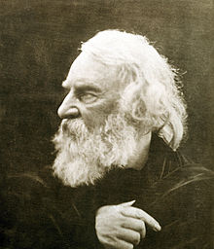
Henry Wadsworth Longfellow (1807-1882)
  American poet (Fireside Poet) and educator
  Born in Portland, Maine and studied at Bowdoin College (late became professor there and at Harvard College)
  Married twice (both tragically died…childbirth and dress caught fire, killing her)
  Died 1882
  Most popular American poet of the time, but seen as an imitator not necessarily and original (copied European styles)

Slide 19
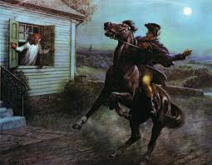
“Paul Revere’s Ride” (1860) Poetry Analysis
Poem focus:
  Commemorates the ride of Paul Revere on April 18th, 1775
To what extent does the poem romanticize American history?
Evaluate the Romantic characteristics of the poem.

Slide 20
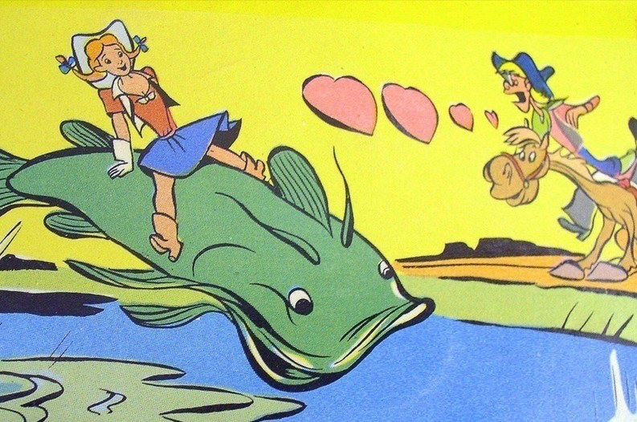
American Folklore & Tall Tales

Slide 21
Learning Targets
I can evaluate the value of tall tales.
I can collaborate to create a visual representation of a tall tale

Slide 22
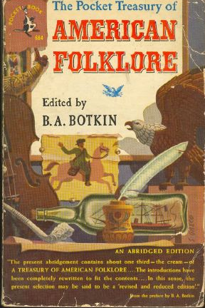
Origin of Tall Tales
One of the forms of literature that came about as a result of this new imaginative way of thinking was the American folklore and tall tales.
By the Romantic time period, the pilgrims landed almost 200 years before.
  Americans began to long for some of their own “origins” and stories that taught moral lessons
The Romantic authors embraced this need and, using the ideals of romanticism (the American forms of chivalry), developed some of the best folk stories of American literature.

Slide 23
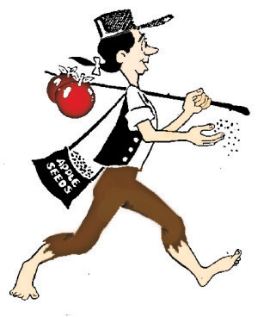
Style of the story
In America, tall tales were first told by settlers who made their homes in the American wilderness. In those days, before TV and movies, people depended on storytelling for entertainment.
After a long day’s work, people gathered to tell each other funny tales.
Each group of workers (cowboys, loggers, and railroad and steel workers) had its own tall-tale hero.
Having a superhuman hero with the same job somehow made their lives easier; perhaps it gave them strength or courage to do their difficult and dangerous work.

Slide 24
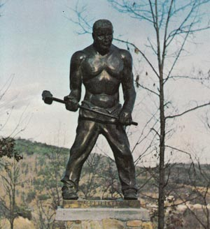
Style of the Story
Tall Tales and Folklore were more than just stories.
  They take the normal story:
    “John met Mary at her house. They said hello, and started to walk to school. When they turned the corner, they saw a dog…”
  and turn it in to a fantastical story:
    “John met Mary at her twelve-story mansion. The house, which was bigger than a football stadium, had solid gold walls that shone as bright as the sun on a summer day. John and Mary greeted each other with a jubilant hello and started to skip to school. When they turned the corner, they saw a ferocious hell hound with giant globs of saliva dripping from his teeth.”

Slide 25
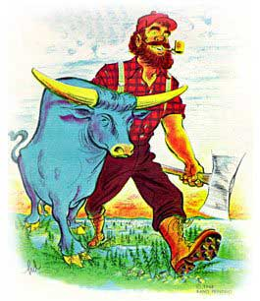
Conventions of a Tall Tale:
Characters: a larger-than-life, or superhuman, main character with a specific job who (attempts) to do impossible things.
Humor: a problem that is solved in a funny way.
Exaggeration: exaggerated details that describe things as greater than they really are.
Use of Colorful Idioms: characters that use everyday language.
Literary Devices: the use of similes and metaphor.

Slide 26
Historical Motivations
Westward migration/exploration
Introspection and debate over issues and ideals surrounding Civil War (sectionalism, slavery)
Pain/death/ destruction resulting from Civil War itself
Religious/philosophical ideals

Slide 27
Working with Tall Tales
As a table group, read the tall tale or summary of the tall tale
Create a children’s book cover for your tall tale
Front:
  Symbolic illustration
  Title
  Idiom that captures the spirit of the story
Back:
  Identify the elements that make this a tall tale
  What is the moral of this tale?
  What are the historical connections?
    (Look these up if you are stumped! Research!)

Slide 28
Tall Tale Options
Paul Bunyan
Johnny Appleseed
John Henry
Pecos Bill
Davy Crockett
“The Notorious Jumping Frog of Calaveras County”

Slide 29
Individual Reflection
This will be going in a homework packet, so please make sure you answer these two questions on something you can submit.
To what extent can we use tall tales as a way to understand American culture and history?
Determine the value of tall tales in American history and culture.

Slide 30
OLDER FILES

Slide 31
“Truth crushed to earth will rise again”

Slide 32
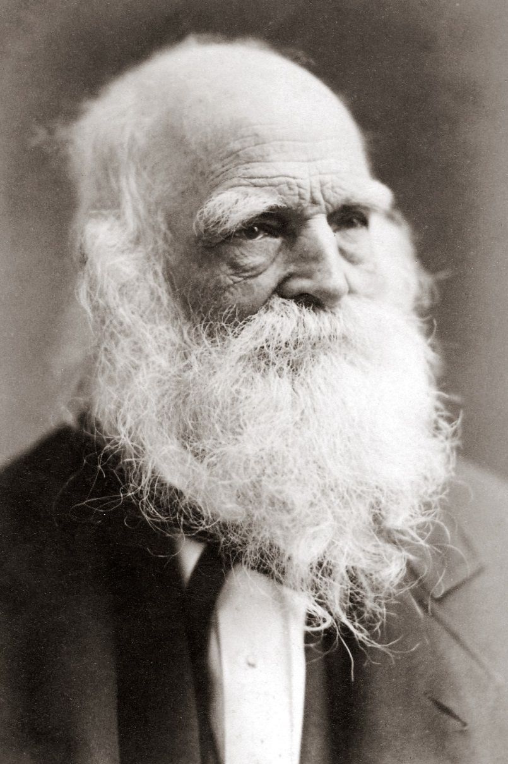
William Cullen Bryant
Lived from 1794 to 1878
American Romantic poet, journalist, and long-time editor of the New York Evening Post.

Slide 33
William Cullen Bryant
Wrote poems and short stories
Struggled as a lawyer and a writer
In 1832, he expanded his book Poems (with the help of Washington Irving) won recognition in Britain as America’s leading poet

Slide 34
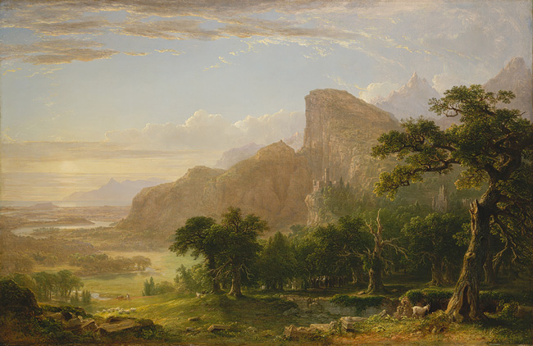
“Thanatopsis”
Scene from Thanatopsis, 1850
Asher B. Durand (American, 1796–1886)

Slide 35
Thanatopsis
Thanos = Death
Opsis = Vision
“A meditation on Death”
Why would it be good to meditate on death?
              Read “Thanatopsis” by William Cullen Bryant (p 338-339)

Slide 36
“Thanatopsis”
To what extent does nature help people cope during times of sadness?
According to lines 22-30, conclude what happens when people die? Justify or argue against the philosophy.
Determine why people should greet death without fear.
Identify as many characteristics of American Romanticism as you can in the poem.
  Share the quote, the line number, and the characteristic to have a complete answer

Slide 37
“Thanatopsis”
“Healing sympathy”… face death without fear, “sustained and soothed by unfaltering trust… like one who… lies down to pleasant dreams…”
The poem embraces the cycle of life and death that both raises humankind, high-born and low, from insensible matter and returns him and her to it.
Determine if this is a happy or sad poem?

