Slide 1
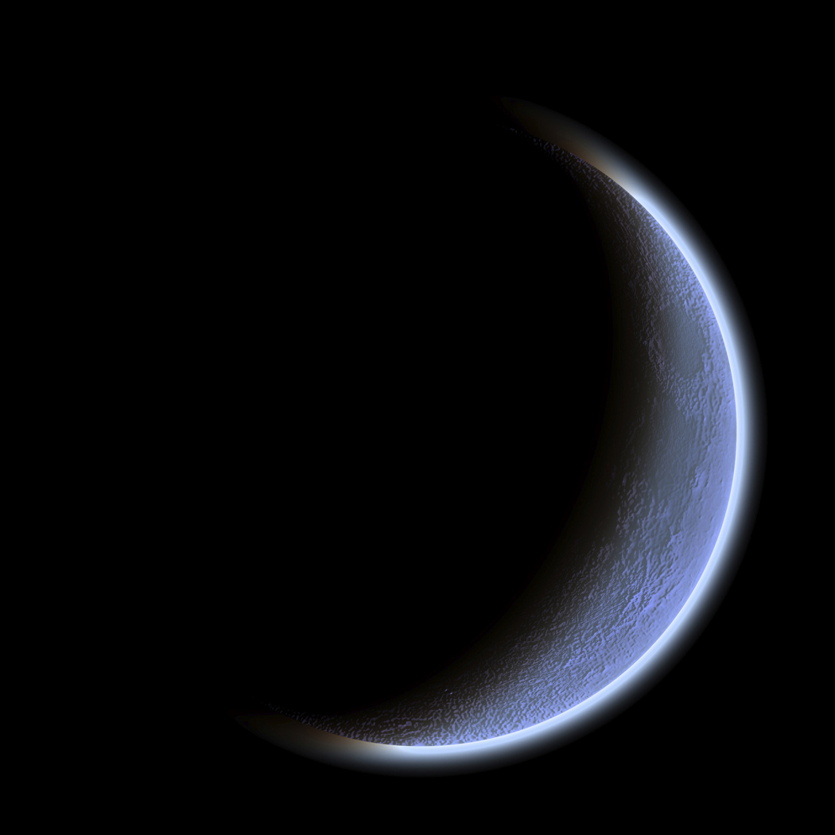
The Dark Romantics

Slide 2
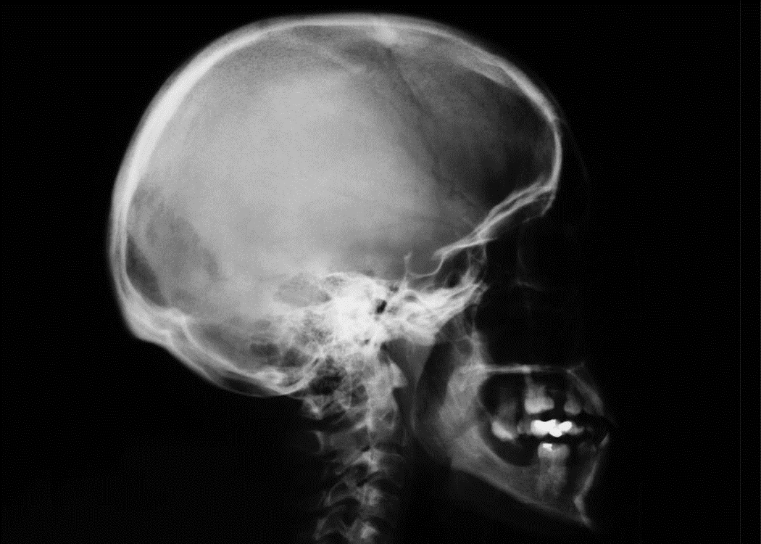
Romanticism
Romantics ideals
Feelings and intuition over intellectualism and rationality.
Traditional language, form
Fascination with “unknowable”

Slide 3
Elements of dark romanticism
The story is characterized by extravagance, emotion and imagination
The world is portrayed as a sinister place
Individuals are portrayed as prone to sin and self-destruction, not as inherently possessing divinity and wisdom
Shows the natural world is dark, decaying, and mysterious
Portrays individuals failing in their attempts to make changes for the better
Characters’ revelations are evil and hellish
Themes of horror, tragedy, the macabre and the supernatural

Slide 4
Literary Elements
Most stories or tales featured:
Heroic despair: hero strays from traditional ideals (outcast of society)
Women don’t fulfill traditional roles
Villain: often misunderstood and lonely
Frankenstein’s monster, Dracula
Murder, nightmare landscapes, sea and wastelands, death, impossible love
Ambivalence: uncertainty, inability to chose

Slide 5
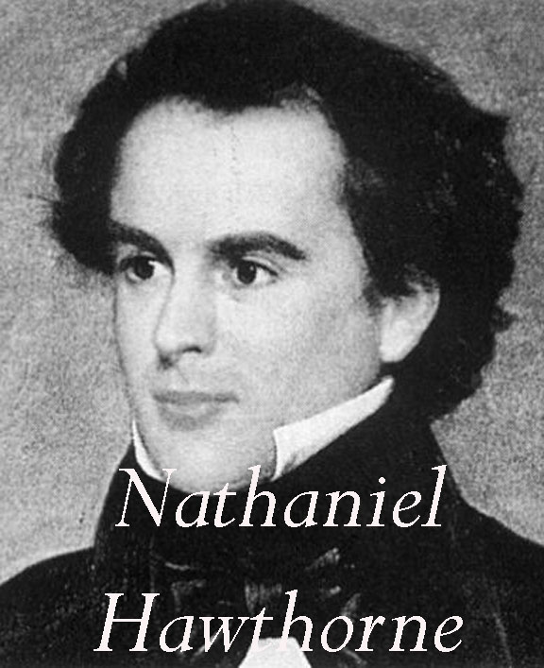
Nathaniel Hawthorne: Darkness in American History (1804-1864)
Good looking, happily married, nice life
Yet still dark and disturbed
Perhaps because his Puritan ancestors (Salem Witch Trials)
Briefly lived in utopian Transcendentalist community Brook Farm: unimpressed
Became somewhat famous from Scarlet Letter in 1850s
Moved to Europe and declined- when he returned he felt out of touch, and died.
Works: Scarlet Letter, The Minister’s Black Veil

Slide 6
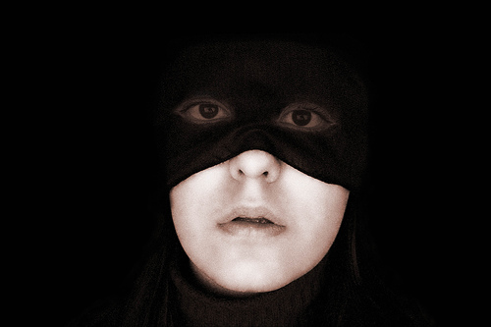
The Minister’s Black Veil
Set in Puritan New England
About preacher who wears a black veil one day and won’t take it off…
But really about how fake appearances are, and what shame, sin, and darkness lie beneath.

Slide 7
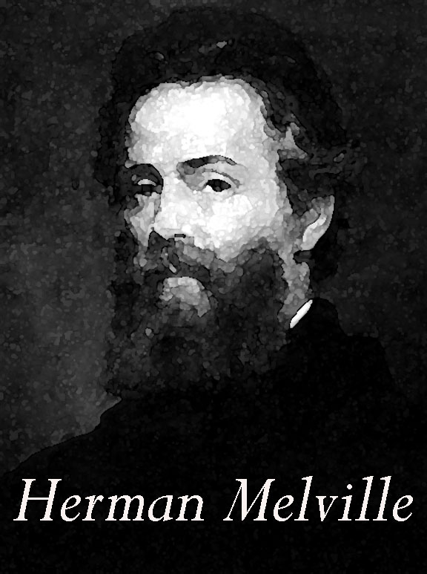
Herman Melville: Darkness in Nature (1819-1891)
Spent much of his life at sea as a whaler
Friends with Hawthorne, who encouraged him
Sons died (one by suicide); he died poor and obscure
Works: Moby Dick, and Billy Budd (never published)
Major themes are obsession, revenge, monomania, and man v. nature.

Slide 8
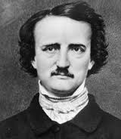
Edgar Allan Poe: Traditional Darkness (Gothic)
Effectively orphaned at 3, unpleasant childhood (dad abandoned family, mum died)
Dropout of West Point
At 25, moved in with aunt and married her 13 year old daughter
Supported them as editor of literary magazines- during this period did much of his writing
Tortured soul- drank heavily
Wife died of TB in 1847, sending Poe into a deathly spiral of heavy drinking- died of complications in 1849

Slide 9
Poe worked in a variety of genres (1827-1849)
Criticism--he gained a national reputation as a sarcastic literary critic. The bulk of his writing consists of his criticism, and his ambition was to become a powerful critic.
Poetry--He was an experimental poet.
Psychological fiction--He wanted to produce the greatest possible horrific effects on the reader.
Detective Story--Poe created this form when he was 32.

Slide 10
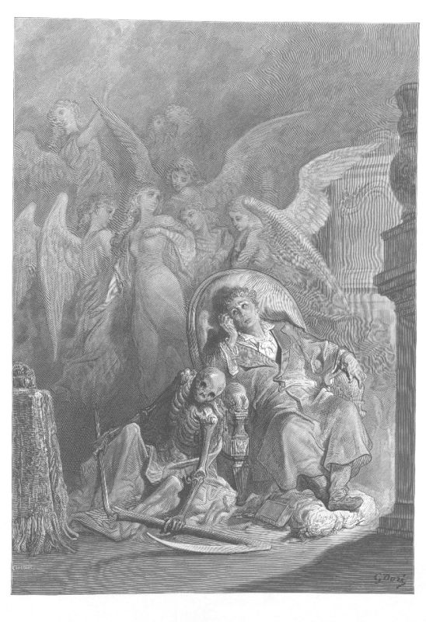
“The Tell-Tale Heart” and “The Raven”
About either crazy people or people going crazy
Not interested in creating realistic people- nor just to shock and frighten
Goal to peel back our “reality” and explore dark, irrational depths of human mind

Slide 11
Question:
In Europe, this “Gothic” tradition was often set in old places: castles, manors, etc. (think Dracula, Frankenstein, etc.) But America is a young country, so where would we set our tales of the terrifying unknown? Why?

Slide 12
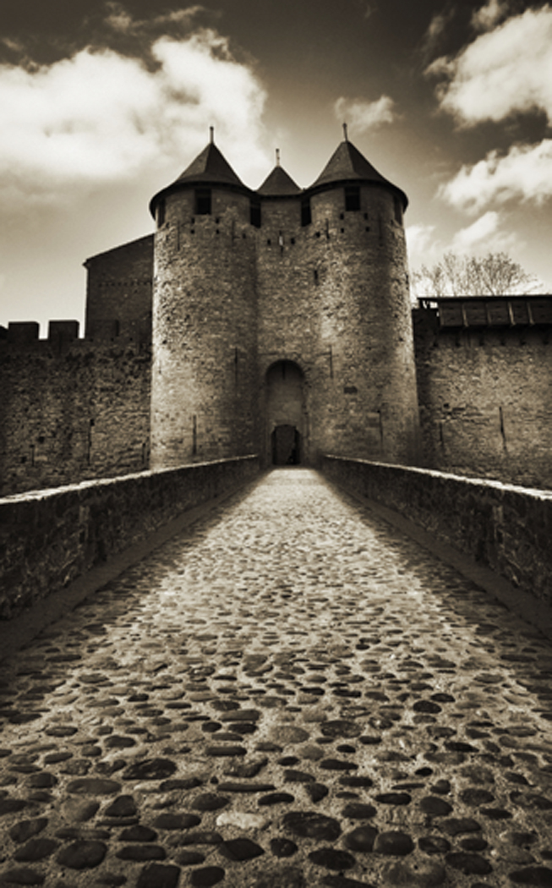
The Gothic Tradition- American Style
In Europe, Dark Romantics fascinated with creepy old castles, crypts, tombs, etc.
But America is a young country, so…
Poe- based stories in Gothic European settings
Hawthorne- resurrected old Historical (Puritan) bogeymen
(Original sin, Puritan angst, shame, etc)
Melville- pitted men vs. unknowable nature

Slide 13
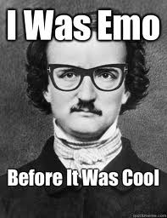
Summary
There is the focus on the tragic.
Belief in sin and evil.
An attention paid to the mysteries of life.
A respect for human nature, and all its struggles.

Slide 14
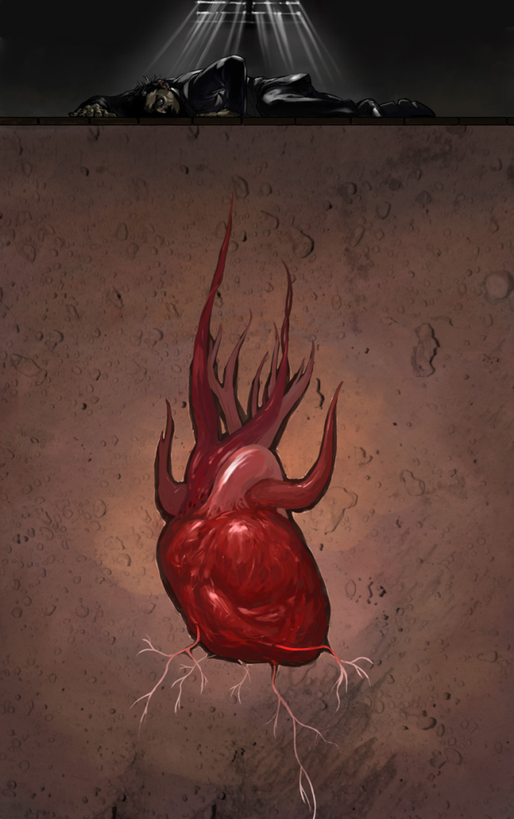
The Tell Tale Heart

Slide 15
The Tell-Tale Heart
What components of a scary story were present in this story?
How reliable is our narrator regarding his sanity?
How does Poe use images and phrases to create an atmosphere of horror?
Why does the killer confess? Does the heartbeat really tell the tale of the murder?

Slide 16
Putting it all together
How does Poe use imagery and setting in particular to convey tone and mood in his work?
Tone: The author’s attitude towards the text
Mood: The feeling the audience has after reading the text

Slide 17
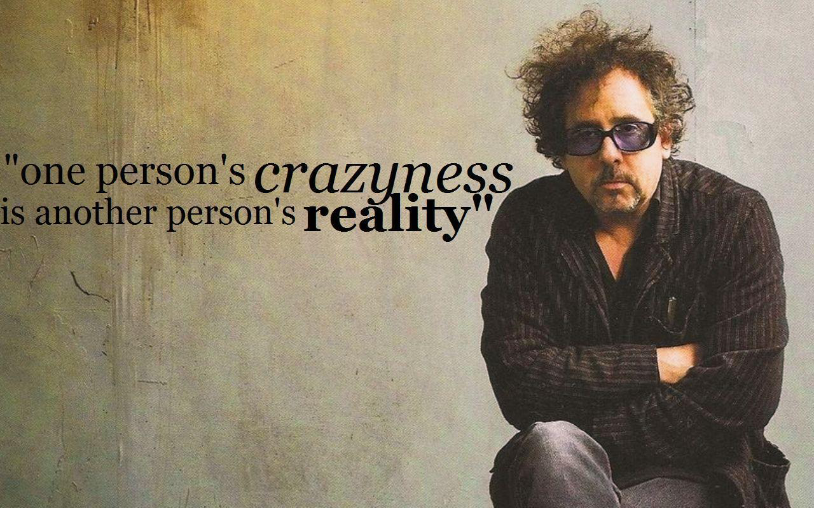
Tim Burton: Modern Poe?

Slide 18
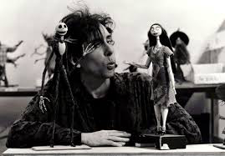
Burton
Born 1958
Film director, producer, writer, artist
Known for his dark, gothic, quirky work
Trademarks
Complex use of light and dark, being caught between two worlds
Has been making films since the 1980s

Slide 19
Tim Burton & Edgar Allan Poe
Both artists share the same story telling techniques
Both artists use the same types of imagery
Both artists use an ominous feel in their works
Poe’s work deals more with people reaching insanity
Burton’s work deals more with the creepy things in life

Slide 20
Burton’s Edward Scissorhands
A scientist builds an animated human being -- the gentle Edward. The scientist dies before he can finish assembling Edward, though, leaving the young man with a freakish appearance with the scissor blades he has instead of hands.
Loving suburban saleswoman Peg discovers Edward and takes him home, where he falls for Peg's teen daughter.
However, despite his kindness and artistic talent, Edward's hands make him an outcast.

Slide 21
Poe Project

Slide 22
Assignment
Groups of 7-8 will read a Poe piece
You will then write a brief summary of the story, focusing on themes and symbols (must present at least three symbols)
You will then create a visual representation of the piece to present to the class (in a gallery walk, so stand alone)
You can get creative, but it must represent the story, the theme(s), and the symbol(s)

Slide 23
Individual Assignment
Tonight: you will all individually read your story
You will take notes on the story, plot, characters, themes, symbols, etc. (I will stamp these tomorrow)
You will work together as a group tomorrow to start creating your project
You must bring in any supplies you might want to class Thursday and Friday (work days)

Slide 24
Project Requirements
Background of story
Summary of story
Theme of story
Symbols of story
Tone and mood of the story
Visual representation of story

Slide 25
Poe Pieces
“The Masque of the Red Death”
“The Fall of the House of Usher”
“The Raven”
“The Cask of Amontillado”
“The Black Cat”
“The Pit and The Pendulum”
“The Purloined Letter”

Slide 26
Older Files

Slide 27
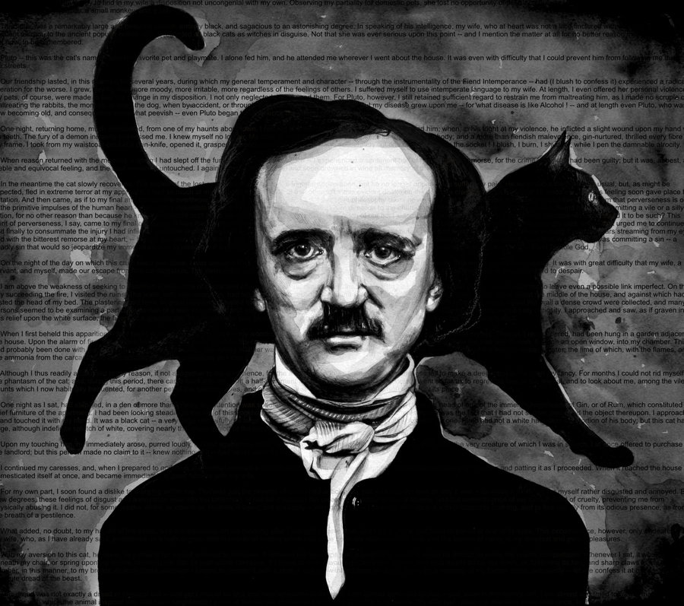
Your turn!
Universal pictures has decided to turn a series of Edgar Allan Poe’s greatest short stories into films, and YOU have been asked to produce the trailer! Congratulations on landing this very exciting opportunity!
First:
Critically read the Poe story you have been assigned, marking specifically for the elements of Gothic literature as you see them appear.
(you will be turning this in for points)

Slide 28
Film Trailers
What is the purpose of a film trailer?
Film trailers are a form of advertising. Trailers are structured to include relevant parts of a film to encourage as many people to see the film at the cinema. They are also designed to help audiences understand the GENRE of a film.
As you watch the Burton trailers, look for two things:
How do you know that this film is dark romanticism?
What elements go in to making up a film trailer?
Notes:
https://www.youtube.com/watch?v=G9boDkpEyvc
https://www.youtube.com/watch?v=M94yyfWy-KI

Slide 29
Poe Trailers
You and a group of 3-4 will put together a film trailer for your story. Your trailer must be between 2-3 minutes, and demonstrate an understanding of the story, as well as the elements of dark romanticism that you see within the story.
You will have all day in class tomorrow as a work day.
Your trailers are DUE by 7 am on Monday 9/19.
(Email Cossano with the youtube link to your trailer!)

Slide 30
Batman Returns Reflection
Determine what makes this a Dark Romantic film.
To what extent is Selena Kyle (Catwoman) a non-traditional female character?
Conclude if Batman is a Romantic hero or a Dark Romantic hero.
What are other examples of Dark Romantic films?

