Slide 1
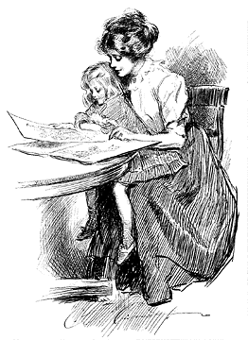
“The Cult of Domesticity”
Understanding Gilman and Chopin

Slide 2
Essential questions
To what extent have gender roles changed since the turn of the century (1890s-1920s)?
Determine the importance of understanding the journey of women at this time.

Slide 3
Learning Targets
I can define gender roles and why those roles have been assigned in history.
I can trace the changes in gender roles.
I can make connections between immigrants, muckrakers, and women writers.
I can explore minority writers through various writings.

Slide 4
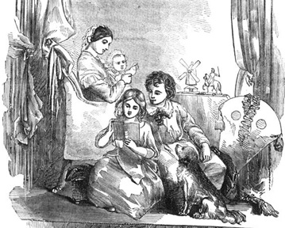
The 19th Century Family
Men could work, women could stay home
No longer the need for all members to work, men had stable jobs
Did not have to make what they needed to survive
Nuclear family
As opposed to extended family
Creation of the “spheres”
Men (outside world)= temptations, danger
Women (home)= safe for delicate creatures
“The Sphere of Woman- 1850”

Slide 5
Historical Context
While what is known as the Gilded Age brought more women into the workforce, few women actually supported themselves.
Young women who were working were often expected to turn their wages over to their parents, and wives were expected to turn wages over to their husbands.
Women who were not in the workforce were burdened with domestic duties.
Neither marriage nor work really loosened the boundaries placed on women; each situation simply offered a different set of rules.

Slide 6
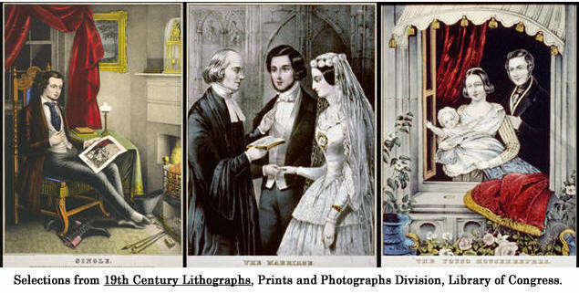
The Cult of Domesticity: or the “True Womanhood”
Piety (Religiousness)
Purity
Being sexually pure stops “fallen woman”
Submissiveness
submit to fate, to duty, to God, and to men
Domesticity
Never leave home if at all possible

Slide 7
Rights of Women
The right to love whom others scorn,
The right to comfort and to mourn,
The right to shed new joy on earth,
The right to feel the soul's high worth,
Such woman's rights a God will bless
And crown their champions with success.
What are the rights of women according to this piece?

Slide 8
Truisms about Women
“A woman has a head almost too small for intellect but just big enough for love.”
“True feminine genius is ever timid, doubtful, and clingingly dependent; a perpetual childhood.”

Slide 9
Scientific Sexism
Women are not educated about their own bodies or reproduction (considered pornography)
Women are physically inferior:
Physically smaller than men
Less stamina—they faint more
They menstruate and are physically incapacitated every month
Brought on temporary insanity
More delicate because their female nervous system was finer and more prone to fatigue because of the reproductive system

Slide 11
Scientific Sexism
“Unpredictable nature” of female reproductive system.
Human sexuality
Human body has finite amount of energy, which must be regulated
Sexual instinct most primitive
Sex strong in men but absent in ladies
Feared in women because they would be like vampires and drain the man of his energy

Slide 12
Godey’s Lady’s Book
Most widely circulated ladies magazine in the US
Encouraged motherhood as a religious value
Paintings and pictured depicted women in each of the four virtues
Fashion stressed to make women attractive to husbands

Slide 13
Feminism
Definition/summary of feminism. Images you think of with the word feminism?
Defining, establishing, and defending equal political, economic, and social rights for women
Advocate for rights and equality of women

Slide 14
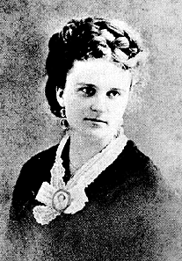
Kate Chopin 1850-1904
Born Katherine O'Flaherty
Born and died in St. Louis, MO
American author of short stories and novels
A forerunner of feminist authors of the 20th century.

Slide 15
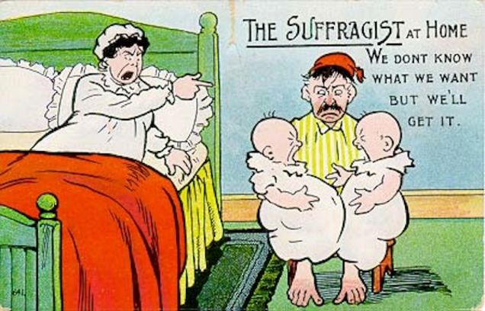
“The Story of an Hour”
You read the story over the weekend, now please answer the following questions as a group

Slide 16
What does Chopin mean when she described Mrs. Mallard as having ‘heart trouble’. To what extent is that important to the story?
The setting of the story is very limited; it is confined to a room, staircase, and front door. How does this help express the themes of the story?
Determine what kind of relationship the Mallards have. Is Brently Mallard unkind to Louise, or is there some other reason for her saying “free, free, free!” when she hears of his death? How does she feel about him?
Mrs. Mallard is described as descending the stairs “like a goddess of Victory”. In what ways does she feel herself victorious?
“When the doctors came they said she had died of heart disease-of joy that kills”. Explain the meaning of this.
Conclude the view of marriage presented in the story. Keep in mind the time period (1894).

Slide 17
Table/Class Discussion
Determine how “The Story of an Hour” captures the plight of women at the time period. Conclude if this is a feminist piece.
To what extent have we, as 2019 Americans or global citizens, made progress or achieved rights for women?
What evidence can you use to support your opinion?
Are these figures progressing women’s rights or pushing them back?
Evaluate if you think society feels being a feminist is a good or bad thing. Explain.

Slide 18
“The Yellow Wallpaper” Homework
Read “The Yellow Wallpaper” (Charlotte Perkins Gilman)
Answer discussion questions on Thursday as a group
Might be a reading quiz Thursday

Slide 19
Learning Targets (Reminder)
I can define gender roles and why those roles have been assigned in history
I can trace the changes in gender roles
I can make connections between immigrants, muckrakers, and women writers
I can explore minority writers through various writings

Slide 20
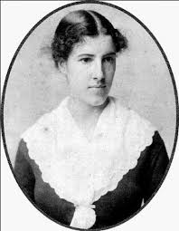
Charlotte Perkins Gilman
1860-1935
Poet, Author
“The Yellow Wallpaper” (1892)
Women and Economics (1898)
Married Charles Stetson (1884)
One child, daughter Katherine
Married George Gilman (1900)
Committed suicide 1935

Slide 21
Interpreting Quotes
Based on the following three Gilman quotes, determine how she would feel about feminism and the cult of domesticity

Slide 22
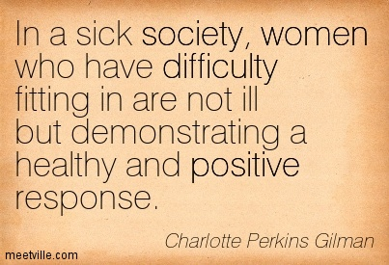

Slide 23
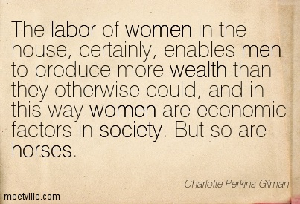

Slide 25
Interpreting Quotes
Based on the previous three Gilman quotes, determine how she would feel about feminism and the cult of domesticity

Slide 26
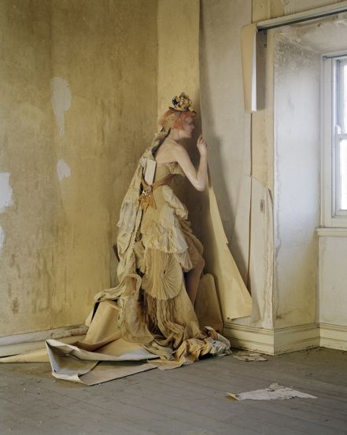
“Such a story ought not to be written; it was enough to drive anyone mad to read it”
-M.D.

Slide 27
Discussion Questions
What is the style of writing? How does this contribute to our understanding?
Determine the reliability of the narrator.
Investigate how 1st person narration affects our understanding.
To what extent is John responsible for the ending?
Justify whether or not John is also a casualty of repressive social conventions.
Conclude if the narrator’s descent into madness is liberating or empowering for this heroine.
Examine if the ending of the story suggest progress (a woman tears down the shackles that are binding her) or pessimism (this woman has become completely unstable)?

Slide 28
What is the narrator actually struggling with?
What is her actual illness?
What symptoms do we see in the text?
How do you know?

Slide 29
Medical Context
Nineteenth century doctors accepted the idea that a woman's energy was centered around her reproductive organs.
When a woman suffered a medical problem, doctors often diagnosed the problem as a problem with channeling energy.
Since reproduction was central to a nineteenth century wife's life, doctors often concluded that a "sick" woman was out of sync with her reproductive organs.
Upper class women made ideal patients. Their husband's bank accounts were large, and they were usually submissive and obedient.

Slide 30
The Weir Mitchell Treatment
Charlotte Perkins Gilman herself was treated for a similar "nervous condition" as that of the narrator in "The Yellow Wallpaper” after her daughter was born.
Her physician, Silas Weir Mitchell, was well known in the United States for his "rest cure," also called the "Weir Mitchell Treatment."
Mitchell believed, as a rule, that no harm was done by rest. He often required patients to stay in bed for six to eight weeks. Most female patients were forbidden to sit up, sew, write, or read.
The inactivity drove Gilman, as well as many other female patients, insane.

Slide 31
“The Yellow Wallpaper” Critics
In 1890, Gilman sent the story to writer William Dean Howells, who submitted it to Horace Scudder, editor of “The Atlantic Monthly.”
Scudder rejected the story as depressing material, and returned it to Gilman.
His handwritten note to her read: “Dear Madam: W. Howells has handed me this story. I could not forgive myself if I made others as miserable as I have made myself! Sincerely Yours, H. E. Scudder.”
Gilman also sent a copy to Weir Mitchell, who never responded, but later changed his treatment plan.
Many who read it felt it was nothing more than a horror story.

Slide 32
Alternative theory of story…

Slide 33
Why I Wrote the Yellow Wallpaper-Gilman in an issue of The Forerunner (1913)
For many years I suffered from a severe and continuous nervous breakdown tending to melancholia
Specialist in nervous diseases applied the rest cure, to which a still-good physique [doctor] responded so promptly that he concluded there was nothing much the matter with me, and sent me home with solemn advice to "live as domestic a life as far as possible," to "have but two hours' intellectual life a day," and "never to touch pen, brush, or pencil again" as long as I lived. This was in 1887.
I went home and obeyed those directions for some three months, and came so near the borderline of utter mental ruin that I could see over.
Then, using the remnants of intelligence that remained, and helped by a wise friend, I cast the noted specialist's advice to the winds and went to work again--work, the normal life of every human being; work, in which is joy and growth and service, without which one is a pauper and a parasite--ultimately recovering some measure of power.
I wrote “The Yellow Wallpaper”, with its embellishments and additions, to carry out the ideal (I never had hallucinations or objections to my mural decorations) and sent a copy to the physician who so nearly drove me mad. He never acknowledged it.
Many years later I was told that the great specialist had admitted to friends of his that he had altered his treatment since reading “The Yellow Wallpaper”.
It was not intended to drive people crazy, but to save people from being driven crazy, and it worked.

Slide 34
Individual Reflection: “The Yellow Wallpaper” (going in homework packet)
According to the story, what is the value of women at the turn of the century?

Slide 35
Older Files

Slide 36
“A Pair of Silk Stockings”
HW: Read Kate Chopin’s “A Pair of Silk Stockings”

Slide 37
Learning Targets (Reminder)
I can understand gender roles and why those roles have been assigned in history
I can trace the changes in gender roles
I can make connections between immigrants, muckrakers, and women writers
I can explore minority writers through various writings

Slide 38
Entry task
After I read each scenario, rank them on a scale of 1-5 (5 being highest), on how they use their financial windfall, and explain why you think it is a good or bad use of money.

Slide 39
Scenario 1
Ryan feels like all he’s been doing lately is working. He is a waiter at an upscale restaurant. One night he received a $100 tip. Maybe he could spend the money on school books. Or he could donate it to charity! Nah. Ryan decides to eat out at the restaurant where he works, where his boss waits on him. He eats really expensive food and drinks really expensive wine and leaves his boss a lavish tip to suck up. The money is all gone.

Slide 40
Scenario 2
Sarah found $100 on the street and turned it in. No one claimed it, so the police said she could keep it. What to do with the money? She needs new books for school. Her mother also needs a new coat. Her old one is practically falling apart, it’s so threadbare. And winter is coming soon. She decides to buy her mother a coat.

Slide 41
Scenario 3
Maggie got $100 from her grandmother for no reason at all. She knows that she should probably use the money to buy something useful like clothes, shoes, or books, but she really wants to go see a Broadway play that’s coming to town. She’s never been to anything like that before, and she doesn’t often have the kind of money it takes to purchase a ticket—this might be her only chance to go. She spends the money on the ticket.

Slide 42
Scenario 4
Dylan owes his parents about $300 for helping him when he got into some trouble with his first credit card. He is unexpectedly allowed to work overtime and earns an extra $100 in his paycheck. He knows he should send it to his parents to pay down his loan, but he really wants to take his girlfriend out for a nice date. She’s a great girl. She might even be the one. His parents don’t need to know he had the extra money. He decides to take his girlfriend out.

Slide 43
Scenario 5
Genevieve’s mother sent her some money to save in case of emergencies. By Genevieve’s calculation, emergencies rarely happen, but $100 can buy a lot of beer to impress her friends at the biggest blowout party of the year. She’s always wanted to be popular. She spends every last dime on the party. Everyone smiles and waves when they pass her on campus, and she’s got a reputation for throwing a great party. Why, even cute Jake has been smiling and waving at her—maybe he’ll ask her out!

Slide 44
According to Mrs. Sommers’ thoughts and actions at the beginning of the story, what is her primary focus in life? What makes supporting t his focus difficult? Has her life always been this way?
What need is awakened in her by the pair of silk stockings? What inner conflict does this reveal about Mrs. Sommers?
Mrs. Sommers spends all of the precious money on herself. Given the responsible nature of her character, what do you think accounts for this self-indulgence?
While at the matinee, what does Mrs. Sommers notice about the other women who are there? What does this suggest about consumerism and the lifestyle that she is currently enjoying so much?
At the end of the story, has Mrs. Sommers day of self-indulgence led to “better days?” In other words, has this fundamentally made Mrs. Sommers’ life better? Why?
At the end of the story, has Mrs. Sommers inner conflict been solved? If so, how was it solved? If not, what would actually solve her problems?

Slide 45
Table Discussion
To what extent does “A Pair of Silk Stockings” capture the plight of women at the time period? Determine if this is a feminist piece.
To what extent was Mrs. Sommers justified in spending all the money?

Slide 46
Homework
You have now read three influential stories depicting the struggle of turn of the century women
Tomorrow we are going to have a student lead discussion
Tonight: create on discussion question to share with the class
Discussion question: should foster discussion, and should not be a one word answer
Ex: Conclude the impact these stories had on cats during the turn of the century.
Ex: Who wrote the stories?

Slide 47
Discussion
Your table group will be having a discussion around feminism and the stories we read.
Discussion must happen for at least 15 minutes.
Going short? Your discussion question was ineffective. How could you have a better discussion?

Slide 48
Satirical Cartoon
On your group sheet of paper, create a satirical cartoon that shows the treatment of the woman at the turn of the century.
Things to think about when creating the cartoon.
How she is being supported by others
How she is being criticized by others

Slide 49
Satirical Cartoon with Quotes
On your group sheet of paper, create a satirical cartoon that shows the treatment of the woman at the turn of the century. Use quotes from the stories as ‘evidence’.
Things to think about when creating the cartoon and selecting the quote
How she is being supported by others
How she is being criticized by others

Slide 50
Homework
Read Roxane Gay’s “Bad Feminist” essay
Write one discussion question to share with the class (going in homework packet)
Thursday:
Continue our discussion of feminism

Slide 51
Roxane Gay (1974-)
America writer, editor, professor
Bad Feminist (2014) addresses both cultural and political issues
“In each of these essays, I’m very much trying to show how feminism influences my life for better or worse. It just shows what it’s like to move through the world as a woman. It’s not even about feminism per se, it’s about humanity and empathy"

Slide 52
List time
Boys: on the board, make a list of why men are better than women
Girls: be silent
Girls: respond to what you see/read
Where do these ideas come from?

Slide 53
Need 3 quotes from “The Yellow Wallpaper”, 3 quotes from the “Story of an Hour” (do this on group sheet from yesterday)
Story Passage
Social context
Role of men
Role of women
Idea/ideals of marriage
Listing passages/quotes that support/prove the social context

Slide 54
Individual Reflection 2 (going in homework packet)
How have gender roles changed since the turn of the century (1890-1910s)? (From then to now)
No change? Why not?
What connections can you make between immigrants, muckrakers, and women writers at this time?

Slide 55
Reading quiz
What do the doctors originally think she is suffering from?
What must she hide from John’s sister?
What does John make her do after each meal?
What does she do with the wallpaper?
What does she believe is behind the wallpaper in the end?

Slide 56
Answers
Nervous disorder or nervous depression
The fact that she is writing
Sleep
Rips it all down
A woman

Slide 57
Summarize
What was life like for immigrants?
Why would they move to America?
Did America do anything to help these immigrants?
Who struggled more: men, women, kids? Why?

