Slide 1
Setting

Slide 2
Learning Targets
I can demonstrate an understanding of ‘setting’
I can practice creating a fictional setting
I can use imagery and descriptions to create a setting

Slide 3
Setting
Basically where and when a story takes place;
however, it is the whole environment in which the character(s) live(s).
One should consider the five senses and what the character sees, hears, tastes, smells, and touches.
The setting is more than background; frequently it’s critical to:
the development of the plot,
to the understanding of the protagonist,
or as a means of establishing the mood within the story.

Slide 4
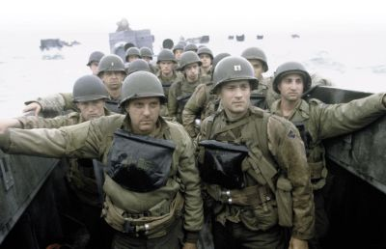
Time
When the story happens
What is the date of the story?
What time of day is your scene taking place?
What time of year is it?
What is going on in history that might affect the character or characters?

Slide 5
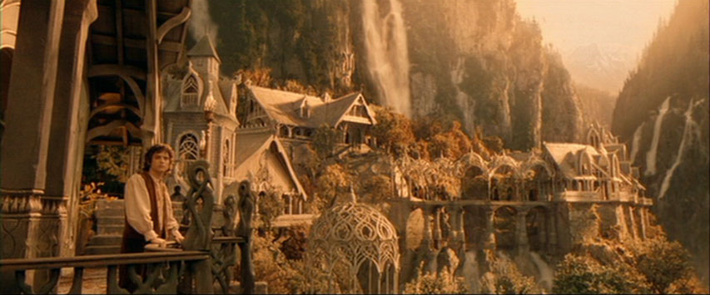
Location
Where, in general, the story happens
What is the weather like?
What is the physical environment like?
What’s the character’s relationship/ comfort with the physical surrounding?
What are the man-made features like?

Slide 6
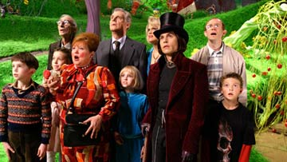
Atmosphere
Where, specifically, the story happens
What does the character see? hear? smell? touch? taste?
What’s the “vibe” of the place?
Are there layers- things you don’t notice right away?

Slide 7
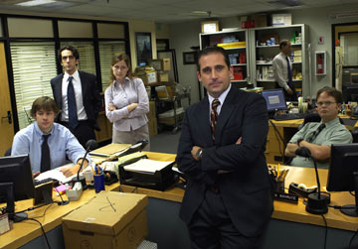
Social Milieu
What are the people are like in the story.
How do they react to stimuli?
What is the characters’ relationship to the people here?

Slide 8
Establishing Setting
Details of setting, like details of character, need to be relevant to story
Too much detail will quickly get boring
Avoid verbs-of-being
Jack was standing on the corner. It was 10:30. It was raining. Vs:
Jack’s watch read 10:30 as he dashed to the corner. “Rats,” he thought, “missed my bus again- and it’s raining.”
Remember your character’s “filter”
One character might feel very differently about a place than another, and this will affect description greatly.

Slide 9
Practice
Think of your favorite movie or book
Using as many details, describe the place:
Time, location, atmosphere, social milieu
You can make a list

Slide 10
Ratatouille Setting Analysis
To what extent is the setting an important part of the story?
In order to create a setting, what details should be present?
Describe one setting from the film, using as many details as possible.
If you had to change the setting of the film, what location would you choose?

Slide 11
Setting assignment

Slide 12
Your task
I am going to give you four possible locations/setting, and you will then create a 300-500 word setting description for one option.
Time
Location
Atmosphere
Social milieu
Reminder: think about your audience and what they need to know about your location
Due date: turnitin.com by 10pm 9/27
Location Options:
Space Station
Remote village in the jungle
Toy factory
Sports locker room

Slide 13
Character and setting
Put them both together…finally!

Slide 14
Assignment
Using strong characters and setting, tell a story.
Any topic, location, characters, plot, etc.
Must be around 1000 words.
Should attempt to use dialogue in the story.
Work time Monday and Tuesday, story is due 10/4 at 10pm on turnitin.com

