Slide 1
Realism
An intro to Mark Twain and Huck Finn

Slide 2
The Realists (1860s- 1900)

Slide 3
Romantics Review
Could find “higher truths” in the natural world
City was the site of corruption and moral decay; nature was site of renewal, truth
Feelings/intuition/imagination over reason or logic
Experiences over school education
Poetry thought to be highest form of expression
Use traditional European themes/style to promote American way of writing

Slide 4
Realism vs. Romantics
Real life
Not really interested in lofty ideas of “higher truth”
Nurture (people products of environment)
Satire and irony
American uniqueness
Language how people actually talk
Feelings and intuition
Fascinated with “higher truth”
Nature (Good and Evil.)
Serious and Straightforward
European Traditionalism
Language fancy and European

Slide 5
Romantics and Realists: Similarities
Both felt cities sites of corruption, death, etc.
Both value lived experience over philosophy
Believe that people are improvable, we can be changed
Reject predestination, direct involvement of divine

Slide 6
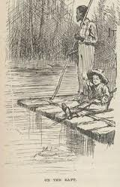
Realist hero
Not focused on “high truth”, instead focusing on life and getting by
Realistic or real portrayal
Often an outcast or a rebel; uneducated, uncultured, powerless, or poor

Slide 7
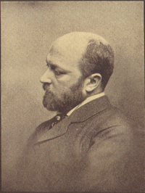
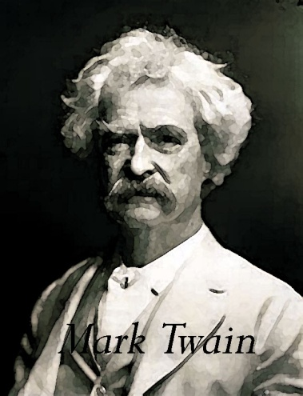
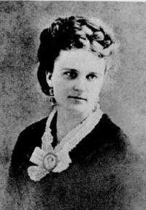
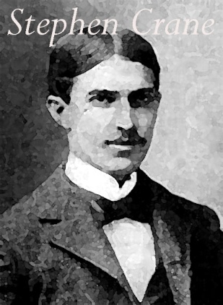
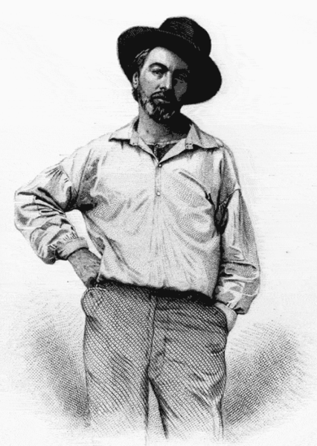
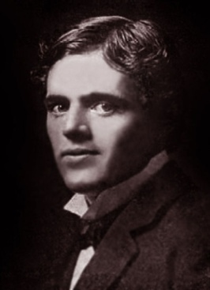
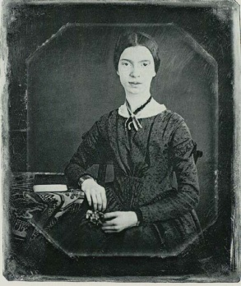
Realism
Psychological
Fiction
Regionalism
“Realist”
Poets
Naturalism
Twain
James, Chopin
Crane, Bierce, London
Whitman,
Dickinson

Slide 8
Realism: Huck Finn
From 1865 to 1915, writers turned away from Romanticism and strove to portray life as it was actually lived.
The major literary movements of the period were Naturalism, Regionalism, and Realism.

Slide 9
Realism
Attempted to present a “slice of life”: sought to portray ordinary life as real people live it and attempted to show characters and events in an objective, almost factual way.

Slide 10
Regionalism and Naturalism
Naturalism: Showed life as the unavoidable working out of natural forces beyond our power to control.
Regionalism: blended Realism with Romanticism: emphasized place, and the elements that create local “color”: customs, dress, speech, and other local differences.

Slide 11
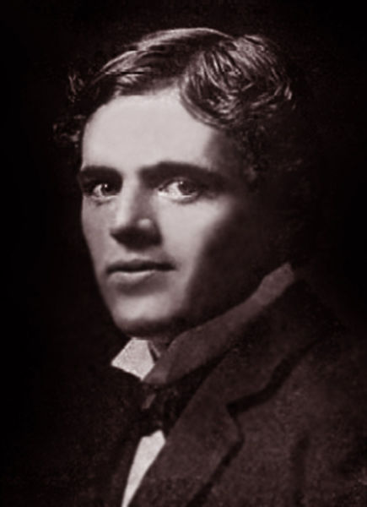
Naturalism
Went Beyond Realism in attempt to describe life as it really was.
Tended to view life as a grim, losing battle where people have few choices and live according to natural laws out of their control.

Slide 12
Regionalism
Realists no longer ashamed of American “provincial” roots
Provincial: the regions outside the capital city of a country; seen as unsophisticated
Portrayed, as accurately as possible: speech patterns, customs, daily life, environment, and music of the region
Goals varied
Showcase unique American character
Expose American flaws in order to bring social change

Slide 13
Psychological Fiction
Henry James, Kate Chopin
Disagreed with Naturalists idea that people driven only by crude instinct or what is natural
Concentrated on detailed studies of characters’ motivations
Emotional/mental reasons for doing things instead of nature impacting one’s actions

Slide 14
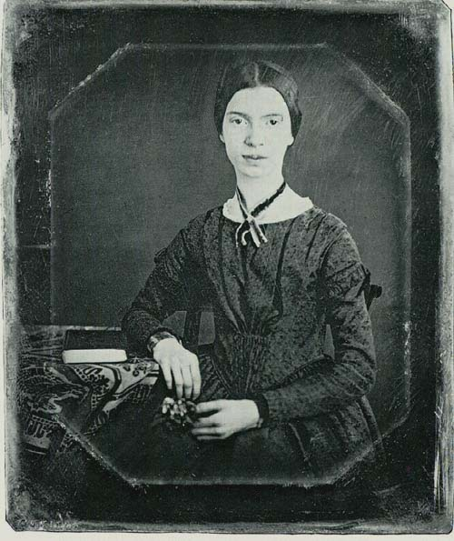
Realist poets
Pioneers of American Poetry
Both abandoned European forms- wrote in “free verse”
Gave two new “jobs” for poetry:
Whitman- celebratory, troublemaking (like Regionalists)
Dickinson- subversive, mental mindset(like psychological fiction)

Slide 15
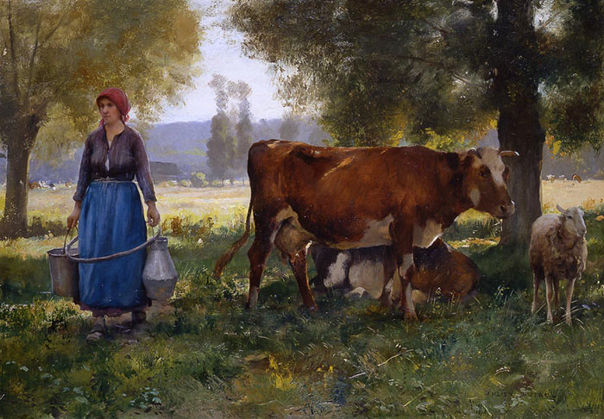
Naturalism

Slide 16
NATURALISM
Social conditions and events are inescapable and not because of the supernatural/God
Portrays things as they actually are
Naturalism literature is a literary movement that seeks to represent an everyday reality
More realistic and believable
Drawing/writing of realistic objects in a natural setting

Slide 17
Your task today
You will be writing about each of the Naturalist paintings presented.
You need to write about what you see, and what you think is happening in the painting.
You will have 1 minute for each painting, and you are expected to write for the full minute.
Painting notes and the overall reflection question will go in the homework packet

Slide 26
Reflection (5 minutes)
What similarities AND difference can you see between Rationalism, Romanticism, Dark Romanticism, Transcendentalism, and Realism (and all of its branches)?

