Slide 1
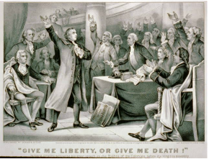
Rationalism
A reaction to puritan thought

Slide 2
So we finished with the Puritans…
What were Puritan values?
Who was most important in their life?
What did they base all knowledge around/on?
As a reaction to Puritans we get the Rationalists…
If you think for yourself and no one else has anything to do with your success…you are a rationalist

Slide 3
Rhetoric
Aristotle described rhetoric as “observing in any given case the available means of persuasion”.
Use rhetorical appeals: ethos, pathos, logos
Make use of shared assumptions
At least pieces of an argument to gain the trust
Use language as an art…think of eloquent speakers
Used to get people to do something, convince someone
Notes:
Logos (using logical arguments such as induction and deduction)
Pathos (creating an emotional reaction in the audience)
Ethos (projecting a trustworthy, authoritative, or charismatic image)

Slide 4
Rationalism Definition
By the end of the 17th century REASON began to present a challenge to the unshakeable and inflexible faith of the Puritans.
Unlike the Puritans the Rationalists believed all people were able to perfect themselves through good works and self-effort
REASON and LOGIC become more important than only living by FAITH and RELIGION
Roughly 1750-1800

Slide 5
“The Age of reason” or “The enlightenment”
Less focus on hell or life after death and more concern with creating a better life on earth…and yet, Christian beliefs still play a central role for the thinkers of the time.
God’s gift to humanity was considered to be REASON.
A belief in God and science was NOT seen as a contradiction.
Thomas Jefferson’s Bible
Jefferson changed parts of the Bible to create a new version that removed what he considered to be the supernatural aspects: miracles, angels, and the divinity and resurrection of Jesus.
He wanted a Bible that showed Jesus as a great moral teacher, but nothing more.
All of this was particularly significant because these Rationalist ideas were being tested as a NEW NATION was formed!!

Slide 6
Rationalist Literature
Mostly devoted to politics, science, philosophy, and ethics
Persuasive essays and pamphlets
Songs
Speeches
Known for their use of powerful persuasive rhetoric
Rationalism thrived on freedom of speech and the freedom to question…everything
Highly ornate writing style
Fiction uses generic plots and characters
Fiction often tells the story of how an innocent young woman is tested by a seductive male
Examples: Ben Franklin, Thomas Paine, Thomas Jefferson, Phyllis Wheatly

Slide 7
Beliefs
Belief that was opposite of the Puritans
Reasoning not religion would lead humans to arrive to the truth of life.
Believed that God gave humans the ability to think
Humans should exploit this gift
Rationalism becoming a point taken by numerous scientists.

Slide 8
Characteristics (and themes in writing)
Emphasis on self-knowledge and self-control
Reason and scientific observation
Rule of law and order
Man’s ability to perfect himself and the world
Freedom from restrictive laws

Slide 9
How writing changed
Writing was less private and religiously based
Writing came away from the Plain Style and became full of flourish and colorful language
Writing was influenced by the Revolutionary War and the growing American spirit of individualism and self-reliance.
Not against God, but saw reason as both spiritual and logical (Jefferson Bible)
How do we create a better life on earth?

Slide 10
Common sense
Read Thomas Paine’s “Common Sense” (pages 376-378).
As a table group, answer questions 1 and 4 on a separate sheet of paper
Focus:
Determine what Paine wants the 13 colonies to do.
Evaluate his goals for government and society.
To what extent is this a Rationalist piece of writing?

Slide 11
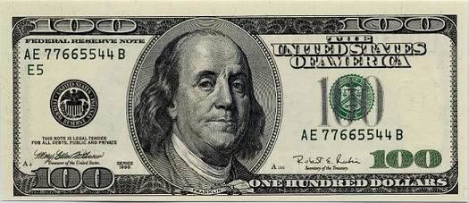
http://www.biography.com/people/benjamin-franklin-9301234/videos/benjamin-franklin-mini-biography-2165760584

Slide 12
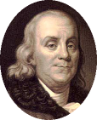
‘13 Virtues’ of a leading rationalist figure
In 1726, at the age of 20, Benjamin Franklin created a system to develop his character.
"I propos’d to myself, for the sake of clearness, to use rather more names, with fewer ideas annex’d to each, than a few names with more ideas; and I included under thirteen names of virtues all that at that time occurr’d to me as necessary or desirable, and annexed to each a short precept, which fully express’d the extent I gave to its meaning."
- Benjamin Franklin

Slide 13
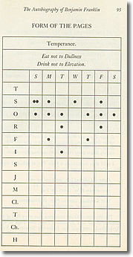
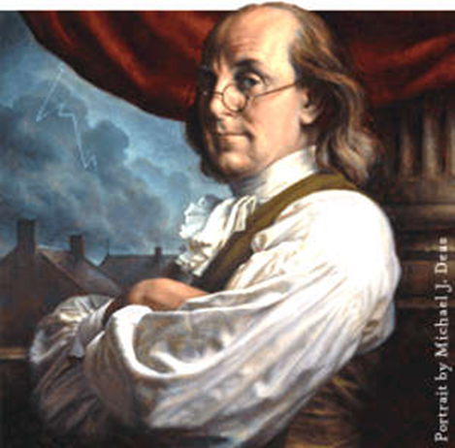

Slide 14
Thirteen Virtues
Temperance. Eat not to dullness; drink not to elevation.
Silence. Speak not but what may benefit others or yourself; avoid trifling conversation.
Order. Let all your things have their places; let each part of your business have its time.
Resolution. Resolve to perform what you ought; perform without fail what you resolve.
Frugality. Make no expense but to do good to others or yourself; i.e., waste nothing.
Industry. Lose no time; be always employ'd in something useful; cut off all unnecessary actions.
Sincerity. Use no hurtful deceit; think innocently and justly, and, if you speak, speak accordingly.
Justice. Wrong none by doing injuries, or omitting the benefits that are your duty.
Moderation. Avoid extremes; forbear resenting injuries so much as you think they deserve.
Cleanliness. Tolerate no uncleanliness in body, cloaths, or habitation.
Tranquility. Be not disturbed at trifles, or at accidents common or unavoidable.
Chastity. Rarely use venery but for health or offspring, never to dullness, weakness, or the injury of your own or another's peace or reputation.
Humility. Imitate Jesus and Socrates.

Slide 15
13 virtues
Go around the table reading the text, paraphrasing each in your own words.
Determine how these compare to Edwards’ resolutions (Puritan work last Thursday).
Conclude what pieces of these reflect the ideals of rationalists at the time.
To what extent do we see these virtues present in our society today?

Slide 16
Make your own!
Think of several beliefs or ideas that you hold strongly.
Come up with at least 4 “virtues” as Franklin did.
Then, use one of your virtues to create a bumper sticker or meme or motivational something that we can put outside our door.
Requirements:
4 virtues (on back)
1 Thoughtful, meaningful, clever statement
Thematic illustration
Color
Use all the space!

Slide 17
Declaration of Independence
Outline the argument
Determine to whom this was this directed.
Conclude the purpose/goal of the Declaration.
Investigate the points they made to prove their point.

