Slide 1
Point of View
And Multiple Narratives

Slide 2
Learning Targets
I can demonstrate an understanding of point of view
I can accurately use point of view with first, second, and third person

Slide 3
Narrator ≠ Author,
Author ≠ Narrator
Common mistake - especially in first-person narration
Narrator (or other characters) is/are often ignorant of many things author knows or has radically different opinion than author
Examples:
Adventures of Huckleberry Finn (Huck v. Twain)
The Great Gatsby (Nick v. Fitzgerald)

Slide 4
Voice- how a character talks
Voice of a character consists of many things- including:
Age/Experience Level
Profession/Area of Expertise
Education
Culture/Ethnicity
Audience (who they are speaking to)
Historical Period
Gender
Interests
Ways this is expressed:
Vocabulary- how large or small, how jargon filled
Use of slang or jargon
Dialect/accent
Length of speech
Content of speech
Emotion of speech
Etc. etc.

Slide 5
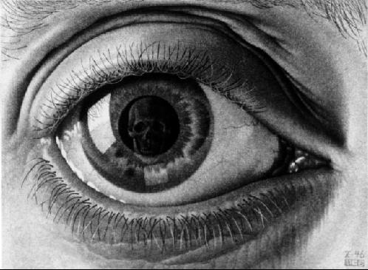
Types of Point of View
First Person
Autobiographical
Fictional
Third Person
Omniscient
Limited
Dramatic
Second Person
Weirdo
Passive voice

Slide 6
First Person
“I walked in the door, put my keys on the table, and suddenly I saw…”
Autobiographical- Author (attempting) to relate matters as s/he experienced them (though beware of bias)
Ex.- memoirs, non-fiction
Fictional- Author writing in a persona
Very important here to remember the author is very often utilizing dramatic irony or other literary devices to separate themselves from the character. Must, in fact, to maintain suspension of disbelief.

Slide 7
Second Person
Weirdo
“You walked in the door, you put your keys on the table, and suddenly you saw…”
Can draw reader into story in more personal way.
Rarely used because considered “gimmicky”
Passive Voice
“The door was walked through, keys were placed on the table, and suddenly ____ was seen..”
Has no subject whatsoever- no idea who is involved.
Generally only used in scientific or technical writing.

Slide 8
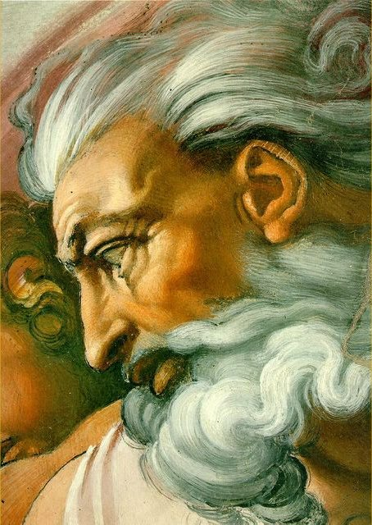
Third Person
“He walked in the door, he put his keys on the table, and suddenly he saw…”
Most common style of narration
Omniscient
Narrator knows everyone’s thoughts, can travel anywhere at will.
Limited
Doesn’t know everyone’s thoughts- though often knows one characters’
Follows a particular character
Dramatic
Just sticks to actions of characters- no thoughts at all.

Slide 9
Questions to consider
What is the point of view of the story?
How is the point of view appropriate to the story? How does it underscore the characterization, conflict and/or central idea of the story?
How might the story be different if told from a different point of view?
Remember: an author chooses a point of view in which to write. If the author wants YOU to analyze the motives for the characters, he or she might use dramatic point of view so that you have no clues in the thoughts of the characters.
If the author, like in The Hunger Games, wants you to see reality NOT objectively, but through the eyes of the main character, then he or she might use first person, or third person limited point of view.

Slide 10
Point of View
Remember: an author chooses a point of view in which to write. If the author wants YOU to analyze the motives for the characters, he or she might use dramatic point of view so that you have no clues in the thoughts of the characters.
If the author, like in The Hunger Games, wants you to see reality NOT objectively, but through the eyes of the main character, then he or she might use first person, or third person limited point of view.

Slide 11
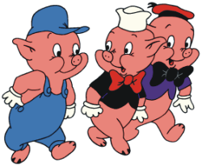
Multiple Point of Views
Who knows the story of the Three Little Pigs?
Three Little Pigs from the Wolf’s Perspective/Point of View:
How can different point of views and narratives impact a story?

Slide 12
Practice
I will give you an event, and you will describe the event from a first person and third person (you can choose limited, dramatic, or omniscient)
Must be 750-1000 words
Event:
Busy street in Sammamish on a Wednesday evening. It is raining. Lots of traffic. There is a traffic accident involving a mom with her two children and a teenage boy.

