Slide 1
Essential questions
Conclude how art or literature can be a representation of culture.
Determine the purpose of art.
To what extent can art be used as a way to criticize or praise culture or cultural norms?
Focus: look at art and culture of the 60s as a way to understand the 1970s

Slide 2
Please define: normal

Slide 3
Review
PURITANS - early 1600s- mid 1700s
REVOLUTIONARY/AGE OF REASON- 1750-1800
ROMANTICISM -1800-1860
TRANSCENDENTALISM -1840-1860
REALISM - 1855-1900
MODERNISM -1900-1950
POSTMODERNISM -1950 to present

Slide 4
Postmodern Literature
A form of literature which is marked, both stylistically and ideologically, by a reliance on such literary conventions as:
Temporal Distortion: time travel
Historiographic metafiction: President Lincoln landing on the moon
Hyperreality: the machines are taking over
Magic realism
Poioumena and metafiction: author as part of the story; story writing as part of the story
Paranoia, black humor, irony
Fragmentation
Paradox
Unreliable narrators
Unrealistic and impossible plots
Parody
Authorial self reference

Slide 5
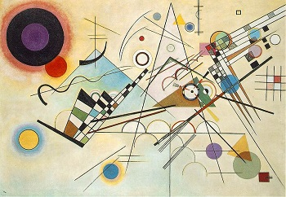
Postmodernism: not just literature
Can be applied to art, philosophy, architecture, fiction, and cultural & literary criticism (among others)
Largely a reaction to the assumed certainty of scientific (or objective) society
HIGHLY dependent on personal reality

Slide 6
Postmodern Authors
Reject outright meaning in their novels, stories and poems
Highlight and celebrate the possibility of multiple meanings, or a complete lack of meaning, within a single literary work
Reject many of the ideas that came with Modernism
Serve to: Dispute, Reverse, Mock, Reject
Instead of following the Modernist quest for meaning in a chaotic world, Postmodernist literature shuns, often playfully, the very possibility of meaning
Postmodern novels, stories, or poems are often presented as parody of the Modernist quest for meaning

Slide 7
Postmodern Philosophy
Reaction to stylistic and ideological limitations of Modernist literature and the radical changes the world underwent after the end of WWII
Modernist writers depicted the world as: fragmented, troubled, and on the edge of disaster…so they search for meaning
Postmodern writers, having already undergone countless disasters and being beyond redemption and understanding, along with the awareness of the possibility of utter disaster and apocalypse on the horizon, feel that locating precise meanings and reasons behind any event is impossible
Conceptualize the world as being impossible to strictly define and understand
Will not end with the neatly tied-up conclusion
Challenges binaries: good vs. evil, darkness vs. light, etc. There are no absolutes

Slide 8
So what does that mean?
Postmodernism is largely a reaction to the assumed certainty of scientific, or objective, efforts to explain reality.
It stems from a recognition that reality is not simply mirrored in human understanding of it, but rather, is constructed as the mind tries to understand its own particular and personal reality.
Highly skeptical of explanations which claim to be valid for all groups, cultures, traditions, or races, and instead focuses on the relative truths of each person.
In the postmodern understanding, interpretation is everything; reality only comes into being through our interpretations of what the world means to us individually. Postmodernism relies on concrete experience over abstract principles, knowing always that the outcome of one's own experience will necessarily be fallible and relative, rather than certain and universal.
Source: PBS.org

Slide 9
Hunter S. Thompson
“I hate to advocate drugs, alcohol , violence, or insanity to anyone, but they’ve always worked for me”

Slide 10
Thompson
1937-2005
Born in Louisville, Kentucky
Troubled childhood
Father died, leaving the family in poverty
Dropped out of high school, jailed for abetting robbery
Joined the Air Force before moving to journalism
Politically minded
Journalistic pursuits
Hell’s Angels
Nixon Campaign
Fear and Loathing In Las Vegas
A rumination on the failure of the 1960s counterculture movement and the subsequent state of the American Dream
“Fiction is often the best fact”

Slide 11
Gonzo Journalism
New kind of journalistic endeavor
Journalists involve themselves so deeply in their writing that they become central characters
An approach to accuracy through the reporting of personal experiences and emotions
The personality of the piece is as important as the event

Slide 12
Sarcasm, humor, exaggeration, profanity are common
“Absolute truth is a very rare and dangerous commodity in the context of professional journalism”
Ralph Steadman
British cartoonist
Caricatures

Slide 13
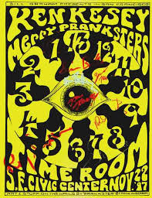
From the Beats to the Hippies
Bridging the counterculture movements of the Beats and the Hippies with Ken Kesey and his Band of Merry Pranksters

Slide 14
The Hippie Movement
Hippie
Used to describe Beatniks who found their “Technicolor heart” in the Haight-Ashbury district of San Fransisco
Derived from ‘hipster’
a term adopted in the 1940s and used to describe people that were interested in jazz → (hepcat)
Characterized by dress, slang, use of marijuana and other drugs, relaxed attitude, sarcastic humor, self-imposed poverty, relaxed sexual codes
New period of fashion, film, literature
Increasingly associated with the anti-War movement

Slide 15
“Make love, not war”
Vocal opposition to US involvement in Vietnam
“Flower Power” coined by Ginsberg in 1965 in order to capture this idea of turning war into peace

Slide 16
Ken Kesey (1935-2001)
“I was too old to be a beatnik and too young to be a hippie”
American author
One Flew Over the Cuckoo’s Nest (1962)
Sometimes A Great Notion (1964)
Considered a link between the Beat generation of the 1950s and the Hippie generation of the 1960s
Born in Colorado, moved to Oregon
Attended University of Oregon
Wrestler, great athlete
Degree from the School of Journalism in speech and communication in 1957, followed by non-degree Creative Writing program at Stanford
Experimented heavily with psychoactive drugs
Took part in government funded study around LSD, mescaline, cocaine, DMT
Inspired Cuckoo’s Nest
Kesey did not believe that patients were insane, but rather that they had been pushed out by society because they did not conform

Slide 17
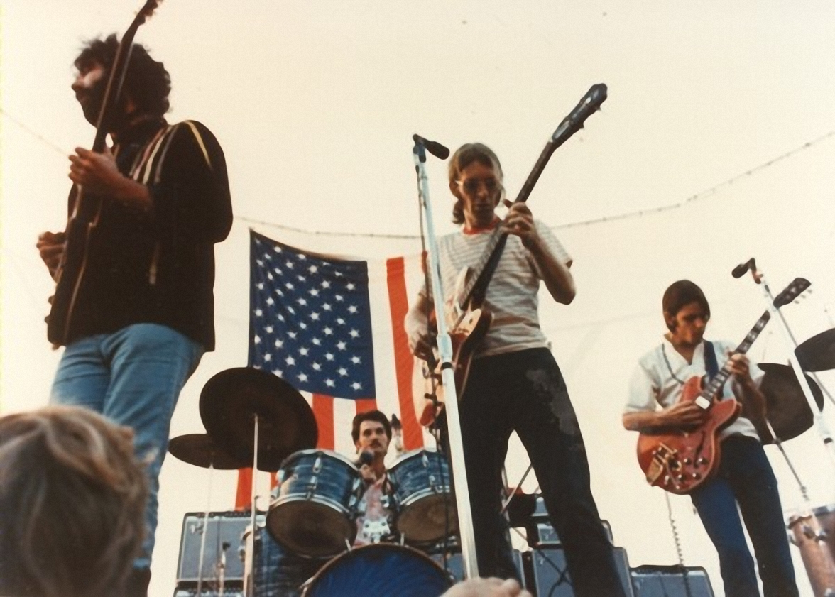
Began hosting “Acid Test” parties
Involved his favorite band The Warlocks (later known as The Grateful Dead) black lights, strobes, florescent paint, and LSD

Slide 18
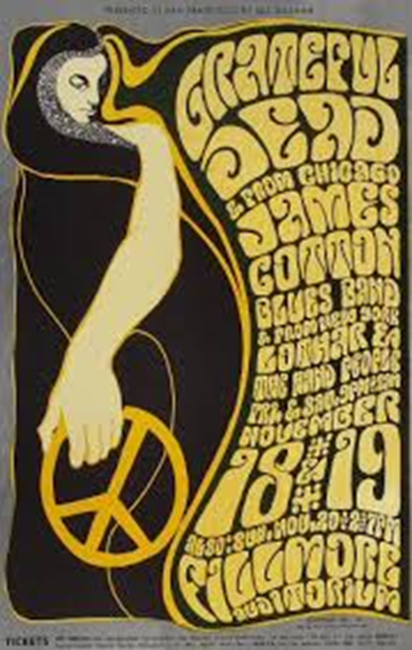
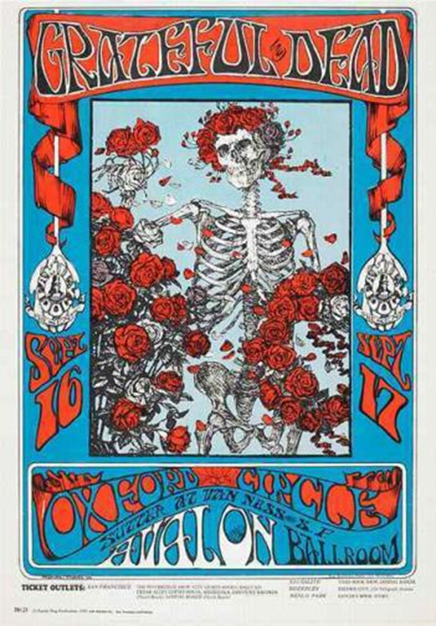
The Grateful Dead
Jam Bands & Postmodernism
Their music and career became defined by the experience of the concert
Many of their songs were too long to be played on the radio, so the real experience came from seeing them in concert, where every show was different.

Slide 19
“Services & Relationships”
“If you want to survive in this business,” the band’s late guitarist Jerry Garcia once told me, “you go out there and pick up your audience, you recruit ‘em. That’s who you’re working for.”
Notes:
“Casey Jones”

Slide 20
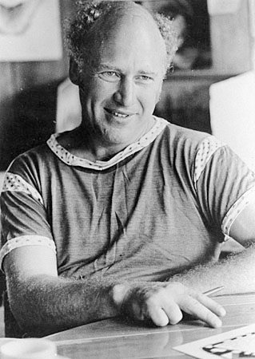
The Merry Pranksters
Cross-country road trip that involved a number of famous Beats
A bus named “Further”
The trip was the group’s attempt to create art out of everyday life and to experience roadway America while high on LSD
“If people could just understand it is possible to be different without being a threat”

Slide 21
Legacy of the Further trip
Rooted in ideals of American freedom
“more haphazard than planned”
Kesey directed the action like a ringmaster
Kesey had intended this to be a summer trip, but people started to adopt it as a lifestyle
Up to the end of his life Kesey praised the psychedelic 60s – he said he would “accept all the bad again, so long as he got the good too”
Popularized the tie-dye effect that would become associated with San Francisco’s hippie scene

Slide 22
Kesey’s Unique Approach to Writing
''You see,'' says Kesey, ''after a certain point, colleges don't teach writing, they teach rewriting. They teach people to figure, 'Well, I'll do an outline, and then I'll work on it and make it real later.' Well, that's valid, but it's no fun. The fun in writing is like jazz–where you're singing, where suddenly the voice is going forward and you're riding it, you're surfing on top of it. That is the art of writing. How does one impart this? How does one find it? It's as hard to find it as it is to teach somebody to find it.''

Slide 23
Class Discussion
Did postmodernism allow for literature and artists like Thompson and Kesey to flourish
Or:
Did literature and artists like Thompson and Kesey bring about the postmodernism movement?

Slide 24
Discuss
Does art need to be original to be creative?
Why?

Slide 25
Andy Warhol
Pop Art: capturing the cultural zeitgeist
Notes:
https://www.youtube.com/watch?v=O6rtCr2Coeo

Slide 26
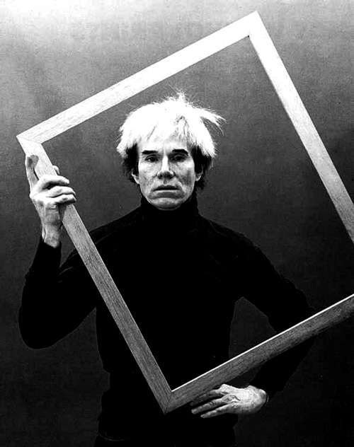
Who is Warhol?
Born Andrew Warhola
Pittsburgh, PA
1928-1987
Known for: printmaking, painting, cinema, photography
Part of the ‘Pop Art’ movement
His work explores the relationship between artistic expression, celebrity culture, and advertisement
Pioneer in computer generated art
The Velvet Underground
New Wave/Punk

Slide 27
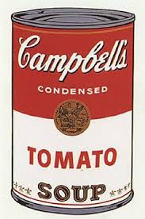
Pop Art
Art movement that emerged in the 1950s, exploded in the 1960s and 70s
Challenges traditions of fine art by including imagery from popular culture
The concept of pop refers not as much to the art itself as to the attitudes that led to it
Emphasized the cliché or kitschy, often ironic
Often referred to as the earliest examples of postmodern art

Slide 28
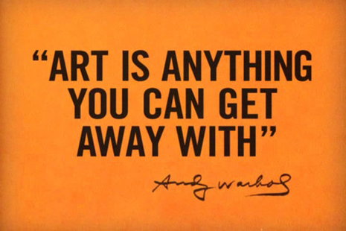
Reaction to Americans being constantly bombarded with mass-produced imagery and products
Occasionally appropriated by comics (DC & Marvel)
Warhol attempted to take Pop Art beyond an artistic style and into a lifestyle
Coined the phrase “15 minutes of fame”

Slide 29
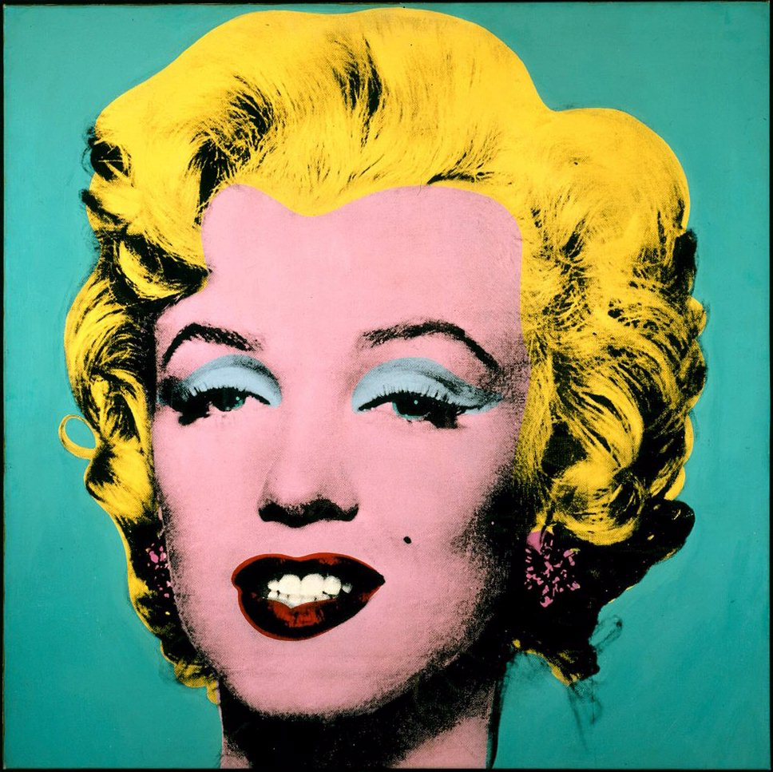
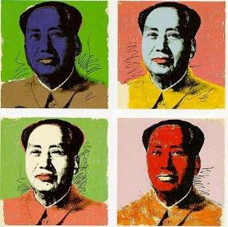
Through the years…
1960s
Campbell’s Soup Cans
Celebrities such as Marilyn Monroe, Elvis Presley, Muhammad Ali, Elizabeth Taylor
Attempted murder of Warhol 1968
Portrait of Mao Zedong 1973
“Making money is art, and working is art, and good business is the best art”
Re-emerged in the 1980s
Criticized for being ‘business art’

Slide 30
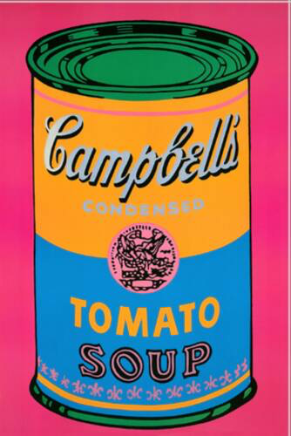
Painting what he loved
“I love Los Angeles. I love Hollywood. They’re so beautiful. Everything’s plastic, but I love plastic. I want to be plastic.”
Celebrities
Silk screening
Later drawings were traced from slide projections
Soup Cans, Dollar Bills
BMW
Produced both comic and serious works

Slide 31
Warhol’s Films
Between 1963-1968 he made more than 60 films
Sleep
Monitors poet John Giorno sleeping for 6 hours
Empire
8 hours of footage of the Empire State Building at dusk
Eat
A man eating mushrooms for 45 minutes
Chelsea Girls
Reminiscent of his silk screen paintings
Projection of two stories being shown in tandem

Slide 32
Other Forms of Art
Time Capsule
1973
Began saving things from his daily life, sealed in plain cardboard boxes
Now housed at the Andy Warhol Museum
Very interested in fashion

Slide 33
Make your own!
Choose
Celebrity
Commercial object
Dark outline, then do your best to ‘Warhol’ it
Have fun!

