Slide 1
Nisei Daughter Lessons

Slide 2
Learning Targets 1/28
I can define rhetoric
I can analyze the use of rhetoric in cartoons
I can determine the message and lessons of a fictional story, connecting it to history

Slide 3
The Sneetches
Learning Targets:
I can analyze the story and make connections to social hysteria and Japanese internment
I can determine the purpose of The Sneetches
While listening and watching, write down your reactions to the story, characters, what is happening. (Notes go in homework packet)
Small group discussion then whole class share

Slide 4
The Sneetches
Summarize the story.
Conclude the message of the story.
What did the Fix-Up Chappie do?
Determine the similarities in the story and history.
How does this story connect to what we have studied so far in history, and why do you think it relates to Japanese internment?
What lesson did the Sneetches learn that the many people in the world still need to learn?

Slide 5
5 minute write (The Sneetches Reflection)
On the bottom of your notes, answer the following in a paragraph…
How can citizens break through barriers of prejudice to promote tolerance?

Slide 6
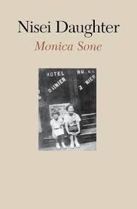
Learning Targets
I can analyze literature for historical context
I can create an opinion and use evidence to support the opinion
I can respectfully engage in discussion with classmates

Slide 7
Individual Entry Task (5-7 minutes)
In a short paragraph, using evidence from the text, explain “when I was a happy six-year-old, I made the shocking discovery that I had Japanese blood. I was Japanese” (3). Conclude how she feels about being Japanese (18-19)?

Slide 8
I used to think, but now I think…
Before chapters 1-2 (from Tuesday)
What do you know about Japanese Americans?
What do you know about second generation immigrants and their parents?
What do you know about Japanese-American relations in the 1930s and 1940s?
After chapters 1-2 (Board Talk)
How did chapters 1-2 challenge your thinking about Japanese immigrants?
Explain if it is ever right to deny citizens their rights. At what point does national security trump individual rights?
Determine how fear can control a society.
What questions do you have from chapters 1-2?

Slide 9
Board Talk Expectations
Be engaged with the comments on the board, not your phones or each other
Should be a silent discussion with the topics on the boards
Respect, honesty, openness

Slide 10
Chapter 1: A Shocking Fact of Life
What was Father’s dream when he moved to America? What was his reality?
What was Mother’s entry into America like? Describe their road to marriage.
Explain the family life in the early days in Seattle.
How does Monica describe her childhood in the hotel?
Describe Skid Row and all its inhabitants.

Slide 11
Chapter 2: The Stubborn Twig
Describe Monica’s reaction to going to Japanese school. Conclude why you think she has that reaction.
Examine Mr. Ohashi, his role in the novel, and his purpose in life. What are his goals for Japanese living in America?
According to Mrs. Matsui, why are Mother and Father bad parents?
Determine the impact the people on Skid Row have on the children.
Conclude why Monica would say, “during those impressionable years, the police became our sworn enemies…” (34). Explain the situation with Father and the police. Examine the character Mr. Kato.

Slide 12
Learning Targets 2/6
I can analyze historical documents
I can use OPCVL and language lenses to analyze a document

Slide 13
Individual Reading
Jigsaw around Executive Order No. 9066 and Evacuation Order (Western Defense Command)
Read your assigned historical document and answer the questions.
You will then share with your table groups.

Slide 14
Executive Order 9066 (1215-1216)
What justification for this executive order does President Roosevelt cite?
This document was issued nearly two months after the United States declared war on Japan. What domestic actions does the president as commander in chief authorize in this document?
What responsibilities does the president designate to assure the protection and care of those affected by this order?
Why do you think that a particular ethnic group, such as the Japanese, is never mentioned in this order? Does that omission lessen the impact of the prejudice against them?
Given the official and legal language of this document, what leeway does the secretary of war have in the treatment of “alien enemies” (par. 5)?

Slide 15
Evacuation Order (1217 -1218)
What is the meaning of the designation “all persons of Japanese ancestry, both alien and non-alien”?
According to this document, in what ways is the Civil Control Station able to “assist the Japanese population”?
How long does each family have to “register” at the Civic Control Center?
What is each family permitted to take with them? What provision is made for belongings and property that cannot be taken along?
What recourse do Japanese individuals or families who wish to request an exception or accommodation have, according to this document?
What euphemisms do you note in this document?

Slide 16
Chapter 5: We Meet Real Japanese
Determine how the kids and family feel like outsiders (or “an alien among them” 108) on their trip to Japan.
Explain the incident with Cousin Yoshiye.
How does Japan compare to their life in America?
Determine how gender roles differ in America and Japan.
How does their trip to Japan end? Explain some of the events.
Determine why Ojih-chan (grandfather) does not move to America with the family.
Investigate Monica’s final reflections on her trip to Japan.

Slide 17
Chapter 6: We Are Outcasts
When the family goes to the sea, why will nobody rent them a house?
Why were Mother and Father not allowed to become “naturalized American citizens”? (113)
Detail Mother’s reaction to the house rentals, and what advice she gives Monica.
Examine Monica’s statement: “terrible curse that went with having Japanese blood” (118).
Analyze the significance of: “Here we were born; here we wanted to live. We had tasted of its freedom and learned of its brave hopes for democracy. It was too late, much too late for us to turn back” (124).

Slide 18
Chapter 7: Paradise Sighted
Who is Haruo, and what role does he play in Monica’s life? Why must she keep this a secret from her parents?
Examine why Monica struggles in high school.
What is Monica’s plan for her future, and what is her reality?
Define “picture marriage” and how Mother feels about this type of marriage (135).
Why does Monica ‘enroll’ in North Pines Sanitarium, and what lessons about herself and society does she learn during her time?

Slide 19
Learning Targets 2/5
I can define rhetoric
I can analyze the use of rhetoric in photographs and cartoons
I can determine the value of common good vs. individual good

Slide 20
Photographs and artwork
Define the term rhetoric
Dorothea Lange photographs and Dr. Suess cartoons
Silently reflect on your sheet of paper
What is the message? What rhetoric or language is being used?
Class discussion around rhetoric during a time like this
Power of images
Common good vs. individual rights

Slide 21
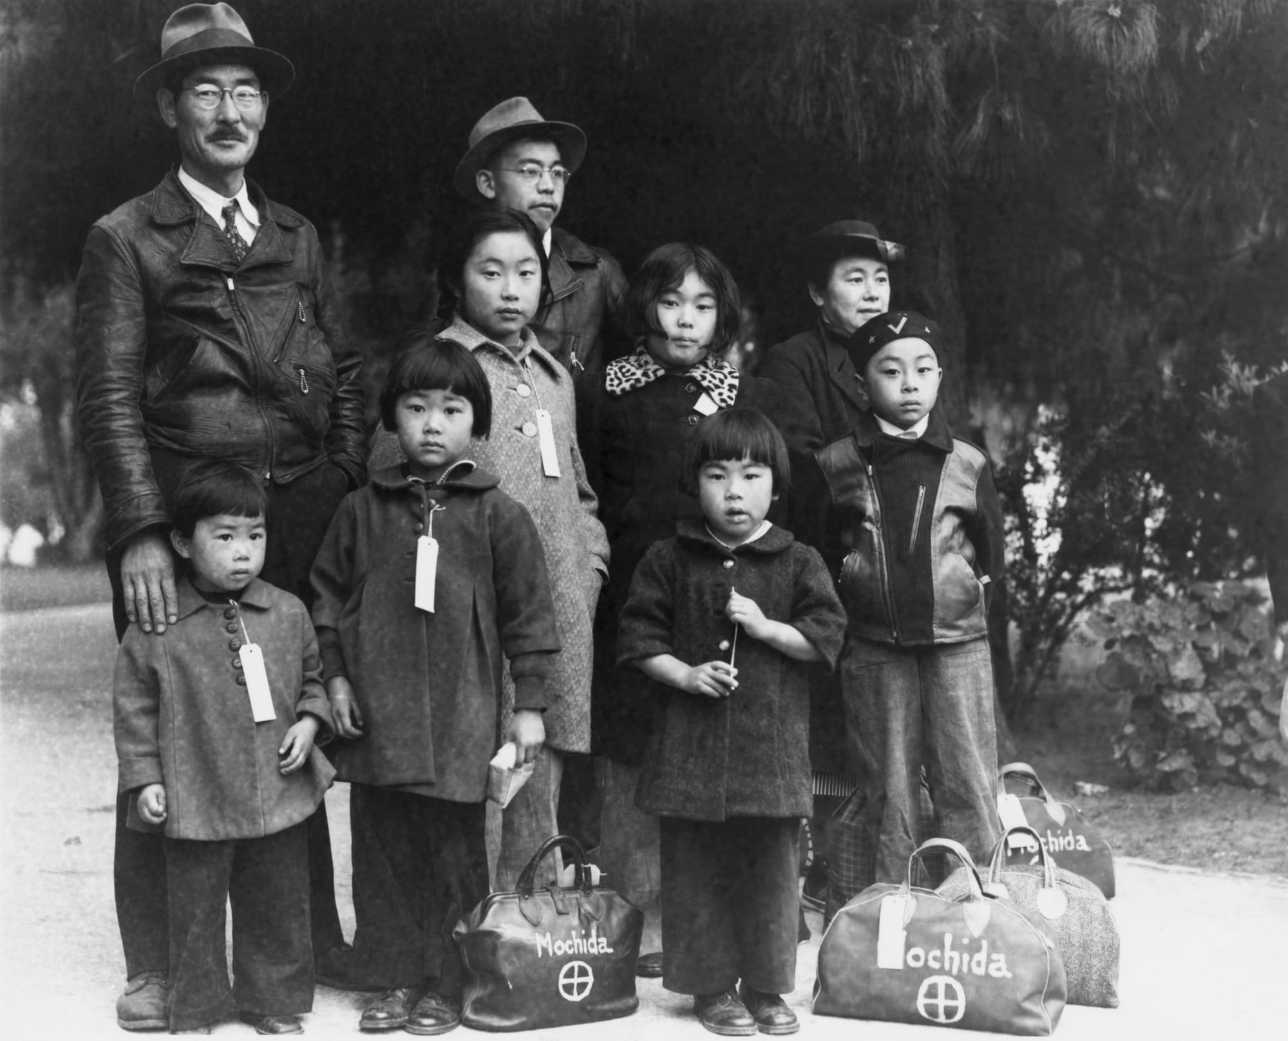

Slide 24
Notes:
Children of the Weill public school, the so-called international settlement, at the flag pledge ceremony in April 1942

Slide 25
Notes:
A young Japanese-American girl waiting to travel with parents to Owens Valley (Los Angeles, April 1942).

Slide 26
Notes:
Santa Anita, California April 1942

Slide 27
Notes:
Internment camp, Santa Anita

Slide 28
Notes:
Hirano family with picture of their son, US serviceman Shigera Hirano. They were held in Colorado River camp.

Slide 32
Learning Targets
I can demonstrate an understanding of Japanese interment and the lasting effects
I can use historical documents, interviews, and memoir as evidence
I can create a visual representation of Japanese interment and its impact

Slide 33
Japanese Internment Found Poem
Objective: To present an interpretation of what you have learned about Japanese Internment, you will create a Japanese Internment Memorial. This will consist of a found poem that you will create, an accompanying visual, and a one-paragraph explanation of your project.
What is Found Poetry? In its purest form, found poetry is poetry assembled from non-literary sources – can labels, road signs, clothing tags, picture titles, advertisements, etc. One way to write a found poem is to gather lines and phrases as they leap out at you, then shape/create your poem afterwards by rearranging the lines and phrases.

Slide 34
Japanese Internment Found Poem
Directions:
You will find your poem on the online museums
www.densho.org
http://amhistory.si.edu/ourstory/activities/internment/
http://caamedia.org/jainternment/camps/index.html
Rabbit in the Moon Documentary
Nisei Daughter
Must use three sources (documentary, websites, and novel)
Take notes on the sources (you will need direct quotes for this assignment)
Note sheet will go in homework packet

Slide 35
Japanese Internment Found Poem
The lines and phrases from the museum that you gather will later become a found poem expressing what you have learned about Japanese Internment.
Once you have written your poem, create a visual to accompany it. The visual may be hand-drawn, created on the computer, collage, or whatever medium you find suitable.
Your memorial should be created in a 2-D format (essentially on paper).
Then write a clear, detailed one paragraph explanation of your poem and visual. This paragraph should be on the back of your visual and should be typed.
20 lines with a partner, or 15 lines if done individually
***You will be graded on creativity, quality of work, thoroughness and clarity of your explanation.***

Slide 36
Learning Targets
I can analyze historical documents
I can define rhetoric
I can analyze the use of rhetoric in photographs
I can determine the value of common good vs. individual good

Slide 37
“I Am an American” by Dorothea Lange
Grab a literature book, and find the photograph on page 1220.
As a table group, answer the following questions (also in the text):
What do you see in this photograph? Describe it as objectively as possible without relying on any background knowledge.
This is a still photo, not one taken in a hurried moment to capture action in progress. What issues, ideas, or meaning do you think Dorothea Lange suggests through her composition?
This photo achieved iconic status in photojournalism and in the story of the Japanese internment. Why? What makes it so memorable—and representative?

Slide 39
“Letter of Apology” by George H.W. Bush
Read the letter on pages 1230-1231 (5 minutes), and answer as a table group:
Analyze the language of the apology letter
What acknowledgment does the letter make? What does it not acknowledge? Is emphasis places on the individual or the community—in terms of both responsibility and restitution?
Ronald Reagan said, “yes, the nation was then at war, struggling for its survival. And it’s not for us today to pass judgment upon those who may have made mistakes while engaged in that great struggle. Yet we must recognize that the internment of Japanese Americans was just that, a mistake”.
Should this have been included in the letter? Are Japanese Americans owed reparations for internment?

Slide 40
Learning Targets 2/10
I can analyze dual identity
I can create a visual representation of dual identity
I can use quotes from the novel as evidence

Slide 41
Chapter 8: Pearl Harbor Echoes in Seattle
How does Monica react to the news of the attack on Pearl Harbor by Japan?
How does Chris (Monica’s friend) react to the bombing/attack?
Discuss the divide in the family caused by the attack on Pearl Harbor.
Explain the reaction of the US government in regards to Japanese Americans.
What advice does Mrs. Matsui give Mother?
Analyze the language of the following quote: “A Jap’s a Jap…You can’t make an American out of little Jap Junior by handing him an American birth certificate” (158).
After all the racism and mistreatment, how does Monica feel about Seattle?

Slide 42
Chapter 9: Life in Camp Harmony
Evaluate the headline “Japs good-natured about evacuation” (171).
Describe the family’s new apartment in Puyallup.
Examine the difference between the reaction of the younger generations and the Issei when they arrive at the camp.
At the start of the evacuations, and at the camp, what role does Henry take in the family?
Why does Monica claim, “my citizenship wasn’t real, after all” (177)?
Describe the first weeks in the Puyallup camp.
Explain, “the advantages of Area D stimulated strange ambitions in some people, often to the discomfort of the rest” (184).
How does Monica’s outlook on life start to change (186)?

Slide 43
Chapter 10: Henry’s Wedding and a Most Curious Tea Party
Examine the quote, “with our glistening faces and baggy clothes we were not looking our best, and we turned away, embarrassed” (191).
Describe Camp Minidoka and Idaho (both when the family arrived and in the other seasons).
Explain the lesson of, “it had also taught us a lesson that man, or at any rate woman, cannot live on pride alone” (197).
Examine the irony in the statement of the President on pages 198-199.
What tactics do the recruiters use to convince the internment camp that a separate Nisei group in the army was beneficial and not segregation?
Explain the visit to town, and the reaction of the townspeople and the family members who visited from the camp.
Describe Henry and Minnie’s wedding and tea party.
Explain, “to try to force East to meet West had been a terrible mistake” (215).

Slide 44
Chapter 11: Eastward, Nisei
Investigate Monica’s feelings about the War Relocation Authority allowing the Nisei to return to the “main stream of life” (216).
Explain the role of Mr. and Mrs. Richardson in Monica’s life.
How do people in town react to Monica and other people of Asian descent?
How does Dr. Moller take advantage of Monica? Why does she not say anything about it at first? What power does he have over her?

Slide 45
Dual Identity Visual
Create a visual representation of the dual identity Monica and many other Nisei struggle with being Japanese American
Must include at least 8-10 quotes from Nisei Daughter

Slide 46
Learning Targets
I can analyze literature for historical context
I can create an opinion and use evidence to support the opinion
I can respectfully engage in discussion with classmates

Slide 47
I used to think, but now I think…
After reading the novel
What do you know about Japanese Americans?
What do you know about second generation immigrants and their parents?
What do you know about Japanese-American relations in the 1930s and 1940s?
After reading (Board Talk)
Explain if it is ever right to deny citizens their rights. At what point does national security trump individual rights?
Determine how fear can control a society.
Evaluate if the US owes Japanese Americans reparations for Japanese interment.

Slide 48
Board Talk Expectations
Be engaged with the comments on the board, not your phones or each other
Should be a silent discussion with the topics on the boards
Respect, honesty, openness

Slide 49
Individual Reflection Thesis Statement
Evaluate Monica’s changing views on her heritage by analyzing, “I was going back into its main stream, still with my Oriental eyes, but with an entirely different outlook, for now I felt more like a whole person instead of a sadly split personality. The Japanese and the American parts of me were now blended into one” (238).

Slide 50
Older files

Slide 51
Oral history compared to Sone
Listen to one of the oral histories
Have students compile notes on the individual experiences
Have them compare this to the experience of Sone and her family
How does hearing a family history compare to reading a family history?

