Slide 1
Nisei Daughter
Monica Sone

Slide 2
Essential Questions
Examine the lasting impact of Japanese internment
Evaluate the role of common good and individual rights
Determine if the United States should pay reparations for past choices/events
Investigate the dual identity of Japanese Americans

Slide 3
Before Reading
What do you know about Japanese Americans?
What do you know about first generation immigrants and their parents?
What do you know about Japanese-American relations in the 1930s and 1940s?

Slide 4
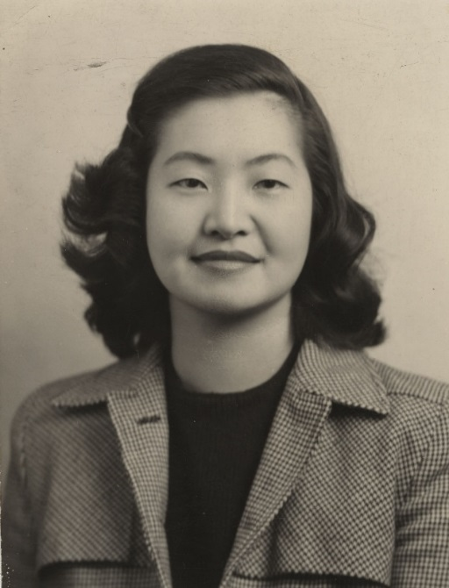
Major Characters
Mr. and Mrs. Itoi: Monica’s parents, own a hotel in Skid Row. Immigrated to Seattle.
Monica “Kazuko” Sone: main character. She still understands Japanese language and culture, but has “an American perception of the world” (xiii).
Siblings: Henry (older brother), Kenji (youngest brother), Sumiko (sister).

Slide 5
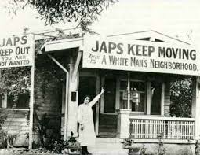
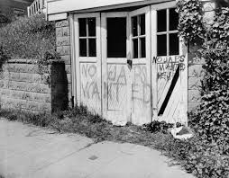
Background
“Autobiographical account by a Japanese-American woman that described her childhood, adolescence, and young womanhood while growing up in a Japanese immigrant family in Seattle” (vii)
The book really focuses on identify during a time when being Japanese was seen as traitorous (WWII and Pearl Harbor)
“One of the few books written by an Asian American author in the 1950s and the first book written about the internment experience from the perspective of a female internee” (xviii)

Slide 6
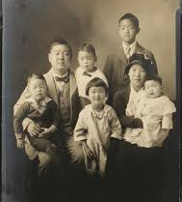
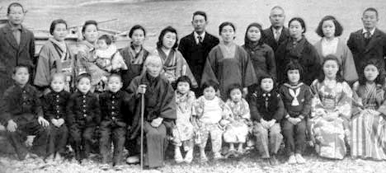
Important Terms
Sei: generation
Issei: first generation
Nisei: second generation
Sansei: third generation
Kenjinkai: prefectural associations
Local entities
Governmental bodies of Japan which are larger than cities, towns, and villages

Slide 7
Issei
Nisei
Men and women who were mostly 20-30 years old when immigrating to America.
Ineligible for US citizenship (permanent alien status).
Obeyed the custom “of the vertical structure of Japanese society, the tendency to grant special rights, privileges, and authority to those in higher status” (x)
Monica’s parents are Issei
Born in America, granted citizenship as birth right.
They were Americans, spoke English, idolized American figures, went to American schools.
Isolated from white American society still, and also had limited participation in Japanese culture because they didn’t speak language fluently or understand traditions.
“A Nisei was American, but not truly part of American society. A Nisei was certainly not Japanese, but Japanese influences seeped into aspects of his character and behavior” (xi-xii)

Slide 8
Historical Context
Immigration Act of 1924: goal was to arrest the flow of Japanese immigrants to America
Immigration and Nationality Act of 1952: ended the prohibition on Japanese Americans naturalizing
HR 442 and SB 1009: “mass incarceration was a national mistake”
First reparation payments of $20,000 was paid in 1990
Skid Row: “area of homeless men” (ix)
Japanese Association: community organization that acted like a sort of government, with clubs and associations
“The outbreak of the war between Japan and the United States, and the evacuation of the Japanese minority, drastically changed the status of the Nisei” (xiv)
“identity problem”
Ten Internment/concentration camps: 120,000 Japanese in 1942 (closed in 1946)

Slide 9
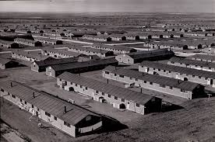
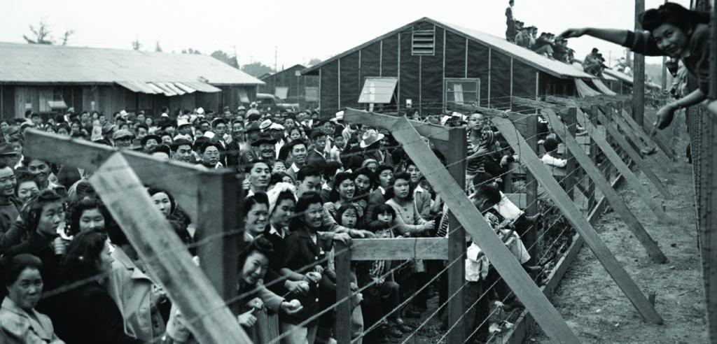
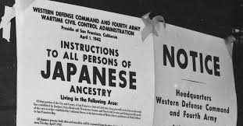
Japanese Internment Camps

Slide 10
Map courtesy of Lives Left Behind During WWII

Slide 11
Unit Guide
Optional reading guide to help support reading comprehension
Final: Found Poem (integrated), and graded discussion
Reading Schedule (the night you will read a chapter)
1/28: chapters 1-2
1/30: chapter 3
1/31: chapters 5-6
2/3: chapter 7
2/4: chapter 8
2/6: chapter 9
2/7: chapters 10-11
2/10: chapter 12

