Slide 1
Music of the Vietnam War

Slide 2
Catching up…
What do we know about the war in Vietnam?
What do we know about the soldiers fighting in Vietnam?
Their attitudes, their mindset, etc.
What do we know about actual events of the war, or reasons for going to war?
How did the American public feel about the Vietnam conflict?
How do people voice their feelings to society as a whole?

Slide 3
The Voice of Music
Survey:
How many people read poetry, or political essays, or go to lectures?
How many listen to music?
Why would people use music as a means to get their ideas out?

Slide 4
60s music
Bob Dylan, Motown, Marvin Gaye, The Temptations, Sam Cooke
“The Times, They are A-Changin’”, “What’s Goin’ on?” “A Change is Gonna Come,” “Papa was a Rolling Stone”
“From now on, I want to write from inside me ...I'm not part of no movement... I just can't make it with any organization..." -Bob Dylan

Slide 5
Task
Key phrases and words
Literary elements: metaphor, simile, imagery, symbolism, satire, etc.
Pro-or anti-Vietnam/soldier
What is the song about?

Slide 6
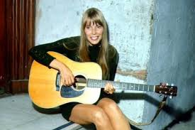
Joni Mitchell “One Tin Soldier”
Impactful words or phrases?
Is this song pro-Vietnam or anti-Vietnam? Use the lyrics to prove your position.
What message is the song putting out to the public? Use the lyrics to prove your position.
Does the gender of each artist change the message or potential effectiveness of the message?

Slide 7
Listen children to a story that was written long ago 'bout a kingdom on a mountain and the valley folk below on the mountain was a treasure buried deep beneath a stone and the valley people swore they'd have it for their very own CHORUS: go ahead and hate your neighbor go ahead and cheat a friend do it in the name of heaven you could justify it in the end There won't be any trumpets blowing come the judgment day on the bloody morning after One tin soldier rides away

Slide 8
So the people of the valley sent a message up the hill, asking for the buried treasure, tons of gold for which they'd kill. Came an answer from the kingdom "with our brothers we will share. All the secrets of our mountain, all the riches buried there." Now the valley cried with anger, "mount your horses, draw your swords" And they killed the mountain people, so they won their just reward. Now they stood beside the treasure, on the mountain dark and red. Turned the stone and looks beneath it; PEACE ON EARTH was all it said. CHORUS REPEAT

Slide 9
Task
Key phrases and words
Literary elements: metaphor, simile, imagery, symbolism, satire, etc.
Pro-or anti-Vietnam/soldier
What is the song about?

Slide 10
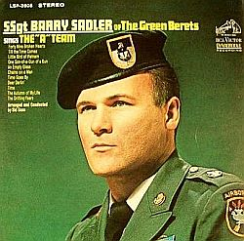
“Ballad of the Green Berets” by SSgt. Barry Sadler

Slide 11
Fighting soldiers from the sky Fearless men who jump and die Men who mean just what they say The brave men of the Green Beret
Silver wings upon their chest These are men, America's best One hundred men we'll test today But only three win the Green Beret Trained to live, off nature's land Trained in combat, hand to hand Men who fight by night and day Courage deep, from the Green Beret

Slide 12
Silver wings upon their chest These are men, America's best One hundred men we'll test today But only three win the Green Beret Back at home a young wife waits Her Green Beret has met his fate He has died for those oppressed Leaving her this last request Put silver wings on my son's chest Make him one of America's best He'll be a man they'll test one day Have him win the Green Beret

Slide 13
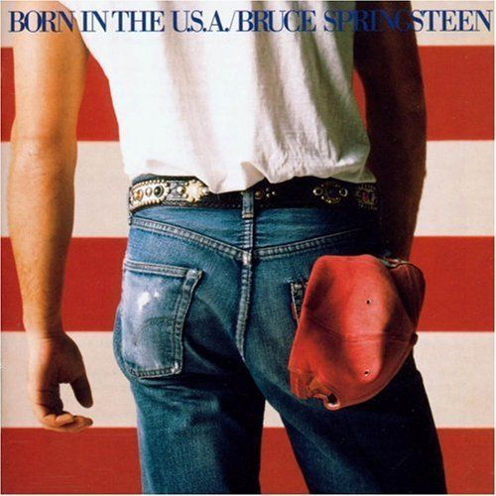
Task
Key phrases and words
Literary elements: metaphor, simile, imagery, symbolism, satire, etc.
Pro-or anti-Vietnam/soldier
What is the song about?

Slide 14
Bruce Springsteen "Born in the U.S.A.”
Born down in a dead man's town The first kick I took was when I hit the ground You end up like a dog that's been beat too much Till you spend half your life just covering up Born in the U.S.A. I was born in the U.S.A. I was born in the U.S.A. Born in the U.S.A. Got in a little hometown jam so they put a rifle in my hand Sent me off to a foreign land to go and kill the yellow man

Slide 15
Born in the U.S.A.
Born in the U.S.A. I was born in the U.S.A. I was born in the U.S.A. I was born in the U.S.A. Born in the U.S.A.

Slide 16
Born in the U.S.A.
Come back home to the refinery Hiring man says "son if it was up to me" Went down to see my V.A. man He said "son don't you understand now" Had a brother at Khe Sahn fighting off the Viet Cong
They're still there he's all gone He had a woman he loved in Saigon I got a picture of him in her arms now Down in the shadow of penitentiary Out by the gas fires of the refinery I'm ten years burning down the road Nowhere to run ain't got nowhere to go

Slide 17
Born in the U.S.A.
Born in the U.S.A. I was born in the U.S.A. Born in the U.S.A. I'm a long gone daddy in the U.S.A. Born in the U.S.A. Born in the U.S.A. Born in the U.S.A. I'm a cool rocking daddy in the U.S.A.

Slide 18
Task
Key phrases and words
Literary elements: metaphor, simile, imagery, symbolism, satire, etc.
Pro-or anti-Vietnam/soldier
What is the song about?

Slide 19
Discussion
Is music an effective way to protest for or against an issue? Why?
What do you think is the most effective way to protest something?
Literature/stories?
Poetry?
Music?
Speeches?

Slide 20
Task
Key phrases and words
Literary elements: metaphor, simile, imagery, symbolism, satire, etc.
Pro-or anti-Vietnam/soldier
What is the song about?

Slide 21
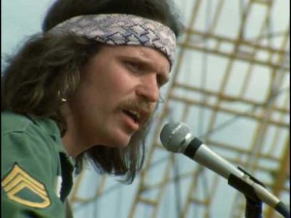
“Feel like I’m Fixin’ to die Rag” Country Joe and the Fish
Well, come on all of you, big strong men, Uncle Sam needs your help again. He's got himself in a terrible jam Way down yonder in Vietnam So put down your books and pick up a gun, We're gonna have a whole lotta fun.

Slide 22
“Feel like I’m Fixin’ to die Rag” Country Joe and the Fish
Chorus:
And it's one, two, three, What are we fighting for ? Don't ask me, I don't give a damn, Next stop is Vietnam; And it's five, six, seven, Open up the pearly gates, Well there ain't no time to wonder why, Whoopee! we're all gonna die.
Come on Wall Street, don't be slow, Why man, this is war au-go-go There's plenty good money to be made By supplying the Army with the tools of its trade, But just hope and pray that if they drop the bomb, They drop it on the Viet Cong.
(Chorus)

Slide 23
“Feel like I’m Fixin’ to die Rag” Country Joe and the Fish
Well, come on generals, let's move fast; Your big chance has come at last. Now you can go out and get those reds 'Cause the only good commie is the one that's dead And you know that peace can only be won When we've blown 'em all to kingdom come. (Chorus)
Come on mothers throughout the land, Pack your boys off to Vietnam. Come on fathers, and don't hesitate To send your sons off before it's too late. And you can be the first ones in your block To have your boy come home in a box. (Chorus)

Slide 24
“Feel like I’m Fixin’ to die Rag” Country Joe and the Fish
Well, come on generals, let's move fast; Your big chance has come at last. Now you can go out and get those reds 'Cause the only good commie is the one that's dead And you know that peace can only be won When we've blown 'em all to kingdom come. (Chorus) Come on mothers throughout the land, Pack your boys off to Vietnam. Come on fathers, and don't hesitate To send your sons off before it's too late. And you can be the first ones in your block To have your boy come home in a box.

Slide 25
And it's one, two, three What are we fighting for ? Don't ask me, I don't give a damn, Next stop is Vietnam. And it's five, six, seven, Open up the pearly gates, Well there ain't no time to wonder why, Whoopee! we're all gonna die.

Slide 26
Def Leppard “Die Hard the Hunter”
Shotgun Let's welcome home the soldier boy from (Far away, far away) No angel of mercy just a need to destroy (Fire away, fire away) Let's toast the hero with blood in his eyes The scars on his mind took so many lives Die Hard the Hunter

Slide 27
“Die Hard the Hunter”
Welcome home soldier boy Put down your pistol, yeah, put down your toy Yeah, they can take your gun away from you But never take away your attitude They can't do that, no, they can't do that You got no enemy, no front line The only battles in the back of your mind You don't know how to change from bad to good You brought the war to your neighborhood Back in the city, he's a man on the loose He is the shadow that's following you He takes no prisoners when he's hunting for game He's got a bullet and it carries your name (Die hard) Caught in a trap (Hunter) There's no lookin' back (Die hard) He hides in the crowd (Hunter) Die Hard and Proud

Slide 28
Charlie Daniels Band “Still in Saigon”
Got on a plane in 'Frisco And got off in Vietnam I walked into a different world The past forever gone I could have gone to Canada Or I could have stayed in school But I was brought up differently I couldn't break the rules Thirteen months and fifteen days The last ones were the worst One minute I'd kneel down and pray And the next I'd stand and curse
No place to run to Where I did not feel that war When I got home I stayed alone And checked behind each door Cuz I'm still in Saigon Still in Saigon I am still in Saigon In my mind The ground at home was covered in snow And I was covered in sweat My younger brother calls me a killer And my daddy calls me a vet

Slide 29
“Still in Saigon”
Everybody says I'm someone else And I'm sick and there's no cure Damned if I know who I am There was only one place I was sure When I was still in Saigon Still in saigon I am still in saigon In my mind Every summer when it rains I smell the jungle, I hear the planes I can't tell no one, I feel ashamed Afraid some day I'll go insane
That's been ten long years ago And time has gone on by Now and then I catch myself Eyes searching through the sky All the sounds of long ago Will be forever in my head Mingled with the wounded cries And the silence of the dead 'Cuz I'm still in Saigon Still in Saigon I am still in Saigon In my mind I am still in Saigon I am still in Saigon Yes, I'm still in Saigon In my mind

Slide 30
Task
Key phrases and words
Literary elements: metaphor, simile, imagery, symbolism, satire, etc.
Pro-or anti-Vietnam/soldier
What is the song about?

Slide 31
Discussion
Questions
Comparisons
What struck you?

Slide 32
Questions
What are some similar themes?
What are similarities in imagery?
How does the music tell a similar/different story from the poems, short stories, novel excerpts?

Slide 33
Option 1: Support or Protest Song
Knowing all you do about Vietnam, write a pro or anti-Vietnam War song
Must be at least 20 lines
Must reference specifics to the war and give an idea of why you are pro/anti
Things to consider:
Why we went there, soldiers experience, Vietnamese experience, controversies/issue, public opinion
Use one literary device (underline)

Slide 34
Option 2: Original Album Cover and Songs
Album cover
Explanation of why you created cover/why you selected the images
8-12 songs that are appropriate representations of the Vietnam War
Real or original song titles
Use literary device in song title or album cover

