Slide 1
Point of View
And Multiple Narratives

Slide 2
Narrator ≠ Author,
Author ≠ Narrator
Common mistake - especially in first-person narration
Narrator (or other characters) is/are often ignorant of many things author knows or has radically different opinion than author
Examples:
Adventures of Huckleberry Finn (Huck v. Twain)
The Great Gatsby (Nick v. Fitzgerald)

Slide 3
Voice- how a character talks.
Voice of a character consists of many things- including:
Age/Experience Level
Profession/Area of Expertise
Education
Culture/Ethnicity
Audience (who they are speaking to)
Historical Period
Gender
Interests
Ways this is expressed:
Vocabulary- how large or small, how jargon filled
Use of slang or jargon
Dialect/accent
Length of speech
Content of speech
Emotion of speech
Etc. etc.

Slide 4
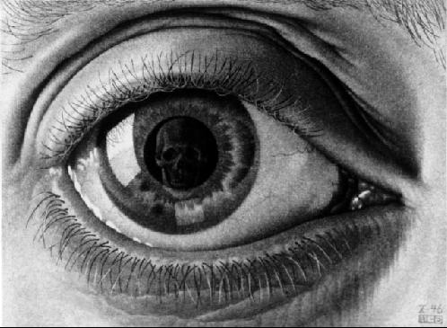
Types of Point of View
First Person
Autobiographical
Fictional
Second Person
Weirdo
Passive voice
Third Person
Omniscient
Limited
Dramatic

Slide 5
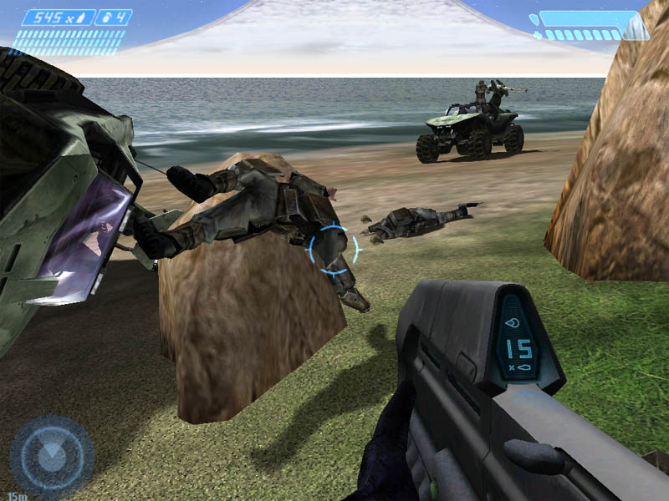
First Person
“I walked in the door, put my keys on the table, and suddenly I saw…”
Autobiographical- Author (attempting) to relate matters as s/he experienced them (though beware of bias)
Ex.- memoirs, non-fiction
Fictional- Author writing in a persona
Very important here to remember the author is very often utilizing dramatic irony or other literary devices to separate themselves from the character. Must, in fact, to maintain suspension of disbelief.

Slide 6
Second Person
Weirdo
“You walked in the door, you put your keys on the table, and suddenly you saw…”
Can draw reader into story in more personal way.
Rarely used because considered “gimmicky”
Passive Voice
“The door was walked through, keys were placed on the table, and suddenly ____ was seen..”
Has no subject whatsoever- no idea who is involved.
Generally only used in scientific or technical writing.

Slide 7
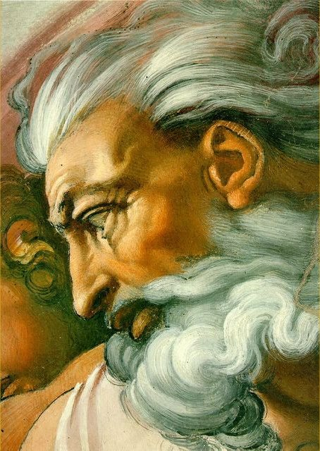
Third Person
“He walked in the door, he put his keys on the table, and suddenly he saw…”
Most common style of narration
Omniscient
Narrator knows everyone’s thoughts, can travel anywhere at will.
Limited
Doesn’t know everyone’s thoughts- though often knows one characters’
Follows a particular character
Dramatic
Just sticks to actions of characters- no thoughts at all.

Slide 8
Questions to consider
What is the point of view of the story? First person, third person (dramatic or omniscient).
How is the point of view appropriate to the story? How does it underscore the characterization, conflict and/or central idea of the story?
How might the story be different if told from a different point of view?

Slide 9
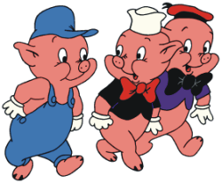
Multiple Point of Views
Who knows the story of the Three Little Pigs?
Three Little Pigs from the Wolf’s Perspective/Point of View:
How can different point of views and narratives impact a story?

Slide 10
Multiple Point of View Practice
A boy and a girl talked in the back of a classroom. Their teacher hushed them three times and then ordered the boy to exit the classroom and go to the principal’s office. The boy swore at the teacher, threw a paper wad at the girl, and exited the room – slamming the door behind him.

Slide 11
Practice
Describe the situation from the boy’s first person perspective.
Describe the situation from the girl’s first person perspective.
Describe the situation from the teacher’s first person perspective.

Slide 12
Learning Targets
I can demonstrate an understanding of genres and point of view
I can create characters and setting that are fully developed

Slide 13
Genres
Types of genres:
Romance
Scary/Horror/Thriller
Mystery/Suspense
Comedy
Detective/Crime
Science Fiction/Fantasy
Western
Action/Adventure
Historical
Realist
Humor
War
Define the term genre…
What would you expect to read in each genre?

Slide 14
Narrative Voices
First Person
“I walked in the door, put my keys on the table, and suddenly I saw…”
Second Person
“You walked in the door, you put your keys on the table, and suddenly you saw…”
Third Person:
Omniscient
Narrator knows everyone’s thoughts, can travel anywhere at will.
Limited
Doesn’t know everyone’s thoughts- though often knows one characters’
Follows a particular character
Dramatic
Just sticks to actions of characters- no thoughts at all.

Slide 15
Multiple Genre/Narratives
Your overall task is to write two stories from different genres that have at least two different perspective or narratives (think horror story with first person, and romance story with third person).

Slide 16
Requirements
Two different stories from two different genres (two different perspectives).
You must have a minimum of two different characters.
Must have at least one setting, but can have more.
Minimum of 1250 words and may not write more than 1800. The words may be divided however you like between the stories.
Turn your final in on turnitin.com by Friday, 2/28 at 10pm.

Slide 17
OLDER FILES

Slide 18
Point of View Practice:
A good exercise to consider point of view is to imagine a couple having a discussion. Retelling the story in different points of view changes the reader's understanding of the conflict and characterization.

Slide 19
From the first person narration (woman's point of view):
"I love you and want to marry you," I said, nodding and smiling, even though I really didn't mean it. "If I can just get my hands on his money, then I can regain my family’s fortune," I thought to myself."
John shuffled his feet and looked pleadingly into my eyes. "I'll do anything to make you happy; I will try to give you the world, " he said as he drew out his wallet and laid ten thousand dollars on the table in front of me. That seemed generous.

Slide 20
In the dramatic point of view:
The woman smiled and nodded as the man laid ten thousand dollar bills on the table.

Slide 21
From third person (omniscient):
"I love you and want to marry you," Mary said unconvincingly even though she nodded and smiled. "If I can just get my hands on his money, then I can regain my family’s lost fortune," she thought to herself.
John shuffled his feet and looked pleadingly into her eyes. He hoped Mary wouldn't notice the minor flaws in the counterfeit bills he placed on the table. He knew he was nearing his goal of "marrying" into her fortune.
"I'll do anything to make you happy; I will try to give you the world, " John said as he drew out his wallet and laid ten thousand dollar bills on the table in an attempt to indicate his generosity.

Slide 22
Point of View
Each one of these points of view would lead to a different interpretation by the reader of what was transpiring between the male and female.
Remember: an author chooses a point of view in which to write. If the author wants YOU to analyze the motives for the characters, he or she might use dramatic point of view so that you have no clues in the thoughts of the characters.
If the author, like in The Hunger Games, wants you to see reality NOT objectively, but through the eyes of the main character, then he or she might use first person, or third person limited point of view.

Slide 23
Narrative Voices Reminder
First Person
“I walked in the door, put my keys on the table, and suddenly I saw…”
Second Person
“You walked in the door, you put your keys on the table, and suddenly you saw…”
Third Person:
Omniscient
Narrator knows everyone’s thoughts, can travel anywhere at will.
Limited
Doesn’t know everyone’s thoughts- though often knows one characters’
Follows a particular character
Dramatic
Just sticks to actions of characters- no thoughts at all.

Slide 24
Task
Each member of your group will be assigned a number from 1-5
Read your assigned story genre (each from a different genre, you can choose which story if there are multiple options for genre)
You will then meet with your group and share:
How would you define your genre?
What characteristics/styles would you say are common in your genre?
What characters/setting are common in your genre?

