Slide 1
Welcome to Journalism
Mrs. Cossano (aka Woldy or Ms. Woldendorp)

Slide 2
Agenda for this week
Get to know me
Get to know you
Pictures
Class procedures and expectations
What is journalism?

Slide 3
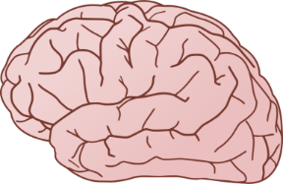
Name Tent
Front Side :
Your name, largely and clearly
4 corners:
Top Left: symbol to figuratively represent your summer
Top Right: symbol to figuratively represent something you are nervous about at SHS
Bottom Left: symbol to figuratively represent something you are good at
Bottom Right: symbol to figuratively represent the last book you read

Slide 4
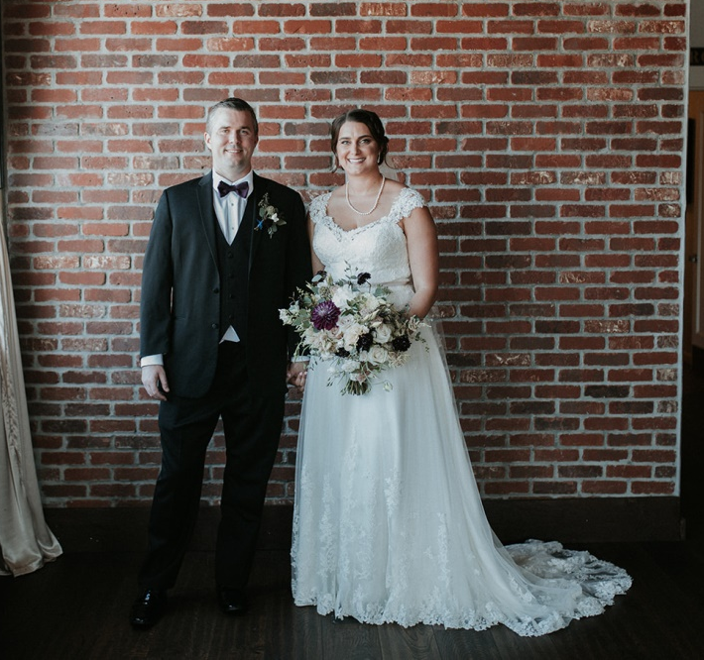
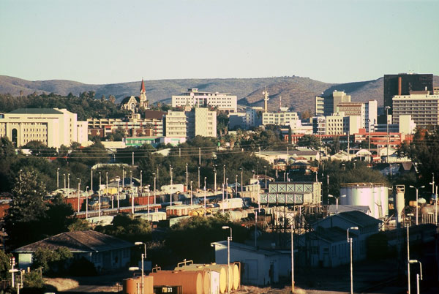
About me
Born in Cape Town, South Africa
Lived in Windhoek, Namibia until 1999
Moved to Seattle with parents, sister in 1999
Graduate of Skyline (class of 2004)
Went to UW for both English undergrad degree and Masters in Education
Got married July 2018
Crazy cat lady

Slide 5
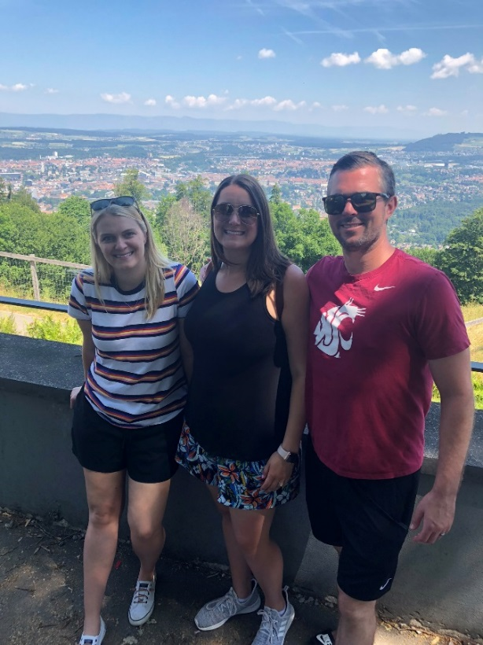
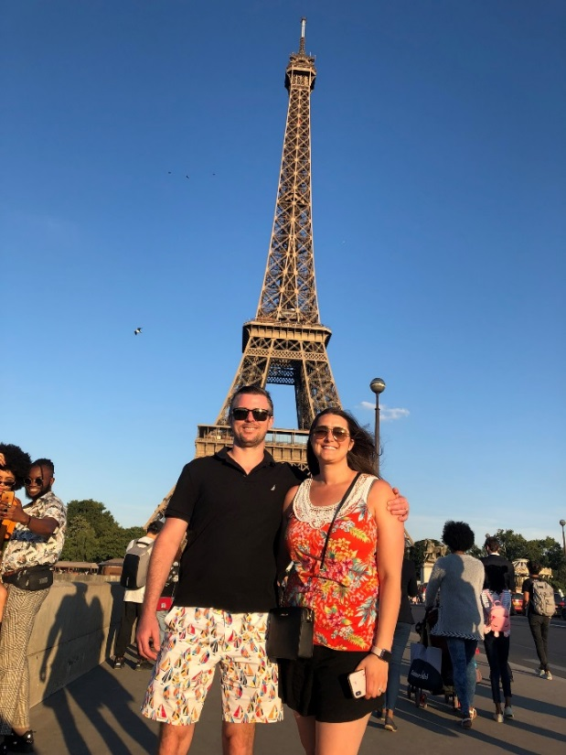
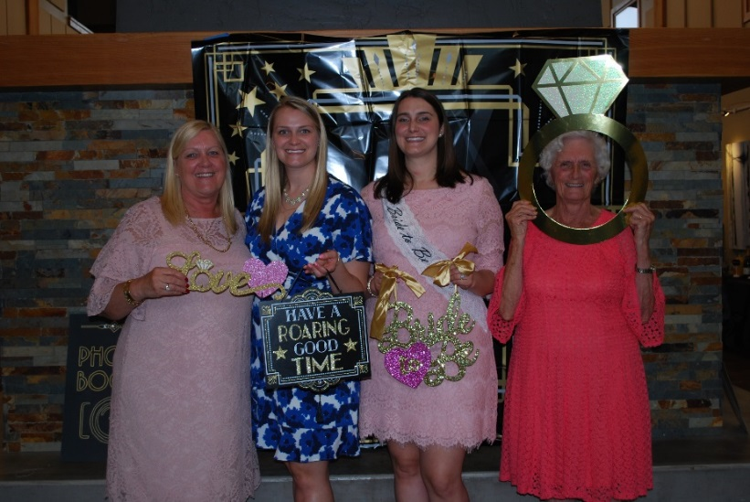
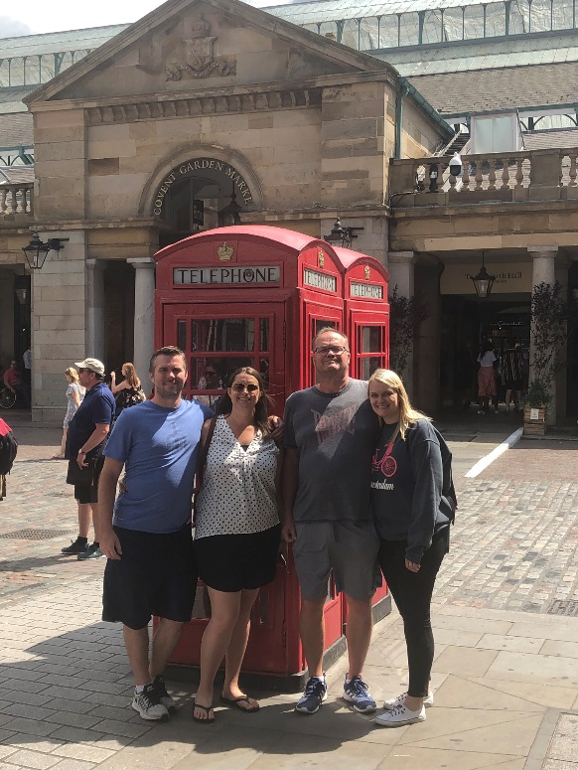

Slide 6
Why Teaching?
I teach because of you.
I want all students to reach their potential and realize that they have a voice that deserves to be heard.
I teach because I love watching students grow and succeed.
I teach because it matters.

Slide 7
About you
Please take a few minutes to fill in the student interest survey so I can get to know you better!
Remember: I am a mandatory reporter as a school employee

Slide 8
Journalism as a class

Slide 9
What is a good journalist?
Skills
Traits
People skills
Talk to people
Advertisers, interviews
Good ideas
Stories, people to interview
Writing
Advertising
Open-minded, no bias
Creativity
Bold, no fear
Flexibility
Honesty
Cleverness
Curiosity
Why would you need to have these traits?

Slide 10
Roles and responsibilities
Editors-in-Chief: manage the overall paper and create the cover. Submit the final paper and are the final eyes on the PDF’s before submittal
News Editor:
Opinion Editor:
Features Editor:
Sports Editor:
Entertainment Editor:
InDesign Editor: manage InDesign help and revisions. Final eyes on InDesign before Editor-in-Chief reviews.
Webmaster: manage The Forum’s new website. Upload articles and maintain pages.
Reporters: everyone in the class writes articles, so you are all reporters!
Are final eyes on articles in these sections

Slide 11
Procedures
Assign sections and have brainstorming session
Action Plan work time and meetings
Rough draft 1: peer edit within sections (word count 500-750)
Rough draft 2: edits by section editors (word count 750-1000)
Rough draft 3: I edit (word count 1000)
All RD are submitted to turnitin.com (that is where I check for your grade)
InDesign creation and editing
Final check by InDesign Editor and Editor-in-Chief
Submit paper
Distribution before school. MANDATORY

Slide 12
Nuts and Bolts for Journalism
Will complete an Action Plan and an Action Plan Meeting for each issue
Will need to get one advertisement for each issue
Make sure you submit all three drafts, and a final draft, of your articles to turnitin.com
Make sure you are meeting the word count!
Each article must have one original photograph
There are some exceptions…
You will complete a weekly log that you will update and submit to the public folder
I will ask for these randomly, so make sure you do these every week

Slide 13
On-going Assignments
Each semester:
You will present a current event to the class (more details to come)
First semester:
You will read a book that has a movie version and write a comparative analysis essay
At least 250 pages and 12th grade reading level
Second semester:
You will write a 1250-1500 words research/impact essay about an influential journalist

Slide 14
Impact on School Community
What is your goal for The Forum?
What impact do you want the paper to have for the community?
How do we accomplish these goals?
How do we keep each issue fresh?

Slide 15
Your Responsibilities
Read the Issaquah School District policies
What can you do in a student publication?
What can’t you do in a student publication?
What are your responsibilities as journalists?

Slide 16
What about you?
What interests you about being a journalist?
What skills and/or traits do you have to contribute to the paper and class as a whole?
What are you hoping to accomplish as a journalist?
What stories do you want to write?
Do you want to be a section editor? Why should I pick you?
Discuss with table partner

Slide 17
Your assignment
Due tomorrow:
One newspaper story that interests you (content, style, etc.). Bring in a printed copy.
Due next Friday:
Signed syllabus

Slide 18
Newspaper article
With a partner:
Share your article
What is the story about?
Why did you select it?
Why is it a ‘good article’?
What makes an article ‘good’?

