Slide 1
"All modern American literature comes from one book by Mark Twain called Huckleberry Finn," Ernest Hemingway
The Adventures of Huckleberry Finn

Slide 2
Mark Twain (1835-1910)
Born in Florida, Missouri. Moved to Hannibal (inspired setting for stories)
Samuel L. Clemens
Gained national attention in 1865 from “The Notorious Jumping Frog of Calaveras County”
The Adventures of Tom Sawyer and Adventures of Huckleberry Finn
Worked on steamboats until Civil War
Moved West, worked as writer/reporter
Wrote major novels during this time
Inspired by time spent with slaves

Slide 3
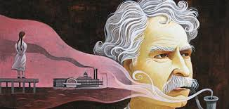
Essential question
To what extent does society play a role in shaping identity?
Determine the difference between the civilized world and the natural world.
Conclude how Huck is seen as a racist novel.

Slide 4
Setting
Written after the Civil War (1883), but about American before the Civil War and Reconstruction (1835-1845)
Mississippi River
St. Petersburg, Missouri
Various river towns through Arkansas
You will be tracking the journey with a Twain created river illustration

Slide 5
Characters
Huck Finn (protagonist)
Jim (protagonist)
Widow Douglas and Miss Watson
Duke and Dauphin (antagonists)
Tom Sawyer
Pa
Judge Thatcher
The Grangerfords and the Shepherdsons
Silas and Sally Phelps
Aunt Polly
THE MISSISSIPPI RIVER

Slide 6
Themes
The effects of racism and slavery
Intellectual, moral, and religious education
Differences, benefits
bildungsroman: a novel of maturation and development
To what extent does Huck actually mature though?
Hypocrisy of civilized society and the benefits of the natural world
People must live outside of society to truly be free
Blind faith and trust in humanity can lead to deception and mistreatment

Slide 7
Huckleberry Finn & Censorship:
First published in 1884.
Controversial from the start.
1885, Concord Public Library banned it.
Twain on March 18, 1885: "The Committee of the Public Library of Concord, Mass., have given us a rattling tip-top puff which will go into every paper in the country. They have expelled Huck from their library as 'trash and suitable only for the slums.' That will sell 25,000 copies for us sure."
1902, Brooklyn Public Library banned The Adventures of Huckleberry Finn with the statement that "Huck not only itched but he scratched," and that he said "sweat" when he should have said "perspiration."

Slide 8
Today:
One of the most challenged books in the U.S.
Debate has centered around the language : objected to on social grounds. Use of “nigger.”
Yielding to public pressure, some textbook publishers have substituted "slave" or "servant" for the term that Mark Twain uses in the book.
Alabama publisher in March of 2011 changed the term to “slave”
In an attempt to avoid controversy, CBS produced a made-for-TV adaptation of the book in 1955 that lacked a single mention of slavery and did not have an African-American portray the character of Jim. 1998: parents in Tempe, Ariz., sued the local high school over the book's inclusion on a required reading list. The case went as far as a federal appeals court; the parents lost.

Slide 9
Challenges associated with reading
The novel is lengthy: 43 chapters
The dialect (regional manner of speaking) that characters use is difficult to understand
Solution: Listen to an audio version of the text
Satire is difficult to identify- when is Twain mocking society and when is he approving?
Solution: Be prepared with questions and be on the lookout for irony (when Twain presents non-examples through the text)

Slide 11
Twain as Humorist:
Humorist: Considered America’s greatest humorist: ability to combine faith in American dream with satire that pointed out weaknesses in society
Used humor to critique what he saw as the discrepancy between promise and reality in America.
Huck Finn combines a lyrical nostalgia for the beauty of Twain’s boyhood Mississippi with a biting satire of Southern society
The novel uses satire, which uses humor to bring awareness to an issue
IE: The Daily Show, South Park, The Colbert Report, and, today, Saturday Night Live
Question for reading: when is Twain mocking society and when is he approving?

Slide 13
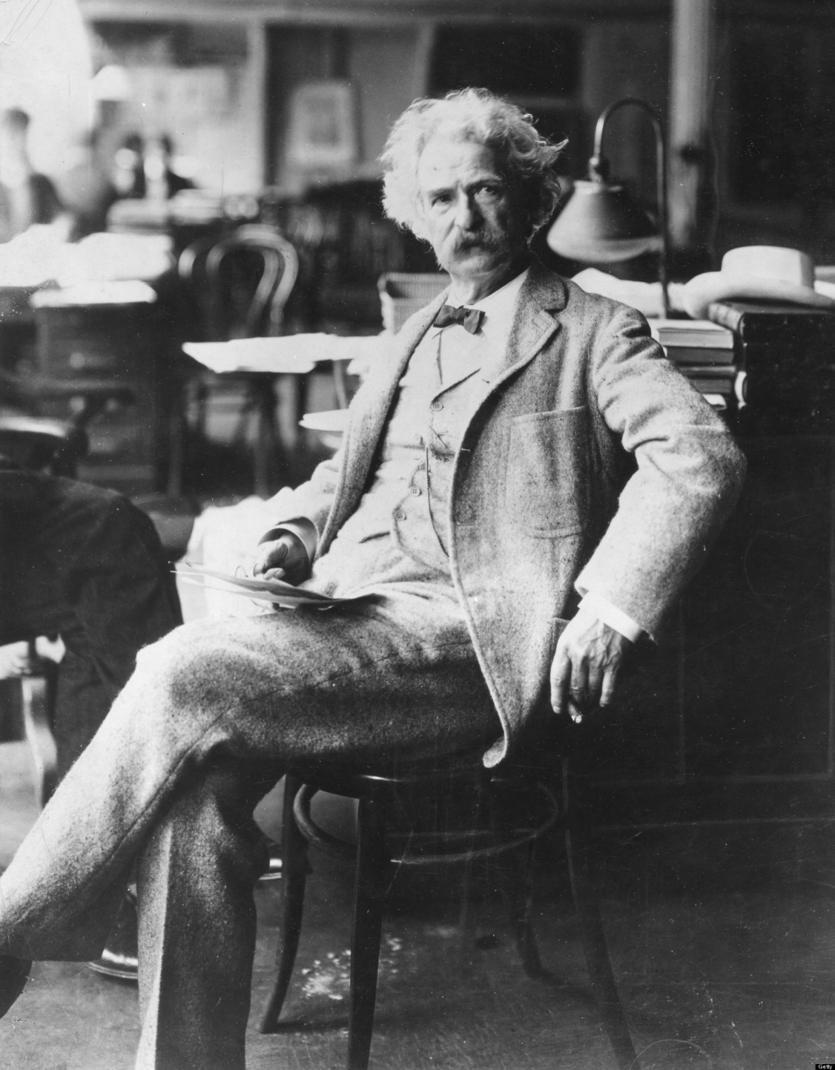
Mark Twain: missouri’s Humorist
“Humor is the great thing, the saving thing. The minute it crops up, all our irritations and resentments slip away and a sunny spirit takes their place”.

Slide 14
Mark Twain: Missouri's Humorist
“I didn't attend the funeral, but I sent a nice letter saying that I approved of it.”
“I have never let my schooling interfere with my education.”
“Education: that which reveals to the wise, and conceals from the stupid, the vast limits of their knowledge.”
“Clothes make the man. Naked people have little or no influence on society”.
“Get your facts first, and then you can distort them as much as you please”.
“I am opposed to millionaires, but it would be dangerous to offer me the position”.
“I have been through some terrible things in my life, some of which actually happened”.

Slide 15
Local Color and Realism

Slide 16
Quick review: Dialect
Dialect is variation of a given language spoken in a particular place or by a particular group of people. A dialect is distinguished by its vocabulary, grammar, and pronunciation.
Dialect is applied most often to regional speech patterns, but a dialect may also be defined by other factors, such as social class.
Accent: If we’re only talking about pronunciation

Slide 17
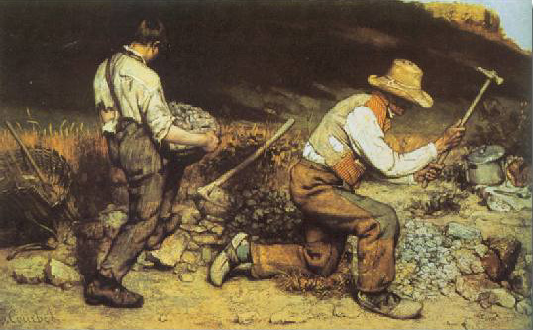
Realism: Huck Finn
From 1865 to 1915, writers turned away from Romanticism and strove to portray life as it was actually lived.
Major literary movements: Naturalism, Regionalism, and Realism.
Attempted to present a “slice of life”: sought to portray ordinary life as real people live it and attempted to show characters and events in an objective, almost factual way.

Slide 18
Regionalism and Naturalism
Naturalism: Showed life as the unavoidable working out of natural forces beyond our power to control.
Regionalism: blended Realism with Romanticism: emphasized place, and the elements that create local “color”: customs, dress, speech, and other local differences.

Slide 19
Huck Finn
First major writer to use real American speech to deal with themes and topics that were important to Americans.
Huck has a strong regional dialect, which makes him even more likable and forces the reader to see things through Huck’s eyes.
Like all great writers, Twain altered the consciousness of the people he wrote for; and he re-defined the terrain for all writers who came after him.

Slide 20
Huck Finn
Part of the answer as to why the novel is so real lies in the way it is told.
Twain said a “good character” to tell his own story “in the first person” was in fact Huckleberry Finn, who was based on a Hannibal childhood contemporary named Tom Blankenship, from a family of poor whites and whose father was the town drunkard.

Slide 21
Regionalism
Realists no longer ashamed of American “provincial” roots
Provincial: the regions outside the capital city of a country; seen as unsophisticated
Portrayed, as accurately as possible: speech patterns, customs, daily life, environment, and music of the region
Goals varied
Showcase unique American character
Expose American flaws in order to bring social change

Slide 22
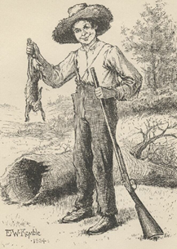
Regionalism: Huck Finn
From the opening sentence to the last, Huck talks to us, and we share his thoughts and feelings, and seem to share his very experience.
“Color” or local flavor in Huck Finn:
Customs: Jim’s superstitions.
Dress: How the duke and king are dressed in various parts of the story.
Speech: Huck’s and Jim’s dialects.

Slide 23
Regionalism: Huck Finn
Speaking of Jim’s dialect:
It’s hard to decode at times: Take your time reading it.
In the end, it’s not that different from Huck’s.
Twain seems to be saying it is not our innate abilities, but rather our societal exposure and opportunities, that often dictate how we express ourselves.
Twain does this by “talking over” Huck’s head to the reader: We understand things that Huck does not, which lets us know how Twain wants us to feel.

Slide 24
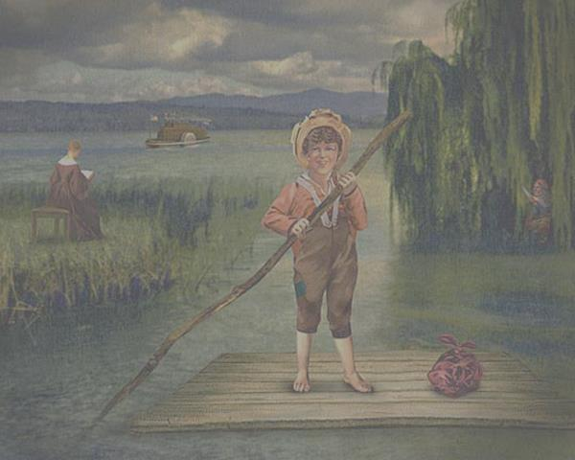
What is Local Color?
Fiction or verse which emphasizes its setting
Concerned with the district, era, customs, dialects, costumes, landscape, clothes, language, traditions, and other peculiarities
Dual influence of romanticism and realism

Slide 25
Group Activity and Discussion
Why are dialect and local color important in literature?
Find examples from chapters 1-4 of local color
One for each of the following:
Setting
Dialect
Traditions/Customs
Beliefs

Slide 26
Plateau Local Color
Then…
If an author used the Plateau for the setting of a novel, what would the local color be?
Setting
Dialect
Traditions/Customs
Beliefs
Values
Clothes

Slide 27
Beliefs
As you read the novel, think about where Huck is getting his political and social beliefs.
Homework:
Complete Quote Analysis Guide (due at end of unit)
Print Huck Finn Study Guide (optional practice)
Read chapters 5-6
Keep river map with you always

