Slide 1
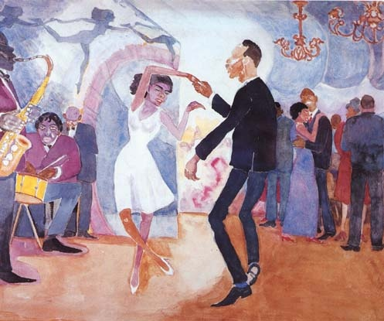
Harlem Renaissance

Slide 2
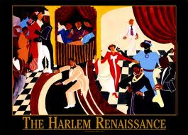
.

Slide 3
Learning Targets
I can define the Harlem Renaissance.
I can define the landmark events of the black experience in the 1920s.
I can determine to what extent the Harlem Renaissance empowered African Americans.

Slide 4
Essential Questions
Conclude why Harlem was chosen for this movement.
Determine the role of minorities in American popular culture.
Determine how fringe ideas moved to the center/mainstream.
Characterize the resistance of the empowered white culture.

Slide 5
Background
1863- Emancipation Proclamation
1865- Civil War ends
1865-1877- “Reconstruction”
1877- Compromise of 1877
Rutherford Hays (Rep) became president, in exchange for end of Reconstruction
1890s- The “nadir”- 2000 lynchings
1896- Plessey v. Ferguson- “Separate but Equal”

Slide 6
Definition
The period from the end of World War I and through the middle of the 1930’s Depression
Celebration of African culture, heritage, and roots, in order to become “The New Negro” (Alain Locke)
A group of talented African-American writers, thinkers and artists produced a sizable contribution to American culture

Slide 7
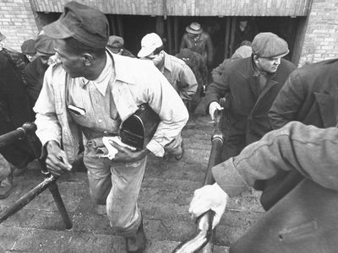
Causes
Great Migration
Black farmers moved to urban North
Searching for jobs, freedom from oppression of institutionalized racism in the South
Settled in Harlem
World War I
Industrial jobs in city instead of just agriculture

Slide 8
Importance
African Americans used art to prove their humanity and demand for equality.
More authors/poets/artists published
Harlem became a racial focal point for Blacks all over the world; remained for a time a race capital.
It encouraged a new appreciation of folk roots and culture.
Brought Black experience and culture into mainstream society.

Slide 9
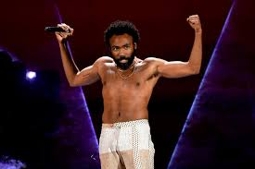
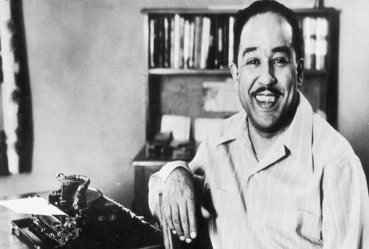
Harlem Renaissance & You
Today’s hip-hop and rap artists would not exist without the poets, musicians, and artists of the Harlem Renaissance
The contemporary underground NY hip-hop scene has been called a ‘new kind of Harlem Renaissance” (Rolling Stone)
Rap = poetry set to music
These mediums capture the culture of a time, and convey the feelings of social upheaval and change felt by the population

Slide 10
Stream of Consciousness Writing

Slide 11
Harlem Renaissance Artists
Jacob Lawrence
1917-2000
‘Dynamic Cubism’… inspired by “the shapes and colors of Harlem”
Dropped out of school at 16, but continued to pursue his art
Art Professor at UW (1970)
Aaron Douglas
1899-1979
Moved to Harlem in 1925
Painter, heavily influenced by African culture
Semi-abstract
Modern Europe, ancient Egypt, West African art

Slide 12
What do you notice about the paintings?
How do the represent African Americans in post-Reconstruction America?

Slide 13
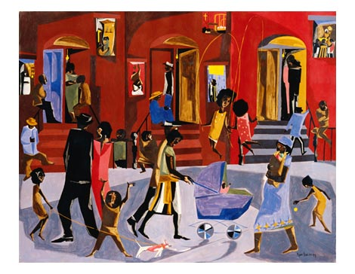

Slide 14
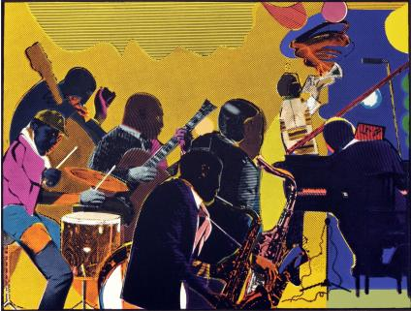

Slide 15
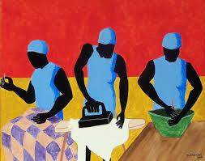

Slide 16
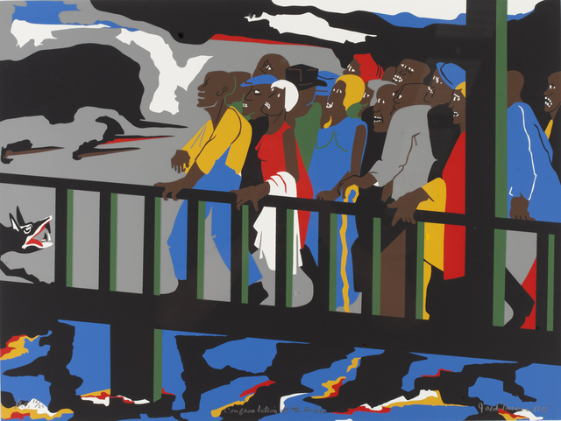

Slide 17
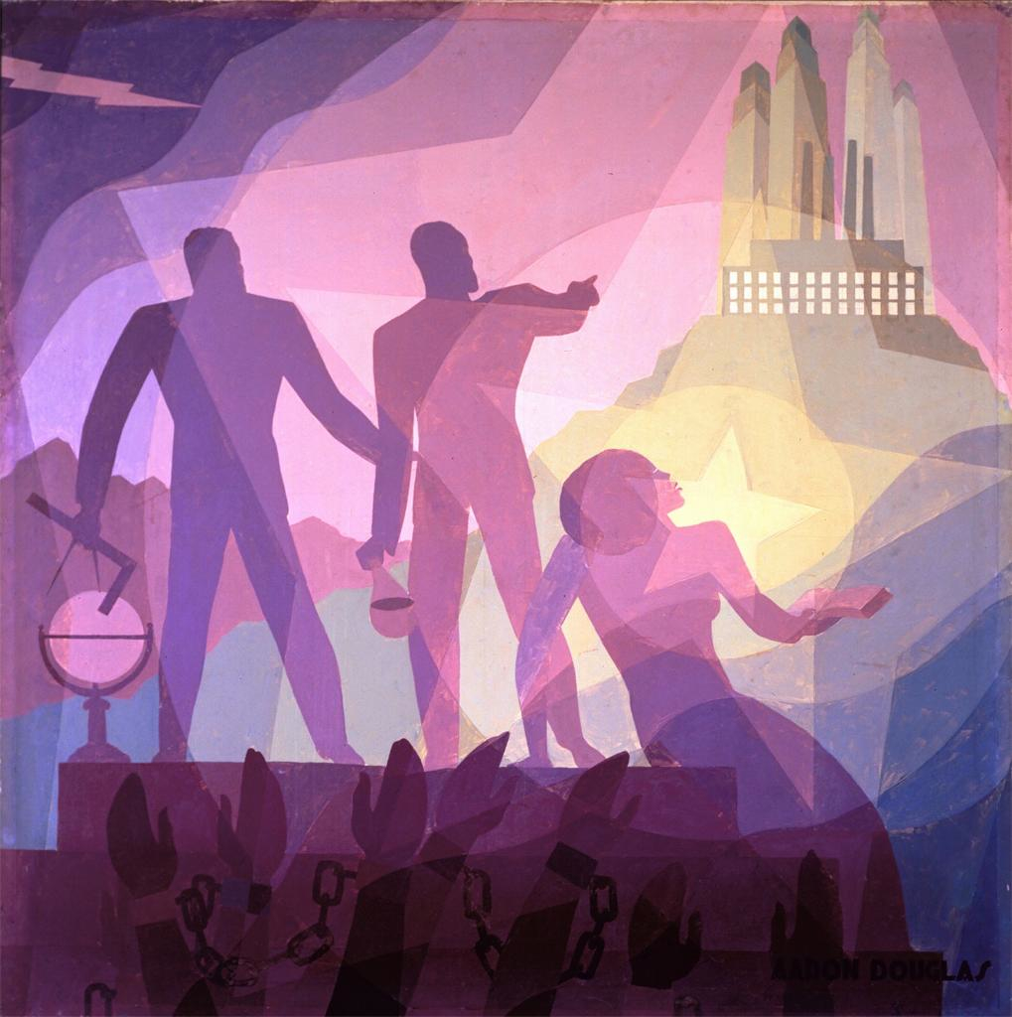

Slide 18
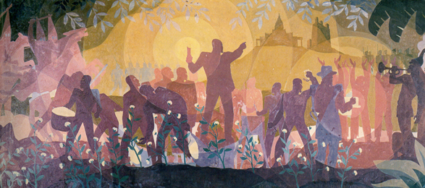

Slide 19
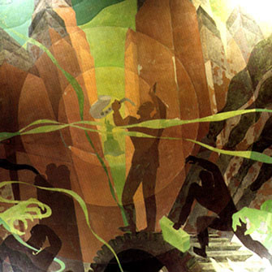

Slide 20
What do you notice about the paintings?
How do the paintings represent African Americans in post-Reconstruction America?

Slide 21
Harlem Renaissance Background
You will be reading the background essay on the Harlem Renaissance
Read, and write down any questions or things that are important to know about the Harlem Renaissance
Monday: we will look at Langston Hughes

Slide 22
Learning Target
I can analyze Hughes writings to determine his social commentary
I can evaluate the role or place of African Americans in 1920s society

Slide 23
Langston Hughes
One of the leading poets of Harlem Renaissance
One of the first African Americans to make a living solely on his writings
Novelist, playwright, essayist
Writings center on poor, working-class African Americans
Kept his language direct
Considered one of the most influential artists of the Harlem Renaissance

Slide 24
Today
Read Langston Hughes “When the Negro was in Vogue”
Answer as a table group:
Describe Harlem in the 1920s.
Conclude why white America suddenly became fascinated with Harlem.
Determine the irony in the situations described in the excerpt.

Slide 25
Today
On the back of your reading, and using only TWO colors, illustrate the image that comes to mind of Harlem according to Hughes.
Your illustration should be supported by what you’ve read in the text
Choose one quote to be your title, what captures the essence of the reading

Slide 26
Learning Target
I can analyze Hughes poetry to determine his social commentary
I can evaluate the role or place of African Americans in 1920s society

Slide 27
Langston Hughes and the American Dream
Clearly, African Americans were not included in the American Dream, and not always given the opportunity to attain their American Dream
As a reaction, Langston Hughes created poems critical of America

Slide 28
Older files

Slide 29
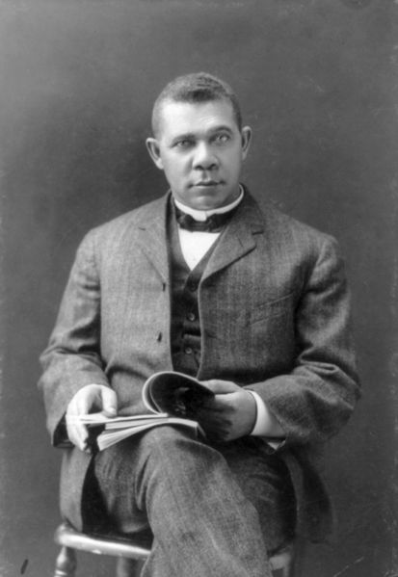
Booker T. Washington- “Cast Down Your Bucket Where You Are”
1856-1915 (Born a slave in VA)
1888- At 25, became president of Tuskegee Institute
Philosophy was to teach young blacks a practical trade (plumbing, masonry, carpentry, etc)
1895- Gives famous “Atlanta Compromise” speech to Atlanta Exposition
1901- Publishes Up From Slavery-
Immediate hit- becomes first A-A guest to White House
Urged African Americans to work patiently within existing framework and equality would come.

Slide 30
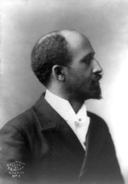
W.E.B DuBois “Double Consciousness”
1868-1963 (Lived 95 years!)
Raised in middle-class Massachusetts- not aware of racism until later childhood
EXTREMELY intelligent- Ph. D. Harvard, studied in Berlin for several years
Wrote many books, including Souls of Black Folk in 1903
Co-founder of NAACP in 1909- Editor in chief of their journal “The Crisis”
Theory of “Double Consciousness”: that blacks simultaneously view themselves through their own eyes AND ALSO through the lens of racist white America.
Strongly (and publicly) disagreed with Washington- believed that SYSTEM had to be changed in order for blacks to finally gain equality- and erase this double consciousness.

Slide 31
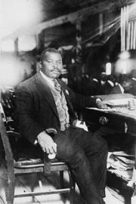
Marcus Garvey- “Back to Africa”
1887-1940
Born in Jamaica- still national hero there
Founded Universal Negro Improvement Association (UNIA) and African Communities League (ACL).
Inspired by B.T. Washington, but was a segregationist believed that blacks should create entirely separate (and black-operated) system
Founded “Black Star Line” and “Negro Factories Corporation”
Also started “Liberia Project” and “Back to Africa” movement- encouraged A-A’s to move to Liberia to form own country where blacks would have equal rights
Believer in “Racial Purity”- that races shouldn’t mix
Had a vicious (and mutual) dislike of Dubois

Slide 32
Harlem renaissance music and art

Slide 33
Harlem Renaissance Literature
Find a piece of literature that speaks to you (for whatever reason)
Art: songs, pictures, photographs, poems (no stories or essays)
Tell me why you picked that literature
Write a brief narrative about the art
Think: creative story about the literature
Submitting:
The literature (you can copy and paste)
Why you picked that literature
300-500 word narrative

Slide 34
Prominent Figures (not limited to this list)
Louis Armstrong
Jacob Lawrence
Aaron Douglas
Augusta Savage
Duke Ellington
Countee Cullen
Links:
Scalar
Smithsonian
SAAM

Slide 35
Harlem renaissance poetry projects

Slide 36
Learning Targets
I can demonstrate an understanding of poetry
I can collaborate with my classmates
I can educated my classmates about my assigned poem

Slide 37
Task
Pick your groups (need 8 groups of about 5 people)
Each assigned a poem from Harlem Renaissance writer

Slide 38
Poster
Your group will create a poster to present your assigned poem
I will give you questions to answer, but you must also create a visually appealing poster to educate your classmates
You must include the questions and answers on your posters, but you do have creative freedom

Slide 39
Poems
I, Too (Hughes) 883
The Weary Blues (Hughes) 884
My City (Johnson) 888
If We Must Die (McKay) 890
Any Human to Another (Cullen) 894
Storm Ending (Toomer) 895
A Black Man Talks of Reaping (Bontemps) 896

Slide 40
Poetry Reflection
What was the Harlem experience like? What was life like for African Americans?
Why would they choose Harlem as a place for their renaissance?
What are common themes between the poems? What are differences? Why?

Slide 41
Speakeasy

Slide 42
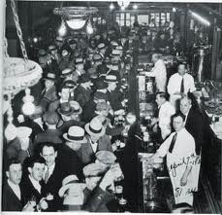
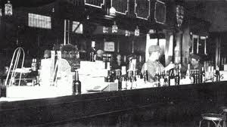
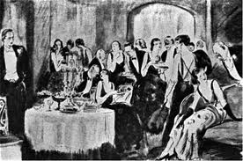
Speakeasy
Establishment that illegally sells alcoholic beverages
Prominent during Prohibition

Slide 43
Speakeasy
Poetry reading:
Will read the poem
Give class 1 minute to process
Share your groups thoughts on the poem
Extra credit for dressing up in 1920s style
Can bring in food and drinks for your table group
Will need to clean up your mess!

Slide 44
Things to Include (I will collect this):
What do these poems say about African Americans and their place in American society?
How do these poets see the future of African Americans?
Prepare a discussion question to present to the class.

Slide 45
Questions for poems
Harlem
Why call it Harlem if there is no mention of Harlem?
Is the explosion good or bad?
Whose dream is deferred? What is the explosion?
The Negro Speaks of Rivers
What is the significance of the river locations?
Meaning of “muddy bosom turn all golden in the summer”?
Pan-Africanism connections?
I, Too
Connections to Walt Whitman?
What is the place or role of African Americans in America?

Slide 46
Questions for Poems
The Weary Blues
Temporariness of jazz and the connections to Harlem?
Is there hope for the future?
My City
Connection of nature in South supposedly being freeing, but see the city as actually freeing?
If We Must Die
What kind of death are they wanting? Why care about their death?
What do they want to achieve before death?

Slide 47
Questions for poems
Any Human to Another
What is the author showing or proving? What is the intent of the poem?
How would white people see this poem?
What differences would the intent/reception be between whites and blacks?
Storm Ending
Think about big storm and what happens during and in the aftermath of a storm?
What does the rebuilding look like?
A Black Man Talks of Reaping
Why are the children’s gleanings described as “bitter fruit”?
Connections to Harlem?

Slide 48
Your task…
In groups of 4, select one of the Harlem Renaissance poems
Your group is responsible for understanding your poem and setting it to music
You may choose either music that was contemporary for the time (jazz or blues) or you may choose a contemporary rap or hip-hop beat (without lyrics)
The TONE of the music you choose must match the TONE of the poem you choose
You will be turning in a 1 paragraph justification that demonstrates your understanding of the poem’s message in the context of the Harlem Renaissance and the tone

Slide 49
Today Continued…
Read Zora Neale Hurston’s How it Feels to be Colored Me (900-904)

Slide 50
Hurston assignment
As a table group, complete the chart. One chart per group.
Can combine paragraphs that have similar ideas. Must have minimum of 5 sections of paragraphs.
Paragraph Number(s) | Main Idea | Quote

Slide 51
Main Ideas
On the Hughes sheet of paper:
Write a thesis statement that argues the main idea of How It Feels to Be Colored Me
Then write three pieces of evidence that you could use to support this thesis statement
Remember: what is she saying about race, being African American, pride, the past?

Slide 52
Main Ideas
The past is done, it is time to move on and not hold grudges
Skin color does not determine your identity
She is proud of her race and her culture
She feels like “a brown bag”
It’s the contents of the ‘bag’ that matter, not what the outside looks like
Brown bag filled with diamonds

