Slide 1
The great depression

Slide 2
Learning targets
I can demonstrate an understanding of the 1930s experience and life
I can demonstrate an understanding of how the excess of the 1920s lead to the Great Depression
I can determine how literature can be used to create social change and awareness
I can explain escapism and how it related to the Great Depression

Slide 3
Escapism
The tendency to seek distraction and relief from unpleasant realities especially by seeking entertainment or engaging in fantasy
Listening to music, painting, watching movies, playing games, etc.
Popular culture and literature grew as citizens sought diversion from their troubles

Slide 4
Fun Fact! ☺
During the 1930s mass-produced, die-cut, cardboard jigsaw puzzles came into huge demand
The jigsaw puzzle became a positive (and relatively cheap) source of family entertainment
A form of escape!
Wooden puzzles were popular among the rich, and cardboard pieces among the poor

Slide 5
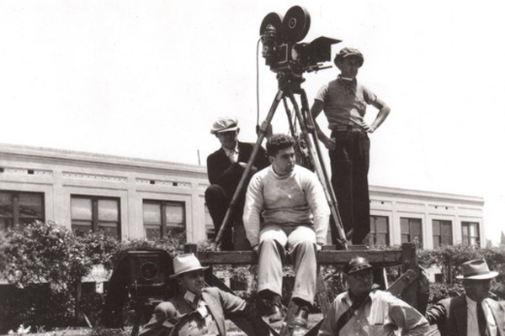
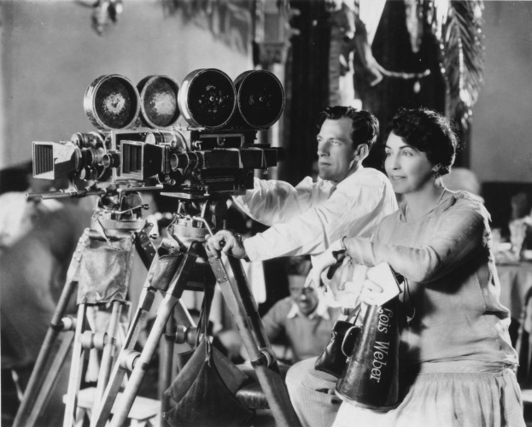
Camera Technology: 1930s
Start to see more of an emergence of actual footage being used in documentary films in the 1930s, as this technology becomes more widely available.
However, this was still very expensive and very difficult, and thus not available to the public at large.
Today, anybody can make a documentary, and almost anybody can make a good documentary, but back then there was a push/drive towards film that was cheap and entertaining, rather than things that dwelled on the awful realities of what was going on around them
(Unlike Twain, they did NOT want to be reminded of what was actually happening)

Slide 6
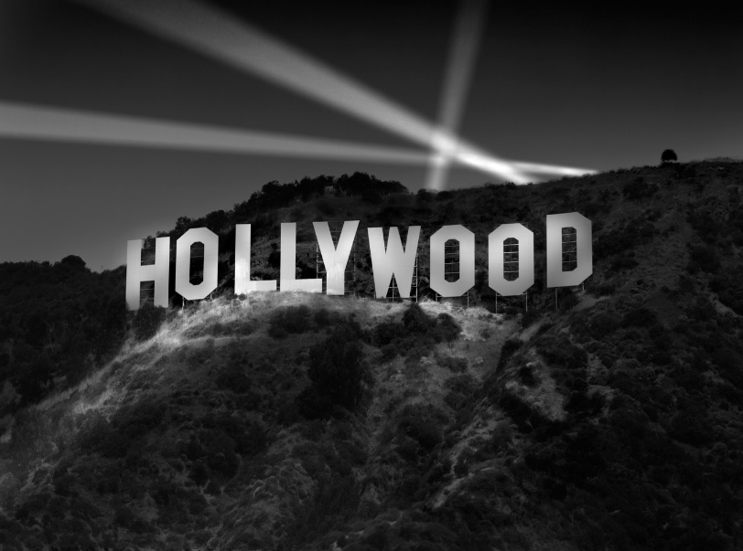
1930s Hollywood
Sound and color revolutions
First color film debuted in 1932, an animated Disney short
1934 saw the first live-action full-color film, La Cucaracha
The advance of the “talkies”
Expanse of genres
First drive-in theatre opened in 1933
Despite the serious effects the Depression had on the film industry theatre attendance remained between 60-75 million a week, even in the worst days of the Depression
Provided a balancing act between cynicism & realism of the Depression and escapism of the arts

Slide 7
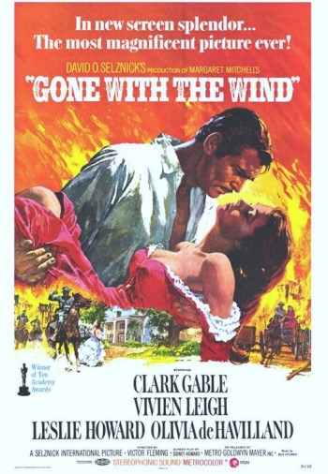
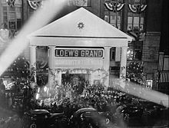
Gone with the wind
Based on Margaret Mitchell’s 1936 novel
Set in the American South, during Civil War & Reconstruction
Made over $390 million at the box office!
Originally ran 4 hours 25 minutes
Release included a parade with limos and thousands of confederate flags
Notes:
https://www.youtube.com/watch?v=8mM8iNarcRc

Slide 8
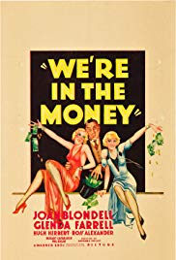
We’re in The Money - 1935
Comedy, musical
“Two gold-digging process servers are tasked with subpoenaing one’s boyfriend, who has been using a pseudonym to avoid breach-of-promise servings and suits” IMBD
Notes:
https://www.youtube.com/watch?v=AIXNSoACp5A

Slide 9
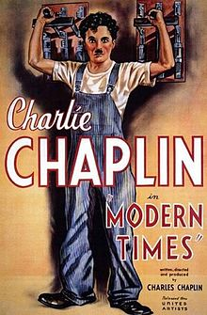
Charlie Chaplin
English comic actor who rose to fame during the silent film era
Difficult childhood growing up in England (poverty and hardship)
Chaplin began performing at an early age
Films characterized by slapstick and pathos
Modern Times
1936 comedy
Written and directed by Chaplin

Slide 10
Modern Times
What is Chaplin’s film about? How do you know?
What historical connections can you make?
How does Chaplin get his message across without necessarily using the spoken word?
Why do you think audiences would have enjoyed this?
Modern Times is Chaplin’s comment on the desperate employment and financial conditions faced by many during the Depression. Chaplin believed these conditions were created by the efficiencies of modern industrialization.

Slide 11
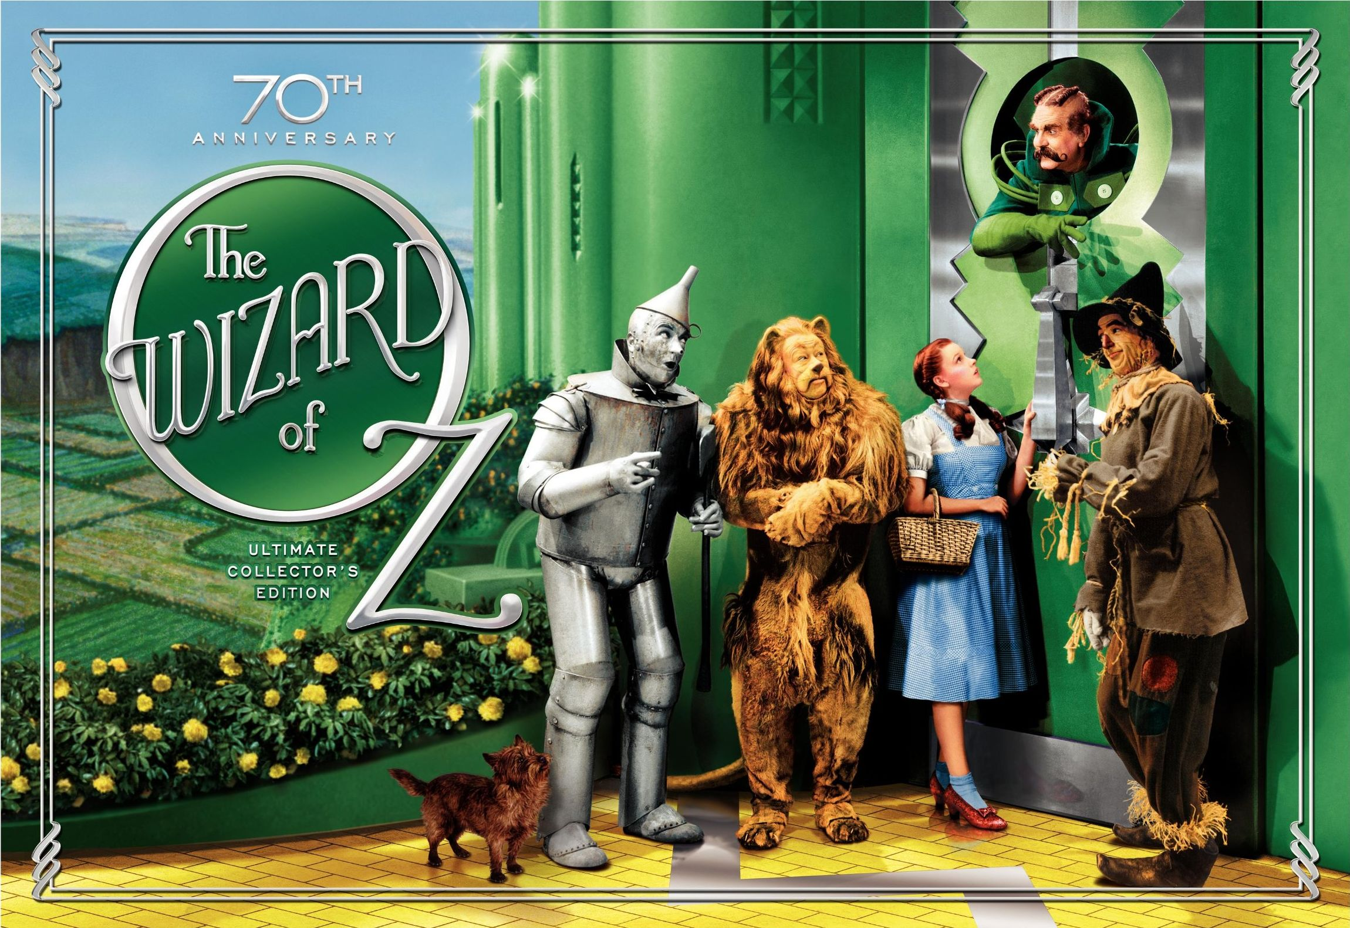

Slide 12
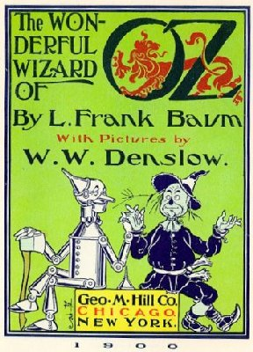
Cultural Significance
Based off of the children’s novel written by Frank L. Baum in 1900
Film made in 1939
Lost Best Picture to Gone with the Wind
Dorothy Gale, swept away from Kansas in a cyclone
Technicolor
Ushering us out of the Depression and into the renewed prosperity of war time!

Slide 13
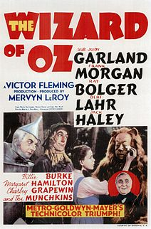
Cultural Significance (cont’d)
Twister: Stock Market Crash, Dust Bowl
Wizard: Roosevelt and his New Deal

Slide 14
Reflection questions
Why did Hollywood and the film industry prosper during the Great Depression?
Why would people use the little money they had to go and watch movies?

Slide 15
Superman: The Power of Comics
Escapism: 1930s-1940s

Slide 16
Why do we need the arts?
Job creation & economic stimulus
But also…
Boosted morale
Restored confidence
Cultural equivalent of the New Deal
Psychological stimulus package

Slide 17
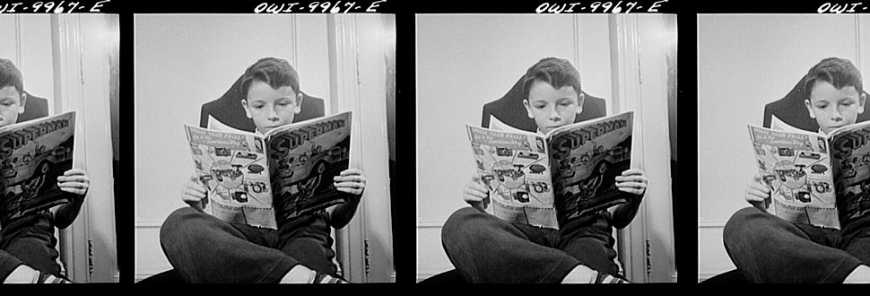
Pre-Reading Questions
What are comics?
Who reads comics?
Why read comics?

Slide 18
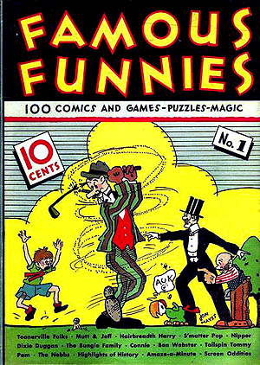
The Origin of Comics
The creation of the comic book reflected the Depression Era in which it was born, when America was in need of cheap distractions
While illustrated weeklies existed in Europe, comics themselves are a uniquely American cultural creation
The first really popular comic book series was known as “Famous Funnies” and promised to entertain readers with “games, comics, puzzles, and magic!”

Slide 19
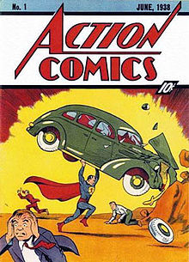
Comics of the Golden Era
Lasted roughly from the late 1930s-1959
In the Golden Era comics were not limited to children, but had mass appeal amongst adults as well
Comic creators used their comics to advance very specific visions
They served as entertainment, but also attempted to modify and shift cultural conventions
The birth of the superhero reflected the desire to fix the wrongs of the Depression, captured the spirit of the New Deal
If Americans were to be saved from the hell of Depression, they needed a hero

Slide 20
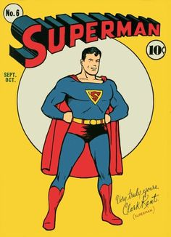
Superman!
Created by Jerry Siegel and John Shuster
Jewish Americans from Cleveland
Introduced in the first issue of Action Comics
First comic book character to be given his own title, 1939
His story reflected the new American culture of the 30s
His adventures were based in the city, rather than the frontier (like previous American folk heroes)
A hero for the common man

Slide 21
Superman: 1930s
Less idealistic than the version of Superman we have today
A little rougher around the edges and a little less powerful
Seemed to thoroughly enjoy beating up bad guys
The early stories reflect his desire to right the wrongs of society
Early Superman does not fight supervillains we have grown used to, but rather real villains of the New Deal era: bosses who do not provide safe working conditions, stock brokers who sell faulty stocks, even a U.S. senator who conspires with a munitions manufacturer
Superman represents Americans desire not just for escape, but for TRIUMPH

Slide 22
Why Create Superman?
“Listening to President Roosevelt’s ‘fireside chats’… being unemployed and worried during the Depression and knowing hopelessness and fear. Hearing and reading of the oppression and slaughter of helpless, oppressed Jews in Nazi Germany… seeing movies depicting the horrors of privation suffered from the downtrodden… I had the great urge to help… help the downtrodden masses, somehow. How could I help them when I could barely help myself? Superman was the answer.” – Jerry Siegel (co-creator of Superman)

Slide 23
Responding to Shifting Social Context (Comics in the 1940s)
As America moved towards war time, comics served as a kind of voluntary propaganda
A recovering economy contributed to rising popularity in comics (by December 1943 monthly comic book sales had climbed to 25 million copies)
If Superman was symbolic of the strength of the everyman during the Depression, he became symbolic of the American role in WWII and the need to extend that heroism to the oppressed in Europe and Asia
Captain America
If Superman represents the ideals of American culture, Captain America represented the nationalistic aims of a country about to enter a world war

Slide 24
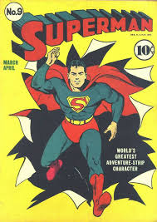
Reading Superman
What do you notice when reading comics?
How is reading images similar or different to reading text? What becomes important?
What do you notice about the message of this comic? What is Superman being used to do?

Slide 25
What Happens in this Comic?
We see the scientific explanation for Superman (sent to earth by his scientist father, has super powers, has alternate identity Clark Kent)
Superman saves an innocent woman from being murdered
Comes to the aid of a woman being beaten up by her husband
Rescues Lois Lane (who works with Clark Kent) from a gangster who kidnaps her at a nightclub for rebuffing him
Goes to Washington D.C. to expose a corrupt senator, kidnapping him and leaping from building to building trying to get a confession out of him

Slide 26
Escapism Culminating Assessment
After looking at the wide variety of Escapism literature used during the Depression for a multitude of purposes, your task is to create an original work that reflects on the State of the Union during the 1930s, and the role of escapism.
Potential Escapism mediums:
Comic book (15 panels minimum)
Recorded song (send Cossano the youtube link) (2 min)
Photo journal + accompanying reports (must be original) (8 photos)
Short story vignettes (100-300 word stories, must do at least two)
Short film (send Cossano youtube link) (3-5 minutes)
Got another creative idea? Let me know!
Grading:
15 pts creativity & effort
10 pts demonstrates clear understanding of the historical context
DUE: Thursday 1/16

Slide 27
The great depression assessment
11 sentence integrated essay
Open note
Prompts:
Define the psychological effects of the Great Depression
Determine the role of escapism
Evaluate the role of art and media during the Great Depression

