Slide 1
11 sentence essay assessment
Thesis statement sentence
One sentence BTS
One quote/fact (cited)
One sentence analysis
One sentence BTS
One quote/fact (cited)
One sentence analysis
One sentence BTS
One quote/fact (cited)
One sentence analysis
One sentence conclusion
On Friday, January 17th, you will be writing an 11 sentence essay as your written assessment for the Great Depression
Open note, open book
Follow the exact format (this is not an essay or full paragraphs)

Slide 2
The great depression assessment
11 sentence essay
Open note
Prompt:
Evaluate the role of art and media during the Great Depression

Slide 3
11 sentence essay assessment
Thesis statement sentence
One sentence BTS
One quote/fact (cited)
One sentence analysis
One sentence BTS
One quote/fact (cited)
One sentence analysis
One sentence BTS
One quote/fact (cited)
One sentence analysis
One sentence conclusion
Evaluate the role of art and media during the Great Depression
Follow the exact format (this is not an essay or full paragraphs)

Slide 4
Superman: The Power of Comics
Escapism: 1930s-1940s

Slide 5
Why do we need the arts?
Job creation & economic stimulus
But also…
Boosted morale
Restored confidence
Cultural equivalent of the New Deal
Psychological stimulus package

Slide 6
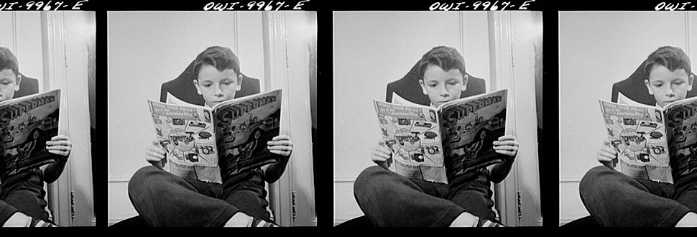
Pre-Reading Questions
What are comics?
Who reads comics?
Why read comics?

Slide 7
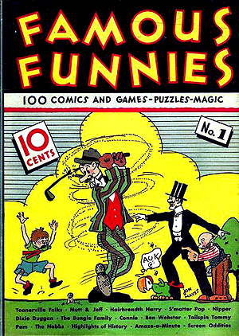
The Origin of Comics
The creation of the comic book reflected the Depression Era in which it was born, when America was in need of cheap distractions
While illustrated weeklies existed in Europe, comics themselves are a uniquely American cultural creation
The first really popular comic book series was known as “Famous Funnies” and promised to entertain readers with “games, comics, puzzles, and magic!”

Slide 8
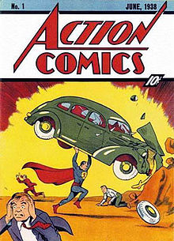
Comics of the Golden Era
Lasted roughly from the late 1930s-1959
In the Golden Era comics were not limited to children, but had mass appeal amongst adults as well
Comic creators used their comics to advance very specific visions
They served as entertainment, but also attempted to modify and shift cultural conventions
The birth of the superhero reflected the desire to fix the wrongs of the Depression, captured the spirit of the New Deal
If Americans were to be saved from the hell of Depression, they needed a hero

Slide 9
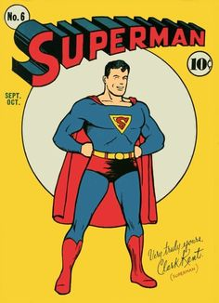
Superman!
Created by Jerry Siegel and John Shuster
Jewish Americans from Cleveland
Introduced in the first issue of Action Comics
First comic book character to be given his own title, 1939
His story reflected the new American culture of the 30s
His adventures were based in the city, rather than the frontier (like previous American folk heroes)
A hero for the common man

Slide 10
Superman: 1930s
Less idealistic than the version of Superman we have today
A little rougher around the edges and a little less powerful
Seemed to thoroughly enjoy beating up bad guys
The early stories reflect his desire to right the wrongs of society
Early Superman does not fight supervillains we have grown used to, but rather real villains of the New Deal era: bosses who do not provide safe working conditions, stock brokers who sell faulty stocks, even a U.S. senator who conspires with a munitions manufacturer
Superman represents Americans desire not just for escape, but for TRIUMPH

Slide 11
Why Create Superman?
“Listening to President Roosevelt’s ‘fireside chats’… being unemployed and worried during the Depression and knowing hopelessness and fear. Hearing and reading of the oppression and slaughter of helpless, oppressed Jews in Nazi Germany… seeing movies depicting the horrors of privation suffered from the downtrodden… I had the great urge to help… help the downtrodden masses, somehow. How could I help them when I could barely help myself? Superman was the answer.” – Jerry Siegel (co-creator of Superman)

Slide 12
Responding to Shifting Social Context (Comics in the 1940s)
As America moved towards war time, comics served as a kind of voluntary propaganda
A recovering economy contributed to rising popularity in comics (by December 1943 monthly comic book sales had climbed to 25 million copies)
If Superman was symbolic of the strength of the everyman during the Depression, he became symbolic of the American role in WWII and the need to extend that heroism to the oppressed in Europe and Asia
Captain America
If Superman represents the ideals of American culture, Captain America represented the nationalistic aims of a country about to enter a world war

Slide 13
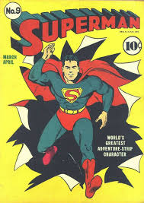
Reading Superman
What do you notice when reading comics?
How is reading images similar or different to reading text? What becomes important?
What do you notice about the message of this comic? What is Superman being used to do?

Slide 14
What Happens in this Comic?
We see the scientific explanation for Superman (sent to earth by his scientist father, has super powers, has alternate identity Clark Kent)
Superman saves an innocent woman from being murdered
Comes to the aid of a woman being beaten up by her husband
Rescues Lois Lane (who works with Clark Kent) from a gangster who kidnaps her at a nightclub for rebuffing him
Goes to Washington D.C. to expose a corrupt senator, kidnapping him and leaping from building to building trying to get a confession out of him

Slide 15
Escapism Culminating Assessment
After looking at the wide variety of Escapism literature used during the Depression for a multitude of purposes, your task is to create an original work that reflects on the State of the Union during the 1930s, and the role of escapism.
Potential Escapism mediums:
Comic book (15 panels minimum)
Recorded song (send Cossano the youtube link) (2 min)
Photo journal + accompanying reports (must be original) (8 photos)
Short story vignettes (100-300 word stories, must do at least two)
Short film (send Cossano youtube link) (3-5 minutes)
Got another creative idea? Let me know!
Grading:
15 pts creativity & effort
10 pts demonstrates clear understanding of the historical context
DUE: Thursday 1/16

