Slide 1
Individual Response
Read the following statements and write down whether you think they are true or false:
Money buys happiness
Money buys power
The rich are able to get away with anything
It's okay to live in the past
It is possible to achieve any dream
A dream can make people do things they would not normally do
Love always lasts
Poor people don't work hard enough
Being average is okay
Society allows the rich to be corrupt

Slide 2
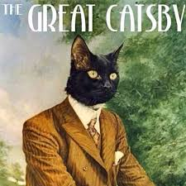
The Great Gatsby
F. Scott Fitzgerald’s

Slide 3
Essential Questions
Define the American Dream.
Conclude the corruptness of the narrator, Nick.
Determine who is to blame for the conclusion.
How is the novel a reflection of the 1920s?
Determine why the 1920s were impossible to sustain.
Conclude the effects of Prohibition.
Determine if jazz is an example of life imitating art or art imitating life.

Slide 4
Historical Background

Slide 5
Prohibition and Gangsters
Prohibition began January 16, 1919, with the ratification of the Eighteenth Amendment of the U.S.Constitution. Ban on alcohol.
Prohibition was finally repealed in 1933.
Increase in organized crime with smuggling and bootlegging of liquor
Major bosses like Al Capone (Chicago)

Slide 6
Jazz Age
Emergence of jazz music and dance
Jazz music was spread through the introduction of the radio in 1922
First popular with African Americans
Billie Holiday, Bessie Smith, Louis Armstrong

Slide 7
Modern Women and Flappers
What were the roles of Women in the 1920s?
majority remained in traditional role of housewife, but
number of working women increased by 25% as a result of the work they had undertaken during WW1.
Workplace: included factory workers, secretaries, salesclerks and telephone operators.
women attending college rose to 10% of the population by the end of the 1920's.
The 19th Amendment was ratified on August 18, 1920

Slide 8
Flappers (Daisy and Jordan)
Young women’s trend and a social statement, a breaking-off from the rigid Victorian way of life.
Represented Modernism - typified the clash of values and the changing status of women of the new era. Young women were labeled ‘flappers’ by older generations.
Flouted convention, cut their hair, listened to jazz and scandalized the older generation.
Fashion: Most women abandoned traditional, restrictive women's clothes, such as long dresses and tight corsets. Silhouettes and style were often more masculine.
Hairstyles: The long hair, traditionally worn by women, was cut into a 'Bob'.
Favored a masculine look - symbolized the independent and modern woman
Challenged the traditional ideas by wearing short skirts, bobbed hairstyles, make-up and cosmetics.
Increased use of cosmetics, which until the 1920s was not typically accepted in American society because of its association with prostitution.
Began drinking and smoking in public and became sexually liberated during the 1920's.

Slide 9
Alienation led to an awareness about one's inner life.
Alienation
Post War soldiers
belong to a "lost generation" (Gertrude Stein),
suffers from a "dissociation of sensibility" (T. S. Eliot),
and have "a Dream deferred" (Langston Hughes). Why am I the way I am? Who am I?
Psychology, Freud, Jung.
Valorization of the despairing individual in the face of an unmanageable future
Disillusionment , lack of hope…

Slide 10
Effect of Industrialization
Sense of individuality
Scenes of the metropolis, cities and urbanscapes
The lowly worker, the rich tycoon

Slide 11
The haves and the have nots:
New money
Technology, industry
vs. old money
Family, inheritance
vs. no money
The burdened and oppressed

Slide 12
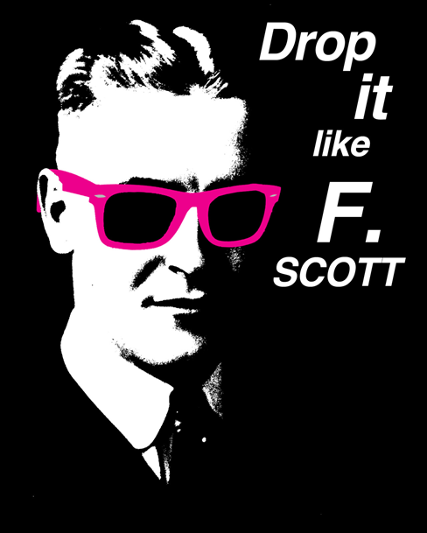
F. Scott Fitzgerald Mini Bio
https://www.youtube.com/watch?v=PL05VV040Ls
“An author ought to write for the youth of his generation, the critics of the next, and the schoolmasters of ever afterward” – Fitzgerald

Slide 13
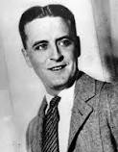
F. Scott Fitzgerald
Francis Scott Key Fitzgerald (September 24, 1896 – December 21, 1940)
Wrote four novels: This Side of Paradise, The Beautiful and Damned, Tender is the Night and his most famous, The Great Gatsby (1925).
The Love of the Last Tycoon after death
Alcoholic, died of massive heart attack

Slide 14
F. Scott and Zelda Fitzgerald
Married Zelda Sayre (1900-1948): wealthy girl, “rich girls don’t marry poor boys”
Had daughter: Frances Scott Fitzgerald
Zelda was institutionalized (schizophrenia) for large part of life, died in a fire
Jazz Age, flappers influenced works
Z: A Novel for Zelda (great fiction about their marriage, life, etc.)

Slide 15
In a 1924 Letter,
Fitzgerald said, “the burden of The Great Gatsby was the loss of those illusions that give such color to the world that you don't care whether things are true or false as long as they partake of the magical glory.”

Slide 16
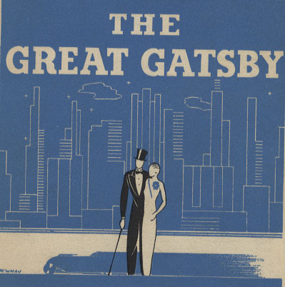
The Great Gatsby

Slide 17
One Sentence Summary
The Great Gatsby tells a story of love and riches in post-WWI America as newcomer Nick learns about the mysterious life of billionaire neighbor Jay Gatsby and how his proclivities cause manifold destruction.

Slide 18
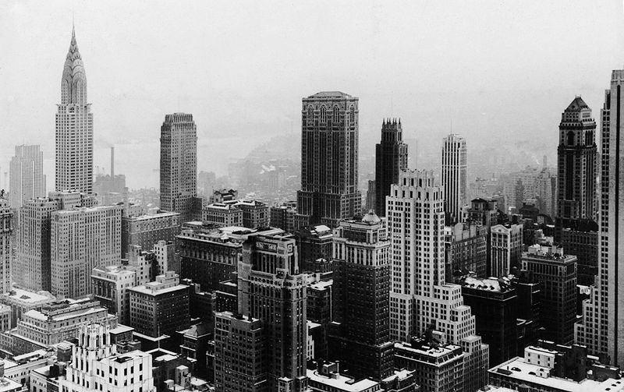
Setting
Set on Long Island's North Shore and in New York City during the summer of 1922
New York City

Slide 19
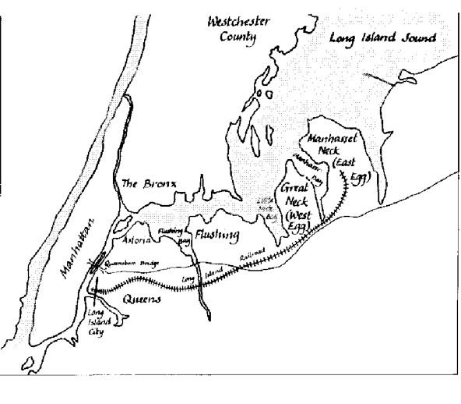
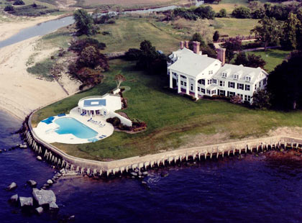
Setting
East Egg: home to Tom and Daisy
West Egg: home to Gatsby and Nick
Mansions, wealth, parties
Carefree existence.

Slide 20
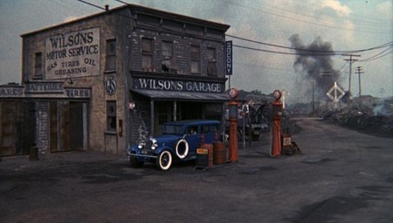
Setting
Valley of ashes
If the Eggs and the city are the party, valley of ashes is the aftermath
Consumption
“This is a valley of ashes – a fantastic farm where ashes grow like wheat into ridges and hills and grotesque gardens; where ashes take the forms of houses and chimneys and rising smoke and, finally, with a transcendent effort, of ash-grey men, who move dimly and already crumbling through the powdery air. Occasionally a line of grey cars crawls along an invisible track, gives out a ghastly creak, and comes to rest, and immediately the ash-grey men swarm up with leaden spades and stir up an impenetrable cloud, which screens their obscure operations from your sight. … The valley of ashes is bounded on one side by a small foul river”

Slide 21
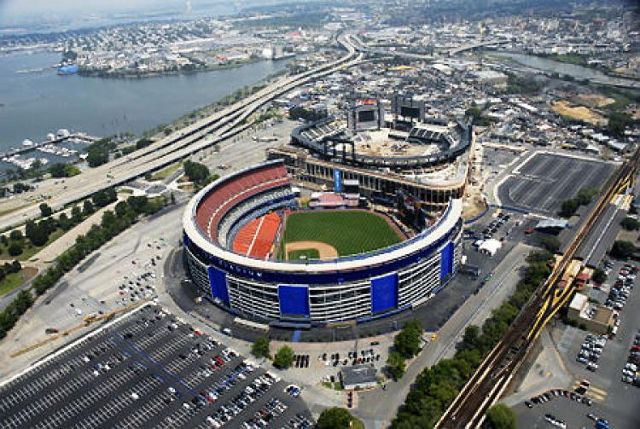
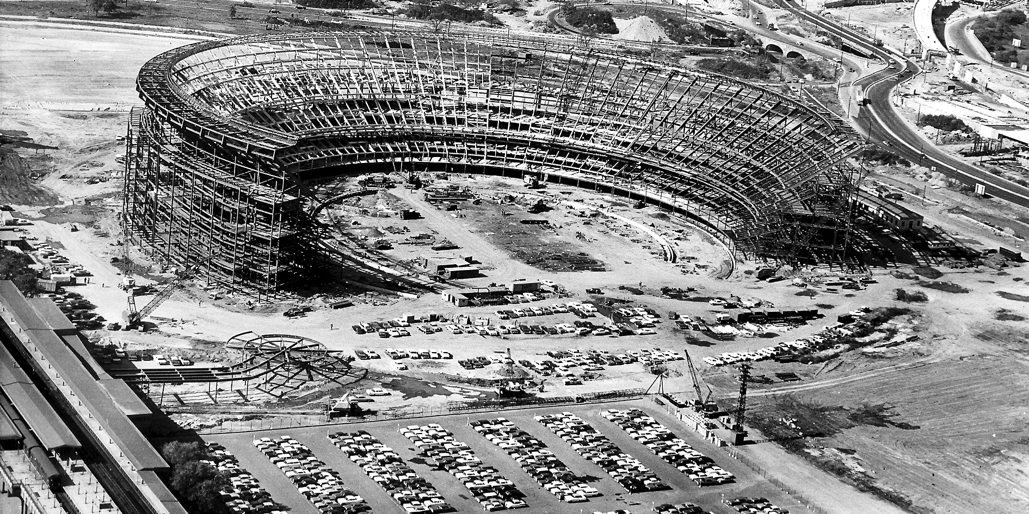
Valley of Ashes: Context
The most literary spot in north central Queens is Flushing Meadows-Corona Park, where Shea Stadium stands directly over the famous "ash piles" -- a garbage dump landfill -- described by F. Scott Fitzgerald in The Great Gatsby.
Used to be site of natural wetlands, world’s fair, and coal ashe dump.

Slide 22
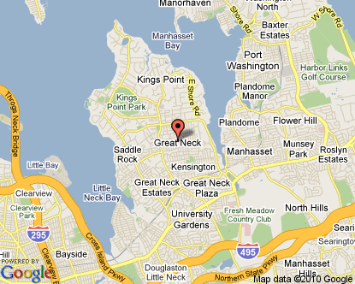
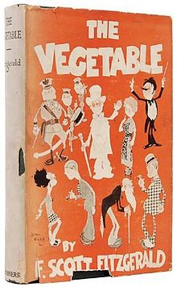
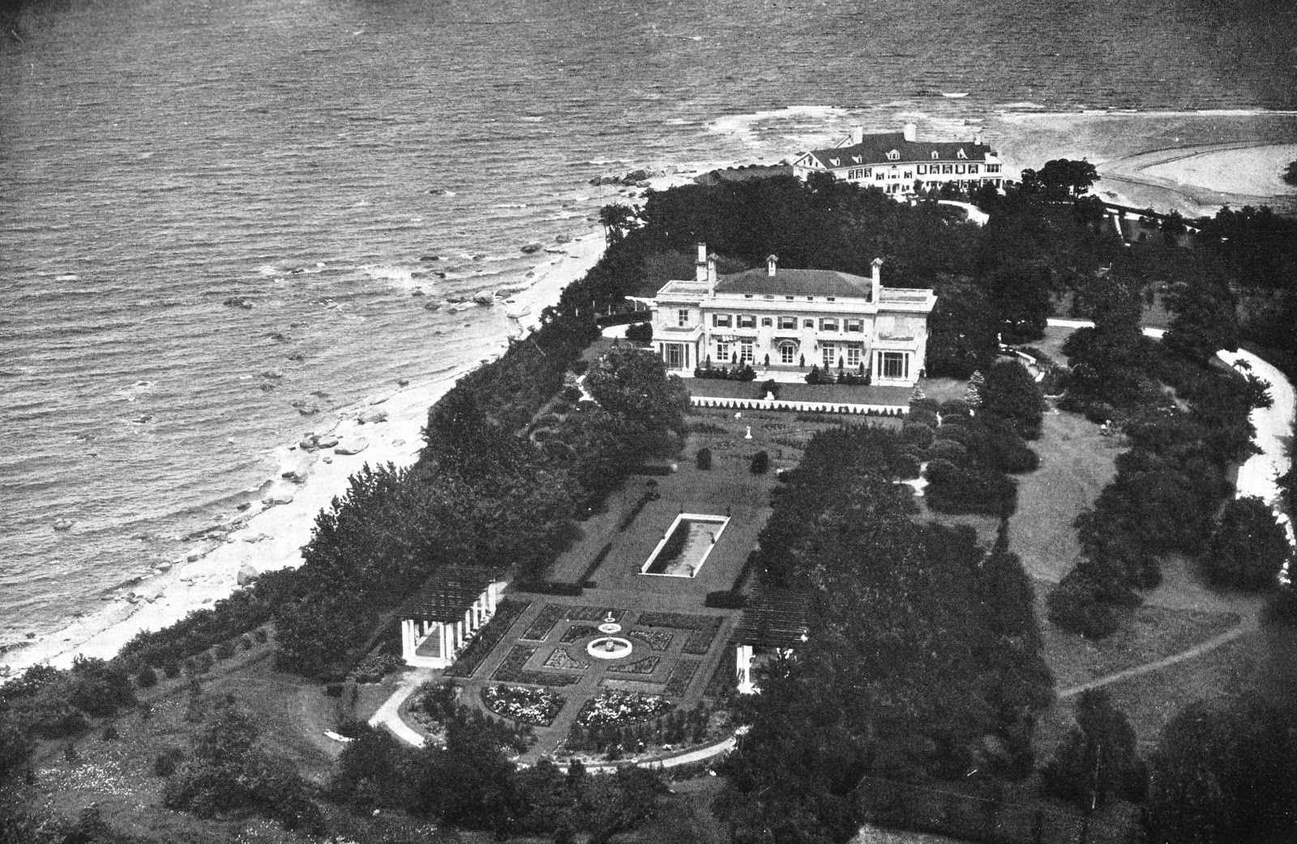
Valley of Ashes: Context
Fitzgerald moved his family from St. Paul. Minnesota to Great Neck, on the north shore of Long Island, in October of 1922 so he could be closer to the Broadway production of his play, The Vegetable.
They stayed until May of 1924 before moving to the French Riviera in the off season, where cheaper living and fewer distractions allowed Fitzgerald to write Gatsby.
Fitzgerald’s experiences in Great Neck, fictionalized as “West Egg,” and Long Island’s Gold Coast, provided material for the book.
Trips to Manhattan during his stay in Great Neck would have taken Fitzgerald through Queens’ Corona dump, whether he rode the Long Island Railroad or drove along Northern Boulevard.
The dump consisted of swamp land west of the Flushing River which was being filled in with garbage, horse manure and ashes from the city’s coal burning furnaces.
It provided Fitzgerald a dramatic contrast to the glamour of Manhattan and the North Shore

Slide 23
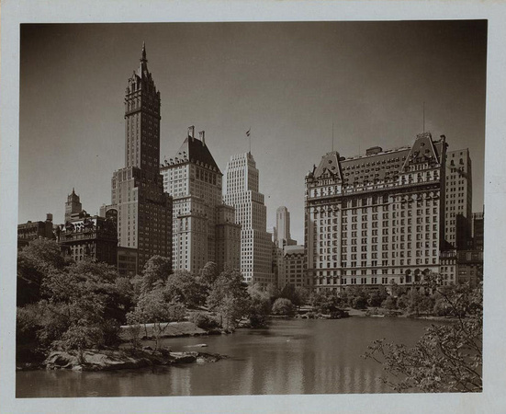
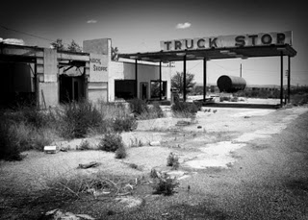
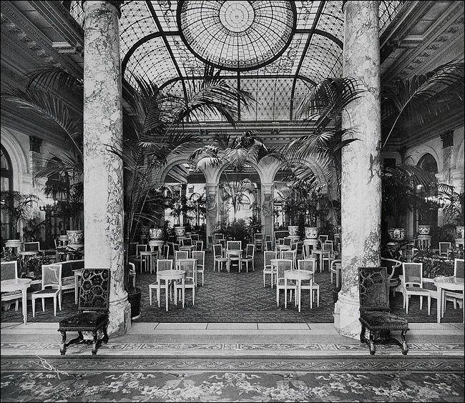
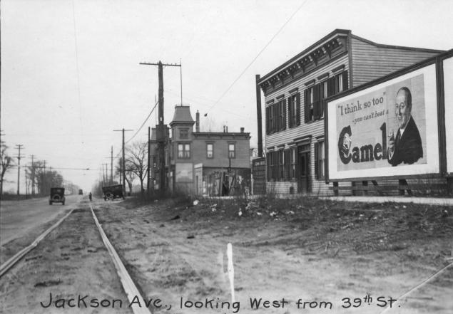
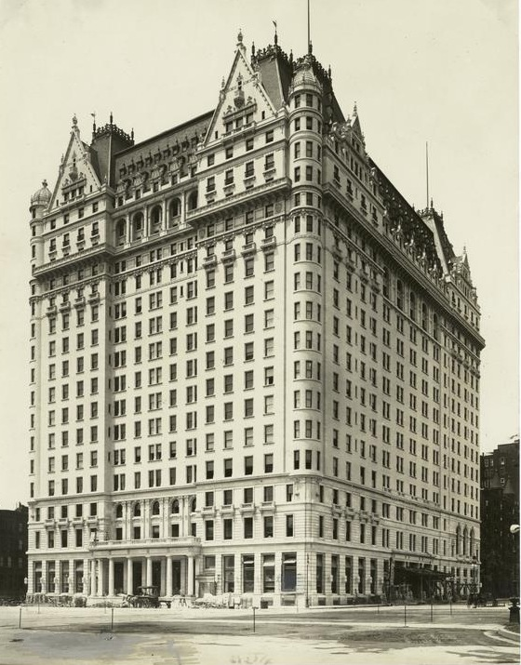

Slide 24
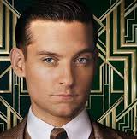
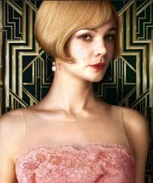
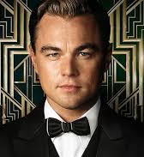
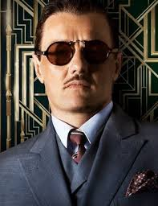
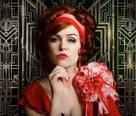
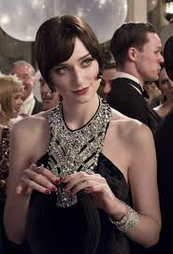
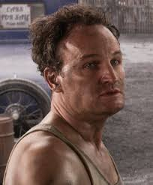
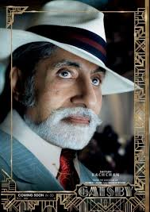
Characters
Nick Carraway
Daisy Buchanan
Jay Gatsby
Tom Buchanan
Myrtle Wilson
Jordan Baker
George Wilson
Meyer Wolfsheim

Slide 25
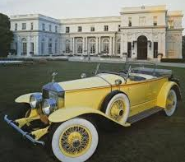
Motifs in The Great Gatsby
Any recurring element that has symbolic significance in a story
Jazz
Automobiles
Money

Slide 26
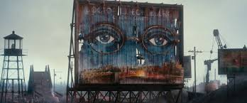
Image Threads Worth Following
Nature:
Flowers
Birds
Moonlight
The golden sun
Eyes
Clocks
The Sea
Colors

Slide 27
Dr. T. J. Eckleburg
“above the grey land and the spasms of bleak dust which drift endlessly over it...the eyes of Doctor T. J. Eckleburg” (27)
“But his eyes, dimmed a little by paintless days under sun and rain, brood on over the solemn dumping ground” (28)
The eyes of God watching over the valley of ashes, not the Eggs or the city.
Represents the dangers and corruption of the past
Worn down and tattered, from the past

Slide 28
Big Ideas
The Roaring 20s: Life & Historical Context
The American Dream: Who’s pursuing it, who has achieved it, and who will never get there?
Social Class: Old Money, New Money, & No Money (consumerism and materialism)
Past & Future: Who is haunted by the past, and who is worried about the future?
Modernism: What characteristics of Modernist writing do we see in Gatsby?
Appearance vs. Reality: Are the characters who they actually appear to be?
Loyalty & Betrayal: Who is loyal to whom, and who is not?
Gatsby as a tragic hero
Corruption: society, morals, wealthy vs. poor
Wealth: carelessness, hollowness of wealth

Slide 29
Homework
Read chapter 1, print out the study guide (this study guide is optional but highly recommended)
You are writing an in-essay on this novel!
We will be watching chapter 1 tomorrow, then you will have work time

Slide 30
OLDER FILES

Slide 31
Themes: The American Dream
What is the American Dream?
American Dream used to be the belief that with hard work, everyone can achieve their goals. It is the pursuit of happiness and individualism, but in the novel the American Dream is about wealth, big houses, material goods.
The 1920s are seen as a time of decreasing social and moral values, with an increase in wealth, greed, and the pursuit of pleasure.
East/West Egg vs. valley of ashes
Gatsby’s Dream: he believes that if he can impress Daisy with his immense wealth, she will leave Tom and marry him.
F. Scott Fitzgerald does not use the words “American Dream” in the novel, but it is evident that he shows the impossibility of achieving happiness through the American Dream.

Slide 32
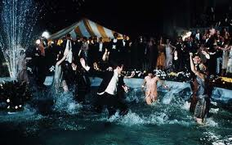
Themes: Corruption of society and morals by the wealthy and careless
Tom: has an affair
Jordan: cheater
Daisy and Gatsby: have an affair
Gatsby: big parties with alcohol, mob connections
Nick: is he corrupt?

Slide 33
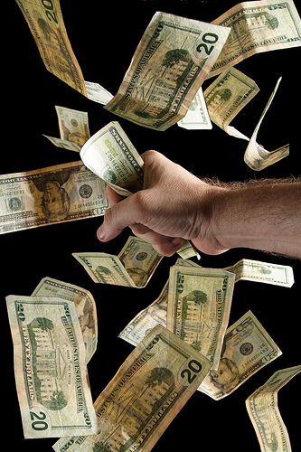
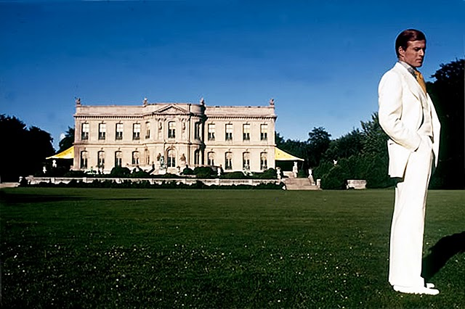
Themes: Consumerism and Materialism leads to decreased morals
Big houses, big parties, trips to the city for parties.
Myrtle wants more…money, house, away from the valley of ashes.
Gatsby uses wealth to woo Daisy.

Slide 34
Themes: Hollowness of Wealth
1920’s = “Gilded Age”: Gilded = covered thinly with gold leaf or gold paint; wealthy and privileged
They are seen as superficial, careless.
Daisy saying, “All right…What’ll we plan? She turned to me helplessly. What do people plan?”
Careless nature of the affairs
Does money buy happiness?

Slide 35
As you read
We will be using post it notes to annotate the book (you can use some of mine or buy your own)
Things to look for:
Quotes that relate to the themes
References to colors
Comments on the 1920s and society in general
Symbolism, motifs, image threads

Slide 36
Essay Prompts (plan ahead)
Conclude if Nick is as careful and honest as he claims to be. Determine his reliability as a narrator.
To what extent does Gatsby represent the 1920s American Dream? Does he ever achieve it?
Investigate if the novel is a fair and accurate representation of the 1920s.
Analyze the symbolism in the novel and how Fitzgerald uses symbolism to provide social commentary of the 1920s.
Explore the language of lightness and heaviness and their effect on the characters/plot and/or development of a theme in The Great Gatsby.
You can create your own topic.

