Slide 1
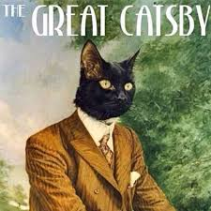
The Great Gatsby
F. Scott Fitzgerald’s

Slide 2
Individual Response
Read the following statements and write down whether you think they are true or false:
Money buys happiness
Money buys power
The rich are able to get away with anything
It's okay to live in the past
It is possible to achieve any dream
A dream can make people do things they would not normally do
Love always lasts
Poor people don't work hard enough
Being average is okay
Society allows the rich to be corrupt

Slide 3
Essential Questions
Define the American Dream.
Conclude what would make Nick a corrupt character.
Determine who is to blame for the conclusion.
How is the novel a reflection of the 1920s?
Determine why the 1920s were impossible to sustain.
Conclude the effects of Prohibition.
Determine if jazz is an example of life imitating art or art imitating life.

Slide 4
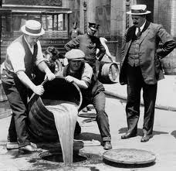
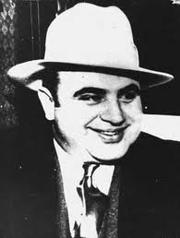
Prohibition and Gangsters
Prohibition began January 16, 1919, with the ratification of the Eighteenth Amendment of the U.S.Constitution. Ban on alcohol.
Prohibition was finally repealed in 1933.
Increase in organized crime with smuggling and bootlegging of liquor
Major bosses like Al Capone (Chicago)

Slide 5
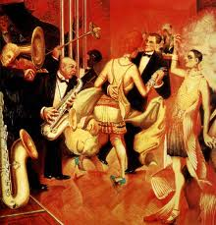
Jazz Age
Emergence of jazz music and dance
Jazz music was spread through the introduction of the radio in 1922
First popular with African Americans
Billie Holiday, Bessie Smith, Louis Armstrong

Slide 6
Flappers (Daisy and Jordan)
The 19th Amendment was ratified on August 18, 1920
Young women’s trend and a social statement, a breaking-off from the rigid Victorian way of life.
Young women were labeled ‘flappers’ by older generations.
Increased use of cosmetics, which until the 1920s was not typically accepted in American society because of its association with prostitution.

Slide 7
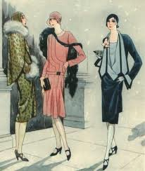
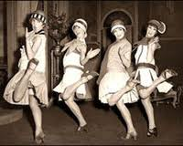
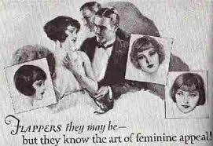

Slide 8
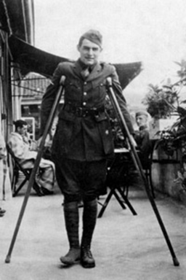
Alienation led to an awareness about one's inner life.
Alienation
Post War soldiers
belong to a "lost generation" (Gertrude Stein),
suffers from a "dissociation of sensibility" (T. S. Eliot),
and have "a Dream deferred" (Langston Hughes). Why am I the way I am? Who am I?
Psychology, Freud, Jung.
Valorization of the despairing individual in the face of an unmanageable future
Disillusionment , lack of hope…

Slide 9
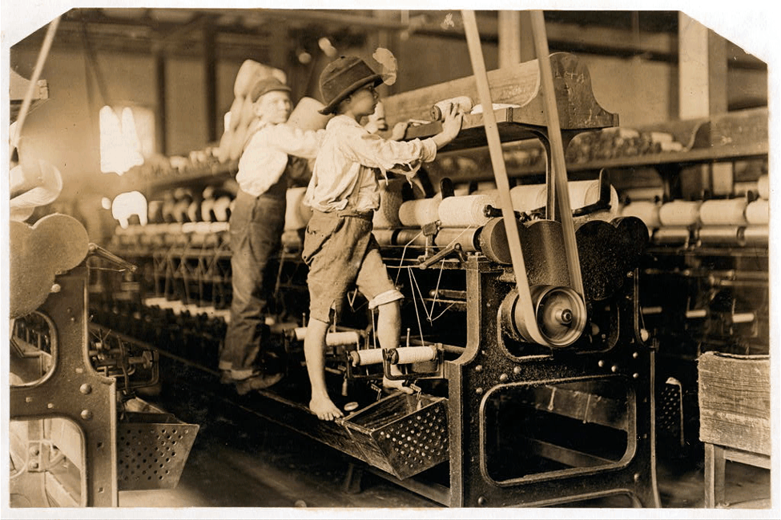
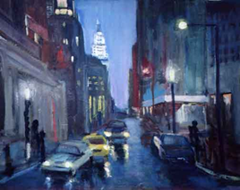
Effect of Industrialization
Sense of individuality
Scenes of the metropolis, cities and urbanscapes
The lowly worker, the rich tycoon

Slide 10
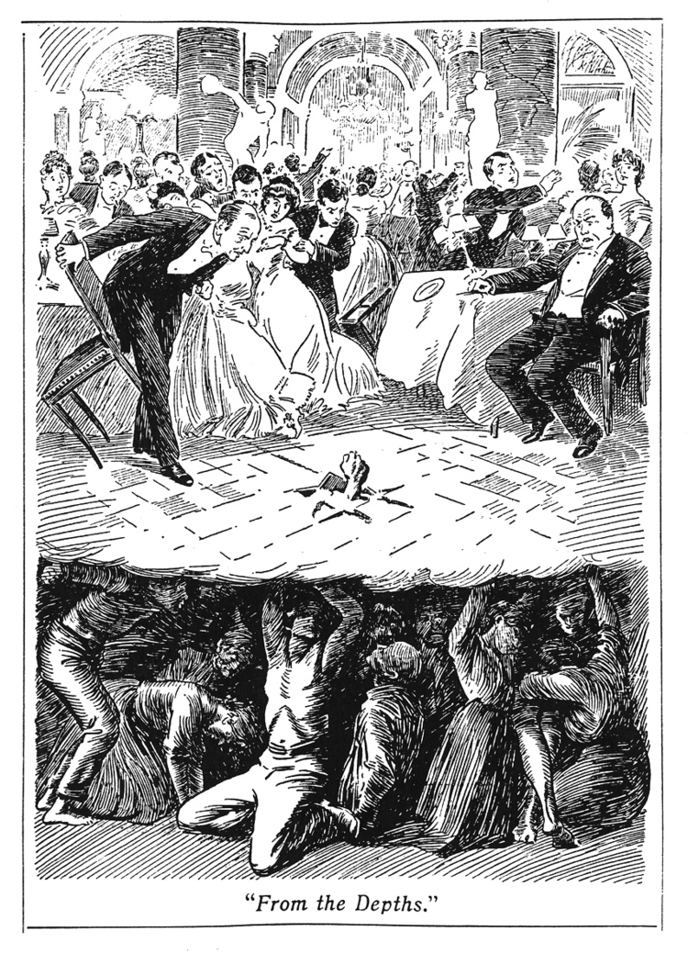
The haves and the have nots:
New money
Technology, industry
vs. old money
Family, inheritance
vs. no money
The burdened and oppressed

Slide 11
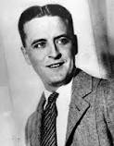
F. Scott Fitzgerald
Francis Scott Key Fitzgerald (September 24, 1896 – December 21, 1940)
Wrote four novels: This Side of Paradise, The Beautiful and Damned, Tender is the Night and his most famous, The Great Gatsby (1925).
The Love of the Last Tycoon after death
Alcoholic, died of massive heart attack

Slide 12
Jazz Age, Zelda
Married Zelda Sayre (1900-1948): wealthy girl, “rich girls don’t marry poor boys”
Had daughter: Frances Scott Fitzgerald
Zelda was institutionalized (schizophrenia) for large part of life, died in a fire
Jazz Age, flappers influenced works
Z: A Novel for Zelda (great fiction about their marriage, life, etc.)

Slide 13
In a 1924 Letter,
Fitzgerald said, “the burden of The Great Gatsby was the loss of those illusions that give such color to the world that you don't care whether things are true or false as long as they partake of the magical glory.”

Slide 14
Literary Modernism
1900-1950
Novels, Plays, Poetry
Highly experimental as writers seek a unique style
Use of stream of consciousness
The pursuit of the American dream
Optimism
Importance of the individual

Slide 15
Influences on Modern Authors
Writers reflect the ideas of Darwin (survival of the fittest) and Karl Marx (how money and class structure control a nation)
Rise of the youth culture
WWI
Harlem Renaissance

Slide 16
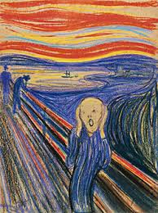
Modernism
Basic Definition: Modernism was a philosophical and artistic movement of the early 20th century
Portrayed the world of men as a harsh, hostile environment in which life had lost its meaning and men and women were isolated from each other, struggling to survive alone.
This world is one in which our dreams are unrealistic and futile.
•T.S. Eliot: It could not accord with "the immense panorama of futility and anarchy which is contemporary history."

Slide 17
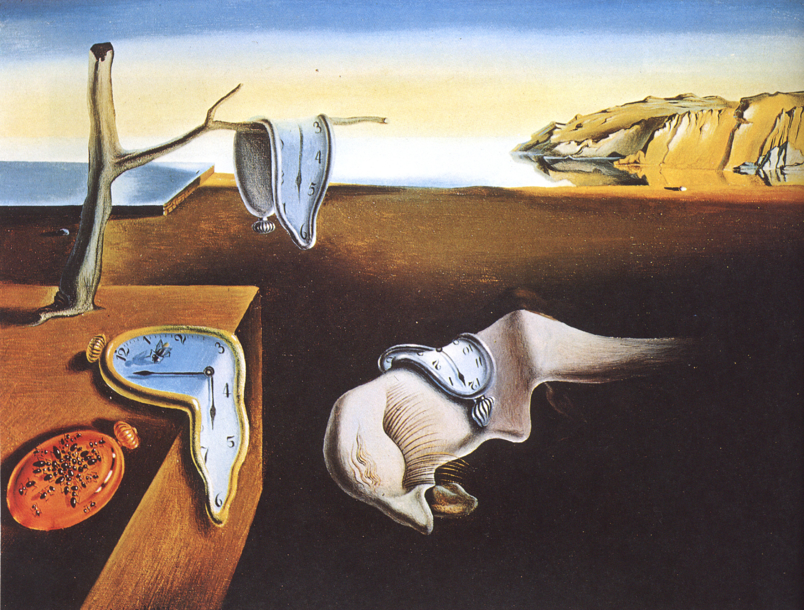
Modernism in Literature
Embraced non-traditional syntax and forms.
Challenged tradition
Writers wanted to move beyond Realism to introduce such concepts as disjointed timelines
The Persistence of Memory, 1931 - Salvador Dali

Slide 18
Characteristics of Modernism in Literature
Open form
Juxtaposition
Discontinuous narrative
Intertextuality
Classical allusions
Borrowing from cultures and other languages
First person and Stream of consciousness
Urban landscapes
Characters on quest for self understanding

Slide 19
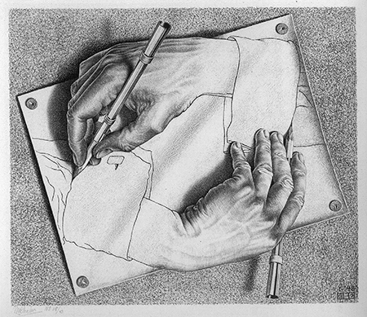
Literary Modernism
Stream of Consciousness
Reveal’s an individual’s POV (first person narrative)
Urban landscapes
Diversity in backgrounds and ideas vs. poverty and crime
Lost in a nameless, faceless crowd
Modernist characters
Quest to understand and/or recreate themselves
Try to live as meaningfully as possible
Loose reference to time
Chronological order is vague/confusing. Time is hazy

Slide 20
Reflect:
How is Modernism a reaction to the times?

Slide 21
One Sentence Summary
The Great Gatsby tells a story of love and riches in post-WWI America as newcomer Nick learns about the mysterious life of billionaire neighbor Jay Gatsby and how his proclivities cause manifold destruction.

Slide 22
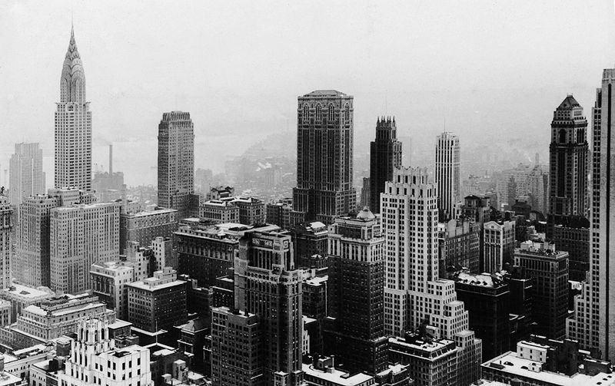
Setting
Set on Long Island's North Shore and in New York City during the summer of 1922
New York City

Slide 23
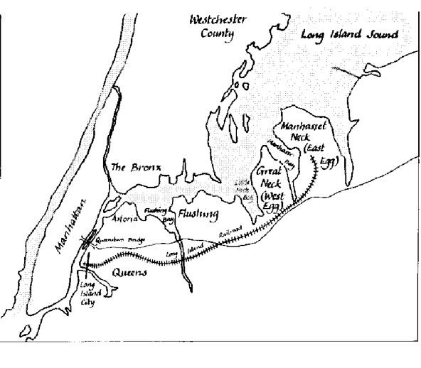
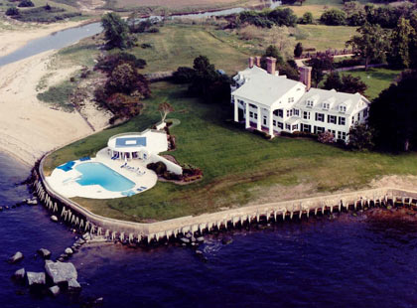
Setting
East Egg: home to Tom and Daisy
West Egg: home to Gatsby and Nick
Mansions, wealth, parties
Carefree existence.

Slide 24
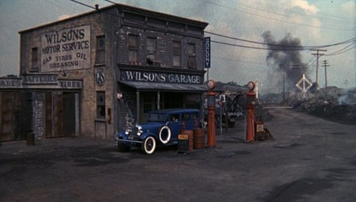
Setting
Valley of ashes
If the Eggs and the city are the party, valley of ashes is the aftermath
Consumption
“This is a valley of ashes – a fantastic farm where ashes grow like wheat into ridges and hills and grotesque gardens; where ashes take the forms of houses and chimneys and rising smoke and, finally, with a transcendent effort, of ash-grey men, who move dimly and already crumbling through the powdery air. Occasionally a line of grey cars crawls along an invisible track, gives out a ghastly creak, and comes to rest, and immediately the ash-grey men swarm up with leaden spades and stir up an impenetrable cloud, which screens their obscure operations from your sight. … The valley of ashes is bounded on one side by a small foul river”

Slide 25
Characters
Jay Gatsby
Nick Carraway
Daisy Buchanan
Tom Buchanan
Jordan Baker
Myrtle Wilson
George Wilson
Meyer Wolfsheim

Slide 26
Motifs in The Great Gatsby
Any recurring element that has symbolic significance in a story
Jazz
Automobiles
Money

Slide 27
Image Threads Worth Following
Cars
Nature:
Flowers
Birds
Moonlight
The golden sun
Eyes
Clocks
The Sea
Colors

Slide 28
Dr. T. J. Eckleburg
“above the grey land and the spasms of bleak dust which drift endlessly over it...the eyes of Doctor T. J. Eckleburg” (27)
“But his eyes, dimmed a little by paintless days under sun and rain, brood on over the solemn dumping ground” (28)
The eyes of God watching over the valley of ashes, not the Eggs or the city.

Slide 29
Themes: The American Dream
What is the American Dream?
American Dream used to be the belief that with hard work, everyone can achieve their goals. It is the pursuit of happiness and individualism, but in the novel the American Dream is about wealth, big houses, material goods.
The 1920s are seen as a time of decreasing social and moral values, with an increase in wealth, greed, and the pursuit of pleasure.
East/West Egg vs. valley of ashes
Gatsby’s Dream: he believes that if he can impress Daisy with his immense wealth, she will leave Tom and marry him.

Slide 30
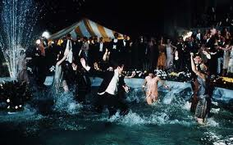
Themes: Corruption of society and morals by the wealthy and careless
Tom: has an affair
Jordan: cheater
Daisy and Gatsby: have an affair
Gatsby: big parties with alcohol, mob connections
Nick: is he corrupt?

Slide 31
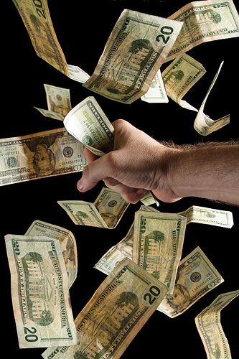
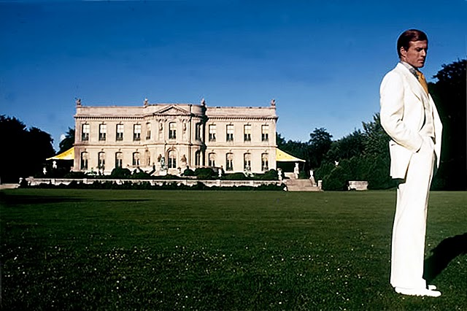
Themes: Consumerism and Materialism leads to decreased morals
Big houses, big parties, trips to the city for parties.
Myrtle wants more…money, house, away from the valley of ashes.
Gatsby uses wealth to woo Daisy.

Slide 32
Themes: Hollowness of Wealth
1920’s = “Gilded Age” Gilded = covered thinly with gold leaf or gold paint; wealthy and privileged
They are seen as superficial, careless.
Daisy saying, “All right…What’ll we plan? She turned to me helplessly. What do people plan?”
Careless nature of the affairs
Does money buy happiness?
They are seen as superficial, careless.
Daisy saying, “All right…What’ll we plan? She turned to me helplessly. What do people plan?”
Careless nature of the affairs

Slide 33
As you read
We will be using post it notes to annotate the book (you can use some of mine or buy your own)
Things to look for:
Quotes that relate to the themes
References to colors
Comments on the 1920s and society in general
Symbolism, motifs, image threads

Slide 34
Homework
Read chapter 1, print out the study guide (this study guide is optional but highly recommended)
We will be watching chapter 1 tomorrow, then you will have work time

