Slide 1
Ending Reflection
To what extent does Gatsby die thinking he achieved his dream?
What is an appropriate ending for the novel?
What would make it a ‘happy ending’? Why?
“So we beat on, boats against the current, borne back ceaselessly into the past”. Explain.

Slide 2
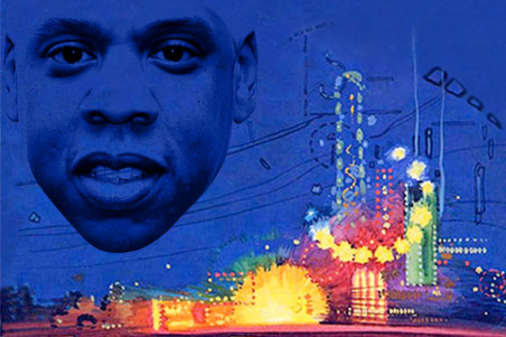
Jay Z and Jay Gatz: Re-imaging Gatsby for Millennials
Notes:
http://www.vulture.com/2013/01/jay-z-great-gatsby-quiz.html

Slide 3
Is 2013 hip-hop an appropriate choice for the soundtrack of a story about the 1920s?

Slide 4
Major themes of hip hop?
Money, status, love, cars (materialism), partying & excess
Major themes of the Jazz Age that Fitzgerald is trying to capture in Gatsby?
Money, status, love, wealth & materialism, partying & excess

Slide 5
Baz Luhrmann (director) draws a parallel between the Jazz-era pop songs that Fitzgerald references and his own soundtrack, ultimately aiming to demonstrate how deeply hip-hop has come to influence rock, pop, and dance music

Slide 6
Jazz used to be lewd and provocative dance music, now seen as refined and sophisticated
The incorporation of hip-hop gives the story a renewed authenticity
Effectively evoked emotion and imagery
More than just entertainment:
Imagine them as messages and images that attempt to transport an old idea to a new audience

Slide 7
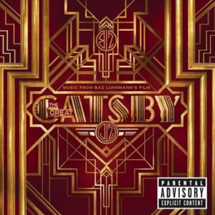
Annotate the lyrics while you listen, paying particular attention to…
Tone
Word Choice
Point of view
Repetition
Metaphor
Allusions

Slide 8
Is Jazz an example of life imitating art or art imitating life?

Slide 9
So, why hip hop?
And why spend time re-imaging an old story like this?

Slide 10
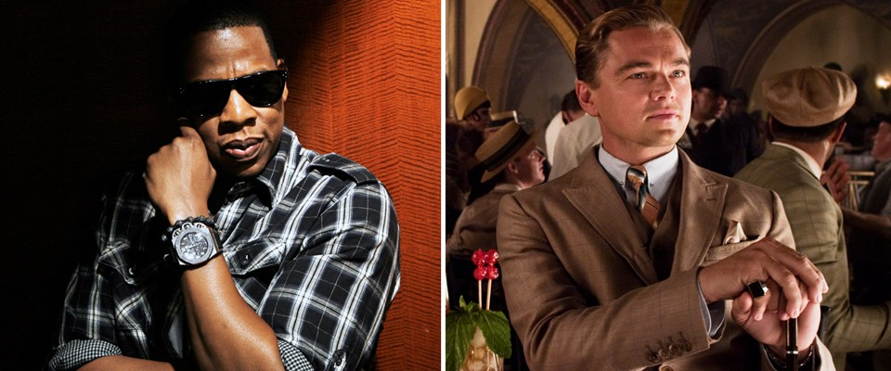
Jay Gatsby & Jay Z
Pseudonym
Filthy rich
Self-made
School drop-out
Gangster associates
Sports connections
Political connections
Great cars

Slide 11
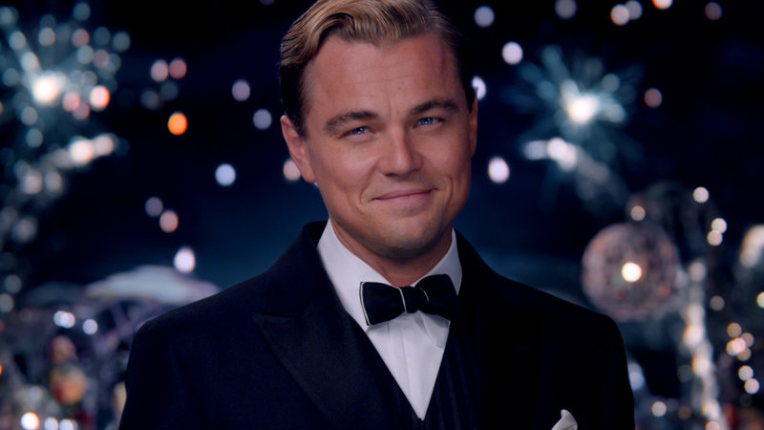
Homework...

Slide 12
Exit Ticket Sound Track: Thematic Connections to Gatsby
Find one song that would be appropriate for the soundtrack of your version of The Great Gatsby.
May correlate to any part of the novel
What you turn in: Write out your rationalization for the songs, including:
Musician & Song Title
Describe the song’s connection to Fitzgerald’s The Great Gatsby (thematic, pace, characterization, etc.)
Cite specific textual evidence to support your choice

