Slide 1
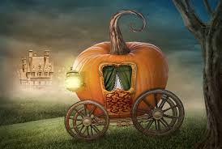
Fairy Tales

Slide 2
Learning Targets
I can define elements of fairy tales in stories AND film
I can compare and contrast original and modern fairy tale versions
I can present my ideas verbally
I can recreate an original fairy tale

Slide 3
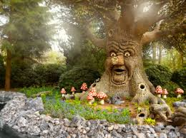
Fairy Tale Definition
A fairy tale is a story, often intended for children, that features fanciful and wondrous characters such as elves, goblins, wizards, and even, but not necessarily, fairies.
Fairy tales are often traditional; many were passed down from story-teller to story-teller before being recorded in books.
Source: literaryterms.com

Slide 4
Original Authors
Jacob and Wilhelm Grimm
Charles Perrault
Hans Christian Andersen
Marie-Catherine Baronne d’Aulnoy
Joseph Jacobs
Source: https://thoughtsonfantasy.com/

Slide 5
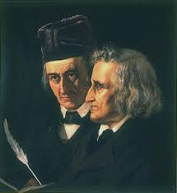
Jacob and Wilhelm Grimm (Brothers Grimm)
German brothers who collected fairy tales and published them in the early 1800s
Popular stories and collections:
Little Red Riding Hood
Hansel and Gretel
Snow White
Sleeping Beauty
The Frog Prince

Slide 6
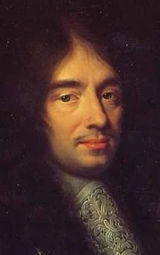
Charles Perrault
French writer in the 1600s who wrote fairy tales inspired by folk tales
“Father of fairy tales”
His version of Cinderella is most famous and inspiration (and different from Brothers Grimm version)
Popular stories and collections:
Little Red Riding Hood
Sleeping Beauty
Cinderella
Puss in Boots

Slide 7
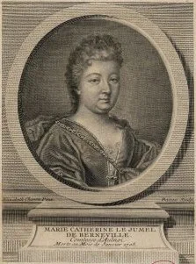
Marie-Catherine d’Aulnoy
French countess writer who published two fairy tale collections
Her 1697 collection created the term “fairy tale”
Not many of her versions are seen in modern fairy tales
Popular stories and collections:
Finette Cendron (like Cinderella)
Graciosa and Percinet (like Snow White)
The White Cat

Slide 8
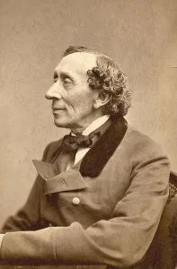
Hans Christian Andersen
Danish fairy tale writer from the 1800s
Many of his stories inspired modern versions
Probably most famous fairy tale author
Popular stories and collections:
The Little Mermaid
The Snow Queen
Thumbelina
The Ugly Duckling
The Princess and the Pea
The Steadfast Tin Soldier

Slide 9
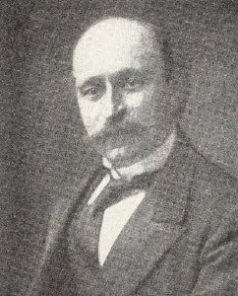
Joseph Jacobs
Australian folklorist
Several English fairy tale collections (some of the best know versions of fairy tales come from him)
Collected fairy tales from Jewish, Indian, and Celtic cultures too
Popular stories and collections:
The Three Little Pigs
Jack and the Beanstalk
Goldilocks and the Three Bears
Jack the Giant Killer
The History of Tom Thumb

Slide 10
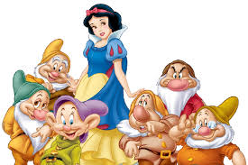
Disney Fairy Tale Version
We are going to watch a Disney version of a famous fairytale, Snow White
Purpose: to compare and contrast the Disney version with the original Brothers Grimm version
Analysis: why has the tale been Disney-fied?

Slide 11
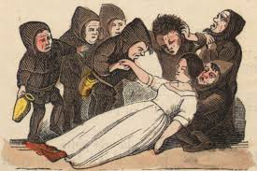
Brothers Grimm Version of Snow White
Today you will read the original Grimm version, Snow White
You will be creating a chart looking at the Disney version vs. the Grimm version
Things to include:
Similarities
Differences
Morals

Slide 12
Your Turn
We have watched a Disney version, and read an original version.
You are now going to select one of the original authors and read one of their original fairy tales
One fairy tale per student

Slide 13
Overall task
You are going to present the original fairy tale to the class in a 3-5 minute presentation including:
Name of fairy tale, author, date published
Summary of original fairy tale
Characters
Moral or lesson of the fairy tale
How this version differs from the Disney or modern version
Three visuals
Works Cited Page
Must be a PowerPoint/Google/Prezi presentation

Slide 14
Eva: Sleeping Beauty
Kody: Robin Hood
Liv: Frog Prince
Parker: Little Red Riding Hood
Kiana: Snow Queen
Isabelle: Emperor and the Nightingale
Amaya: Peter Pan
Alisa: The Little Match Girl
Raegan: Little Mermaid
Norah: Rapunzel
Bri: Cinderella
Shivani: Beauty and the Beast
Tomas: King Midas
Jenna: Ugly Duckling
Jack: Puss in Boots
Jamil: Goldilocks and Three Bears
Jack: Three Little Pigs

Slide 15
Modern Retelling
Taking your original fairy tale, you are going to retell the story
Things you can do:
Change the ending
Change the perspective
Create a new character
Create a new setting
Modernize the story

Slide 16
Requirements
750-1000 words
20 points in Culminating
Due 11/22 by 10pm

