Slide 1

Fairytale Archetypes
The Novel Unit

Slide 2
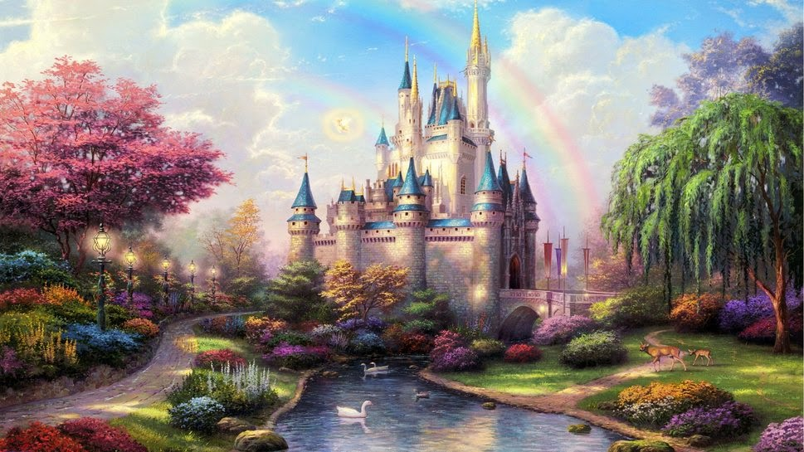
The Project
You and a partner (or you by yourself) will create a poster analyzing a traditional fairytale for archetypes and how that continues to be portrayed in modern society.
Archetype: a very typical example of a certain person or thing.

Slide 3
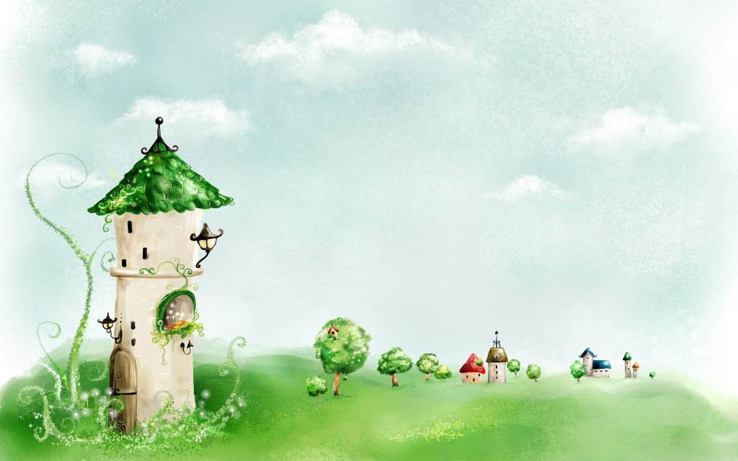

The Original Tale
Brief note about the author and context/history of the original tale
Briefly summarize the story with key plot points and characters
You may choose to do this in a list, a story arch, or any other creative format you wish.

Slide 4
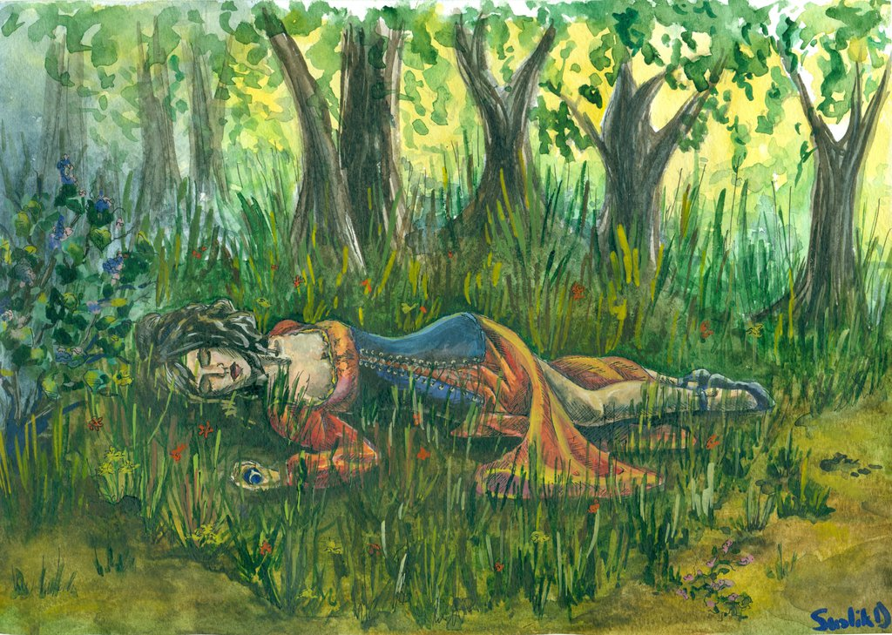
Literary Analysis
Themes (Remember a theme contains a verb: love conquers all is a theme; love is not.)
Symbols
Morals (Lessons)
Archetypes (Plot & Character)
  Sometimes referred to as Tropes & Stock Characters

Slide 5
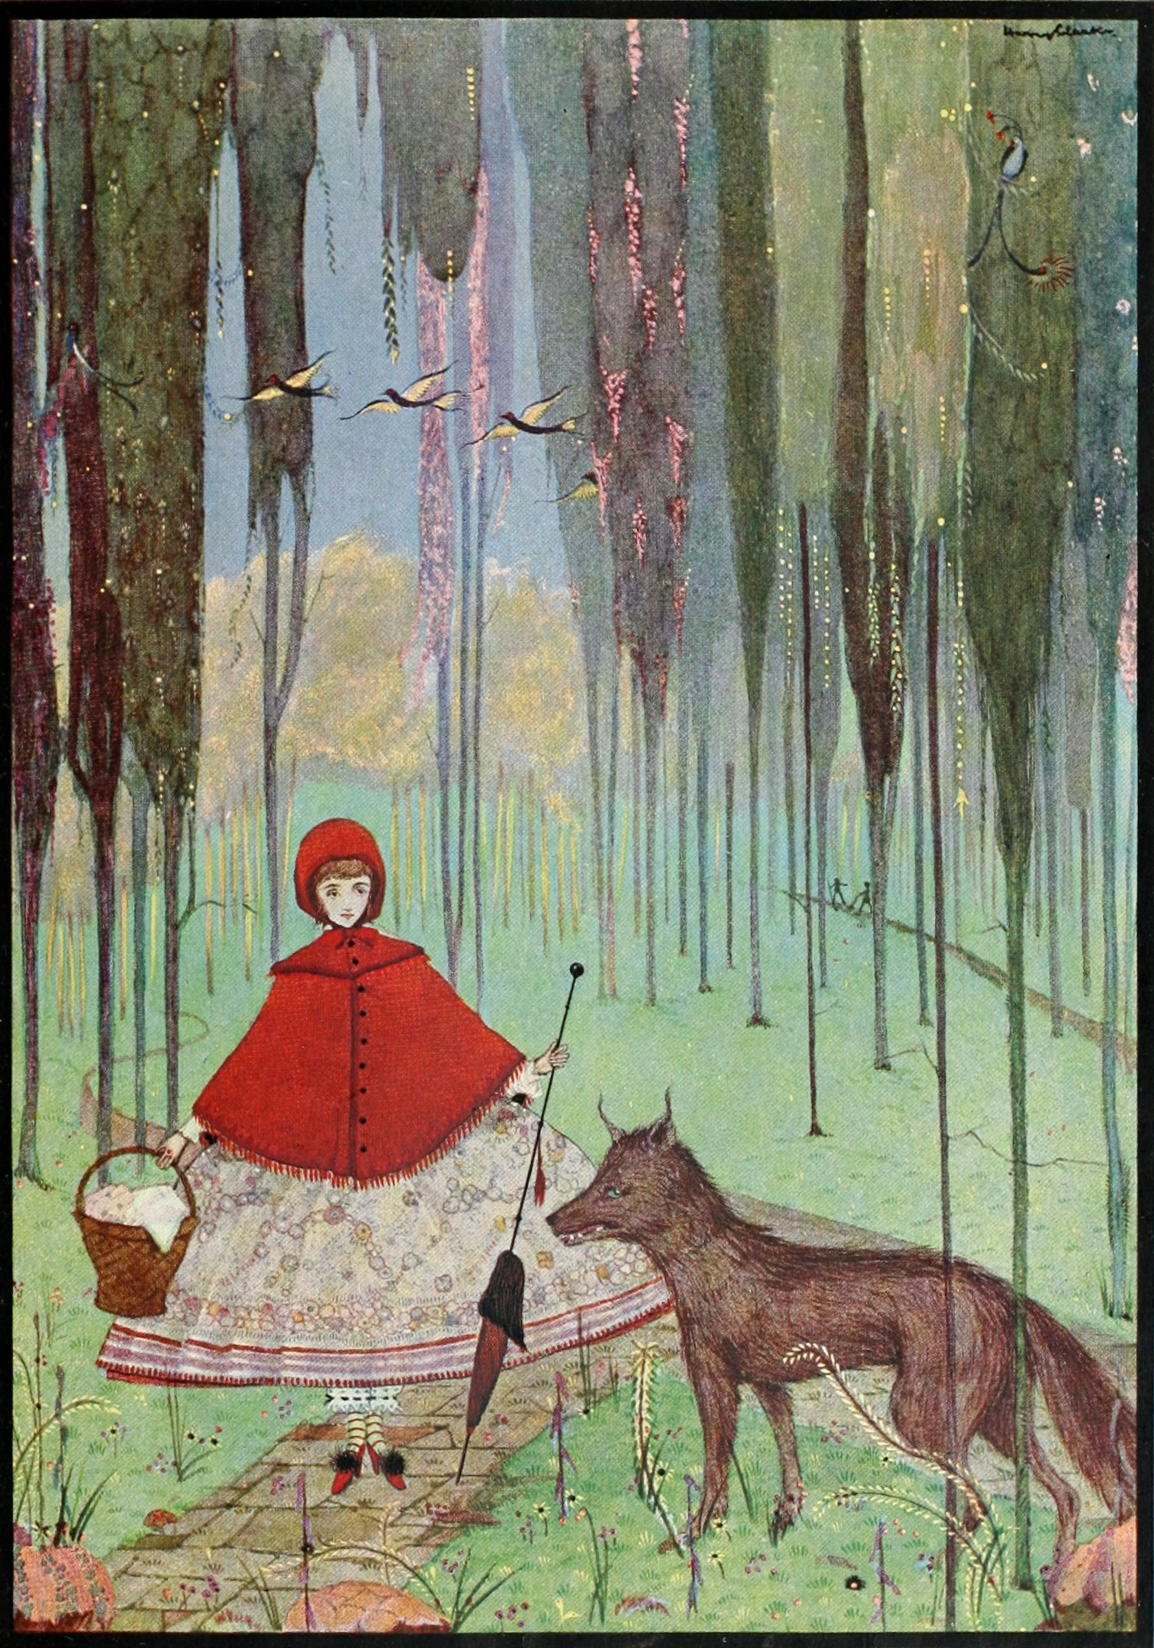
Modern Depictions in Media
Examples of Classic Faerie Tales:
Red Riding Hood
Rapunzel
Hansel and Gretel
Cinderella
The Brave Little Tailor
Snow White
The Princess and the Pea
The Little Mermaid
Thumbelina
Find TWO modern versions to share and comparatively analyze
  Think Easy A and The Scarlett Letter
Be creative, be thorough
Each faerie tale can only be used by one group though
You will have three work days in class for this. This project will be presented on Monday, November 7th (gallery walk)

Slide 6
Comparative Analysis
Find similarities and differences
Develop a thesis
Write a few paragraphs (with evidence) supporting your thesis

Slide 7
Group Selections
Cooper, Bryce: Little Mermaid
Emily, Sarah, Elaine: Rapunzel
Drew, Ryan: Snow White
Annie, Alex, CJ: Cinderella
Sarah, Madison: Little Red Riding Hood
Izzy, Alex: Hansel and Gretel
Emily, Alysse: Sleeping Beauty
Tyler, Jack: Jack and the Bean Stalk
Jack, Luke: Goldilocks and Three Bears
Claire, Sara: Beauty and the Beast
Paul, Spencer: Thumbelina
Gina, Olivia: Pinocchio
Noelle: Snow Queen
Dustin, Lily: Rumpelstiltskin
KC, Trevor, Sophia: Peter Pan

