Slide 1
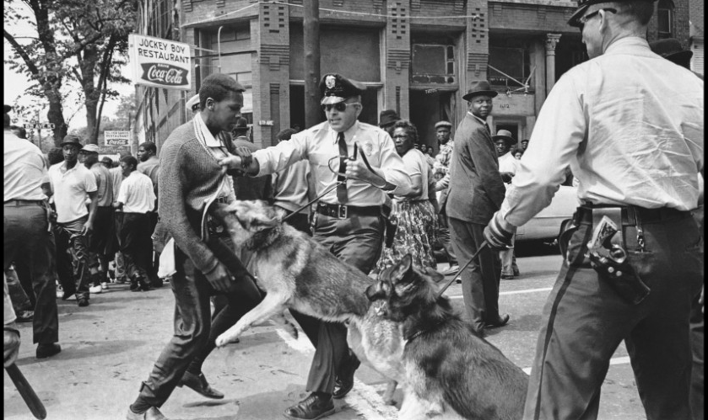
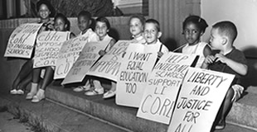
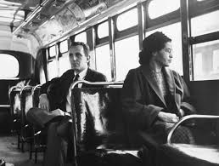
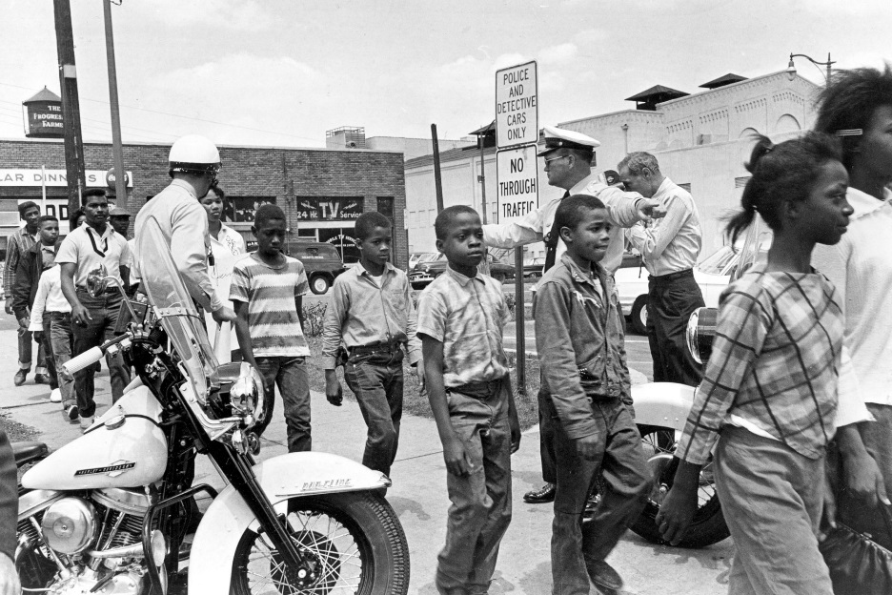
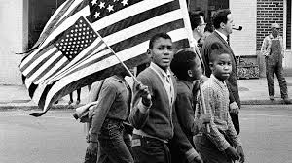
Civil Rights Movement

Slide 2
Essential questions
Appraise how speeches empower people. (power of words?)
Rank and defend the most effective form of protest.
Decide the message that inaction sends.
Conclude when it is time to take action.
Decide the power/role of the media.
To what extent did images/imagery change or help protests?

Slide 3
What are civil rights? “rights of citizens”
Protect individuals' freedom from unwarranted intrusion by governments/private organizations
Ensure one's ability to participate in the civil life of the state without discrimination or repression
Civil rights include:
The ensuring of peoples' physical integrity and safety
Protection from discrimination on grounds such as physical or mental disability, gender, religion, race, national origin, age, uniformed services, sexual orientation, or gender identity
Privacy, the freedoms of thought and conscience, speech and expression, religion, the press, and movement.

Slide 4
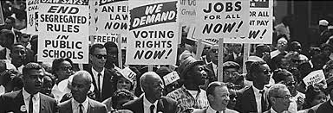
Leaders
MLK, Jr: brotherhood, uniting America, forgive white people, let go of bitterness and hate; bank of justice is not bankrupt
Angela Davis: unite all those oppressed by white Imperialism/American government, America is a war economy
Malcolm X: speaking to all African Americans (need to unite), 1964 is election year (ballot), blames government for oppression, civil rights to human rights, black Nationalism, any means necessary (bullet…could turn violent)
SPLC, NAACP, freedom riders, Rosa Parks, sit-ins, boycotts

Slide 5
Learning Targets
I can analyze Martin Luther King Jr.’s “Letter from a Birmingham Jail”.
I can determine the impact of the “Letter” on the Civil Rights Movement.
I can examine King’s value in the Civil Rights Movement.

Slide 6
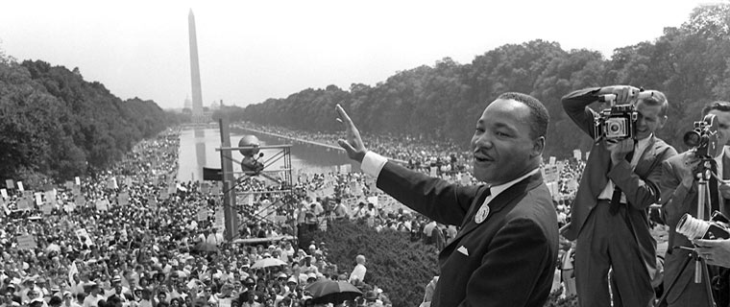
“Letter from a Birmingham Jail”
Recall what lead to the decision to start the protests in Birmingham.
Determine the four steps involved in King’s nonviolent campaigns.
Conclude what exactly King means by “nonviolent direct action”.
In King’s view, what is the difference between defying the law and breaking an ‘unjust’ law?
In what ways does King criticize the Church? What does he believe they are doing well? Could be doing better?

Slide 7
Learning Targets
I can analyze a poem to determine the value during the Civil Rights Movement.
I can determine author intent in poetry.

Slide 8
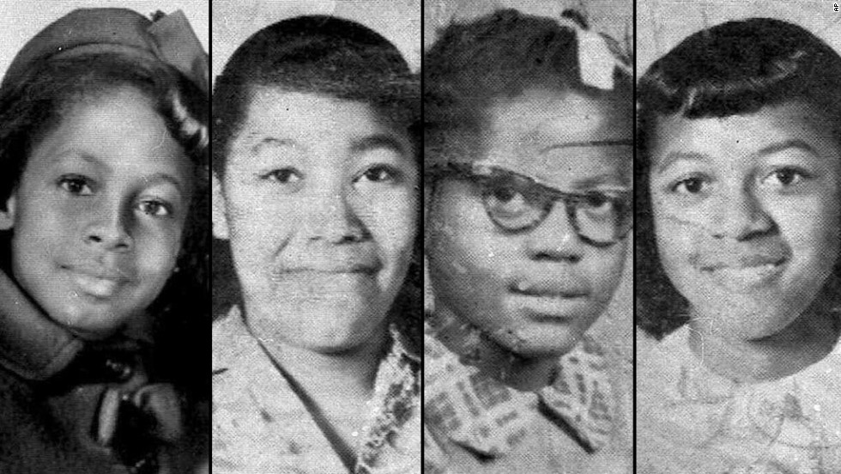
Dudley Randall
“Ballad of Birmingham” (1969) (Lit Book:1214-1215)
What happens to the child in the poem?
What is the mother’s primary interest or motivation? What is the child’s primary interest or motivation?
True story of 1963 bombing of MLK, Jr.’s church by white terrorists.

Slide 9
“Mother dear, may I go downtown
Instead of out to play,
And march the streets of Birmingham
In a Freedom March today?”
“No, baby, no, you may not go,
For the dogs are fierce and wild,
And clubs and hoses, guns and jails
Aren’t good for a little child.”
“But, mother, I won’t be alone.
Other children will go with me,
And march the streets of Birmingham
To make our country free.”
“No, baby, no, you may not go,
For I fear those guns will fire.
But you may go to church instead
And sing in the children’s choir.”
She has combed and brushed her night-dark hair,
And bathed rose petal sweet,
And drawn white gloves on her small brown hands,
And white shoes on her feet.
The mother smiled to know her child
Was in the sacred place,
But that smile was the last smile
To come upon her face.
For when she heard the explosion,
Her eyes grew wet and wild.
She raced through the streets of Birmingham
Calling for her child.
She clawed through bits of glass and brick,
Then lifted out a shoe.
“O, here’s the shoe my baby wore,
But, baby, where are you?”

Slide 10
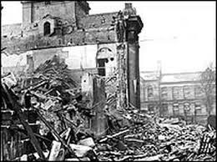
“Ballad of Birmingham” Table Questions
To what extent would this poem help the civil rights movement?
Is the child in the poem one of the South’s heroes? Why or why not?
Assess when action speak louder than words. Assess when words are better than action.
Determine what message inaction sends. When it is time to take action?

Slide 11
Learning Targets
I can analyze a poem to determine the value during the Civil Rights Movement.
I can determine author intent in poetry.

Slide 12
Task
You and a partner will visit the Poetry Foundation website (Civil Rights section)
Pick one of the poems (broken down by years)
For your poem (you may also use a pre-approved song):
Include the original poem (copy and paste it)
What is the meaning/message of the poem
Determine the value of this poem in the Civil Rights Movement
Who is the author (brief background)
Write two discussion questions
https://www.poetryfoundation.org/collections/146367/poetry-and-the-civil-rights-movement

Slide 13
Civil rights collage
Touching on ethos, pathos, and logos
Create a collage of the most powerful imagery and words from the civil rights speeches, events, and people that we have studied
Words: think of buzz words or phrases
Images: what imagery are the speakers using to convey their message
The collage should be a visual representation of the message of the Civil Rights Movement
Think about what the leaders were trying to achieve
Due Friday, April 26th

Slide 14
Learning Targets
I can analyze Angela Davis’ “The Liberation of our People” speech.
I can determine the impact of the speech on the Civil Rights Movement.
I can examine Davis and her value in the Civil Rights Movement.

Slide 15
Ethos, pathos, logos reminder…
Ethos: trustworthiness, reputation or credibility of the writer or speaker. Convincing by the character of the author
Pathos: emotional appeal. Appeal to the audience's sympathies and imagination.
Logos: the clarity of the claim, the logic of its reasons, and the effectiveness of its supporting evidence

Slide 16
Angela Davis biography
Activist, scholar, and write who works to bring a voice to the oppressed
Born January 26, 1944 in Birmingham, Alabama
Grew up in Dynamite Hill (called that because of multiple bombings by KKK)
Grew up around prejudice and discrimination
Knew the four girls killed in Birmingham church bombing of 1963
Member of the US Communist Party until 1991
Briefly a member of the Black Panthers during Civil Rights Movement
Taught at University of California, Santa Cruz until 2008
Continues to lecture: race, criminal justice system, women’s rights
Co-chair of Women’s March in DC after Trump’s inauguration

Slide 17
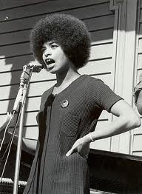
Angela Davis
“The Liberation of our People” speech
Need specifics from the speech to
answer each topic.
Determine the tone and style.
Explain how she uses ethos, pathos, logos.
Find five powerful words. Find five powerful phrases. What makes them powerful?
Determine Davis’ opinions of America (specifically white America).
What is her message and goal?
How can people achieve her goal?

Slide 18
Learning Targets
I can analyze speeches for ethos, pathos, and logos
I can determine the impact of the speeches on the Civil Rights Movement.
I can examine whether King or Malcolm X had a larger impact on the Civil Rights Movement.

Slide 19
Martin vs. Malcolm Debate
You will be reading MLK, Jr.s “I Have a Dream” speech, or Malcolm X’s “Ballot or the Bullet” speech as a way to:
Determine the message and technique of the speaker and leader
Determine which man was the more effective civil rights leader
Task:
Read the assigned speech, writing down what the message is, and what Malcolm X or MLK want African Americans and the general American population to do
On Friday: we will be having small group debates about which Civil Rights leader was more effective in using their speech to promote their message.
This is a speech analysis assignment, so take notes on their word choice, message, and ethos/pathos/logos.
You must have cited evidence!

Slide 20
Civil Rights timeline
Much like Martin Luther King Jr.’s march on Selma, the Civil Rights Movement was a long and arduous journey
Your group will be creating a timeline to track this journey
Things you need to include
Event/speech/person, etc.
Brief description of event (2-3 sentences max) and how it impacted the Civil Rights Movement
Angela Davis “The Liberation of Our People” speech
Malcolm X “Ballot or the Bullet” speech
Martin Luther King, Jr. “I Have a Dream” speech
Brown vs. Board of Education
Rosa Parks and refusing to move
Sit-ins at lunch counters and freedom riders
Selma marches
1963 MLK, Jr. church bombing
Civil Rights Act of 1964
Voting Rights Act of 1965
MLK, Jr. assassination
JFK assassination
John Lewis and SNCC
Any poem/song of your choice

Slide 21
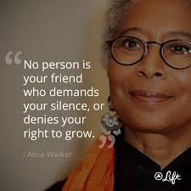
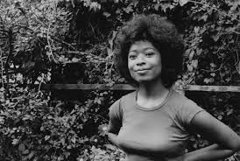
Alice Walker
Pulitzer Prize-winning, African-American novelist and poet most famous for authoring The Color Purple.
Walker was able to attend Spelman College in Atlanta (through scholarship), later switched to Sarah Lawrence College in New York.
Walker visited Africa as part of a study-abroad program. She graduated in 1965.
Very active during Civil Rights Movement

Slide 22
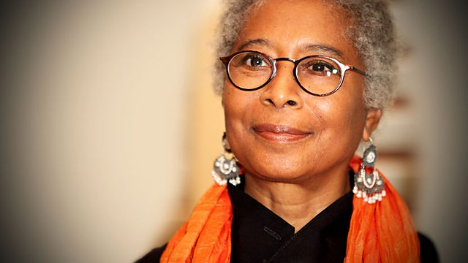
What Good was the Civil Rights Movement? –Alice Walker
“The Civil Rights Movement: What Good Was It?” paragraph reflection
Use evidence from Walker’s essay
Must integrate at least one quote
Keep in mind focus on the “good” for African-Americans

Slide 23
Civil Rights Essay
Final assessment

Slide 24
11 Sentence Essay
Thesis statement sentence
BTS
One quote/fact
One analysis
BTS
One quote/fact
One analysis
BTS
One quote/fact
One analysis
One sentence conclusion

Slide 25
Prompt
Conclude who or what had the biggest impact on the Civil Rights Movement using evidence from the unit.

Slide 26
11 Sentence Essay
Thesis statement sentence
BTS
One quote/fact
One sentence analysis
BTS
One quote/fact
One sentence analysis
BTS
One quote/fact
One sentence analysis
One sentence conclusion
Conclude who or what had the biggest impact on the Civil Rights Movement using evidence from the unit.

Slide 27
Older files

Slide 28
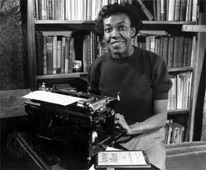
Gwendolyn Brooks
Read Brooks’ poem “Riot!”
Investigate the meaning of the poem
Define the allusions/references
Determine the emotions that she is conveying

Slide 29
Focus Questions
John Cabot: (Italian explorer, discovered parts of America) but also white man killed during Chicago riots. John Wycliffe: fought for separation of church and state in 1330s.
Determine why Gwendolyn Brooks uses these white figures? What is Brooks saying about white people?
Jaguar, Grandtully, Richard Gray, Distelheim, Maxim’s, Maison Henri.
What are they?
Investigate what including these says about white society?
Conclude how Cabot (main character) describes black society and the riots.
Why “It” and “blackness”?
Meaning of “que tu es grossier”?
To what extent is John Cabot a desperate man, and how would he “die expensively?
What is the “old averted doubt jerked forward”?
Meaning/significance of the last line? (“Lord….they do”)
What is the reference?

Slide 30
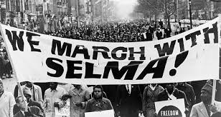
Selma
“Although the Civil Rights Act of 1964 legally desegregated the South, discrimination was still rampant in certain areas, making it very difficult for blacks to register to vote. In 1965, an Alabama city became the battleground in the fight for suffrage. Despite violent opposition, Dr. Martin Luther King Jr. and his followers pressed forward on an epic march from Selma to Montgomery, and their efforts culminated in President Lyndon Johnson signing the Voting Rights Act of 1965.”
Stars:
David Oyelowo (MLK), Carmen Ejogo (Coretta Scott King)
Oprah Winfrey (Annie Lee Cooper)
Tom Wilkinson (President Johnson)
Common (James Beval)
Dylan Baker (J. Edgar Hoover)
Tim Roth (Gov. George Wallace)
Nigel Thatch (Malcolm X)

Slide 31
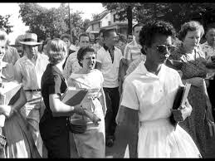
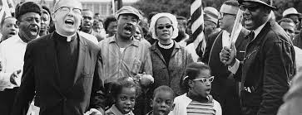
Civil Rights Jigsaw
So many African Americans impacted the fight for civil rights in America, but we do not have time to analyze every person or event
You will be reading about certain events, reading speeches, and analyzing the impact on the movement
You will each be assigned something different, and then will teach your group about your topic, focusing on the impact on the Civil Rights Movement

Slide 32
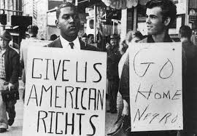
Topics
Angela Davis “The Liberation of Our People” speech
Malcolm X “Ballot or the Bullet” speech
Martin Luther King, Jr. “I Have a Dream” speech
Gwendolyn Brooks “Riot” poem
Rosa Parks and refusing to move
Sit-ins at lunch counters and freedom riders
Ruby Bridges and Brown vs. Board of Education
Selma marches
Civil Rights Act of 1964
Voting Rights Act of 1965

Slide 33
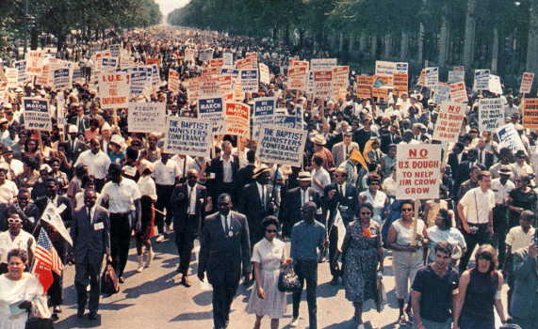
Prep work
Brief summary of event/person/literature/speech
Highlight key phrases, key things that happened during event, key rulings in court cases, etc.
Choose the key people. Brief biography of important figures.
Conclude the impact (MOST IMPORTANT PIECE)

Slide 34
1.Angela Davis “The Liberation of Our People” speech
2.Malcolm X “Ballot or the Bullet” speech
3.Martin Luther King, Jr. “I Have a Dream” speech
4.Gwendolyn Brooks “Riot” poem
5.Rosa Parks and refusing to move
6.Sit-ins at lunch counters and freedom riders
7.Ruby Bridges and Brown vs. Board of Education
8.Selma marches
9.Civil Rights Act of 1964
10.Voting Rights Act of 1965

Slide 35
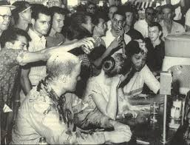
Jigsaw
Meet with groups, and share
your information on your topic
At the end:
Your group must decide who or what had the biggest impact on the Civil Rights Movement, what the impact was, and why they had the biggest impact.
You will submit a paragraph explanation justifying your chosen event or person with evidence

Slide 36
Group Task
Write down everything you know about the Civil Rights Movement
People
Events
Places
Results
Laws
EVERYTHING

Slide 37
What makes a speech strong?
Know your audience; catch their attention, don’t let it go
No ‘aah’ and ‘umms’ (fillers)
Message: clear, concise, helpful
Speaker cares about message, makes audience care about message
Repeat crucial points, buzzwords
Use previews and summaries
Short, simple sentences
Call to action
Touch on ethos, pathos, logos

Slide 38
Silent board talk
You will have 10 minutes to prepare your answers on the table posters
Need cited evidence from the poem
You will then have 10 minutes to respond to the questions on the boards around the room.
Remember: this is a table group board talk…no talking or socializing with other groups

Slide 39
Martin vs. Malcolm
You will be reading MLK, Jr.s “I Have a Dream” speech, and Malcolm X’s “Ballot or the Bullet” speech as a way to:
Determine the message and technique of each speaker and leader
Determine which man was the more effective civil rights leader
Task:
Read each speech, writing down what the message is, and what each man wants African Americans and the general American population to do
On Tuesday: we will be having a graded class discussion about each leader, which is more effective, and their overall contribution to the movement (you can use DBQ as a resource too)

Slide 40
Angela Davis
The Liberation of our People speech
Need specifics from the speech to
answer each topic!
Tone and style?
Explain how she uses ethos, pathos, logos.
Find five powerful words. Find five powerful phrases. What makes them powerful?
What are her opinions of America (specifically white America)?
What is her message and goal?
How can people achieve her goal?

Slide 41
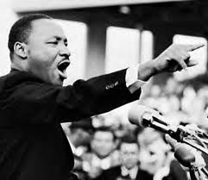
Martin Luther King, Jr.
I Have a Dream speech
Need specifics from the speech to answer each topic!
Find five powerful words AND find five powerful phrases. What makes them powerful?
Characteristics of his speech?
Tone and style?
What is his message and goal?
How does he believe people can
achieve his goal?

Slide 42
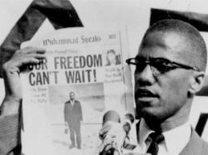
Malcolm X
Ballot or the Bullet
Need specifics from the speech to answer each topic!
Tone and style?
Find five powerful words AND find five powerful phrases. What makes them powerful?
What is his vision for America? For the African American community?
What is his message and goal?
How can people achieve his goal?

Slide 43
Socratic Seminar
We will be having a Socratic Seminar on March 24th as your assessment for the Civil Rights unit.
You will be creating the potential questions.
Go to google form link on my website (home page) and list at least two potential Socratic seminar discussion questions (put your name too)
https://docs.google.com/spreadsheets/d/1XDqch_y02IOmT46VP2_xFrt3gb9XrHfSMNYHbmOXDrE/edit?usp=sharing

Slide 44
Socratic seminar questions
Was the civil rights movement a result of the culture of the time or specific individuals in society?
Who or what events do you think made the greatest contribution towards the Civil Rights Movement?
Was Malcolm X right in preaching a violent approach to the Civil Rights movement? Was non-violence the best approach?
With everything that is happening in the media lately (Black Lives Matter), are we seeing a new Civil Rights movement emerging today?
What does "injustice anywhere is a threat to justice everywhere" mean? How could this be used to inspire the Civil Rights Movement?
What good was the Civil Rights Movement? Be specific.

Slide 45
Seminar Online Discussion Board
Why would people follow MLK vs. Malcom X?
What was the greatest impact of the Civil Rights Movement?
What situations call for violent protest over peaceful protest?
What was the most impactful civil rights movement group/person?
What was the most effective way to end segregation?

Slide 46
Socratic seminar reflection
After reading and analyzing speeches, poetry, and historical documents, studying figures and protests, and watching Selma; answer the following reflection question:
Was the Civil Rights Movement actually successful? Did the participants achieve their goals? Explain your reasoning.
This will go in the homework packet due Monday!

Slide 47
In-class work and homework
Read The Civil Right Movement: What Good Was It? by Alice Walker (under Civil Rights tab)
Answer in a paragraph: “What good was the Civil Rights Movement?” using evidence from the essay
Homework: Read Letters from a Birmingham Jail in English textbook (my.hrw.com, usernames are under my Forms and Docs tab) on pages 1204-1213

Slide 48
1950s/Civil Rights Homework Packet
Pleasantville viewing guide
American terms/critical reading (stamped)
McCarthyism prep work (stamped)
“What good was the Civil Rights Movement?” response (stamped)
MLK,, Jr./Malcolm X graded discussion prep work (stamped)
Black Panther paragraph (stamped)
Angela Davis Liberation speech notes and questions
Selma viewing guide

