Slide 1
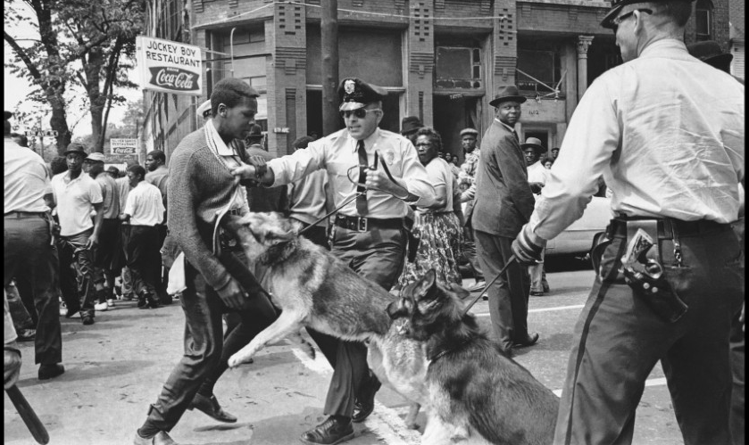
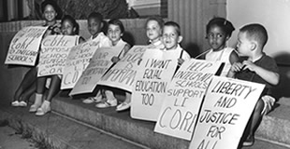
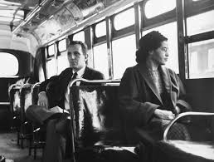
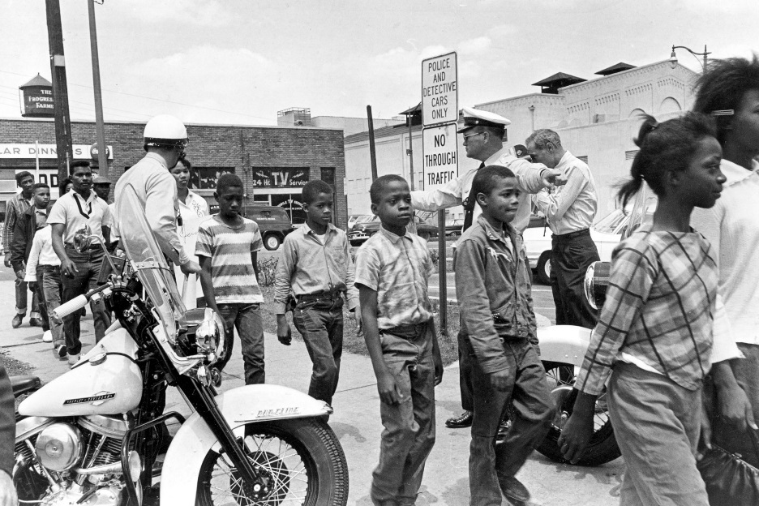
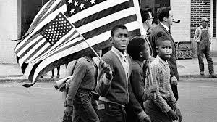
Civil Rights Movement

Slide 2
Essential questions
Appraise how speeches empower people. (power of words?)
Rank and defend the most effective form of protest.
Decide the message that inaction sends.
Conclude when it is time to take action.
Decide the power/role of the media.
To what extent did images/imagery change or help protests?

Slide 3
What are civil rights? “rights of citizens”
Protect individuals' freedom from unwarranted intrusion by governments/private organizations
Ensure one's ability to participate in the civil life of the state without discrimination or repression
Civil rights include:
The ensuring of peoples' physical integrity and safety
Protection from discrimination on grounds such as physical or mental disability, gender, religion, race, national origin, age, uniformed services, sexual orientation, or gender identity
Privacy, the freedoms of thought and conscience, speech and expression, religion, the press, and movement.

Slide 4
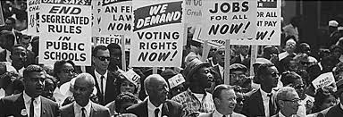
Leaders
MLK, Jr: brotherhood, uniting America, forgive white people, let go of bitterness and hate; bank of justice is not bankrupt
Angela Davis: unite all those oppressed by white Imperialism/American government, America is a war economy
Malcolm X: speaking to all African Americans (need to unite), 1964 is election year (ballot), blames government for oppression, civil rights to human rights, black Nationalism, any means necessary (bullet…could turn violent)
SPLC, NAACP, freedom riders, Rosa Parks, sit-ins, boycotts

Slide 5
Learning Targets 4/20
I can analyze a poem to determine the value during the Civil Rights Movement.
I can determine author intent in poetry.

Slide 6
“Mother dear, may I go downtown
Instead of out to play,
And march the streets of Birmingham
In a Freedom March today?”
“No, baby, no, you may not go,
For the dogs are fierce and wild,
And clubs and hoses, guns and jails
Aren’t good for a little child.”
“But, mother, I won’t be alone.
Other children will go with me,
And march the streets of Birmingham
To make our country free.”
“No, baby, no, you may not go,
For I fear those guns will fire.
But you may go to church instead
And sing in the children’s choir.”
She has combed and brushed her night-dark hair,
And bathed rose petal sweet,
And drawn white gloves on her small brown hands,
And white shoes on her feet.
The mother smiled to know her child
Was in the sacred place,
But that smile was the last smile
To come upon her face.
For when she heard the explosion,
Her eyes grew wet and wild.
She raced through the streets of Birmingham
Calling for her child.
She clawed through bits of glass and brick,
Then lifted out a shoe.
“O, here’s the shoe my baby wore,
But, baby, where are you?”

Slide 7
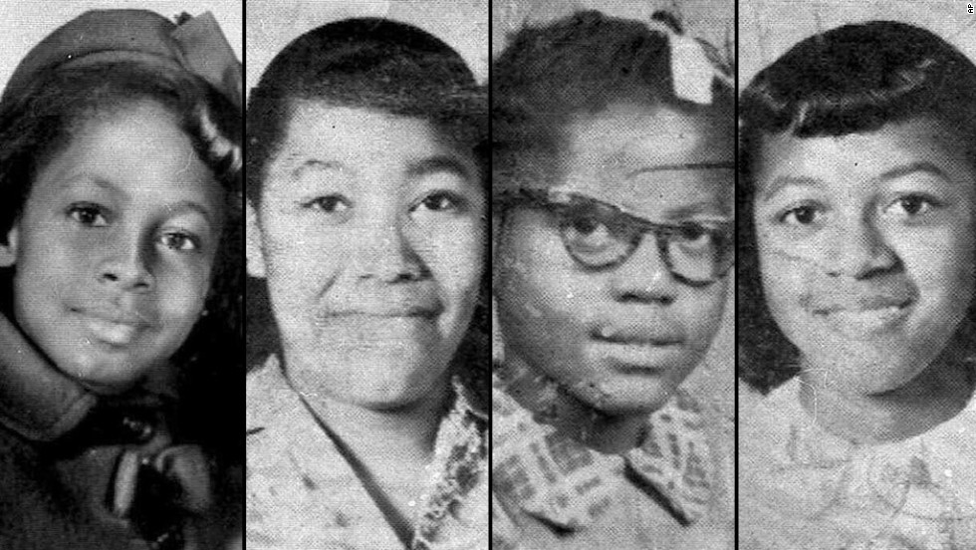
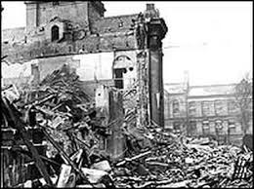
Dudley Randall
“Ballad of Birmingham” (1965)
True story of 1963 bombing of MLK, Jr.’s church by white terrorists.

Slide 8
“Ballad of Birmingham” Questions
Task: answer the following questions and submit to turnitin.com (Ballad of Birmingham Questions)
What happens to the child in the poem?
What is the mother’s primary interest or motivation? What is the child’s primary interest or motivation?
To what extent would this poem help the civil rights movement?
Is the child in the poem one of the South’s heroes? Why or why not?
Assess when action speak louder than words. Assess when words are better than action.
Determine what message inaction sends. When it is time to take action?

Slide 9
Learning Targets 4/21-4/24
I can analyze significant events, people, and organizations of the Civil Rights Movement
I can create a timeline

Slide 10
Civil Rights Timeline
Much like Martin Luther King Jr.’s march on Selma, the Civil Rights Movement was a long and arduous journey
You will be creating a timeline to track this journey
Things you need to include
Put the events in order of the date they happened
Event/speech/person, etc.
Brief description of event (2-3 sentences max) and how it impacted the Civil Rights Movement
Submit to turnitin.com by Friday, April 24th at 10pm
Angela Davis “The Liberation of Our People” speech
Malcolm X “Ballot or the Bullet” speech
Emmett Till murder
Martin Luther King, Jr. “I Have a Dream” speech
Brown vs. Board of Education
Rosa Parks and refusing to move, bus boycotts
Sit-ins at Woolworths lunch counters
Freedom Rides
Selma marches
1963 MLK, Jr. church bombing
Civil Rights Act of 1964
Voting Rights Act of 1965
MLK, Jr. assassination
JFK assassination
John Lewis and SNCC
Watts Riots
Little Rock Nine

Slide 11
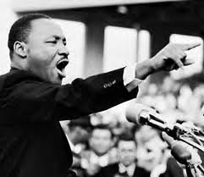
Learning Targets 4/27
I can analyze MLK, Jr.’s value during the Civil Rights Movement
I can determine the message of “I Have a Dream”

Slide 12
Ethos, pathos, logos reminder…
Ethos: trustworthiness, reputation or credibility of the writer or speaker. Convincing by the character of the author
Pathos: emotional appeal. Appeal to the audience's sympathies and imagination.
Logos: the clarity of the claim, the logic of its reasons, and the effectiveness of its supporting evidence

Slide 13
Martin Luther King, Jr. “I Have a Dream” speech
Need specifics from the speech to answer each topic! Submit to turnitin.com by 10pm 4/27 (MLK Speech)
Find five powerful words AND find five powerful phrases. What makes them powerful?
Summarize the speech in three sentences.
What is the overall tone and style of the speech?
What is his message and goal?
How does he believe people can achieve his goal?
How is MLK going to target more than African Americans with this speech?

Slide 14
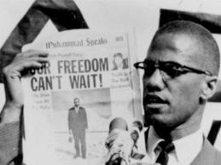
Learning Targets 4/29
I can analyze Malcolm X and MLK, Jr.’s value during the Civil Rights Movement
I can determine the more effective leader

Slide 15
MLK, Jr. and Malcolm X
In a paragraph or two, using evidence from the lessons and readings of MLK, Jr. and Malcolm X, answer the following prompt
Submit to turntin.com by 10pm 4/29 (MLK vs. Malcolm X)
Prompt: Determine which leader best lived up to their ideals or stood up for the rights of African Americans.

Slide 16
Learning Targets 4/30
I can determine the impact of the Civil Rights Movement.
I can analyze primary source documents.

Slide 17
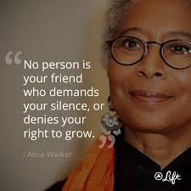
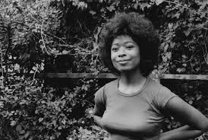
Alice Walker
Pulitzer Prize-winning, African-American novelist and poet most famous for authoring The Color Purple.
Walker was able to attend Spelman College in Atlanta (through scholarship), later switched to Sarah Lawrence College in New York.
Walker visited Africa as part of a study-abroad program. She graduated in 1965.
Very active during Civil Rights Movement

Slide 18
What Good was the Civil Rights Movement? –Alice Walker
“The Civil Rights Movement: What Good Was It?” paragraph reflection
Use evidence from Walker’s essay
Must integrate at least one quote
Keep in mind focus on the “good” for African Americans

Slide 19
Civil Rights Essay
Final assessment

Slide 20
11 Sentence Essay
Thesis statement sentence
BTS
One cited quote/fact
One analysis
BTS
One cited quote/fact
One analysis
BTS
One cited quote/fact
One analysis
One sentence conclusion

Slide 21
Prompt
Conclude who or what had the biggest impact on the Civil Rights Movement using evidence from the unit.
Due 5/4 at 10pm on turnitin.com

Slide 22
11 Sentence Essay
Thesis statement sentence
BTS
One cited quote/fact
One sentence analysis
BTS
One cited quote/fact
One sentence analysis
BTS
One cited quote/fact
One sentence analysis
One sentence conclusion
Conclude who or what had the biggest impact on the Civil Rights Movement using evidence from the unit.

