Slide 1
Character and Characterization

Slide 2
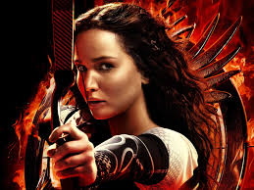
Terms
Characters are people that inhabit stories.
Protagonist--Major character at the center of the story.
Example: Katniss or Harry Potter
Antagonist--A character or force that opposes the protagonist.
Example: President Snow or Voldemort
Minor character--Often provides support and illuminates the protagonist
Example: Peeta/Gale/Haymitch or Hermoine/Ron/Hagrid

Slide 3
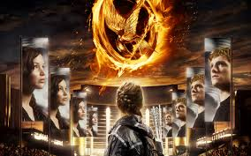
Terms
Static character--A character who remains the same.
Dynamic character--A character who changes in some important way.
A flat character is not fully developed; know only one side of the character.
A round character is fully-developed, with many traits--bad and good--shown in the story. We feel that we know the character so well that he or she has become a real person.

Slide 4
Relationships of Character
Character | Dynamic | Static
Round | Considered the best type of character development. Usually the protagonist. | Development is considered well-done. Often found in protagonists in books for younger children or in “epic” literature.
Flat | Characters cannot be dynamic and flat, because in a flat character we do not know enough about them for them to recognize a change. If a flat character seems to change, it is usually due to poor writing. | In very simple books, or in fairy tales, the protagonist may be flat and static. Also appropriate for minor characters in other books.

Slide 5
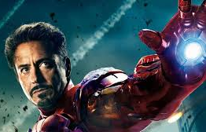
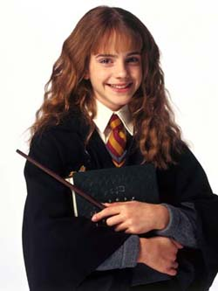
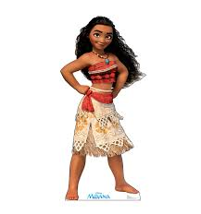
Quick Quiz: Where do these characters fit?
Character | Dynamic | Static
Round | Considered the best type of character development. Usually the protagonist. | Development is considered well-done. Often found in protagonists in books for younger children or in “epic” literature.
Flat | Characters cannot be dynamic and flat, because in a flat character we do not know enough about them for them to recognize a change. If a flat character seems to change, it is usually due to poor writing. | In very simple books, or in fairy tales, the protagonist may be flat and static. Also appropriate for minor characters in other books.

Slide 6
Characterization
Defies expectation- Avoids stereotype
For example:
Katniss is young and poor, yet defies everyone’s expectation by being so brave and skilled
Haymitch seems to be a jaded drunk, yet evolves into an inspirational leader and advocate

Slide 7
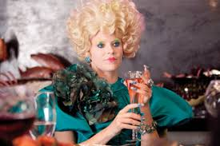
Characterization
Delivers relevant and interesting physical description such as…
Physical traits
Attire
Mannerisms-
Speech patterns
Yet, avoids “all points bulletin” style
Limit description to what relevant to plot
Something needs a reason to be noticed

Slide 8
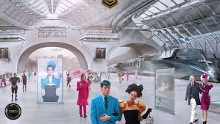
Characterization
Places character convincingly in environment
People tend to be either products or their environment or are defined in their opposition to it.
For example:
What do they do for a living? For Fun?
Goes hunting
How would they react to different places:
District 12, The Capitol, the game arena
What stuff do they have?
Ex. Crossbow and arrow
Where do they live?
District 12

Slide 9
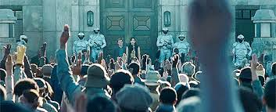
Characterization
Puts character in motion
Characters don’t just stand around to be described-
What are they doing? How are they doing it?
Example- Descriptions of the Hunger Games, and the players actions

Slide 10
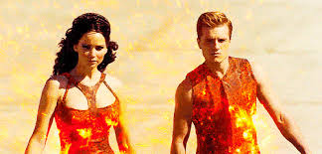
Characterization
Reveals the character’s inner world
Dreams, visions, memories, and thoughts
Gives us “two for one” descriptions of places, other characters, etc.- not only what they’re like but how our character feels about them.
Katniss with Peeta

Slide 11
Character

Slide 12
Table Discussion
What do you value most in a character?
As a table group, come up with a list of the top 5-7 things a ‘good character’ should have in a story
Who would you say is the ‘best character’ in film or literature, and why?

Slide 13
Film Analysis
We are going to be analyzing the film….
As you watch, you are going to take notes on one of the main characters:
Age, physical description, personality, history, family, friends, hobbies, dreams, hopes, etc.
Categorize that character: static, dynamic, round, flat
Justification for that categorization

Slide 14
Characters in literature
Who is your favorite literary character and why?
Describe the character
Short story analysis: describe that character in the story
What do we know?
What information is lacking or do we still want to know?
How does the information or lack of information shape the story?

Slide 15
Character dossier

Slide 16
Character dossier
You are going to create a character that you will eventually include in a short story
The first part of this is a character dossier
Dossier: a collection of documents about a particular person, event, or subject.

Slide 17
Need to include
Character name:
Gender:
Age:
Place of Birth:
Domicile:
Height, weight:
Eye color:
Hair quantity, texture, and color:
Unusual facial and bodily features:
Marital status:
Family relationships:
Pets:
Occupation:
Education:
Medical conditions:
Nervous habits:
Favorite clothes:
Goal (publicly proclaimed):
Obsession (public or private):
Sins:
Virtues:
Secret passion:
Main frustration and obstacle:

Slide 18
Illustration
Create an illustration of your character to go along with your character dossier from Monday

Slide 19
Choose one scene to write for your character (750-1000 words):

Slide 20
Option 1
Let your character go to the wrong event. He or she got the address wrong but has realized this after a good description of character and setting. By now, it’s too late. What is going on at the wrong party? Perhaps instead of a wedding, your character is at a wake; or instead of a wake, he or she is at a wedding; or instead of a support group, he or she is attending an annual fund-raiser. He or she feels very out of place at this event.
Make sure your character, setting, and event are original, unique, even quirky, but avoid too much weirdness (this isn’t science fiction). Use your imagination. Will you make this misunderstanding comic, tragic, or somewhere in between?

Slide 21
Option 2
Your character is in desperate need of an item which he or she may purchase at a convenient location. What is this store like (hardware, salon, grocery, pharmacy, nursery, antiques, shoes, art supplies)? However, the salesperson (or people) are less than helpful—in fact, he (or they) ignore your character. What are they doing instead? Your character does not want to explode in public rage, but becomes increasingly agitated due to the desperate need. What does he or she do? How does he or she get what is necessary? Provide enough frustration for your character to do something out of the ordinary for him or her (no M-16s or James Bond-like gadgets, please).

Slide 22
Option 3
Write about an event in the character’s family. Your event should be dramatic. Perhaps a disaster happens: the house burns down, someone is ill, a family member is a criminal. Or perhaps a lesser disaster happens: a fight at a celebration (wedding, graduation, anniversary, birthday), a holiday meal goes horribly awry, unresolved childhood tensions explode on a vacation. Be creative!

