Slide 1
70s-90s culture

Slide 2
“Hills Like White Elephants”
Ernest Hemingway
EMBRACE THE CONFUSION

Slide 3
Learning Targets
I can collaborate to determine a story meaning
I can respectfully engage in discussion
I can define 70s culture through the story

Slide 4
Let’s read it together!
Volunteers for reading:
The Narrator : You will read anything that is not dialogue.
Jig (the girl)
The American
A woman (the waitress)

Slide 5
Multiple Meanings for White Elephant?
A few possibilities…
White Elephant: The game where people pass around gifts that nobody wants.
White Elephant: revered and worshipped in India as sacred and something to be cherished.
The expression, “The Elephant in the Room”

Slide 6
What is absinthe?
Green colored drink with very high level of alcohol by volume that originated in Europe.
Banned in the US, France, Netherlands, Belgium, Switzerland, and Austria-Hungary by 1915 for “psychoactive properties.” Revival in 1990s in Europe. Legalized in the USA again in 2007.
Known for being mysterious, addictive, and “mind altering.” Reportedly, these cases of psychosis were over exaggerated.
Sweet taste with a bitter aftertaste…how does this represent the relationship we see in the short story?

Slide 7
Table Group Questions
Conclude what is literally happening in the story.
Determine the importance of what is not being said in the story?
Conclude the motivation/desire of the male character and the female character.
Determine the nature of their relationship. Use examples from the text to justify your response.
Can you think of any other stories or movies that address the issues discussed here? If so, how are they similar or different to “Hills Like White Elephants”?

Slide 8
Reflection Questions
What is the major conflict between the couple? What “procedure” is Jig going to possibly have? What’s the impact of Hemingway’s choice to not tell the reader this info directly?
Would you feel differently about the story if the roles of Jig and the man were reversed, that is, if Jig wanted the abortion and the man wanted her to marry him and keep the baby?
Should the father and mother have equal say when it comes to having an abortion? Does that fact that the woman’s body is involved, while the man’s is not, factor into your opinion?
Could the story be used to support a “pro-life” position? What about a “pro-choice” position?

Slide 9
Roe vs. Wade
Read the history.com summary of the Roe vs. Wade case
Keeping opinions of whether or not abortion should be legal, determine what the arguments are used for/against the government making laws to govern personal choice (issues such as abortion)
Class discussion after…

Slide 10
Environmentalism

Slide 11
Learning Targets
I can define environmentalism
I can define 70s culture through the story
I can determine why environmentalism exploded in the 70s

Slide 12
Environmentalism
Improve and protect the quality of the natural environment
New concern for the ecology of the human habitat
As a result of the space program, the energy crisis, scientific warnings about pollution and a future shortage of natural resources, the counterculture's back-to-the-earth movement.
1970 President Nixon signed the National Environmental Policy Act
required government agencies to assess the environmental impact of public projects
Notes:
Ecology: study of environmental systems, relationships between living organism

Slide 13
Environmentalism,
The Re-Vision of Planet Earth: Space Flight and Environmentalism in Postmodern America (William Bryant)
Reading excerpt: “Spaceship Earth”
Questions to answer individually (for participation packet)

Slide 14
Questions
Explain the environmental movement (purpose, goals).
To what extent did environmentalists think the environmental movement would be popular/successful?
Determine what a “cowboy economy” and a “spaceman economy” are.
Differences? Benefits? Reasoning/justification for each?
Explain the metaphor in the selection.
Conclude why the metaphor for environmentalism would be “self-defeating”.
Determine what metaphor you would use to describe environmentalism/environmentalists.

Slide 15
Feminism in the 1970s

Slide 16
Learning Targets
I can define feminism
I can explain why feminism is not about bringing down men
I can research influential feminist icons

Slide 17
Feminism
First Wave: 1850s- 1920s
Second Wave: 1950s-1970s
Third Wave: 1990s- Present

Slide 18
Feminism
“organized rage against real oppression”
re-examination of women's roles
National Organization for Women (NOW) in 1966 marked the formation of an official group to represent and campaign for women's concerns.
National Abortion and Reproductive Rights Action League
National Displaced Homemakers,
the battered women's movement,
the Women's Equity Action League,
Women Organized for Employment,
Women Office Workers.
Notes:
Ask what some feminism issues are

Slide 19
Things Women Could Not Do in the 60s
Get a credit card. A woman was not allowed to issue a credit card without the permit of her husband. In the case if an unmarried woman is requesting a credit card, a bank could refuse to issue it. The things got changed in 1974 once with the issue of the Equal Credit Opportunity Act that claimed that it was illegal to refuse a credit card to a woman based on her gender.
Get pregnant at work. Until the issue of The Pregnancy Discrimination Act from 1978, a pregnant woman could be easily fired for becoming pregnant
Get an Ivy League education. Yale and Princeton did not accept female students until 1969. Cornell University and the University of Pennsylvania started accepting women in 1870 and 1876, Harvard didn't admit women until 1977. Columbia started accepting women to high education at the beginning of 1981
Serve on a jury. The reason why women could not serve on a jury is that they have been seen in that period of time as housewives and home makers with the primary place at home. Women in 1950 - 1970s were just too fragile and dependent to men in order to undertake such serious jobs in that positions. The things got changed in 1973 when women could start serve in juries in around all 50 states of America.
Go on the birth control pill. In 1960, the pill was approved to be used as a legal contraceptive in some US states. Before that, women faced serious restriction when she decided to make an abortion due to the fact that terminating a pregnancy was seen as an illegal procedure against the state. Once with the approval of pill usage, the sexual revolution has begun. The opponents of the pill were arguing that legalization of pill will "promote prostitution". The pill was seen a long time as immoral when used by married women.
Experience equality in the workplace. Pregnant and working women from 1950s were fighting with a hard discrimination on the workplace. The Civil Rights Act from 1964 stated that it was illegal to discriminate on the basis of gender, or race women on the workplace. The provisions of this civil rights act forbade "discrimination on the basis of sex as well as race in hiring, promoting, and firing" .Two years later, the National Organization of Women (NOW) enforced full equality for women. In 1980, Equal Employment Opportunity Commission issued guidelines declaring sexual harassment a violation of sexual nature that constituted sexual harassment
Source: http://americanwomen20century.weebly.com/1950-1970.html

Slide 20
Feminism – 3rd Wave
Against ideas of “universal womanhood”, gender, sexuality and heteronormativity (basically belief in gender roles)
Reclaims lip-stick and high-heels that first two waves identified as male opposition.
Strong and empowered women, eschewing victimization, reclaiming words like “slut” and “bitch”
Ambiguous and refuse definition. Often even refusing to identify as “feminists”
Notes:
Ask what some feminism issues are

Slide 21
Feminism Readings
Read Gloria Steinem’s 'Women's Liberation' Aims to Free Men, Too
Questions about the reading
Focus:
Determine what it means to be a feminist.
Conclude if there is a correct way to be a feminist?
Then: pick one of the feminist icons on the next slide, and research them
What did they do? How did they fight oppression? How did society (men and women) view this person?
Add this to the bottom of your questions for the Steinem article, and print for Tuesday

Slide 22
Icons
Betty Friedan
Ruth Bader Ginsburg
Florynce Kennedy
Andrea Dworkin
Billie Jean King
Alice Walker
What did they do? How did they fight oppression? How did society (men and women) view this person?
Add this to the bottom of your questions for the Steinem article, and print for Tuesday
Marilyn Monroe
Janis Joplin
Mary Tyler Moore
Diane von Furstenburg
Gloria Steinem
Lucille Ball
Dear Abby letters
Bra burners
Bella Abzug

Slide 23
Discussion
How does Steinem define feminism and the feminist movement?
Share information about your selected feminist icon.
Determine if there is a right way to be a feminist.
Conclude who you would you consider the ‘best’ feminist icon.

Slide 24
Culture of the late 70s, early 80s

Slide 25
Learning Targets
I can use historical documents and primary sources to form an opinion
I can explain the change in family dynamics in the 1970s
I can determine what caused a change in culture

Slide 26
Assignment
Read two articles and a poem:
The Evolution of Divorce
Legitimation through Disaster: AIDS and the Gay Movement
“How to Watch Your Brother Die” (poem)
Will be formulating an opinion so take notes on the readings
Can use this as part of spring analysis in-class essay (details to come Thursday)
Debriefing readings on Thursday, and I will be stamping notes

Slide 27
Question to consider
Determine if the feminist/gay rights movement/AIDS epidemic/higher divorce rates caused the cultural shift of the 60s and 70s.
OR
Determine if the cultural shift of the 60s and 70s allowed for more openness, leading to feminism/gay rights movement/AIDS epidemic/higher divorce rates.

Slide 28
Reflection
To what extent was this cultural shift a good thing for America? Who benefited the most?
Determine if the cultural shift made Americans selfish.

Slide 29
“What They Carried”

Slide 30
Learning Targets
I can use historical documents and primary sources to form an opinion
I can explain the emergence of AIDS
I can participate in a class discussion
I can determine what caused a change in culture and a fear of gay men

Slide 31
“What They Carried”
Taken from Jameson Currier’s short story collection Dancing on the Moon: Short Stories about AIDS (1993)
Written after the death of one of his friends in the 80s
His blog:
http://jamesoncurrier.blogspot.com/2008/10/about-what-they-carried.html

Slide 32
Table Reading Questions
Conclude why Adam’s friends would be “upset and hurt” by his decisions? (pg 3)
To what extent did the friends feel “carrying their feelings inside” was necessary? (pg 4)
Explain the relationship between Adam and Danny. Adam and the rest of the men.
Explain what Danny carried. (Both literally and metaphorically) (pg 6-7)
Conclude what Adam is carrying (besides the disease).

Slide 33
Table Reading Questions
To what extent was it a good thing for Adam to plan for the future? Explain. (pg 10)
Why would Danny be concerned that Adam was “telling him things he told no one else”? (pg 10-11)
Determine why the author devoted a paragraph to when the friends cried. (pg 14-15)
“As Danny walked back to the apartment, the weight grew heavier; he couldn’t shake the thought of what he carried”. Explain. (pg 15)

Slide 34
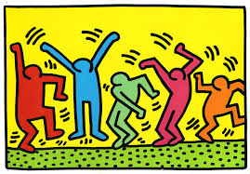
The AIDS Epidemic
Hysteria in 1980s America

Slide 35
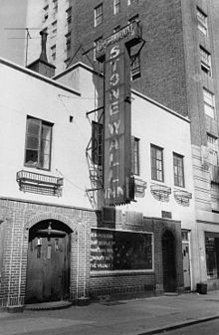
Stonewall: history around gay rights in America
Series of spontaneous, violent demonstrations by members of the gay community
Actions took place against a police raid early on June 28, 1969 at the Stonewall Inn in New York
Stonewall
Owned by the mafia
Catered to the poorest and most marginalized people in the gay community
Police raids were routine
Officers lost control, incited a riot
Within weeks Greenwich Village residents organized into activists groups
One year later (June 28, 1970) the first Gay Pride parades were held in NY, LA, San Francisco, and Chicago

Slide 36
AIDS Epidemic
First US appearance was in 1969, likely entered the US through a single infected immigrant
Originally identified as men with Kaposi’s Sarcoma, a cancer
GRID
Gay Related Immune Deficiency
Renamed AIDS in 1982
Played a pivotal role in the rollback of the sexual revolution
Fueled by misconceptions, fear, hatred
Reagan administration was criticized by many for dragging their feet on the issue due to homophobia
Did not mention it publically until 1985

Slide 37
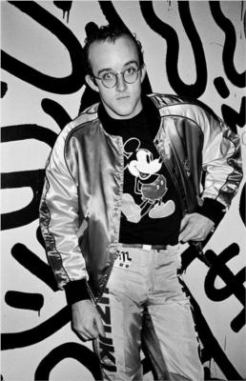
Keith Haring
1958-1990
Got his start in art by creating graffiti murals (pop art) in NYC subways
Later works addressed political and social themes; especially centered on homosexuality and AIDS
He criticized the avoidance of social issues such as AIDS through a piece called "Rebel with Many Causes“
Diagnosed with AIDS: 1987
How can art be used to criticize social issues?

Slide 38
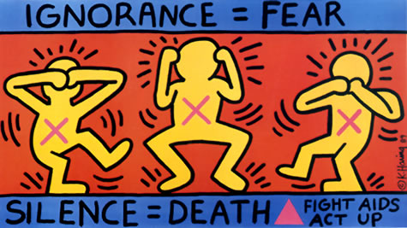

Slide 39
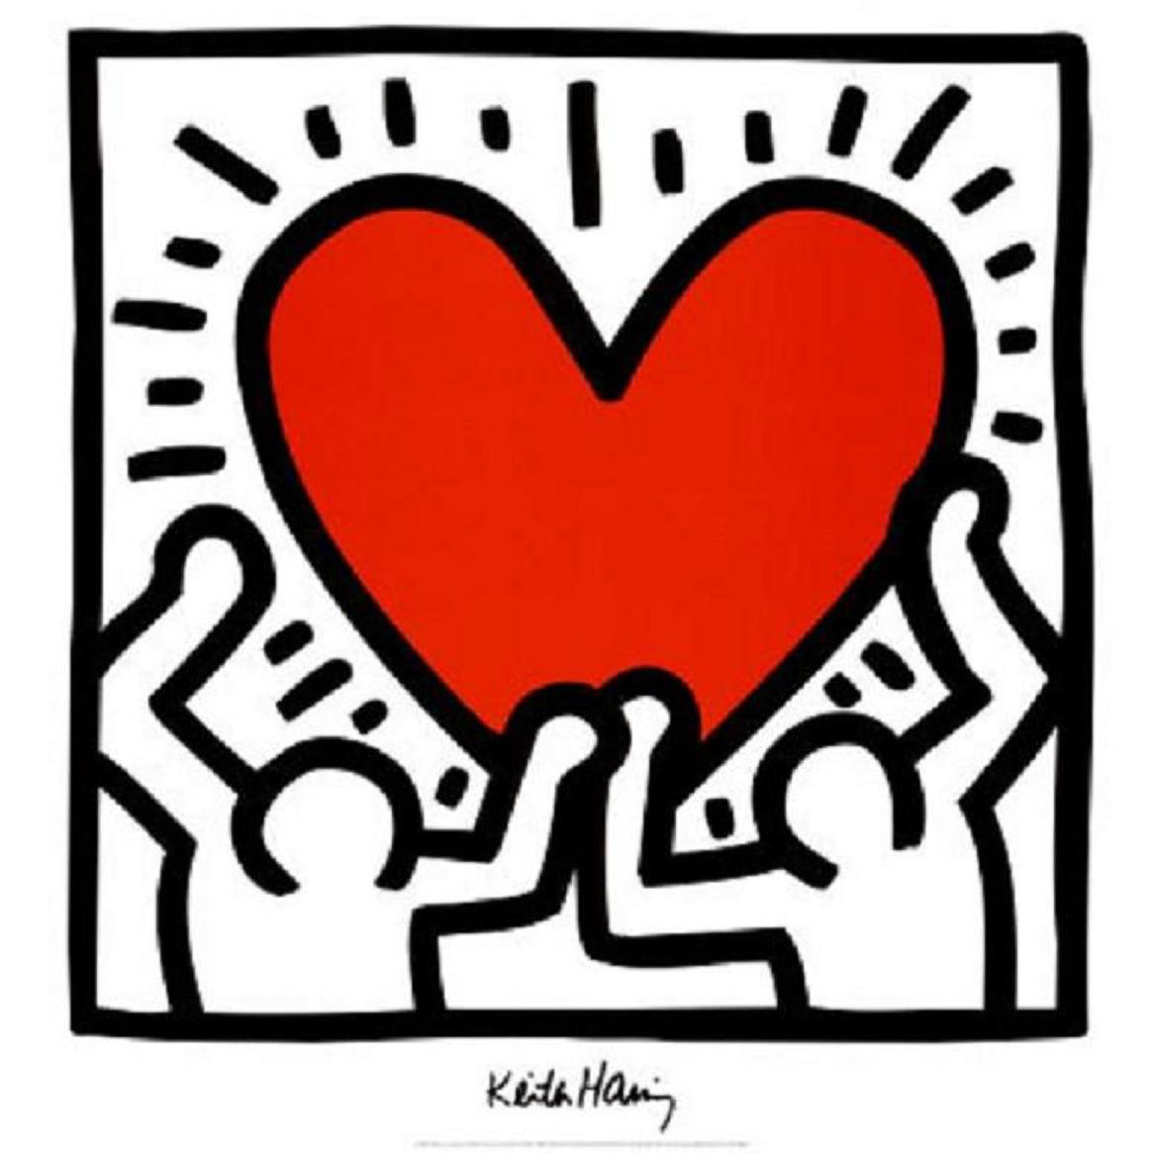

Slide 40
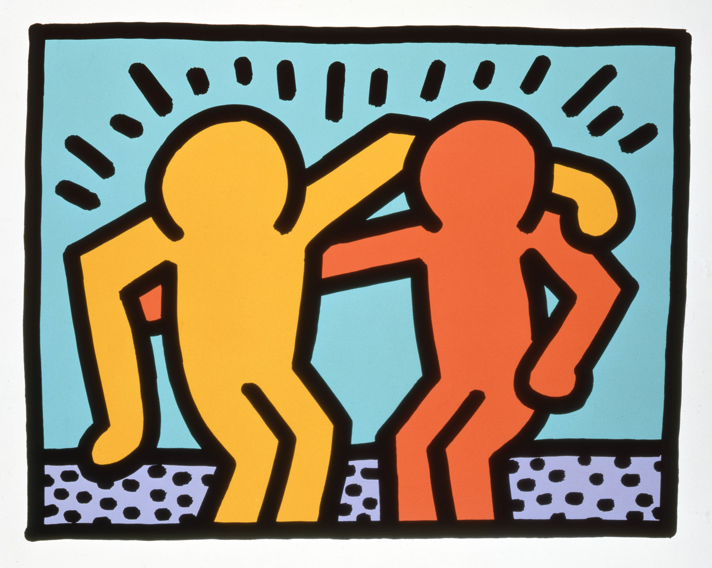

Slide 41
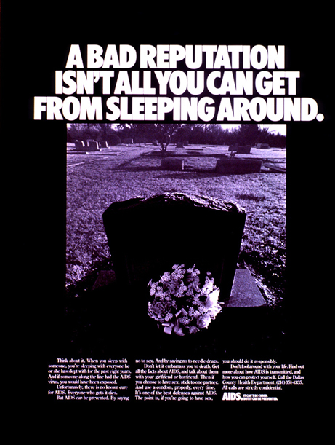
“AIDS is grim enough without exaggeration” NY Times 1987
Two epidemics
Real health epidemic
Epidemic of the mind
Which is worse for society? Why?

Slide 42
Choices in rhetoric
Fundamental question of public health
Do you spread information by scaring people?
Or do you do it by trying to tap into pleasure?
Or do you try to recognize and change a larger social structure?

Slide 43
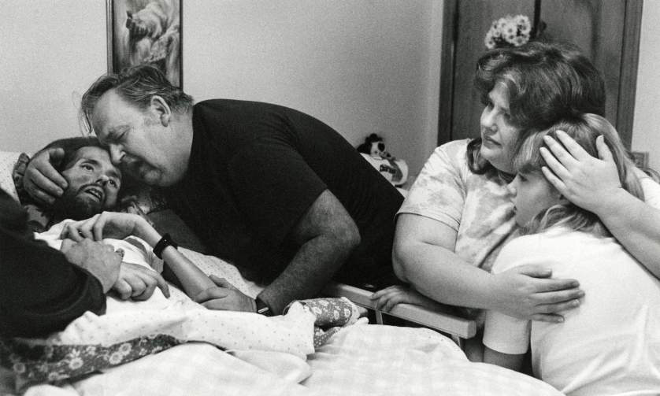
LIFE magazine
David Kirby
1990

Slide 44
LIFE Magazine 1990
Photo of David Kirby, surrounded by family, on his death bed
Kirby was gay rights activist
When diagnosed, he contacted family and said he wanted “to die with his family around him. The Kirbys welcomed their son back”
How would this going against the norm for society?
Photo taken by journalism student Therese Frare
She made no money on photo, purely used for social awareness

Slide 45
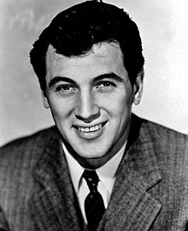
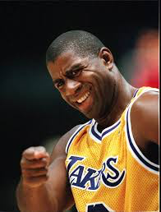
“AIDS kills…. Coming from the Wu, it’s real”
Importance of celebrity awareness
Wu-Tang Clan “America”: song about safe sex, not getting AIDS
Rock Hudson: “death gave AIDS a face”, increased funding for researching a cure
Ryan White: poster child for AIDS, got it after blood transfusion
Magic Johnson: HIV announcement in 1991
Sex Education programs
Who has the biggest impact around raising awareness?

Slide 46
Reflection Exit Ticket (Individual)
To what extent does our view of gay people have something to do with the AIDS epidemic?
Conclude why society ostracizes or marginalizes individuals who are different or do not conform to the ideals of that society.

Slide 47
Multiculturalism and the 80s-90s

Slide 48
Learning Targets
I can define multiculturalism
I can explain the difference between multiculturalism and the melting pot
I can collaborate and discuss, in a respectful manner, other cultures

Slide 49
Multiculturalism
Push for inclusion of distinct cultural groups with equal cultural and political status.
Old: Melting Pot Ideal
New: Multicultural Ideal
Accept and embrace differences

Slide 50
Today
You will be learning about multiculturalism in America, and how it shapes American culture
5-10 minutes to answer the questions
Brief discussion
South African lesson in American Literature

Slide 51
Questions to Answer
Define multiculturalism.
Conclude the benefits of multiculturalism.
To what extent does America (or do Americans) embrace multiculturalism?
What does an American look/sound/dress/act like? Determine if there is a correct way to talk/act/dress American.
Determine what proper English looks/sounds like. Why do we use slang words?

Slide 52
“Mother Tongue” (Amy Tan)
Define multiculturalism.
Author of The Joy Luck Club
About her mother’s struggle with speaking the ‘correct’ English
Literature books page 1264-1269 (15 min)
Questions that your table group needs to answer
One sheet per table group (list all names please)

Slide 53
Questions
Tan describes situations in which she was forced to act as a go-between for her mother. In what ways do these interactions differ from the typical mother-daughter relationship? Explain.
Describe Tan’s changing perceptions of her mother’s use of English, using evidence from the essay. What power does language hold? Did Tan change your views of language?
Tan claims that the language spoken at home is more influential, or shapes the individual more than the language spoken by peers. Do you agree or disagree? Explain.
What does proper English look/sound like? Why do we use slang words?

Slide 54
South African Slang
Cool—kif, lekker
BBQ—braai
Oh man—ag man
Ouch—ai na
Sweetheart—bokkie
My friend—my china
Hello—howzit
Male friend—bra
Idiot—domkop
Smack—klap
Stupid person—moegoe
"kicking, shooting and beating people up“— skop, skiet en donner

Slide 55
90s Music
Music as poetry

Slide 56
Homework Assignment
Select a song from the 90s that you think best exemplifies the decades
Due Tuesday, May 28th
Please print out the song lyrics (you cannot just have access on your phone or computer)

Slide 57
Table groups
Share the songs and lyrics with the people at your table group
Why did you choose this song? Why is it the best representation of the decade?
Pick the best song from each decade (and know why)
Activity you will do for each ‘best’ song

Slide 58
Literary Devices: As a table group
Look for: metaphor, simile, hyperbole, imagery, personification, rhyme
How do these contribute to the overall tone and mood of the song?

Slide 59
Analysis: As table group
What does the title of the song mean? Explain in detail.
Is it an appropriate title for the song? Explain.
What would you have titled the song? Why?
Contemporary issues represented in the song? Explain.

Slide 60
Reflection/Thesis
Based on the songs from the 90s, how would you categorize/describe the decade?
Are songs creators of social change or does social change result in songs?

Slide 61
90s
Cultural Study

Slide 62
Learning Targets
I can analyze primary source information.
I can examine the impact of events on the 90s.
I can evaluate long term impacts of events.

Slide 63
90s background
Pick one of the “90 Moments from the 90s”, then research that world event
What happened/what is your selected moment (think background)? Who was involved? Impact? How did this event shape the 90s? https://www.cnn.com/2017/07/05/world/gallery/90-moments-from-the-90s/index.html
WARNING: Some images are graphic

Slide 64
Older Files

Slide 65
Table Group Questions
Conclude what is literally happening in the story.
Determine the importance of what is not being said in the story?
To what extent is the male character admirable? What does he want? How do you know?
To what extent is the female character admirable? What does she have going for her? Explain with textual evidence.
Determine the nature of their relationship. Use examples from the text to justify your response.

Slide 66
Table Group Questions continued…
Explain why she looks with fascination at the fields and trees across the plain. Determine if her comment about the hills being like white elephants is silly or profound. Explain.
Conclude who you sympathize with more, the man or the girl? Explain.
Can you think of any other stories or movies that address the issues discussed here? If so, how are they similar or different to “Hills Like White Elephants”?

Slide 67
60s-90s culture
Cultural brochure

Slide 68
Cultural Brochure
Research one cultural event, person, fashion trend, film, literature, show, or music from the 1980-1990s .
Create a brochure for a person from 2100 to let them know what the topic is about:
Who, what, when, why, how?
Impact of topic?
Images to represent topic (at least five)
MUST BE IN YOUR OWN WORDS

Slide 69
Topics…
Doris Day
Mary Tyler Moore
Saturday Night Fever
Charlie’s Angels
The Godfather
Star Wars
Alfred Hitchcock
Paul Newman
HBO
Jackie Kennedy
Twiggy
Cher
Diane von Furstenburg
The mini skirt
The bikini
Polyester
Bell bottoms
Platform shoes
Haight Ashbury
Jane Fonda
Atari 2600
Payola
Blondie
Donna Summers
Diana Ross
Stevie Wonder
Joan Jett
The Beatles
Jimi Hendrix
The Beach Boys
Dick Clark/American Bandstand
Bob Dylan
Janis Joplin
The Byrds
The Grateful Dead
Andy Warhol
Mark Rothko
Roy Lichtenstein
Willem de Kooning
David Smith
Donald Judd
Ansel Adams
Kurt Vonnegut
Betty Friedan
Muhammad Ali
Marvin Gaye
BeeGees
Led Zepplin
ACDC
Rush
Whitney Houston
Clueless

Slide 70
Ronald Reagan
George H.W. Bush
Oliver North
Patient Zero (Gaetan Dugas)
Ryan White
Karl Rove
Christian Coalition
Parents Music Resource Center (PMRC)
Matthew Shepard
TV Evangelism
E.T.
Titanic
First Blood
Raging Bull
Raiders of the Lost Ark
Do the Right Thing
Back to the Future
The Personal Computer
Mobile telephone
Compact discs
Hubble Telescope
Internet
Nintendo
Tiger Woods
Michael Jordan
Bo Jackson
Pete Sampras
Andre Agassi
Florence Griffith-Joyner
Mary Lou Retton
Cabbage Patch Kids
New Coke
Mir Space Station
AIDS
Exxon Valdez Oil spill
Doc Martens
Jurassic Park
Forest Gump
Quentin Tarantino
The Terminator
The Lion King
Bill Clinton
The Simpsons
Operation Desert Storm
L.A. Riots
Clinton Impeachment
Oklahoma City bombing
Columbine
Miracle on ice
1984 Olympic Games
1994 Soccer World Cup
1992 Olympic Dream Team
Challenger Space Shuttle
Mt. St. Helens
Iran Hostage Crisis
Assassination attempt on Ronald Reagan
Assassination attempt on Pope John Paull II
Challenger
Persian Gulf War
Fall of the Berlin Wall
Bon Jovi
Walk This Way
MTV
The Message
LL Cool J
Michael Jackson
Thriller
Whitney Houston
Video Killed the Radio Star
We are the World
Pearl Jam
Nirvana
Gangsta rap
Madonna
Weird Al Yankovic
Backstreet Boys
*NSYNC

Slide 71
90s Culture project

Slide 72
90s-2000s project
Tracing TV show, song, personality, movie roots
Think: how did ___ show/film/personality come to be? What happened in American history to ‘allow’ this to happen?
Feminism, gay rights, self-expression, multiculturalism, general social issues, divorce, media, marriage dynamics
Visually represent the roots
Mind web, illustration, graphic, collage
One group per topic
Groups of 2-3

Slide 73
Ideas
Real World
FRIENDS
Will and Grace
Ellen
Arsenio Hall
Fresh Prince
The Daily Show
My So Called Life
Family Matters
TLC
Christina Aguilera
American Idol
Spike Lee
Mean Girls
Philadelphia
The Truman Show
Million Dollar Baby
Pearl Jam’s “Jeremy”
Rage Against the Machine
“American Idiot”

Slide 74
80s and 90s Music
Music as poetry

Slide 75
Homework
Select a song from the 80s and 90s that you think best exemplifies the decades
One from the 80s
One from the 90s
Bring in the printed lyrics for Monday (not just on your phone)

Slide 76
Table groups
Share the songs and lyrics with the people at your table group
Why did you choose this song? Why is it the best representation of the decade?
Pick the best song from each decade (and know why)
Activity you will do for each ‘best’ song

Slide 77
Literary Devices: As a table group
Look for: metaphor, simile, hyperbole, imagery, personification, rhyme
How do these contribute to the overall tone and mood of the song?

Slide 78
Analysis: As table group
What does the title of the song mean? Explain in detail.
Is it an appropriate title for the song? Explain.
What would you have titled the song? Why?
Contemporary issues represented in the song? Explain.

Slide 79
Reflection/Thesis
Based on the songs from the 80s and the 90s, how would you categorize/describe the two decades?
Are songs creators of social change or does social change result in songs?

Slide 80
Social media in culture
Table group then whole class discussion:
How does social media effect literacy and written communication? Personal expression?

Slide 81
Homework
Either print or use your phone to bring in the following on my website for tomorrow
“The Evolution of Divorce”
“Legitimization through Disaster: AIDS and the Gay Movement”
“How To Watch Your Brother Die” (poem)
We will be reading them during class on Tuesday, and preparing for a graded class discussion and reflection on May 14th.

Slide 82
Australian Slang
Aussie Slang
Strine - Aussie Slang
Arvo - Afternoon
Barbie - Barbeque
Bloke - Male
B.O.B (pronounced Bob) - Deodorant (stands for Body Odor Basher)
Maccas - McDonalds
Servo - Service Station
Sunnies - Sunglasses
Uni - University
Ta - Thank you
Thongs - Flip Flops
Chook - Chicken
Cockie - farmer, cockroach, or cockatoo
Joey - Baby Kangaroo
All Blacks - The New Zealand Rugby Team

