Slide 1
1950s
Conformity vs. Counterculture

Slide 2
Essential Questions
Was conformity something people wanted, or did they feel obligated to conform? (choice vs. force)
What role did gender and age play in the 1950s?
How did people use fear to force conformity?
What is the ideal 50s family? What is the real 50s family?

Slide 3
Pleasantville
What were the family values of the 1950s? What were the roles of each of the family members?
What was valued most in society during the 1950s?
What were some key traits of the ideal 1950s man/woman?
What commentary is the movie making about conformity?
Why does the movie change from black and white to color?
David claims the people “are happy like this”. Do you think the people of the 1950s were really happy? Explain with evidence from the film.
Why did people resist change in the 1950s?
What does the trial scene remind you of? Why?
What does the last scene mean?

Slide 4
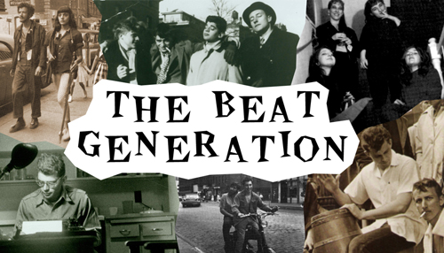
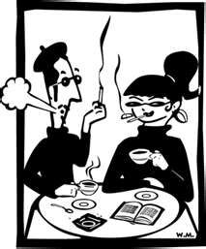
The Beats and the Beat Movement
1950s

Slide 5
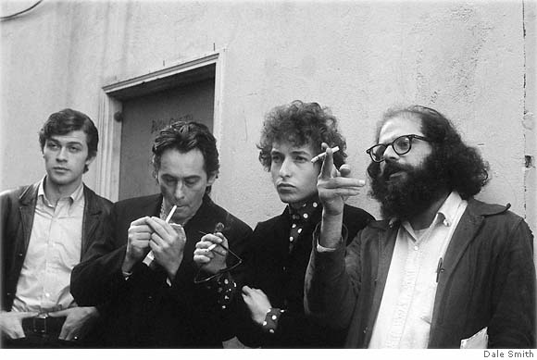
The Beat Generation
“the only people for me are the mad ones, the ones who are mad to live, mad to talk, mad to be saved, desirous of everything at the same time, …[who] burn, burn, burn like fabulous yellow roman candles exploding like spiders across the stars.” -Jack Kerouac (On the Road)

Slide 6
The Beats
Bohemian
The practice of an unconventional lifestyle
Celebrated non-conformity and spontaneous creativity
Focus on performance, which later inspired ‘Slam Poetry’
Drew a lot of inspiration from Romanticism
Thoreau, Emerson, Whitman, Poe, Dickinson

Slide 7
Founders
Allen Ginsberg (1926-1997)
Howl, America
Mostly Poetry
Opposed militarism, materialism and
sexual repression
Jack Kerouac (1922-1969)
On the Road (1957)
Buddhism, Catholic spirituality, jazz, drugs, sexuality and travel
Wanted to write ‘the next Great American Novel’
William S. Burroughs (1917-1997)
Naked Lunch (1959)
Almost predicted future (AIDS, crack pandemic, liposuction)
Semi-autobiographical work
Former heroin addict, traveler, convicted of manslaughter (wife in 1951), depression
Novels, novellas, short stories, essays

Slide 8
Gary Snyder
The “Thoreau of the Beats”
Rural background & wilderness experience
Moved to Japan, Zen Buddhism
Met in New York City, ended up in San Francisco in the mid-1950s
Name was coined by Kerouac, dual meanings of both being “tired” or “beaten down” and “upbeat” “beatific”
This was directly in response to a casual conversation about Fitzgerald and the Lost Generation of the American 1920s
Largely middle-class, white, definitely a ‘boys club’
PNW (!!)
Kerouac spent a bunch of time in the North Cascades
The Dharama Bums
On the Road
Reed College (Portland, OR)

Slide 9
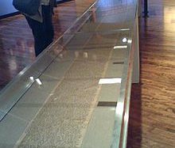
Scroll of On the Road

Slide 10
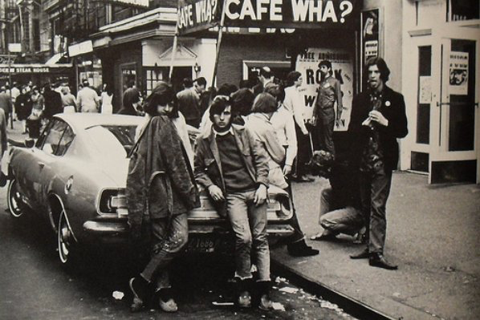
Important Places
Columbia
Greenwich Village
San Francisco

Slide 11
What?
Counterculture movement
Non-conformity and spontaneous creativity
Nuclear family, ideas of home/house
Term ‘beat’ from Kerouac
Meaning tired or beaten down
Also: upbeat
Characterized by drug use, sexuality, liberal, bohemian
Interested in changing consciousness and defying conventional writing

Slide 12
Characteristics of the Beat Culture
Rejection of received standards
Innovations in style
Use of illegal drugs
Alternative sexualities
An interest in examining religions
A rejection of materialism
Explicit portrayals of the human condition

Slide 13
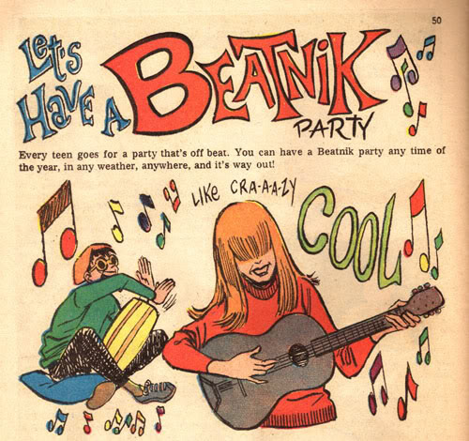
Beatniks
The name suggested that Beats were
Far out of the mainstream society
Possibly pro-Communist
Used as a new stereotype
Man with a goatee and a beret reciting nonsensical poetry and playing bongo drums
Became satirized and appeared in cartoons, movies, etc.
Some original Beats embraced the beatniks stereotypes, though many criticized them as inauthentic poseurs
Original hipsters?
Later became Hippies

Slide 14
Legacy & Impacts
The Obscenity Trials
Lawrence Ferlinghetti arrested for distributing Howl in 1957
In the 1960s elements of the Beat movement were incorporated into the hippie and larger counterculture movements
Spiritual liberation
Sexual revolution (or liberation)
Demystification and/or decriminalization of marijuana
Evolution of rhythm and blues into rock and roll as a high art form (Bob Dylan, the Beatles, Janis Joplin, The Grateful Dead, The Rolling Stones, etc.)
Spread of ecological consciousness
Opposition to the military-industrial machine civilization

Slide 15
Causalities of the Beats
“Kerouac was a casualty too. And there were many other casualties that most people have never heard of, but were genuine casualties. Just as, in the 60s, when Allen and I for a period there were almost publicly recommending people to take acid. When I look back on that now I realize there were many casualties, responsibilities to bare.” – Gary Snyder
Much of the drug use that the Beats advocated for spiraled from an emphasis on opening creative spaces into a recreational dependence that bordered on (or outright was) dangerous

Slide 16
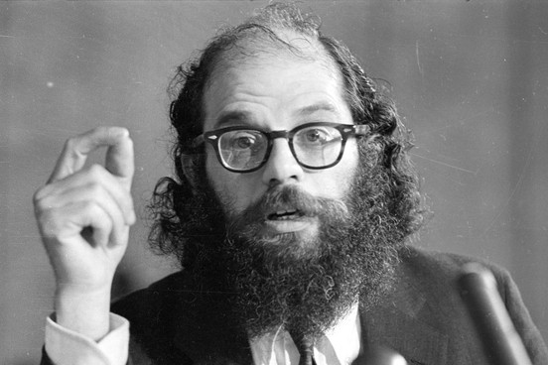
Allen Ginsberg

Slide 17
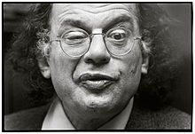
I saw the best minds of my generation destroyed by
madness, starving hysterical naked,
dragging themselves through the negro streets at
dawn looking for an angry fix,
angelheaded hipsters burning for the ancient
heavenly connection to the starry dynamo in the
machinery of night . . .
—Allen Ginsberg, “Howl”

Slide 18
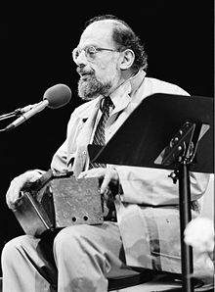
Allen Ginsberg (1926-1997)
Leading figure of beats
Howl, America
Styled after epic, free verse of
Walt Whitman
Work is biographical
Mostly poetry

Slide 19
Ginsberg Background
Spent a short period of time in a mental institution (Bellevue) after being accused of a crime (pled insanity, not guilt)
Father – high school English teacher in New Jersey
Mother – loyal Communist, battled mental illness throughout her life, attempted suicides
Gay, Jewish, no strongly-declared political affiliation (though definitely left-leaning)

Slide 20
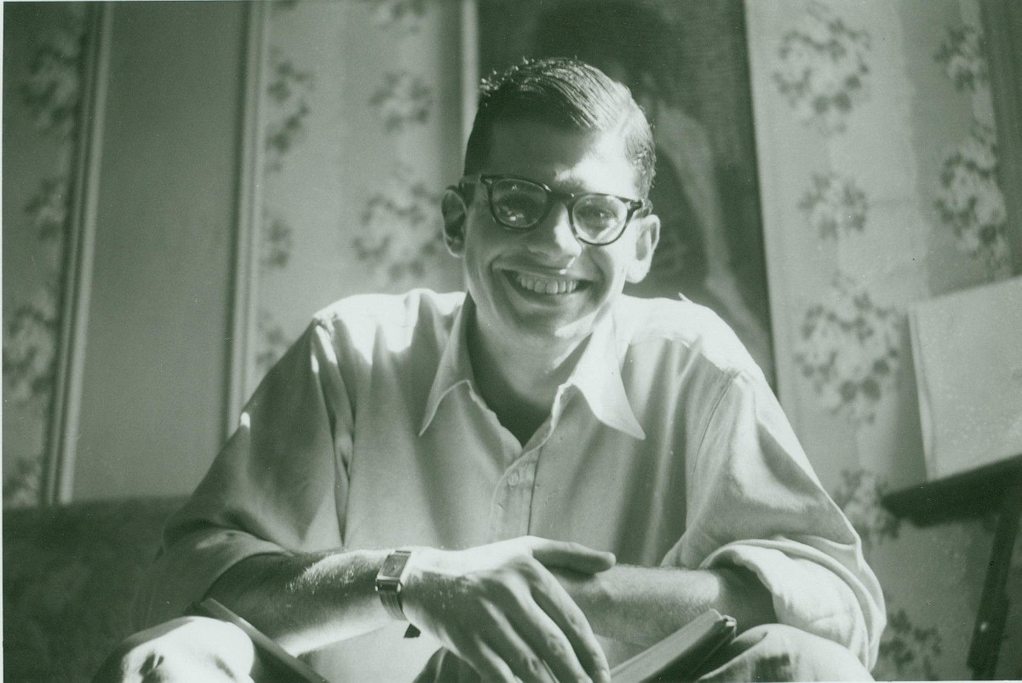
“America”
Written 1956, soon after the McCarthy Red Scare
Somewhat rambling, stream-of-consciousness
Political, and also personal

Slide 21
The Beats
You will be critically reading “America” (Ginsberg) to determine what exactly beat poetry is.
Anything underlined: historical allusion (look them up and write them on the poem as your critical reading assignment

Slide 22
Beats
How does Ginsberg feel about/describe America?
Characteristics of beat poetry?
If the beats were popular today, what social issues do you think they would write about?

Slide 23
“America”
Choose 6 historical allusions in the poem and explain EXACTLY what is being alluded to. This may take research – may use your cell phone.
After you have completed this, with a partner, rewrite the poem with new more modernly relevant allusions. EX: America when will you send your eggs to India becomes American when will you send your troops to Sudan.
Pick one line in the poem and analyze for theme
Turn in your poem/analysis with both names

Slide 24
Discussion Questions
Does this poem's focus on a past historical period, with all its historical references, make it less relevant to a modern audience?
Is the speaker more hopeful about the prospects for America's future? Or more pessimistic? How can you tell?
Based on his complaints and desires that we learn about in the poem, what, specifically, do you think the speaker plans on doing when he "[puts his] queer shoulder to the wheel”?

Slide 25
Writing you own beat poetry
To better understand the beats and their literature, you will be writing your own beat poetry
You will be writing a beat poem to share in small groups. You will have the rest of the period to prepare, and then will present them to small groups on Thursday. You will then pick the best from the group to share with the whole class (optional whole class sharing).
Minimum of 20 lines
Keep the subject matter school appropriate.
Follow the guidelines.
Review the Essentials of Spontaneous Prose by Jack Kerouac
http://www.writing.upenn.edu/~afilreis/88/kerouac-spontaneous.html

Slide 26
Guidelines
SET-UP The object is set before the mind, either in reality. as in sketching (before a landscape or teacup or old face) or is set in the memory wherein it becomes the sketching from memory of a definite image-object.
PROCEDURE Time being of the essence in the purity of speech, sketching language is undisturbed flow from the mind of personal secret idea-words, blowing (as per jazz musician) on subject of image.
METHOD No periods separating sentence-structures already arbitrarily riddled by false colons and timid usually needless commas-but the vigorous space dash separating rhetorical breathing (as jazz musician drawing breath between outblown phrases)--"measured pauses which are the essentials of our speech"--"divisions of the sounds we hear"-"time and how to note it down." (William Carlos Williams)
SCOPING Not "selectivity' of expression but following free deviation (association) of mind into limitless blow-on-subject seas of thought, swimming in sea of English with no discipline other than rhythms of rhetorical exhalation and expostulated statement, like a fist coming down on a table with each complete utterance, bang! (the space dash)-Blow as deep as you want-write as deeply, fish as far down as you want, satisfy yourself first, then reader cannot fail to receive telepathic shock and meaning-excitement by same laws operating in his own human mind.
LAG IN PROCEDURE No pause to think of proper word but the infantile pileup of scatological buildup words till satisfaction is gained, which will turn out to be a great appending rhythm to a thought and be in accordance with Great Law of timing.

Slide 27
Guidelines
TIMING Nothing is muddy that runs in time and to laws of time-Shakespearian stress of dramatic need to speak now in own unalterable way or forever hold tongue-no revisions (except obvious rational mistakes, such as names or calculated insertions in act of not writing but inserting).
CENTER OF INTEREST Begin not from preconceived idea of what to say about image but from jewel center of interest in subject of image at moment of writing, and write outwards swimming in sea of language to peripheral release and exhaustion-Do not afterthink except for poetic or P. S. reasons. Never afterthink to "improve" or defray impressions, as, the best writing is always the most painful personal wrung-out tossed from cradle warm protective mind-tap from yourself the song of yourself, blow!-now!-your way is your only way-"good"-or "bad"-always honest ("ludi- crous"), spontaneous, "confessionals' interesting, because not "crafted."
STRUCTURE OF WORK Modern bizarre structures (science fiction, etc.) arise from language being dead, "different" themes give illusion of "new" life. Follow roughly outlines in outfanning movement over subject, as river rock, so mindflow over jewel-center need (run your mind over it, once) arriving at pivot, where what was dim-formed "beginning" becomes sharp-necessitating "ending" and language shortens in race to wire of time-race of work, following laws of Deep Form, to conclusion, last words, last trickle-Night is The End.
MENTAL STATE If possible write "without consciousness" in semi-trance (as Yeats' later "trance writing") allowing subconscious to admit in own uninhibited interesting necessary and so "modern" language what conscious art would censor, and write excitedly, swiftly, with writing-or-typing-cramps, with "beclouding of consciousness." Come from within, out-to relaxed and said.

Slide 28
In summary
Continuous writing (for at least 15 minutes)
Don’t worry about grammar, punctuation, spelling, structure
Just write whatever comes to mind
Write like you are in a trance, in the zone
Don’t have a preconceived idea of what you are going to write about…just start writing and don’t stop
Please keep it school appropriate
Keep it to 20 lines

