Slide 1
1950s
Conformity vs. Counterculture

Slide 2
Essential Questions
To what extent was conformity something people wanted, or did they feel obligated to conform? (choice vs. force)
Determine the role of gender and age in the 1950s.
Conclude how people used fear to force conformity.
Define the ideal 50s family. What is the real 50s family?

Slide 3
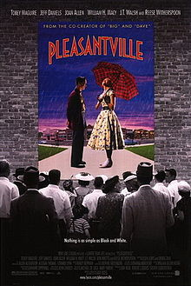
Pleasantville
1998 American comedy-drama
Two American teens in the mid-1990s are transported back to the world of their favorite sitcom, based in the 1950s and set in the fictional “Pleasantville”
An excellent example of the postmodern genre
What is the purpose of this film?
What comment is being made on conformity, etc.?

Slide 4
Pleasantville Reflection
Director Gary Ross stated, "This movie is about the fact that personal repression gives rise to larger political oppression...That when we're afraid of certain things in ourselves or we're afraid of change, we project those fears on to other things, and a lot of very ugly social situations can develop”.
Utopia vs Dystopia

Slide 5
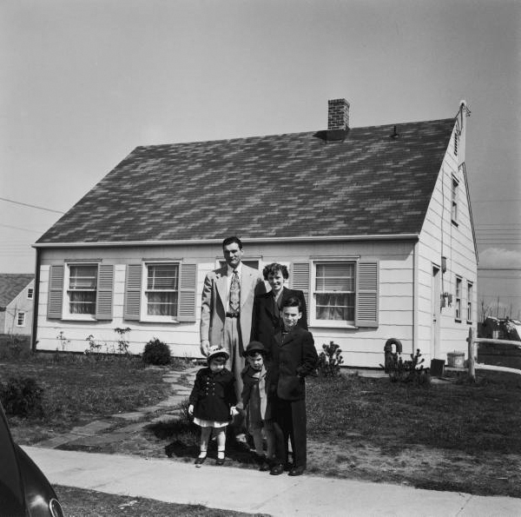
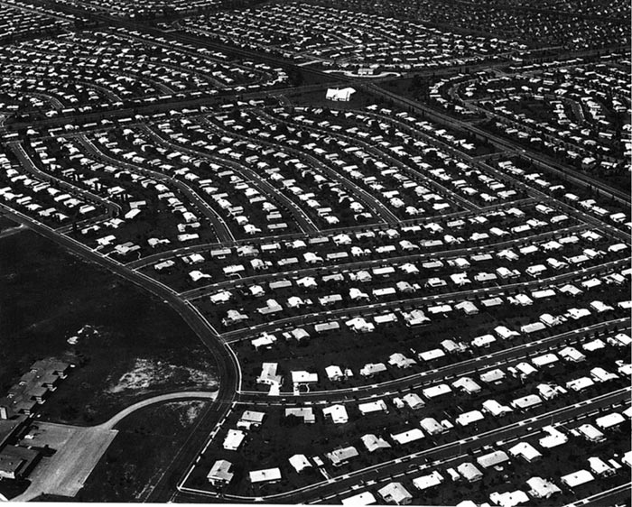
America in the 1950s
NORMALCY
Levittown
(ie the original Klahanie)

Slide 6
Pleasantville
What were the family values of the 1950s? What were the roles of each of the family members?
What was valued most in society during the 1950s?
What were some key traits of the ideal 1950s man/woman?
Why does the movie change from black and white to color?
David claims the people “are happy like this”. To what extent do you think the people of the 1950s were really happy? Explain with evidence from the film.
Why did people resist change in the 1950s?
When speaking about the town meeting, and Betty’s “condition”, she says she doesn’t want it to go away. Beyond the visual, aspects, what could she be talking about?
Conclude what the last scene means.
What is the purpose of this film?
What comment is being made on conformity, etc.?
What connections can you make to lit/history we have been covering over the past few weeks?

Slide 7
Pleasantville Reflection
What is the purpose of this film?
What comment is being made on conformity, etc.?
What connections can you make to lit/history we have been covering over the past few weeks?

Slide 8
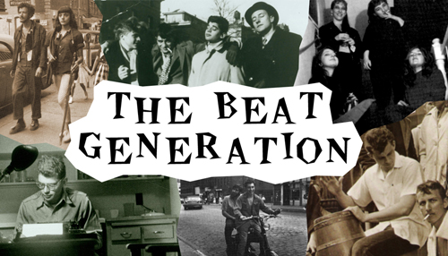
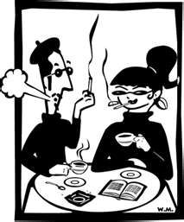
The Beats and the Beat Movement
1950s

Slide 9
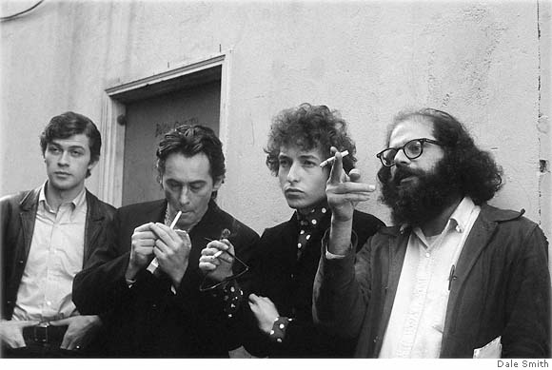
The Beat Generation
“the only people for me are the mad ones, the ones who are mad to live, mad to talk, mad to be saved, desirous of everything at the same time, …[who] burn, burn, burn like fabulous yellow roman candles exploding like spiders across the stars.” -Jack Kerouac (On the Road)

Slide 10
The Beats
Bohemian
The practice of an unconventional lifestyle
Celebrated non-conformity and spontaneous creativity
Focus on performance, which later inspired ‘Slam Poetry’
Characterized by drug use, sexuality, liberal, bohemian
Interested in changing consciousness and defying conventional writing
Drew a lot of inspiration from Romanticism and writers such as Thoreau, Emerson, Whitman, Poe, Dickinson

Slide 11
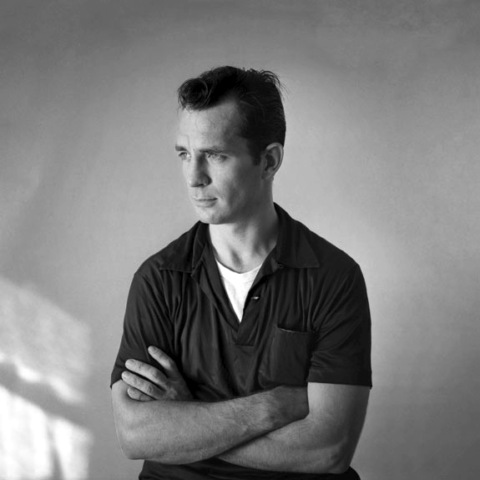
Founders
Allen Ginsberg (1926-1997)
Howl, America
Mostly Poetry
Opposed militarism, materialism and
sexual repression
Jack Kerouac (1922-1969)
On the Road (1957)
Buddhism, Catholic spirituality, jazz, drugs, sexuality and travel
Wanted to write ‘the next Great American Novel’
William S. Burroughs (1917-1997)
Naked Lunch (1959)
Almost predicted future (AIDS, crack pandemic, liposuction)
Semi-autobiographical work
Former heroin addict, traveler, convicted of manslaughter (wife in 1951), depression
Novels, novellas, short stories, essays
Gary Snyder (1930-)
The “Thoreau of the Beats”
Rural background & wilderness experience
Moved to Japan, Zen Buddhism

Slide 12
Met in New York City, ended up in San Francisco in the mid-1950s
Name was coined by Kerouac, dual meanings of both being “tired” or “beaten down” and “upbeat” “beatific”
This was directly in response to a casual conversation about Fitzgerald and the Lost Generation of the American 1920s
Largely middle-class, white, definitely a ‘boys club’
PNW (!!)
Kerouac spent a bunch of time in the North Cascades
The Dharma Bums
On the Road
Reed College (Portland, OR)

Slide 13
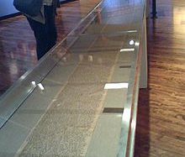
Scroll of On the Road

Slide 14
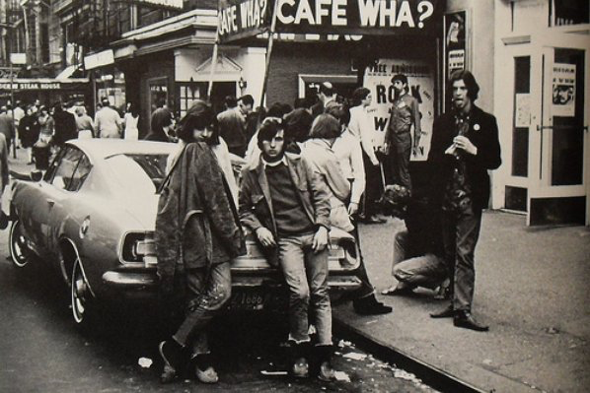
Important Places
Columbia
Greenwich Village
San Francisco

Slide 15
Characteristics of the Beat Culture
Rejection of received standards
Innovations in style
Use of illegal drugs
Alternative sexualities
An interest in examining religions
A rejection of materialism
Explicit portrayals of the human condition

Slide 16
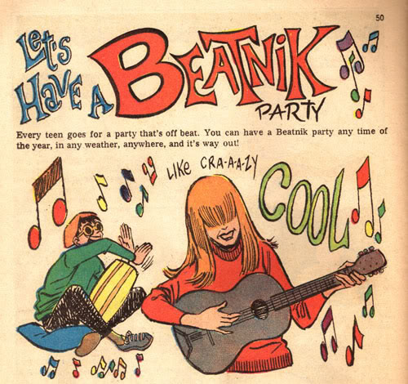
Beatniks
The name suggested that Beats were
Far out of the mainstream society
Possibly pro-Communist
Used as a new stereotype
Man with a goatee and a beret reciting nonsensical poetry and playing bongo drums
Became satirized and appeared in cartoons, movies, etc.
Some original Beats embraced the beatniks stereotypes, though many criticized them as inauthentic poseurs
Original hipsters?
Later became Hippies

Slide 17
Legacy & Impacts
The Obscenity Trials
Lawrence Ferlinghetti arrested for distributing Howl in 1957
In the 1960s elements of the Beat movement were incorporated into the hippie and larger counterculture movements
Spiritual liberation
Sexual revolution (or liberation)
Demystification and/or decriminalization of marijuana
Evolution of rhythm and blues into rock and roll as a high art form (Bob Dylan, the Beatles, Janis Joplin, The Grateful Dead, The Rolling Stones, etc.)
Spread of ecological consciousness
Opposition to the military-industrial machine civilization

Slide 18
Causalities of the Beats
“Kerouac was a casualty too. And there were many other casualties that most people have never heard of, but were genuine casualties. Just as, in the 60s, when Allen and I for a period there were almost publicly recommending people to take acid. When I look back on that now I realize there were many casualties, responsibilities to bare.” – Gary Snyder
Much of the drug use that the Beats advocated for spiraled from an emphasis on opening creative spaces into a recreational dependence that bordered on (or outright was) dangerous

Slide 19
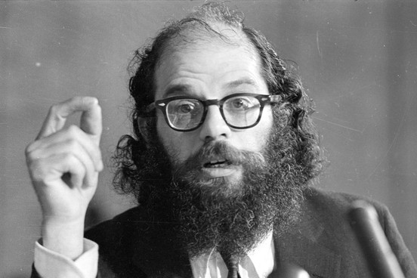
Allen Ginsberg

Slide 20
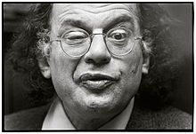
I saw the best minds of my generation destroyed by
madness, starving hysterical naked,
dragging themselves through the negro streets at
dawn looking for an angry fix,
angelheaded hipsters burning for the ancient
heavenly connection to the starry dynamo in the
machinery of night . . .
—Allen Ginsberg, Howl

Slide 21
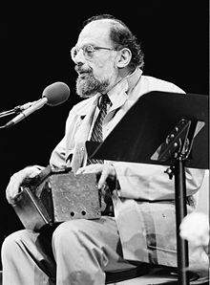
Allen Ginsberg (1926-1997)
Leading figure of beats
Howl, “America”
Styled after epic, free verse of Walt Whitman
Work is biographical
Mostly poetry

Slide 22
Ginsberg Background
Spent a short period of time in a mental institution (Bellevue) after being accused of a crime (pled insanity, not guilt…theft)
Father – high school English teacher in New Jersey
Mother – loyal Communist, battled mental illness throughout her life, attempted suicides
Gay, Jewish, no strongly-declared political affiliation (though definitely left-leaning)

Slide 23
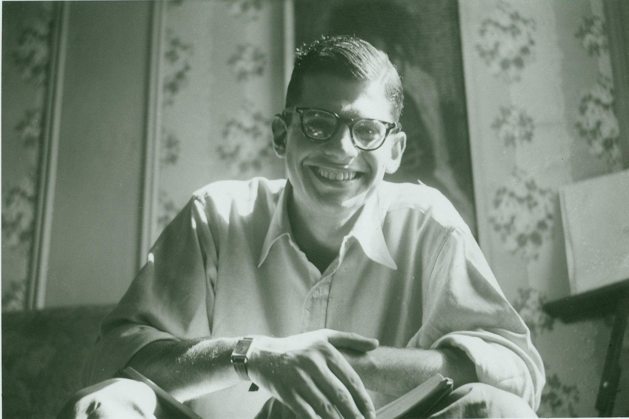
“America”
Written 1956, soon after the McCarthy Red Scare
Somewhat rambling, stream-of-consciousness
Political, and also personal

Slide 24
Learning Targets
I can critically read “America” by determining the meaning of historical allusions
I can determine how the poem could reflect both 1950s America and 2020 America
I can collaborate to OPCVL the poem

Slide 25
First Step
Individually read the poem
As a group, examine the underlined terms and create a common theme (10 minutes)
As a group, OPCVL the poem (15 minutes)
We will OPCVL as a class after

Slide 26
Discussion Questions
Does this poem's focus on a past historical period, with all its historical references, make it less relevant to a modern audience?
Is the speaker more hopeful about the prospects for America's future? Or more pessimistic? How can you tell?
Based on his complaints and desires that we learn about in the poem, what, specifically, do you think the speaker plans on doing when he "[puts his] queer shoulder to the wheel”?
To what extent are poets still relevant? Determine their role in change and in society.

Slide 27
Confessional Poets and Women Poets
Anne Sexton
How and why were the confessional poets a reaction to the male dominated beats?

Slide 28
Learning Targets
I can analyze poetry for social commentary
I can determine the theme of a poem
I can contrast beat poets and confessional poets

Slide 29
What is so intriguing and interesting to us about social media? Reality TV?
(What is it that draws us in and keeps us wanting more??)
Confessional Poetry = the origins of this kind of ‘over-sharing’ in America

Slide 30
Women of the beat generation
Beat writings of Kerouac, Ginsberg and Burroughs:
Women as boring, traditional gender roles, 50s American housewife
Marginalized, repressed women
Women beat writers did exist, but not widely published or known because of the sexism
Also harder to live ‘bohemian’ lifestyle as a woman
Not really beats, more confessional poets

Slide 31
What is Confessional Poetry?
Major figures: Anne Sexton and Sylvia Plath
Written during the 1950s and 1960s
First person narration, traditional writing style remained
Intimate autobiographical subject matter
Sometimes referred to as grotesque
Family life, infidelity, mental disorders, gender roles, sexuality, depression, suicidal tendencies, alcoholism, drug abuse

Slide 32
Anne Sexton
Born in Newton, Massachusetts in 1928
Sexton’s childhood was materially comfortable but not happy
Rumors of abuse
Married Alfred “Kayo” Sexton at age 19
Had two children (1953 and 1955)
Suffered from post-partum depression
Had breakdown requiring hospitalization after first child
Therapist recommended writing as part of her therapy
Struggled with depression and bipolar disorder most of her adult life, and committed suicide at age 46 (1974)
Celebrated and awarded poet

Slide 33
“She is an important poet not only because of her courage in dealing with previously forbidden subjects, but because she can make the language sing. Of what does [her] artistry consist? Not just of her skill in writing traditional poems… But by artistry, I mean something more subtle than the ability to write formal poems. I mean the artist’s sense of where her inspiration lies… There are many poets of great talent who never take that talent anywhere… They write poems which any number of people might have written. When Anne Sexton is at the top of her form, she writes a poem which no one else could have written.”
–Erica Jong (literary critic)

Slide 34
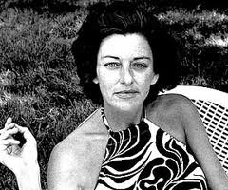
“Housewife” Group Analysis
Explain the poem.
Conclude Sexton’s meaning when she says “some women marry houses”.
Define “the walls”.
Determine the meaning of “A woman is her mother. That’s the main thing”.

Slide 35
“Housewife”
Some women marry houses.
It's another kind of skin; it has a heart,
a mouth, a liver and bowel movements.
The walls are permanent and pink.
See how she sits on her knees all day,
faithfully washing herself down.
Men enter by force, drawn back like Jonah
into their fleshy mothers.
A woman is her mother.
That's the main thing.

Slide 36
1950s Housewife

Slide 37
Learning Targets
I can determine the role and value of women in 1950s society
I can use a political cartoon to demonstrate my understanding of the 1950s housewife

Slide 38
Expectations of a housewife…
What stereotypes exist about the 50s housewife?
Determine where these stereotypes come from.
To what extent do we still have the same expectations for women today?

Slide 39
What drove culture (& counter-culture) in the 1950s & 60s?

Slide 40
How do we go from this…

Slide 41
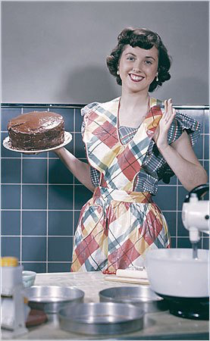
…to this?

Slide 42
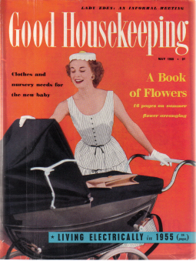

Slide 43
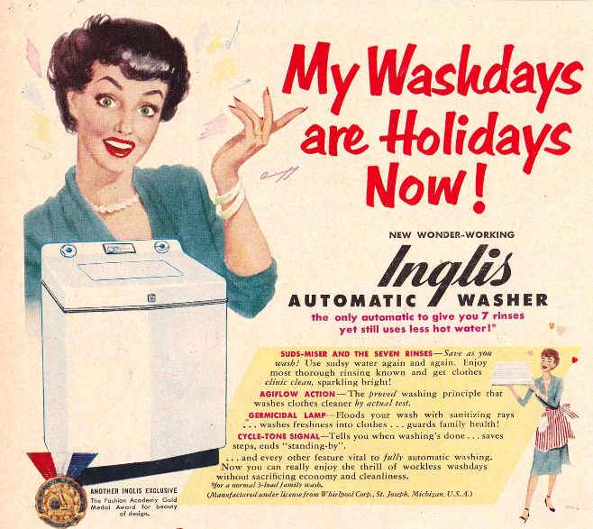

Slide 44
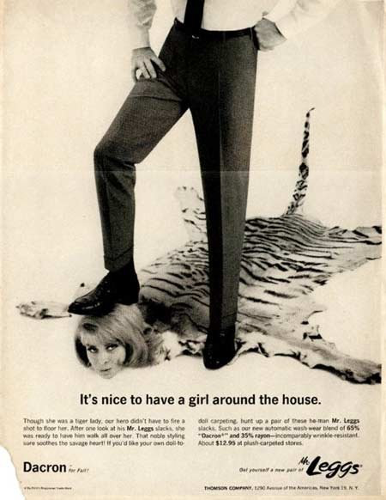
Actual advertisements from the 1950s and 60s…

Slide 45
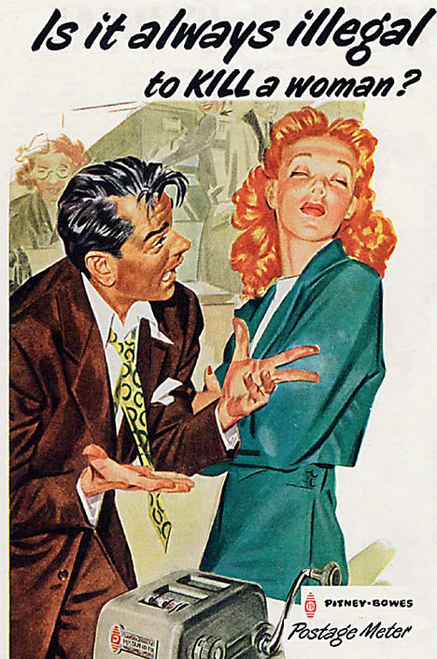

Slide 47
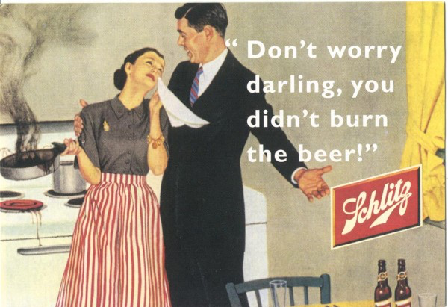

Slide 48
TV Land
While televisions became available in crude form in the 1920s, they did not become commonplace until the 1950s
This contributed to a rise in this common culture
All of a sudden everyone could watch the same shows, access the same images
Similar to the radio, but even more powerful
Average advertisement was one minute long
Whether they realized it or not, the American people were being heavily influenced by what they saw on their TV sets

Slide 49
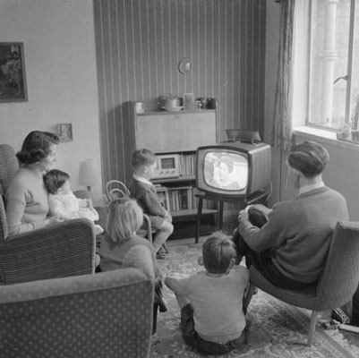
50s Television: Perpetuating Conformity
The FCC regulated EVERYTHING that appeared on television and radio in the 1950s.
It still regulates all broadcast television.
It had very strict rules on what could air, which helped perpetuate the image of perfection and conformity of the American family and society.

Slide 50
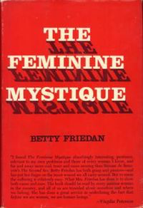
Betty Friedan (1921-2006)
Writer, feminist, women’s rights activist
Wrote The Feminine Mystique (1963)
Co-founded NOW (The National Organization for Women) (1966)

Slide 51
The Feminine Mystique
Written in 1963
Sparked 2nd Wave Feminism
1960s-1980s (roughly)
Broadened the debate about women’s rights from simply suffrage to include a wider range of issues including reproductive rights, family, workplace, etc.
Combined interviews with suburban housewives with research into psychology, advertising, media in order to draw attention to what she saw as “the problem that had no name”
Originally intended to publish an article (not a book), but no magazine would publish her

Slide 52
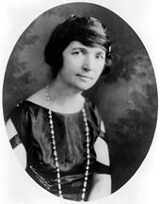
Women and Reproductive Rights
Planned Parenthood
Margaret Sanger
Started in 1916 as The American Birth Control League
Operating 222 clinics by 1941
Morphed into Planned Parenthood Federation in 1942
1960 – FDA approved the combined oral contraceptive pill

Slide 53
Sexual Revolution
Began in the 1960s, coincided with the 2nd wave feminist movement
Purpose: to challenge traditional ideas regarding sexuality
Particularly regarding female and queer sexuality
Eliminating undue favorable bias towards men and objectification of women
Associated with both physical and psychological freedom for women
Sex was expanding beyond the personal, becoming political as well
While a lot of these ideas took their roots from the 1920s, the 1960s is when they really began to take off!

Slide 54
Task Today
After reviewing the how to guide for being a 50s housewife, ads, and Tips for Keeping Your Man, your table group will create a political cartoon for the woman’s place in 1950s society.
Must include: role, stereotype, some words, image
Written explanations of cartoon on the back

Slide 55
Political Cartoon
Definition: illustrations or comic strips containing a political or social message that usually relates to current events or personalities (google.com).

Slide 56
Older Files

Slide 57
Pleasantville
What were the family values of the 1950s? What were the roles of each of the family members?
What was valued most in society during the 1950s?
What were some key traits of the ideal 1950s man/woman?
What commentary is the movie making about conformity?
Why does the movie change from black and white to color?
David claims the people “are happy like this”. To what extent do you think the people of the 1950s were really happy? Explain with evidence from the film.
Why did people resist change in the 1950s?
What does the trial scene remind you of? Why?
When speaking about the town meeting, and Betty’s “condition”, she says she doesn’t want it to go away. Beyond the visual, aspects, what could she be talking about?
Conclude what the last scene means.

Slide 58
Learning Targets
I can critically read “America” by determining the meaning of historical allusions
I can determine how the poem could reflect both 1950s America and 2020 America
I can collaborate to modernize the poem to reflect an understanding of the message of “America”

Slide 59
The Beats
You will be critically reading “America” (Ginsberg) to determine what exactly beat poetry is.
Anything underlined: historical allusion (look them up and write them on the poem as your critical reading assignment

Slide 60
With your group
With your table group, collaborate and share the historical allusions you researched for homework (10 minutes)
Come up with commonalities (things that are the same):
Who are all the people?
How would you group the people (politicians, communists, minorities, etc.)?
What part of politics does he criticize and why?
What parts of society does he criticize and why?
Notes:
Politicians
People punished for different politics
Different religions
Different sexuality

Slide 61
Learning Targets Reminder
I can critically read “America” by determining the meaning of historical allusions
I can determine how the poem could reflect both 1950s America and 2018-19 America
I can collaborate to modernize the poem to reflect an understanding of the message of “America”

Slide 62
Beats Refresher
Conclude how Ginsberg feels about/describes America.
Define the characteristics of beat literature.
If the beats were popular today, what social issues do you think they would write about?

Slide 63
“America”
With a partner, rewrite the poem with new, more modernly relevant allusions. EX: America when will you send your eggs to India becomes American when will you send your troops to Syria.
Pick one line in the poem and analyze for theme
Turn in your poem/analysis with both names (turnitin.com) tomorrow before class

Slide 64
Analyzing for Theme
First: what is the theme of the poem?
Pick a line that you think best represents/demonstrates the theme
Then analyze (explain) how that line supports the theme of “America”
Theme: overall message or point of something. Will be a sentence, and not just one word
EX: hysteria causes loss of control vs. hysteria

Slide 65
Resources For You
Use laptops to access the original document, and rewrite that way
Use the allusions charts created Friday to remind yourselves about historical allusions and to create modern allusions
Reminder: when creating modern poem, remember the purpose of Ginsberg’s original poem.
What was he trying to say about 1950s America? Keep that spirit alive in your modern version.

Slide 66
Confessional Poetry as Postmodern Poetry
Postmodern poetry, like its prose counterpart, often dealt with levels of reality, societal contradictions, truth and perception, and critical (not necessarily cynical) analysis of technology and rapid modernization.

Slide 67
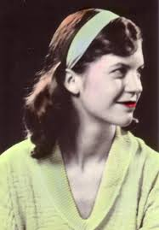
Sylvia Plath
Born in 1932 in Boston. Parents: father was German immigrant professor, mother was his student.
Poet, novelist (most famous for Bell Jar)
Her poetry addresses and explores her suffering and mental anguish, her visions of herself, her troubled marriage to poet Ted Hughes, and her strained relationship with her parents (poetryfoundation.com).
Suffered from depression and committed suicide (at age 30)
“It is as if my life were magically run by two electric currents: joyous positive and despairing negative—whichever is running at the moment dominates my life, floods it.”-Sylvia Plath

Slide 68
Sylvia Plath (Table Group Analysis)
Each table group will be assigned a different Plath poem to analyze
For your poem, answer:
Determine the message of the poem
Conclude the theme of the poem
Examine her “confession” in the poem
Create a discussion question for your poem

Slide 69
Plath and Sexton Reflection
To what extent would it be challenging to be a female poet during the 1950s?
How do Plath and Sexton fit with 1950s gender roles?
Determine what they are arguing or fighting for with their poetry.
Conclude how the male beat poets would respond to the female confessional poets.
Conclude how females of the 1950s would respond to the confessional poets.
Determine any similarities in music/poetry today.

Slide 70
Mad Girl’s Love Song
Sylvia Plath: poet, novelist (most famous for Bell Jar), depression and ultimate suicide
Determine what the poem is about.
Conclude who the ‘you’ is in the poem?
To what extent does this poem fit within the 50s and 60s culture of conformity?

Slide 71
Ginsberg’s characteristics
Liberation: sexual, religion, black, women
Liberation of the world from censorship
Make drugs normal and legal
Rhythm and blues into rock and roll as a high art form
The spread of ecological consciousness, "Fresh Planet"
Opposition to the military-industrial machine civilization
Return to an appreciation of idiosyncrasy as against state regimentation
Respect for land and indigenous peoples and creatures

Slide 72
Writing you own beat poetry
To better understand the beats and their literature, you will be writing your own beat poetry
You will be writing a beat poem to share in small groups. You will have the rest of the period to prepare, and then will present them to small groups on Thursday. You will then pick the best from the group to share with the whole class (optional whole class sharing).
Minimum of 20 lines
Keep the subject matter school appropriate.
Follow the guidelines.
Review the Essentials of Spontaneous Prose by Jack Kerouac
http://www.writing.upenn.edu/~afilreis/88/kerouac-spontaneous.html

Slide 73
Guidelines
SET-UP The object is set before the mind, either in reality. as in sketching (before a landscape or teacup or old face) or is set in the memory wherein it becomes the sketching from memory of a definite image-object.
PROCEDURE Time being of the essence in the purity of speech, sketching language is undisturbed flow from the mind of personal secret idea-words, blowing (as per jazz musician) on subject of image.
METHOD No periods separating sentence-structures already arbitrarily riddled by false colons and timid usually needless commas-but the vigorous space dash separating rhetorical breathing (as jazz musician drawing breath between outblown phrases)--"measured pauses which are the essentials of our speech"--"divisions of the sounds we hear"-"time and how to note it down." (William Carlos Williams)
SCOPING Not "selectivity' of expression but following free deviation (association) of mind into limitless blow-on-subject seas of thought, swimming in sea of English with no discipline other than rhythms of rhetorical exhalation and expostulated statement, like a fist coming down on a table with each complete utterance, bang! (the space dash)-Blow as deep as you want-write as deeply, fish as far down as you want, satisfy yourself first, then reader cannot fail to receive telepathic shock and meaning-excitement by same laws operating in his own human mind.
LAG IN PROCEDURE No pause to think of proper word but the infantile pileup of scatological buildup words till satisfaction is gained, which will turn out to be a great appending rhythm to a thought and be in accordance with Great Law of timing.

Slide 74
Guidelines
TIMING Nothing is muddy that runs in time and to laws of time-Shakespearian stress of dramatic need to speak now in own unalterable way or forever hold tongue-no revisions (except obvious rational mistakes, such as names or calculated insertions in act of not writing but inserting).
CENTER OF INTEREST Begin not from preconceived idea of what to say about image but from jewel center of interest in subject of image at moment of writing, and write outwards swimming in sea of language to peripheral release and exhaustion-Do not afterthink except for poetic or P. S. reasons. Never afterthink to "improve" or defray impressions, as, the best writing is always the most painful personal wrung-out tossed from cradle warm protective mind-tap from yourself the song of yourself, blow!-now!-your way is your only way-"good"-or "bad"-always honest ("ludi- crous"), spontaneous, "confessionals' interesting, because not "crafted."
STRUCTURE OF WORK Modern bizarre structures (science fiction, etc.) arise from language being dead, "different" themes give illusion of "new" life. Follow roughly outlines in outfanning movement over subject, as river rock, so mindflow over jewel-center need (run your mind over it, once) arriving at pivot, where what was dim-formed "beginning" becomes sharp-necessitating "ending" and language shortens in race to wire of time-race of work, following laws of Deep Form, to conclusion, last words, last trickle-Night is The End.
MENTAL STATE If possible write "without consciousness" in semi-trance (as Yeats' later "trance writing") allowing subconscious to admit in own uninhibited interesting necessary and so "modern" language what conscious art would censor, and write excitedly, swiftly, with writing-or-typing-cramps, with "beclouding of consciousness." Come from within, out-to relaxed and said.

Slide 75
In summary
Continuous writing (for at least 15 minutes)
Don’t worry about grammar, punctuation, spelling, structure
Just write whatever comes to mind
Write like you are in a trance, in the zone
Don’t have a preconceived idea of what you are going to write about…just start writing and don’t stop
Please keep it school appropriate
Keep it to 20 lines

Slide 76
Today
Listen to Kimberly by Patti Smith
Read Mad Girl’s Love Song by Sylvia Plath
Read Housewife by Anne Sexton
Discussion questions after

Slide 77
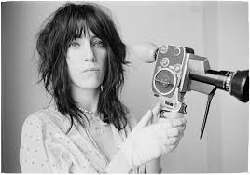
Kimberley
Patti Smith: American singer, songwriter, poet
Kimberly comes from 1975 debut album Horses
Who is Kimberly?
What is the relationship between Patti Smith and Kimberly?
What does Smith want for Kimberly?

