Slide 1
Confessional Poets and Women Poets
Sylvia Plath and Anne Sexton
How and why were the confessional poets a reaction to the male dominated beats?

Slide 2
What is so intriguing and interesting to us about social media? Reality TV?
(What is it that draws us in and keeps us wanting more??)
Confessional Poetry = the origins of this kind of ‘over-sharing’ in America

Slide 3
Women
Beat writings of Kerouac, Ginsberg and Burroughs:
Women as boring, traditional gender roles, 50s American housewife
Marginalized, repressed women
Women beat writers did exist, but not widely published or know because of the sexism
Also harder to live ‘bohemian’ lifestyle as a woman
Not really beat women, more confessional poets

Slide 4
What is Confessional Poetry?
Written during the 1950s and 1960s
First person narration, traditional writing style remained
Intimate subject matter
Autobiographical by design
Intimate autobiographical subject matter
Sometimes referred to as grotesque
Family life, infidelity, mental disorders, gender roles, suicide, and sexuality, masturbation, depression, suicidal tendencies, alcoholism, drug abuse

Slide 5
Confessional Poetry as Postmodern Poetry
Post modern poetry, like its prose counterpart, often dealt with levels of reality, societal contradictions, truth and perception, and critical (not necessarily cynical) analysis of technology and rapid modernization.

Slide 6
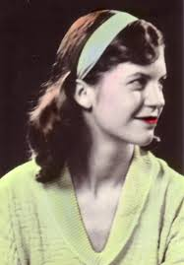
Mad Girl’s Love Song
Sylvia Plath: poet, novelist (most famous for Bell Jar), depression and ultimate suicide
What is the poem about?
Who is the ‘you’ in the poem?
How does this poem fit within the 50s and 60s culture of conformity?

Slide 7
Mad Girl's Love Song-By Sylvia Plath
"I shut my eyes and all the world drops dead;
I lift my lids and all is born again.
(I think I made you up inside my head.)
The stars go waltzing out in blue and red,
And arbitrary blackness gallops in:
I shut my eyes and all the world drops dead.
I dreamed that you bewitched me into bed
And sung me moon-struck, kissed me quite insane.
(I think I made you up inside my head.)
God topples from the sky, hell's fires fade:
Exit seraphim and Satan's men:
I shut my eyes and all the world drops dead.
I fancied you'd return the way you said,
But I grow old and I forget your name.
(I think I made you up inside my head.)
I should have loved a thunderbird instead;
At least when spring comes they roar back again.
I shut my eyes and all the world drops dead.
(I think I made you up inside my head.)"
Notes:
seraphim in the highest rank in the Christian angelic hierarchy and in the fifth rank of ten in the Jewish angelic hierarchy.

Slide 8
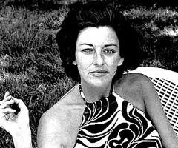
Housewife
Anne Sexton: poet, highly personal poems
What does she mean by “some women marry houses”?
What are “the walls”?
Meaning of “A woman is her mother. That’s the main thing”?

Slide 9
Housewife-Anne Sexton
Some women marry houses.
It's another kind of skin; it has a heart,
a mouth, a liver and bowel movements.
The walls are permanent and pink.
See how she sits on her knees all day,
faithfully washing herself down.
Men enter by force, drawn back like Jonah
into their fleshy mothers.
A woman is her mother.
That's the main thing.

Slide 10
Plath and Sexton
Why would it be challenging to be a female poet during the 1950s?
How do Smith, Plath, and Sexton fit with 1950s gender roles?
What are they arguing or fighting for with their poetry?
How would the male beat poets respond to the female poetry?
How would females of the 1950s respond to the female (confessional) poetry?
Do you see any similarities in music/poetry today?

Slide 11
1950s Housewife

Slide 12
Expectations of a housewife…
What stereotypes exist about the 50s housewife?
Where do these stereotypes come from?
Do we still have the same expectations for women today?

Slide 13
What drove culture (& counter-culture) in the 1950s & 60s?

Slide 14
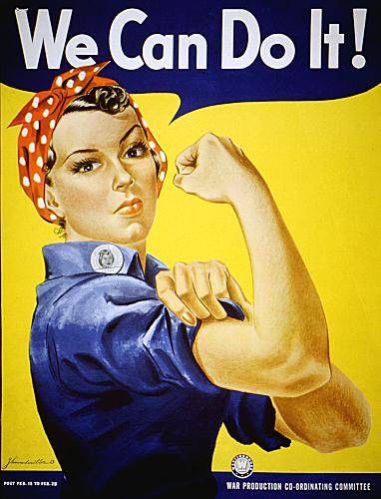
How do we go from this…

Slide 15
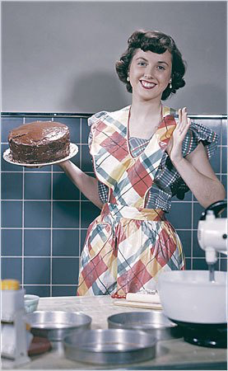
…to this?

Slide 16
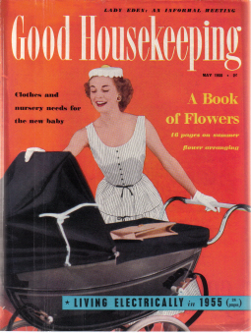

Slide 17
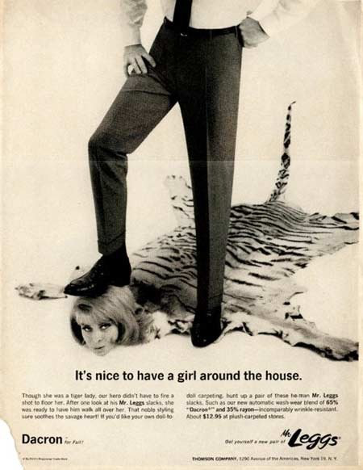
Actual advertisements from the 1950s and 60s…

Slide 18
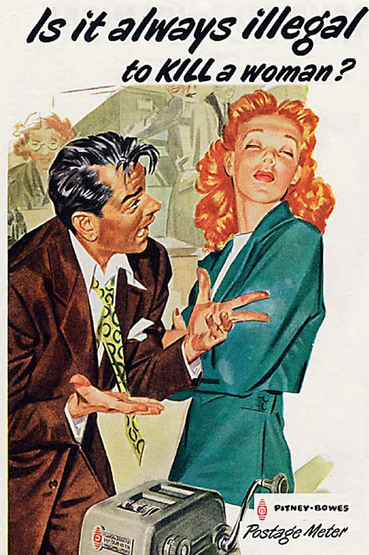

Slide 19
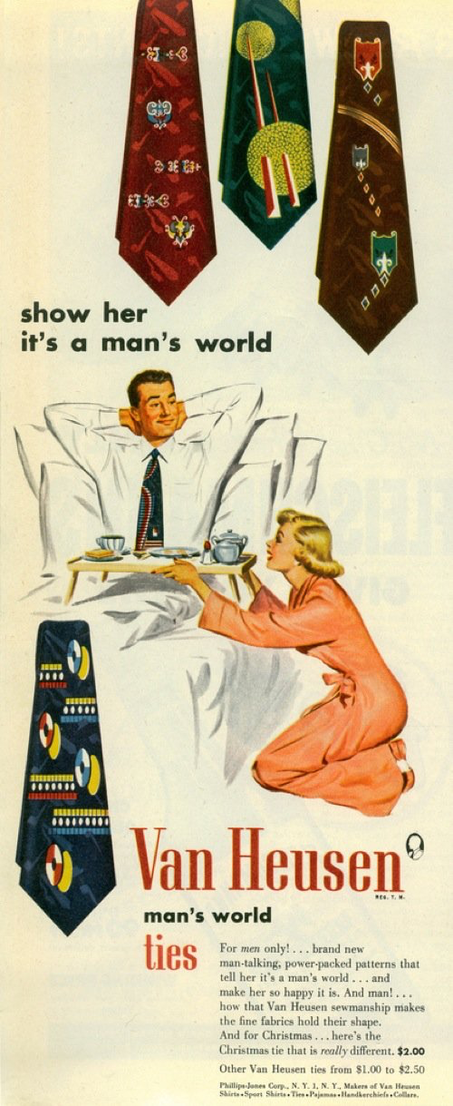

Slide 20
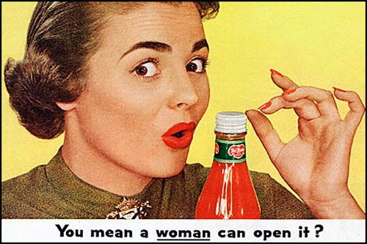

Slide 21
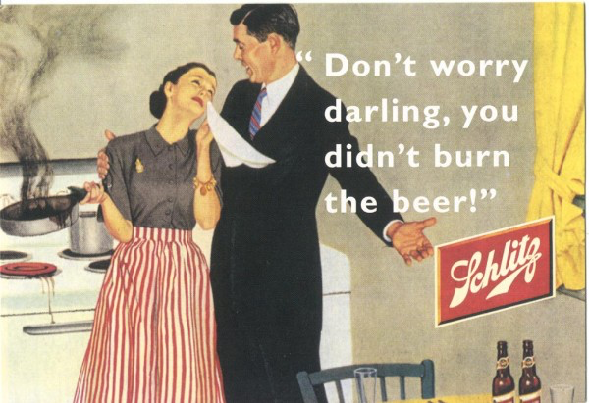

Slide 22
TV Land
While televisions became available in crude form in the 1920s, they did not become commonplace until the 1950s
This contributed to a rise in this common culture
All of a sudden everyone could watch the same shows, access the same images
Similar to the radio, but even more powerful
Average advertisement was one minute long
Whether they realized it or not, the American people were being heavily influenced by what they saw on their TV sets

Slide 23
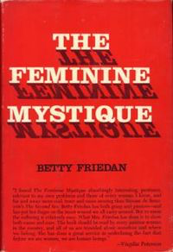
Betty Friedan (1921-2006)
Writer, feminist, women’s rights activist
Wrote The Feminine Mystique (1963)
Co-founded NOW (The National Organization for Women) (1966)

Slide 24
The Feminine Mystique
Written in 1963
Sparked 2nd Wave Feminism
1960s-1980s (roughly)
Broadened the debate about women’s rights from simply suffrage to include a wider range of issues including reproductive rights, family, workplace, etc.
Combined interviews with suburban housewives with research into psychology, advertising, media in order to draw attention to what she saw as “the problem that had no name”
Originally intended to publish an article (not a book), but no magazine would publish her

Slide 25
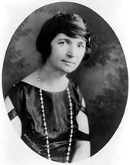
Women and Reproductive Rights
Planned Parenthood
Margaret Sanger
Started in 1916 as The American Birth Control League
Operating 222 clinics by 1941
Morphed into Planned Parenthood Federation in 1942
1960 – FDA approved the combined oral contraceptive pill

Slide 26
Sexual Revolution
Began in the 1960s, coincided with the 2nd wave feminist movement
Purpose: to challenge traditional ideas regarding sexuality
Particularly regarding female and queer sexuality
Eliminating undue favorable bias towards men and objectification of women
Associated with both physical and psychological freedom for women
Sex was expanding beyond the personal, becoming political as well
While a lot of these ideas took their roots from the 1920s, the 1960s is when they really began to take off!

Slide 27
Political Cartoon
Definition: illustrations or comic strips containing a political or social message that usually relates to current events or personalities (google.com).

Slide 28
Task Today
After reviewing the how to guide for being a 50s housewife, ads, and Tips for Keeping Your Man, your table group will create a political cartoon for the woman’s place in 1950s society.
Must include: role, stereotype, some words, image

