Slide 1
Turn of the century America
Immigrants, muckrakers, and industrialization

Slide 2
Far and Away
Tom Cruise as Joseph, Nicole Kidman as Shannon
Irish immigrants in America
Objectives:
To understand immigrant lives
To determine the reality of achieving the American Dream
To discuss the role of immigrants in American culture
To discuss what it means to be an American
To identify immigrant stereotypes and Nativist attitudes

Slide 3
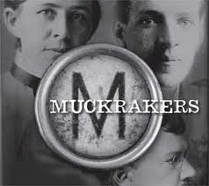
Muckrakers

Slide 4
Structure & Objectives
Objective: To understand the minority experience during this time and to determine the role or impact of minority groups on American culture from the Civil War to WWI
Some of our Essential Questions:
Determine the role of government
To what extend does the media drive social reform?
Conclude the dangers of laissez-faire.
How were minorities abused/taken advantage of?
To what extent did the change come from a shift in power or from the minority groups forcing their way into power?

Slide 5
Learning Targets
I can critically read articles and photographs to analyze for impact
I can make connections between immigrants, muckrakers, and women writers
I can explore minority writers through various writings

Slide 6
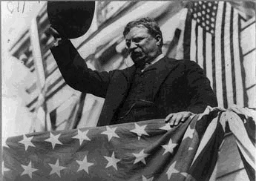
The Progressive Era
A focus on American Literature from the 1890s to 1920s

Slide 7
What is the Progressive Era/Gilded Age?
Period of social activism and political reform
Goal: to eliminate corruption in government by exposing and undercutting political machines and their bosses, to establish more ‘direct democracy’
Supported
Prohibition
The Women’s movement
Urban-Industrial society
Avid modernizers
Believed in science, technology, educational expertise as the grand solution to society’s weaknesses

Slide 8
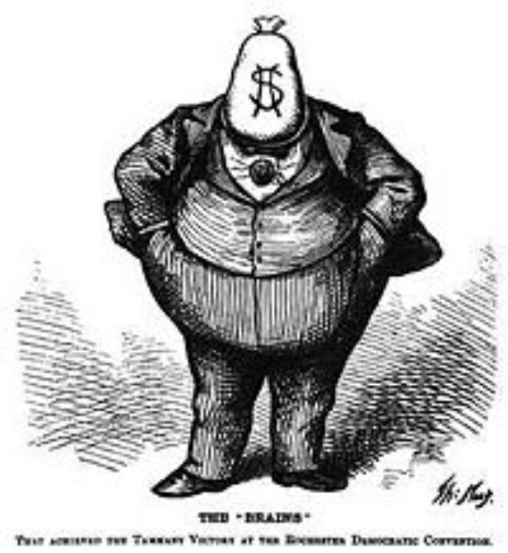
Gilded Age
The term came into use in the 1920s, and referred to a text written by Mark Twain that satirized an era of serious social problems covered in a thin golden lining
Era of rapid economic growth
Political landscape was marked by corruption, high voter turnout, and dominated by issues that were cultural (i.e. education, issues that affected the working classes, ethnic/racial groups)

Slide 9
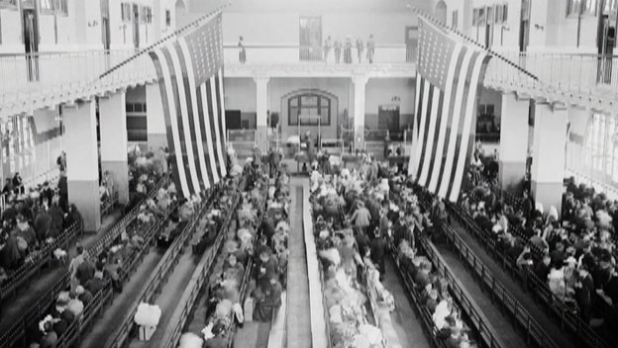
Ellis Island
1892 – Designated by President Harrison as the nation’s first ‘immigration station’
By no means the only place that immigrants came into the country by, but certainly the most well known
Immigrants were taken from their ships to be processed at Ellis Island before they could enter the country
About 12 million immigrants passed through Ellis Island during its time of operation

Slide 10
What were they searching for?
Why did immigrants come to America? What do you suppose they were searching for?
If you were an immigrant that recently moved to the US… what do you think your first reactions would be? What about goals/plans?

Slide 11
Question
What do you think would happen with a combination of the Gilded Age and extreme wealth of some, and an increase in immigrants needing work and places to stay?

Slide 12
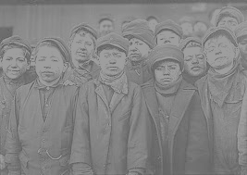
What are muckrakers?
American journalists, novelists, and critics who attempted to expose the corruption of politics and abuses of businesses
Gained popularity in early 1900’s.
President Theodore Roosevelt
Agreed with their claims, but not their methods
Irresponsible, sensational
Term comes from the word muckrake
Only interested in filth

Slide 13
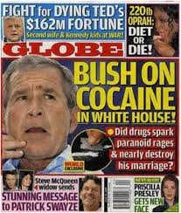
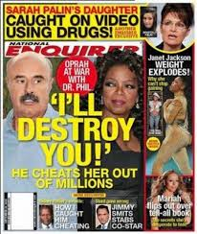
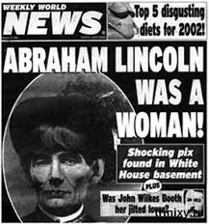
Yellow Journalism
Journalism based on sensationalism & crude exaggeration

Slide 14
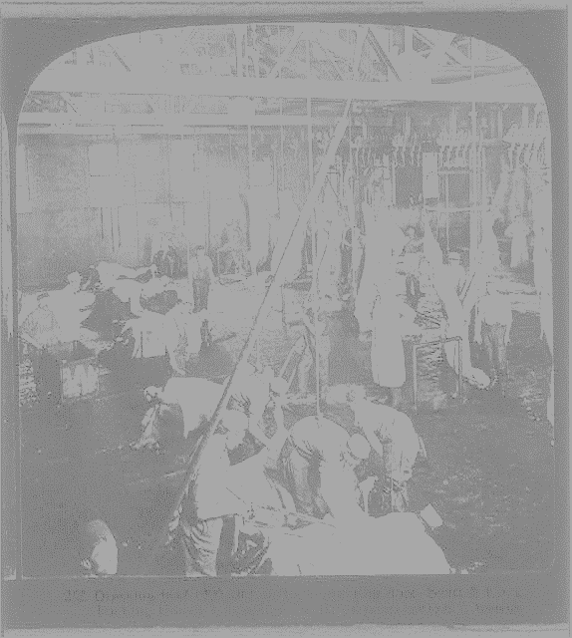
Famous Muckrakers
Charles Edward Russell “chief of the muckrakers”: forced the richest church to clean up its slum housing, federal oversight of food and drugs, helped found the NAACP
Upton Sinclair: wrote The Jungle, exposing meatpacking factories and the horrible conditions
Jacob Riis: How the Other Half Lives, exposed life in the slums of New York, photographer
John Spargo: The Bitter Cry of the Children, about children working in sweatshops
Helen Hunt Jackson: A Century of Dishonor, attacked U.S. policy regarding Native Americans
Charlotte Perkins Gilman: attacked child labor

Slide 15
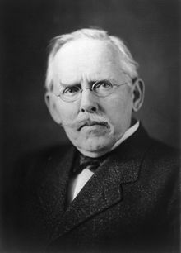
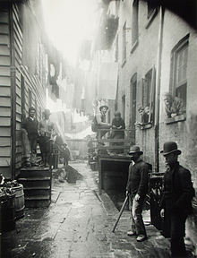
Jacob Riis
Early Muckraker journalist
Immigrant himself
Danish American
Used photographs and journalism as a way of standing up and fighting for the rights of folks he believed were being taken advantage of

Slide 16
Read the excerpt from Riis’ How The Other Half Lives
Answer the questions on the reading and the photographs
This will go in your homework packet

Slide 17
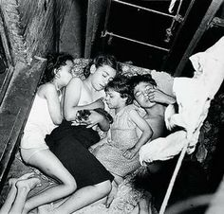
Images from Jacob Riis’
How The Other Half Lives

Slide 18
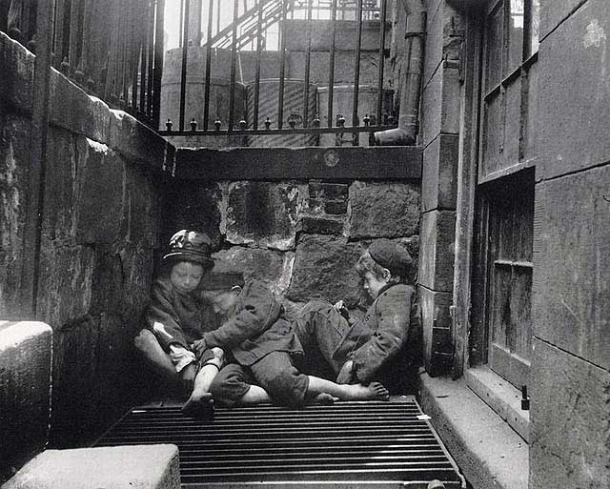

Slide 19
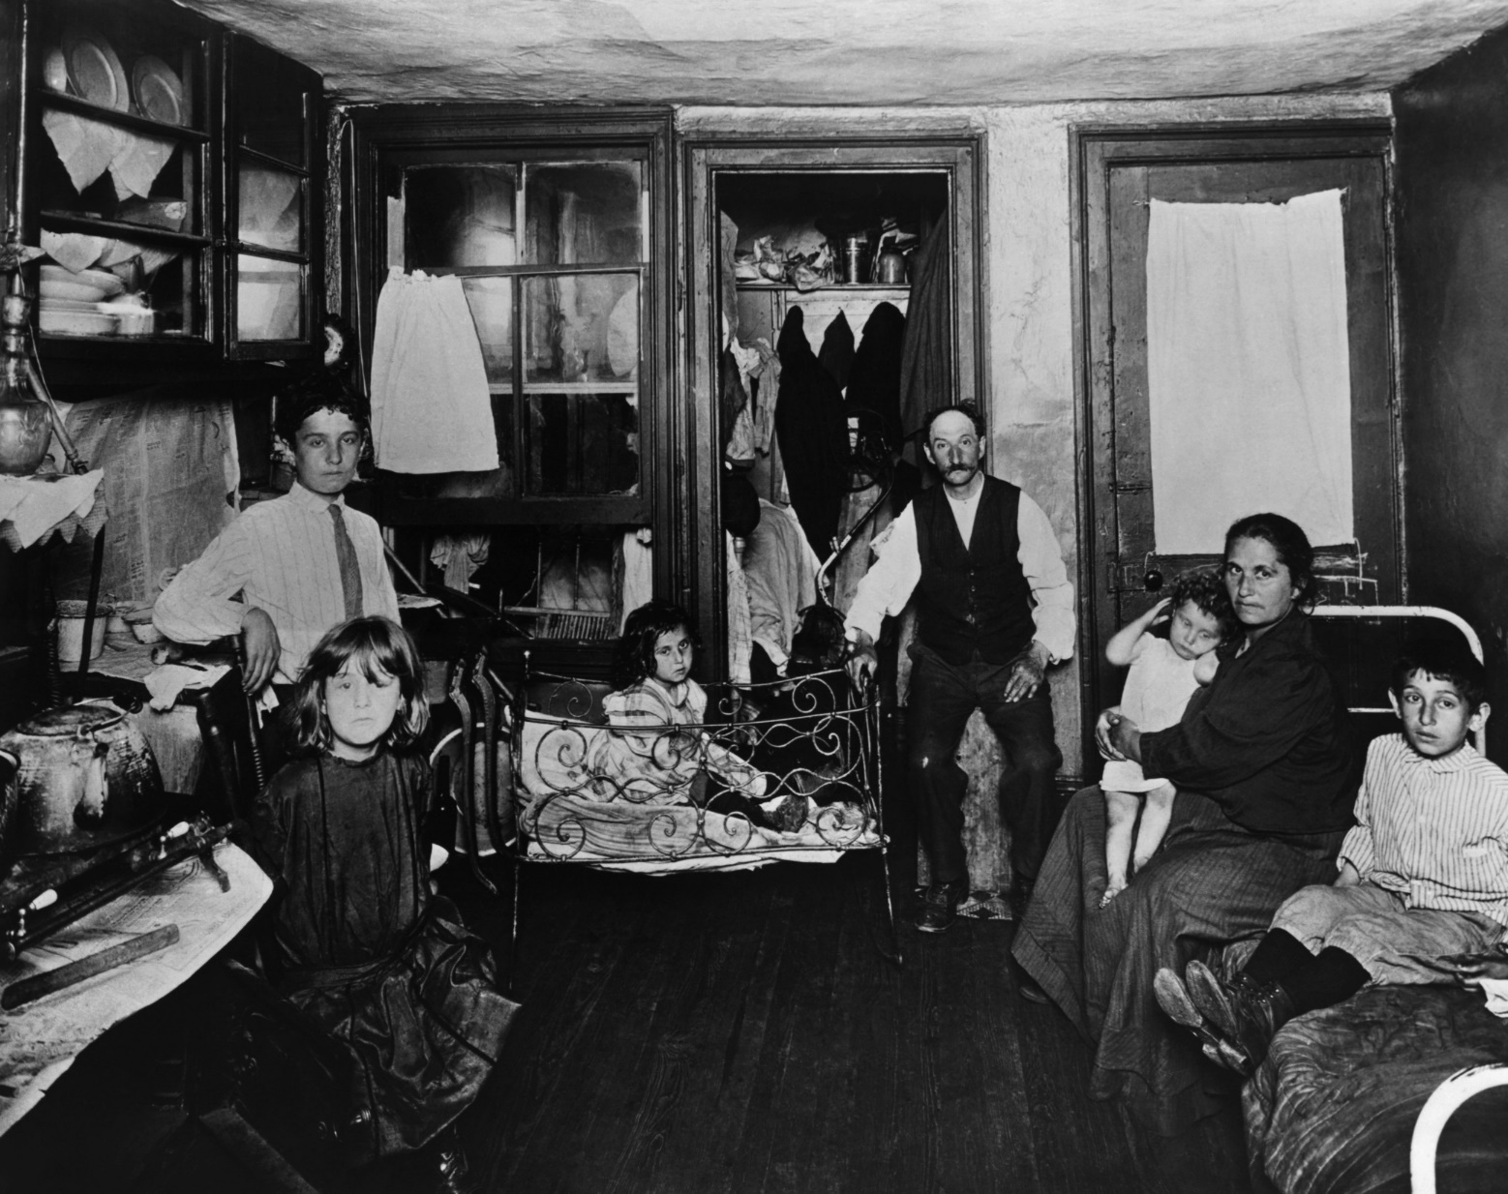

Slide 20
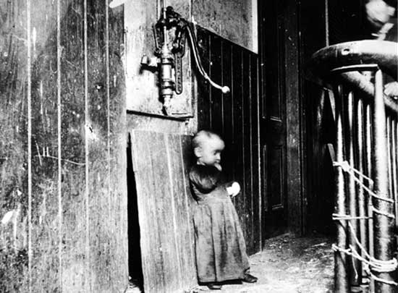

Slide 21
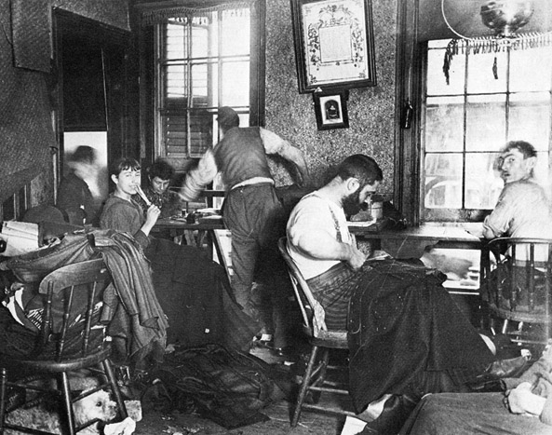

Slide 22
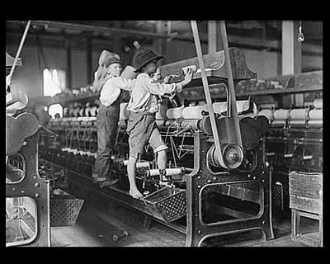

Slide 23
Discussion Questions
What impact would the photographs and imagery from the stories have on the American public?
Who do you think struggled more: adults or children? Why?
Who all was really affected by this?

Slide 24
Learning Targets
I can critically read articles and photographs to analyze for impact
I can make connections between immigrants, muckrakers, and women writers
I can explore minority writers through various writings

Slide 25
Your food & you…
What do you think about when you think about your food?
Do you know where most of your food comes from? Do you care?

Slide 26
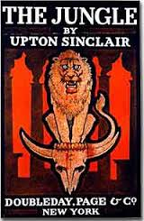
Upton Sinclair and The Jungle
Written in 1906
Fictional story following an immigrant family working in a meat-packing factory
An exposé of the Chicago meat-packing industry
Led to sweeping reforms in the meat-packing industry, along with federal regulations regarding sanitary practices in the industry
“I aimed for the public’s heart, and hit it in the stomach instead.”

Slide 27
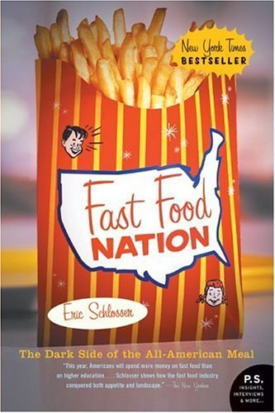
Fast Food Nation
Published in 2001
Nonfiction
Investigative journalist Eric Schlosser
Local and global influence of United States fast food industry
First serialized in Rolling Stone in 1999, later turned into a book

Slide 28
The Jungle
You will need to read/answer questions for
The Jungle chapters 1, 9, 14 (excerpts)
Worksheets with questions
The readings and the worksheets/questions are on my website
We will be having an open note, timed write Friday on the turn of the century (women, muckrakers, immigrants)

Slide 29
Timed Write
The next slide has some potential questions. You need to pick 2 to answer using formal academic essay writing, and citing evidence from the readings/photographs you analyzed last week
You must write for the full 30 minutes, but will not have more than 30 minutes
You can write 2 individual paragraphs (one per question), or you can combine 2 questions to write a short essay response.
Grading: using analysis category of rubric

Slide 30
Timed Write Topics
Determine why immigrants would move to America.
To what extent would the photographs and imagery from the stories impact the American public?
Conclude if the lives of immigrants were better in their home countries or in America. Why?
Determine who struggled more: adults or children? Why?
What aspects of immigrant culture remained? Should immigrants be allowed to maintain their culture and traditions if living in America?
Determine why men would continue to work in the factories from The Jungle?
To what extent does the government have an obligation to help factory workers and help improve conditions.
What is the power of the media in times like these? Should the media be required to help in change/progress?

Slide 31
Rubric
Analysis has depth and accuracy Analysis consistently and clearly connects to all parts of thesis Analysis clearly connects to so what Analysis clearly connects evidence to BTs | Analysis is accurate, but lacks depth at times Analysis connects to all parts of thesis Analysis connects to so what Analysis connects evidence to BTs | Analysis at times undeveloped or unclear Analysis attempts to connects to thesis; or only partially connects to thesis Analysis does not address so what Analysis lacks a connection to evidence or summarizes or restates evidence | Analysis undeveloped, inaccurate, and/or unclear Analysis does not support thesis Analysis does not address so what Analysis is irrelevant

Slide 32
Older files

Slide 33
Triangle by David Von Drehle
Triangle: the Fire that Changed America by David Von Drehle, tells the tragic story of the 145 workers that died in the Triangle shirtwaist factory fire on March 25th, 1911 and what led up to this event. David Von Drehle shows how society’s eyes were opened to the terrible conditions, and how they saw the need for reform.
“Exploration and invention were the two faces on the coin of progress, and progress was the spirit of the age”
“The mansion and its furnishings cost nine million dollars—the equivalent of more than 150 million dollars today. “Extravagance and ostentation marked every social gathering” at Marble House, the New York Times observed, and “
“The Triangle fire of March 25, 1911,was for ninety years the deadliest workplace disaster in New York history—and the most important millions of dollars.”
“It [the Triangle fire] was different because it was more than just a horrific half hour; it was a crucial moment in a potent chain of events—a chain that ultimately forced fundamental reforms from the political machinery of New York, and, after New York, the whole nation”
He wants to “open up the horror of the Triangle fire, to gaze intently and unflinchingly at it, and to settle on the facts and their meaning”

Slide 34
Discussion Questions
Why would men continue to work in the factories from The Jungle?
Does the government have an obligation to help factory workers and help improve conditions?
Does Muckraker journalism go too far in portraying the experiences of these people? When does journalism go too far?
What role do you think media plays in social reform today? How do we see this being the same or different from this period? What role should it play?

Slide 35
Turn of the Century Photo Journal
You and partner are going to create a photo journal for Turn of the Century America (1890-1920)
Should have between 13-15 photographs with a short description for each
What is happening in the photo?
Need a so what: what does this picture say about the era?
When was the photo taken? Where was the photo taken?
Submit to turnitin.com by 10pm Friday
This is your assessment for the unit
20 points in Culminating
Thesis: to what extent did the turn of the century impact America?

Slide 36
Assessment
For your assessment, you will be creating a collage of words and images that you think best represent the struggle of minority groups during the turn of the century
One the back: a one paragraph explanation of the selections
Cite your quotes/words/images on the back
Due Monday 11/19

Slide 37
Day 1 Reflection
Why were Shannon and Joseph trying to escape Ireland and immigrate to America? What were they searching for?
What was life like for immigrants?
Would you immigrate? Explain using connections to the film.

Slide 38
Day 3 Reflection
Shannon goes from being a rich woman to being a poor worker. How does the change in status/social class affect her?
What does it mean to be an American?
Do Joseph and Shannon achieve the American Dream?
What is their American Dream?

Slide 39
In-Class Essay
Pick one to respond to:
When do Joseph and Shannon become American?
Does citizenship determine being an American?
What does it mean to be culturally American?
How did the immigrant experience shape their identity and how did it shape the American identity?
Use specifics from the film, stories, and history to support your answers.

Slide 40
13 Sentence Essay
Thesis
BTS
3. Evidence
4. Analysis
5.Analysis
6. BTS
7. Evidence
8. Analysis
9. Analysis
10. BTS
11. Evidence
12. Analysis
13. Analysis
Use specifics from the film, stories, and history to support your answers
When do Joseph and Shannon become American?
Does citizenship determine being an American?
What does it mean to be culturally American?
How did the immigrant experience shape their identity and how did it shape the American identity?

