Slide 1
The Things They Carried
Lessons

Slide 2
Chapter 1: The Things They Carried

Slide 3
Chapter 1
This was not Mount Sebastian, it was another world, where there were no pretty poems or midterm exams, a place where men died because of carelessness and gross stupidity. Kiowa was right. Boom-down, and you were dead. Never partly dead. (24 )

Slide 4
Chapter 1: The Things They Carried
Overview: This story introduces the reader to O'Brien's platoon leader, Lieutenant Jimmy Cross. The story travels between Cross' infatuation with a girl named Martha that he's in love with based on a single date in college, the death of the soldier Ted Lavender, and an itemized chronicle of what the men carried at war, from supplies, to tokens of luck, to emotions.

Slide 5
Turnitin.com Questions
In the list of all the things the soldiers carried, what item was most surprising? Which item did you find most evocative of the war? Which items stay with you?
In what sense does Jimmy love Martha? Why does he construct this elaborate, mostly fictional, relationship with her: What does he get out of it?
Why do the soldiers tell jokes about the war, about killing?
How is the idea of weight used and developed in the story? How do you, as a reader, feel reading those lists of weight? What effect does it have on you?
How has Jimmy changed by the end of the story? How will he be a different person from this point on? What has he learned about himself? Or to put it another way, what has he lost and what has he gained?
What is the purpose of the pebble Martha mails to Jimmy? What is your impression of Martha and why?
What is the platoon’s mission? What strategy do they employ to achieve this mission?

Slide 6
Chapter 4: On The rainy River

Slide 7
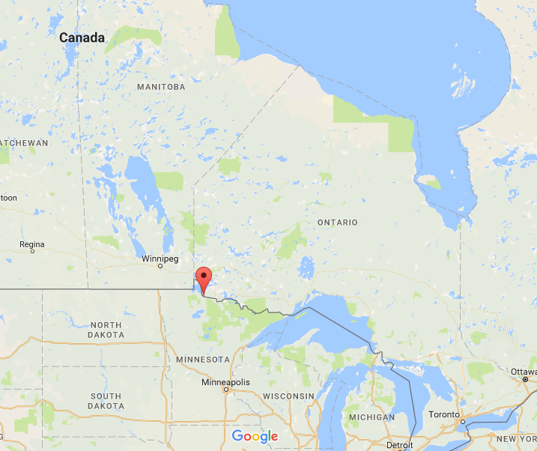

Slide 8
Chapter 4
Overview: Before going to Vietnam, Tim O'Brien decides to dodge the draft, and he drives north to Canada but stops near the border at The Tip Top Lodge, owned by an old man named Elroy Berdahl. O'Brien credits Berdahl with being "the hero of his life." O'Brien spends six days at the Lodge, trying to decide whether or not to flee. Berdahl takes him out on a boat so he's only yards away from Canadian soil. O'Brien feels forced to go to war for fear of embarrassing himself and his family, more than he fears death.

Slide 9
Focus Questions (to help your reading)
How do the opening sentences prepare you for the story?: “This is the one story I’ve never told before. Not to anyone.” What effect do they have on the reader?
What were Tim’s options once he received his draft notice? Who did he hold responsible for his situation? Who did he think should go to war instead of him?
What does Tim say is Elroy Berdhal’s role in his life?
Why does O’Brien relate his experience as a pig declotter? How does this information contribute to the story? Why go into such specific detail?
At the story’s close, O’Brien almost jumps ship to Canada, but doesn’t: “I did try. It just wasn’t possible.” What has O’Brien learned about himself, and how does he return home as a changed person?

Slide 10
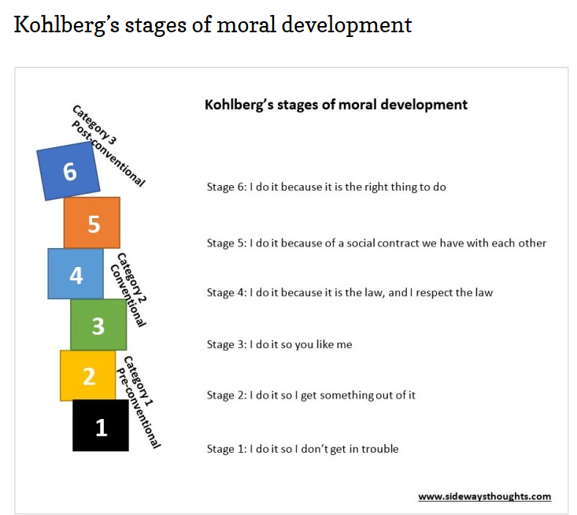
Kohlberg’s stages of morality

Slide 11
In this chapter, we learn the 21-year-old O'Brien's theory of courage: “Courage, I seemed to think, comes to us in finite quantities, like an inheritance, and by being frugal and stashing it away and letting it earn interest, we steadily increase our moral capital in preparation for that day when the account must be drawn down. It was a comforting theory.”
What might the 43-year-old O'Brien's theory of courage be?

Slide 12
Pick Two to Answer
Analyze Historical Context : The 1960s was a period in which many young people rebelled against the beliefs and traditions of older generations. How does “On the Rainy River” reflect this historical context?
Identify Author’s Perspective: How might the author’s upbringing in a small Minnesota town have influenced his view of events and people in the story? Cite evidence from the text.
Analyze Symbol: A symbol is a person, a place, an object, or an activity that represents something beyond itself. What does the narrator’s job at the meat-packing plant symbolize? Explain your answer.
Draw Conclusions: The narrator describes Elroy as “the hero of my life.” Identify some of Elroy’s admirable traits and actions. Then explain why he was so important to the narrator.
Make Judgments: Do you agree with the narrator that his decision to go to Vietnam was an act of cowardice? Give reasons for your answer.
Evaluate: Would this story be as effective if Tim O’Brien had not served in Vietnam? Explain why or why not.

Slide 13
Chapter 7: How to Tell a True War Story

Slide 14
Chapter 7
Overview: O'Brien writes that war stories have no moral, they are often not true (at least completely), and if a story is true you can tell by the kinds of questions a story gets after it's told. O'Brien tells the story of Rat Kiley's reaction to Curt Lemon's death as an example, as well as Mitchell Sanders' story about a platoon of soldiers that started having auditory hallucinations. When O'Brien tells the story of Lemon's death, usually an older woman will say it's too sad, and O'Brien resolves he has to keep telling the stories and adding to them to make them truer.
Ultimately, in war, the conventions of good and evil in civilized society fall by the wayside. After Rat Kiley loses his best friend, Curt Lemon, to a booby trap he tortures a baby water buffalo as everyone else looks on. No one tries to stop it. Mitchell Sanders says that in Vietnam there are new sins created that have never existed before. War re-defines morality, it changes the definition.

Slide 15
Turnitin.com Questions
Why does this story begin with the line: “This is true.” How does that prepare you, as a reader, for the story? In what sense is “this” true?
Find a few of O’Brien’s elements of a “true war story.” (such as, “A true war story is never moral.”)
Why does O’Brien believe these elements are important to a “true” war story?
O’Brien explains that this story was “not a war story. It was a love story.” In what sense is this a “love story”? Why?
What does he mean when he says that true war stories are never about war? In what sense is a “true” war story actually true? That is, in O’Brien’s terms, what is the relationship between historical truth and fictional truth?

Slide 16
Chapter 13: Ambush

Slide 17
Chapter 13
Overview: In this story, O'Brien uses a first-person narrator to recount an incident of war. The narrator's nine-year-old daughter, knowing that her father writes war stories, asks him if he has ever killed anyone. The story follows Tim and Kiowa during an ambush.

Slide 18
Turnitin.com Questions
The narrator "keep[s] writing war stories." What does he expect the writing to do? Do you think it is working?
Why doesn't the narrator let the soldier pass? How do you think you would have reacted in a similar situation?
Why do you think the narrator focuses on the gory details of the soldier's death?
Kiowa tells the narrator that it was a "good kill." What does this phrase mean in its military context? Do you agree or disagree with Kiowa's interpretation? Why/Why not?
Why does the narrator lie to his daughter, and how does he justify it? Do you think she will ask him the same question when she's older? Why/Why not?
How do individuals justify killing during wartime when they would not kill during times of peace? What does this tell you about humans' tendencies toward self-preservation?

Slide 19
Assessment
Analyze the impact stories about war have on the war movement of public support. How would a novel like The Things They Carried have changed (or not changed) public perception and support of the Vietnam War?
Need 4 quotes
Must have thesis statement
1-2 paragraphs

