Slide 1
To Kill a Mockingbird
Harper Lee

Slide 2
Table Talk
Take a few moments to individually answer:
How can citizens, particularly ourselves, break through barriers of prejudice to promote tolerance?
What does it mean to be an individual in society? Does society force its citizens to take unpopular, but moral, stances in order to promote change?
Table discussion around answers

Slide 3
Essential Questions
Conclude how citizens in TKAM broke through barriers of prejudice to promote tolerance.
In TKAM, determine what it means to be an individual in society. To what extent did Maycomb society force its citizens to take unpopular, but moral, stances in order to promote change?
Examine how the legacy of slavery and the failure of Reconstruction is depicted in TKAM

Slide 4
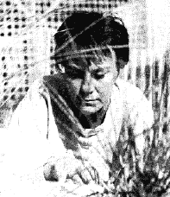
Harper Lee
Born 1926 in Monroeville, Alabama
Best friends with Truman Capote
Wrote In Cold Blood together
Very Private Person
Early 1950s
Studied law
Airline hostess
Began writing some during this time

Slide 5
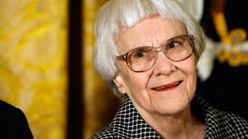
Family Life
Youngest of four, grew up as tomboy in a small town.
Her father was a lawyer, a member of the Alabama state legislature and also owned part of the local newspaper.
For most of Lee's life, her mother suffered from mental illness, rarely leaving the house.
Harper Lee died on February 19, 2016, at the age of 89; died in her sleep at an assisted living facility in Monroeville.
Source: biography.com

Slide 6
To Kill a Mockingbird
Published in 1960
Very Popular coming-of-age story
Racial prejudices in the South
Made into a Oscar winning movie (1962)
1961: Pulitzer Prize for Fiction
In November 2007, President George W. Bush presented Lee with the Presidential Medal of Freedom for her "outstanding contribution to America's literary tradition" at a ceremony at the White House.

Slide 7
Similarities Between Novel and Author’s Life
Novel is NOT autobiographical
Towns
Monroeville & Maycomb: similar layout and size
Fathers
Both Lawyers
Lee’s father’s middle name is Finch; Finch is the last name of family
Both had genuine humility and natural dignity
Time Frame
Lee same age as Scout at the time the story takes place

Slide 8
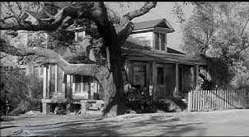
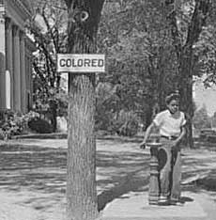
Setting
Fictional Maycomb, Alabama
1933-1935
During the Great Depression
Deep South
Segregated and Racist
Poverty

Slide 9
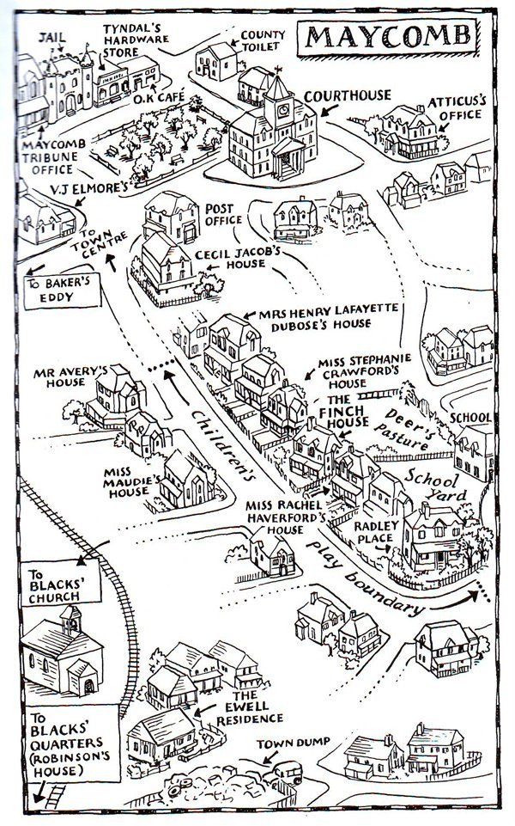
Courtesy of Big Think

Slide 10
Characters
Major
Minor
Scout (narrator)
Jem (brother)
Atticus Finch (father)
Calpurnia (maid)
Dill (friend)
Boo Radley (neighbor)
Miss Maudie (neighbor)
Tom Robinson (black man, trial for him)
Aunt Alexandra
Miss Caroline (teacher)
Bob Ewell (father)
Mayella Ewell (daughter, accuses Tom of rape)
Cunningham family
Heck Tate (sheriff)
Mrs. Dubose (older woman, read to her)

Slide 11
Southern Gothic
Subgenre of Gothic fiction set in the American South
Common Themes:
Deeply flawed, disturbing or eccentric characters
Ambivalent gender roles
Decayed or derelict settings
Grotesque situations
Other sinister events relating to or stemming from poverty/alienation/crime/violence
Merges Dark Romanticism + Southern Humor + New Literary Naturalism
POWERFUL FORM OF SOCIAL CRITIQUE

Slide 12
Themes
Importance of morality and ethics (be a good person)
Risk of the loss of innocence
Having courage during hard times
“You never really understand a person until you consider things from his point of view … until you climb into his skin and walk around in it”-Atticus

Slide 13
Historical Significance
Lee was six years old at the start of the Scottsboro trial and Scout is six years old at the beginning of the Robinson trial.
Similarities exist between the Robinson trial in the text and the Scottsboro trial of the 1930s.
Both trials involve black men wrongfully charged with raping white women.
In both trials the justice system (or lack thereof) progresses very similarly
Jim Crow laws in the South, impact of Great Depression

Slide 14
To Kill a Mockingbird’s Point of View
In this novel the story is told from Scout’s point of view (1st person).
The novel is primarily told by the child, Scout, but the narrator also uses the fact that it has been years since the event to fill in other details (showing maturity).

Slide 15
Symbols
Mockingbird is filled with symbols. Keep track of them while reading the novel.
They are important to the novel and understanding the main ideas/themes

Slide 16
Homework Tonight
Read chapter 1
Sign-up for chapter presentation before the end of class
Groups of 2
Optional: Print study guide (whole 3 pages!)

