Slide 1
The Post

Slide 2
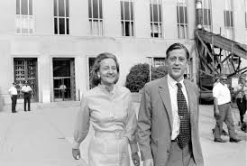
Film synopsis
“Katharine Graham is the first female publisher of a major American newspaper -- The Washington Post. With help from editor Ben Bradlee, Graham races to catch up with The New York Times to expose a massive cover-up of government secrets that spans three decades and four U.S. presidents. Together, they must overcome their differences as they risk their careers -- and very freedom -- to help bring long-buried truths to light”.
Source: google.com

Slide 3
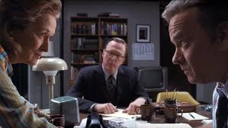
Cast and awards
Meryl Streep: Katherine Graham
Tom Hanks: Ben Bradlee
Sarah Paulson: Tony Pinchot Bradlee
Academy Award Nominee for Best Picture, Best Actress
American Film Institute Top Ten Films of 2017
Golden Globe Nominee: Best Picture, Actress, Director, Screenplay
Seattle Film Critics Society Nominee: Best Picture, Actress, Ensemble

Slide 4
Discussion questions
“It is remarkable how more and more relevant the First Amendment theme became as we were in production,” said Josh Singer, co-writer of The Post and writer of Spotlight (which we will watch later in the year). To what extent is Singer correct as you think of how presidents in 1971 and 2019 view the press.
Conclude the role the press and journalists play in society. Determine the value of a free press.

