Slide 1
The Great Gatsby
Daily Lessons

Slide 2
Discussion 11/22
How does Fitzgerald describe East Egg?
How does he describe West Egg?
What does Nick say about Gatsby?
What are your impression/questions regarding chapter 1?
Film Version!

Slide 3
Hemingway & Style
11/25

Slide 4
Learning targets
I can Determine the major differences between Fitzgerald and Hemingway.
I can Conclude what type of writing style was valued more by the people of the 1920s.
I can Conclude which writing style would be best for conveying social commentary or criticism.

Slide 5
Ernest Hemingway
In Another Country Excerpt
What do you notice about his writing?
How is this story an example of modernism?
What differences and similarities do you see between Hemingway and Fitzgerald (think about their writing styles)?

Slide 6
Hemingway Piece
“In the fall the war was always there, but we did not go to it any more. It was cold in the fall in Milan and dark came very early. Then the electric lights came on, and it was pleasant along the streets looking into the windows. There was much game hanging outside the shops, and the snow powdered in the fur of the foxes and the wind blew their tails. The deer hung stiff and heavy and empty, and small birds blew in the wind and the wind turned their feathers. It was a cold fall and the wind came down from the mountains.”

Slide 7
Style
Contributing Factors:
Types of adjectives and adverbs (simple or complex)
Clause length
Sentence length
Paragraph length
Use of dialogue
Use of vernacular
Choice of punctuation
Why does style matter?
How does Hemingway’s style affect the mood of his story?
How does Hemingway’s style shape character development?

Slide 8
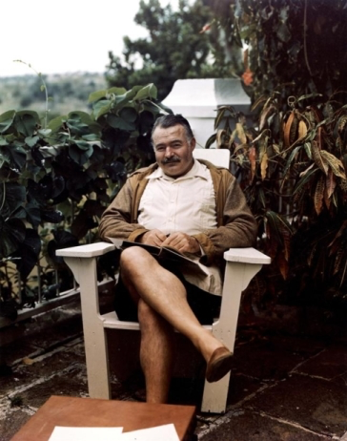
Hemingway
Served in WWI
Moved to Paris
Known for his style of writing: a break in traditional narrative
Sparse, deliberate choices to break from flowery language of the past
Left out essential information of the story in the belief that omission can sometimes strengthen the plot of the novel
Major Themes: Love, war, wilderness, loss

Slide 9
Hemingway’s Style: Iceberg Theory
The Iceberg Theory (Theory of Omission) is the characteristic writing style of Ernest Hemingway.
Hemingway chooses to give very little context or interpretation in his stories. His style is minimalistic and focuses on surface elements without specifically explaining underlying themes.
Hemingway believed the deeper meaning of a story should not be evident on the surface, but should shine through implicitly.
You start with the tip of the iceberg, but there is much more complexity and meaning beneath the surface.
Critics argue that this Iceberg writing style functioned to distance Hemingway from his characters.

Slide 10
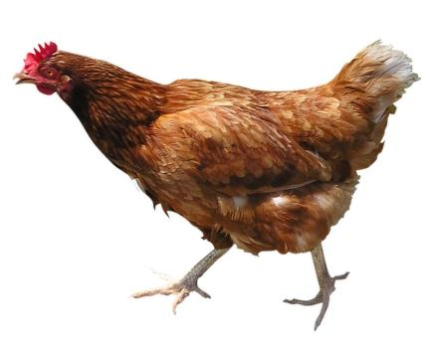
What would Hemingway say?
Why did the chicken cross the road?
To die. In the rain.

Slide 11
Six Word Stories
For sale: baby shoes, never worn.
What does this story reveal to the reader?
How does Hemingway manage to tell us an entire story in just a few words?
Notes:
https://www.youtube.com/watch?v=nc5VbZ2RnTg

Slide 12
Homework:
Create your own six word story!
In the spirit of Hemingway, you are going to create your very own six word story.
Be creative & have fun!
Due tomorrow, 15 points
10 pts for your six word story
5 pts for creativity and presentation (Make it pretty! They will be on display!)

Slide 13
Learning Targets 11/27
I can collaborate with classmates in a productive, focused, and engaged manner
I can demonstrate an understanding of the great Gatsby by using evidence and analysis
I can determine the different writing styles of 1920s authors

Slide 14
Discussion chapter 2-3
How is Myrtle described?
How is Tom’s apartment described?
What effect is his ‘friendship’ with Tom having on Nick?
What is the mood of the scene in the apartment? How is this achieved? (textual evidence)
What is the marriage of Daisy and Tom like? The marriage of Myrtle and George?
What happens at the party in chapter 2?
What is Nick’s reaction to the party?
Is Nick gay? Why would this matter to the story and his role as a narrator?

Slide 15
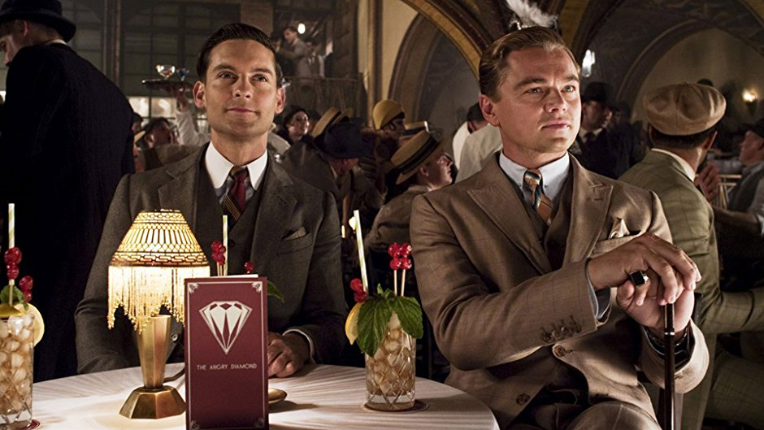
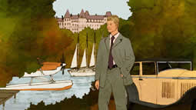
Who is Gatsby? (10 minutes)
Using direct quotes:
What do we know about Gatsby?
How do we know this information?
What is the truth?

Slide 16
Chapter 4 and 5: Narrative Structure & Prose Appreciation
12/4

Slide 17
Learning Targets
I can analyze nick’s role as our narrator
I can collaborate with classmates in a productive, focused, and engaged manner
I can demonstrate an understanding of the great Gatsby by using evidence and analysis
I can demonstrate an understanding of character motivation and desire by using multiple perspectives

Slide 18
Who is our narrator? Who is describing every event?
Conclude the issues around Nick being the narrator.

Slide 19
Why first person narration?
Advantages of a first person narrative
The writer can give the narrator inner feelings and private thoughts and so create a personal narrative, as if confiding in the reader, to manipulate the reader’s response to the character.
The reader discovers information and experiences feelings with the narrator as Nick slowly discovers the truth about Gatsby, giving a realistic feel through this slow revelation and the various responses to it.
Limitations of a first person narrative
The reader can only know what the narrator knows and so gets a limited, partial account of events and relationships.
We, as readers, only get to know what the writer/narrator wants us to know and so the account can be selective, incomplete, biased, unreliable. However, the writer might do this deliberately, to create suspense and make the reader work harder to understand the story.

Slide 20
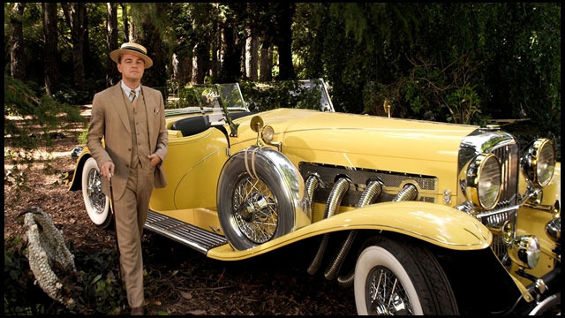
Chapter 4
This chapter is structured in three parts:
Nick lists party guests as though we should know them, they are treated as celebrities. The dark misbehavior emphasizes the secret lives of the wealthy and the carefree lavish lifestyle they lead.
We get a glimpse of the real Gatsby at lunch. His connection with Wolfsheim raises suspicion that Gatsby may be a criminal.
In contrast, Jordan’s description of Gatsby’s past romance with Daisy presents him as an innocent, romantic young soldier.
Using the car journey to New York in chapter 4 as evidence, assess whether the reader ever gets to see the real Gatsby in the novel.

Slide 21
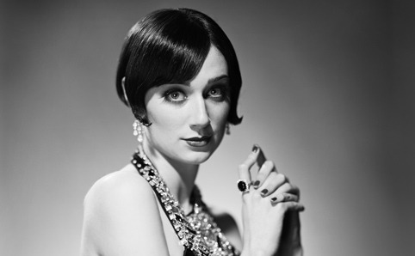
Narrative Shift
The second part of the chapter shifts to Jordan’s first person narrative. Nick tells the story in her voice. Why might this be?
What does this reveal about the character of Gatsby and how does it contribute to the novel as a whole? (Why is it that we need to hear Jordan’s version of events?)
Jordan’s story makes Gatsby a more sympathetic character, and for Nick, Gatsby becomes a real person.
Also gives us information about Daisy that affects our understanding of her character.

Slide 22
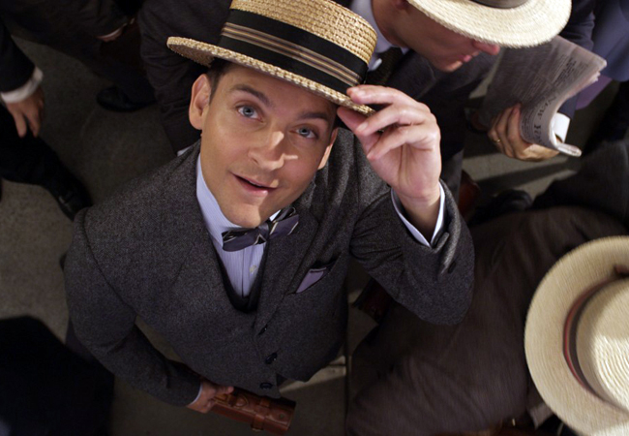
Chapter 5 – Nick’s Morality
Nick presents himself as a moral character, but is he consistent?
He arranges for Daisy to meet Gatsby, and he witnesses Tom and Myrtle’s affair, even though he claims he doesn’t want to.

Slide 23
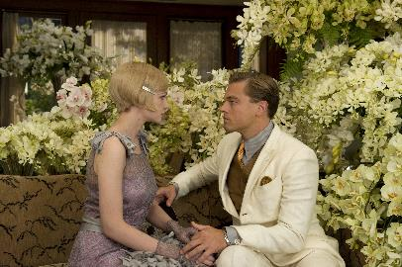
Chapter 5: The Big Meet-up!
How would you describe the initial meeting between Gatsby and Daisy in one word? How did it make you feel?
During chapter 5, Fitzgerald contrasts the behavior of Gatsby to the behavior of Daisy in terms of how they react to their meeting.
For each character their attitudes shift as the day together goes on. How does it change?
Awkward!! Why was this so uncomfortable?

Slide 24
Narrative Perspective
Rewrite the scene in which Gatsby and Daisy meet from their perspectives (not as Nick describes it).
What would they be thinking about the situation based on what you know about their characters?
How would this affect our understanding of the characters?
Incorporate 3 pieces of evidence (don’t forget page numbers!) in your writing, but use the voice of your character and the prose of Fitzgerald!
You can choose to write a paragraph or two from Gatsby or from Daisy, or switch between the two characters for a few paragraphs (minimum two paragraphs)

Slide 25
Learning Targets 12/5
I can use evidence from the great Gatsby to support a claim
I can use analysis to support why my evidence supports a claim
I can challenge the claims of classmates by using evidence and analysis from the great Gatsby

Slide 26
Chapter 5-6 Questions
What does Gatsby believe it is possible to do (but nick does not agree)?
How did Dan Cody impact Gatsby?
What is Gatsby’s grand vision for his life with daisy?
How does she fail to live up to his vision?

Slide 27
Symbolism Board Talk
"You don't write because you want to say something, you write because you have something to say.“-F. Scott Fitzgerald
Take 10 minutes at your desks to come up with answers for the questions
Will have time to wander around the room, answering/discussing the different questions…SILENTLY
Must use specifics (facts, quotes, plot details) with a page number
Must write your name after each comment
Please interact with what your classmates write (debate or discussion)

Slide 28
Symbolism board talk (15 minutes)
Fitzgerald chooses to use colors to represent certain people because…
Fitzgerald uses the moonlight to symbolize…
It is raining when Gatsby and Daisy meet again at Nick’s cottage because…
Dr. T.J. Eckleburg is used in the novel to…
The Eggs are eggs because Fitzgerald is trying to…
Fitzgerald chose to have Daisy and Myrtle be completely opposite women because…
Fitzgerald has shown his views on the 1920s through/by…

Slide 29
Additional Symbols

Slide 30
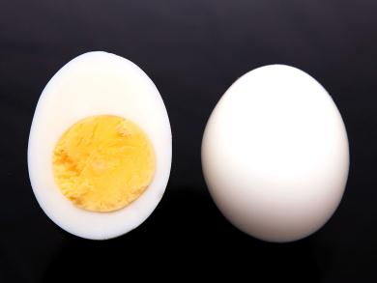
Why the Eggs?
Eggs are white on the outside & yellow on the inside.
White symbolizes innocence & purity.
Yellow represents money, status & greed.
Innocent & Pure
$$$$ + cholesterol

Slide 31
Daisy=Not that great…
Daisy –a beautiful flower that looks fragile on the surface, but is actually hardy. White on the outside, with a yellow middle. Think like the eggs.
Well-known, popular flower.
Have you ever smelled a Shasta daisy? They smell terrible.
The daisy is considered a noxious weed in some states. It slowly takes over your garden.
Beautiful
Terrible smell when you get too close.

Slide 32
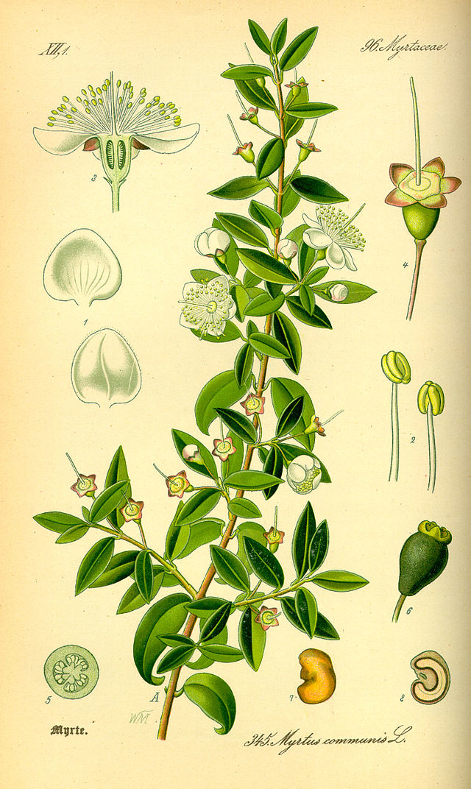
Myrtle & her surplus of flesh
Myrtle is a tough and durable shrub.
Myrtle is a symbol for love and marriage.
Can grow very tall….like Myrtle trying to rise above her station.
In Greek mythology, myrtle is sacred to Aphrodite, goddess of love.

Slide 33
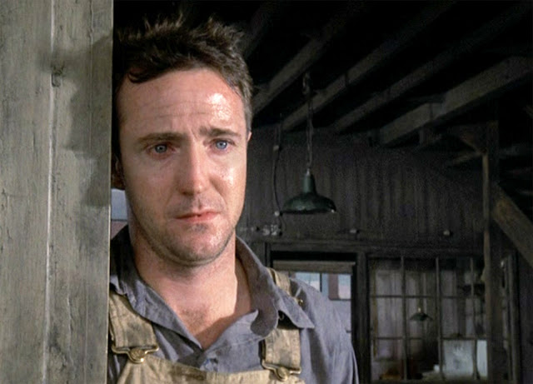
George Wilson
Wilson- Similar to the President, Wilson is a defeated idealist disillusioned by the loss of his own American Dream.
He is described with gray, like the ash, to represent his hopelessness.

Slide 34
Other symbols
Moonlight: think about how things can be hidden in the dark, but the moonlight only reveals what is not in the dark
Loneliness of the dark/moonlight?
Water/pool: draining the pool is like the draining of Gatsby’s dream of achieving Daisy
Love: think about this…the only three people who truly love (Gatsby, Myrtle, George) all end up dead

Slide 35
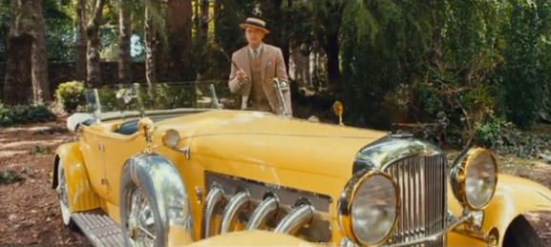
Chapter 7: Integrity and the Moral Universe of Gatsby 12/6 “The rich are different from you and me…”

Slide 36
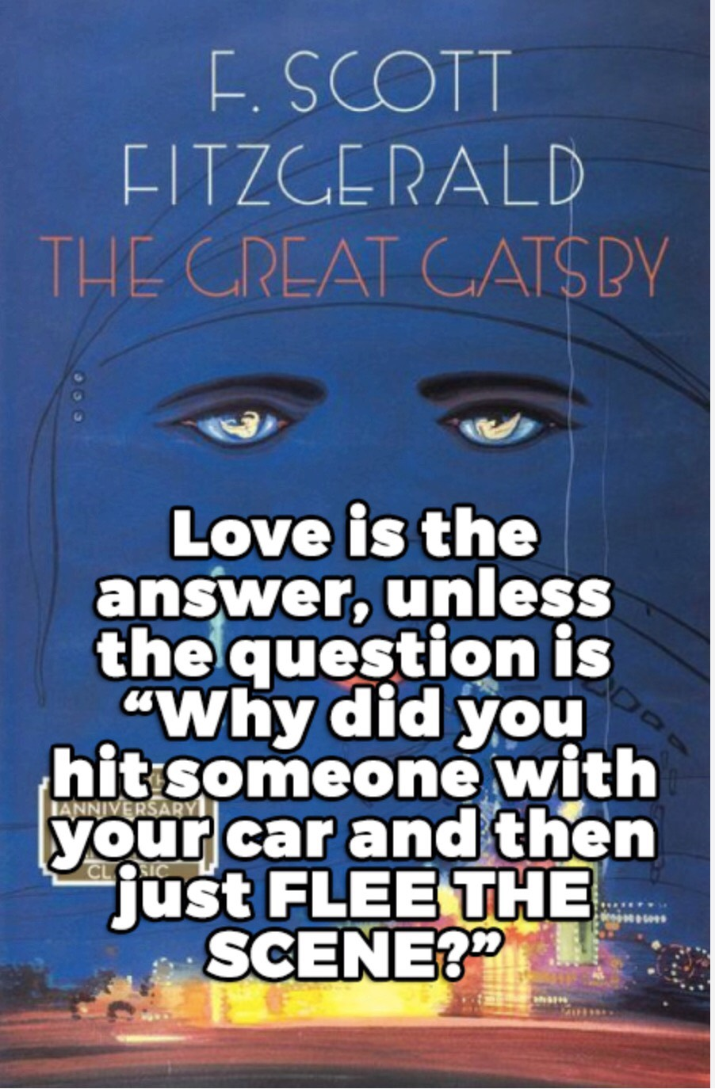

Slide 37
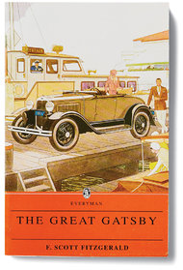
“She was incurably dishonest. She wasn’t able to endure being at a disadvantage and, given this unwillingness, I suppose she had begun dealing in subterfuges (deceits used in order to achieve a goal) when she was very young in order to keep that cool, insolent smile turned to the world and yet satisfy the demands of her hard, jaunty body.” (chapter 3, Nick Describing Jordan)
Income inequality, intergenerational wealth and, of course, the American dream are at the heart of Fitzgerald’s novel.

Slide 38
Chapter 7 Class Discussion
How does Fitzgerald use setting in Chapter 7?
Conclude what Daisy meant when she tells Gatsby, “you always look so cool?” Conclude how her manner of speaking to him has changed
How does Gatsby’s explanation of Daisy’s voice begin to fill in some blanks for the reader?
If money = corruption, and Daisy’s voice is “full of money”, what has happened to Daisy?
Evaluate the importance of cars in this chapter
Investigate how Daisy changes in the chapter.
Determine the significance of eyes throughout this chapter.
What happens to Myrtle? Determine Who is responsible for what happened to Myrtle?
What are Tom and Daisy doing at the end of the chapter? What does this tell us about their characters?
Explain the significance of Gatsby keeping watch over Daisy at the end of the chapter?

Slide 39
Can we think about this idea of “not being able to endure being at a disadvantage” in relation to today, perhaps as it relates to elite competitive sports or cheating in high school… ?
Determine if being at the top necessarily mean sacrificing one’s integrity
Conclude if material wealth leads to a loss of integrity
Define the American Dream
To what extent is the novel a reflection of the 1920s?
Investigate if Nick is a corrupt character

Slide 40
Learning Targets
I can use evidence from the great Gatsby to support a claim (who is to blame for Gatsby’s death)
I can use analysis to support why my evidence supports a claim (who is to blame for Gatsby’s death)
I can collaborate with classmates in a productive, focused, and engaged manner
I can challenge the claims of classmates by using evidence and analysis from the great Gatsby
I can demonstrate an understanding of the great Gatsby by using evidence and analysis

Slide 41
Blame Game
Objective: to assign blame for the death and fate of Gatsby
Round 1:
You have 15 minutes to create a pie chart that is assigning blame for the death of Gatsby in chapter 8.
I suggest making a list of those responsible first and then assigning percentages.
You must also have cited evidence that you can use to support your blame
At the end of 15 minutes, your poster must be on your desk with the pie chart complete and your group names on the back.

Slide 42
Blame Game
Round 2: You and your group have 15 minutes to grab a marker and argue against the choices made by other groups. Use the text when applicable to make your point. All arguments against must be made on the left side of the poster and outside the pie chart itself. Please include your group name next to your comments.
Round 3: Come back to your own poster and, on the right side, defend your positions. Use the text and be sure to respond directly to the opposing arguments.

Slide 43
Ending Reflection (going in Homework Packet)
Justify who is most to blame for Gatsby’s death/fate.
To what extent does Gatsby die thinking he achieved his dream?
Conclude what would be an appropriate ending for the novel. Conclude what would be a ‘happy ending’ for the novel.
To what extent does Gatsby’s death represent Fitzgerald's views of the 1920s?
How does Fitzgerald use the novel to share his views of wealth and morality in the 1920s?
Investigate whether the story needs to take place in the 1920s, or if it could happen in 2019 America.
Determine the meaning of the last line: “So we beat on, boats against the current, borne back ceaselessly into the past”.

Slide 44
Gatsby’s Eulogy
Eulogy (n)
A speech or piece of writing that praises somebody or something very highly, especially a tribute to somebody who has recently died.
At the end of chapter 8, Gatsby is murdered by George Wilson. Before his murder, Gatsby loses his dream—which may be a much greater loss for him. As we have read and discussed in class, Gatsby’s dream of success and fortune was linked to his love for Daisy. Beyond himself, however, Gatsby represented the desire of each American to rise above the socio-economic position of their birth and ascend to the heights of society.

Slide 45
Gatsby partner Eulogy
For this assignment you will create a eulogy for Gatsby and his dream. The eulogy must be your own work.
Your eulogy may take the form of a speech, poem, drawing, or a song.
It will include one specific symbol from the novel and a clear reference to Gatsby’s dream—both why it was important and how it died.
The eulogy should also include three specific colors (and the symbolism associated with the colors)
This assignment is worth 20 points in culminating and is due Friday the 20th for a gallery walk
Song or Poem: 20 lines
Speech: 300 words

Slide 46
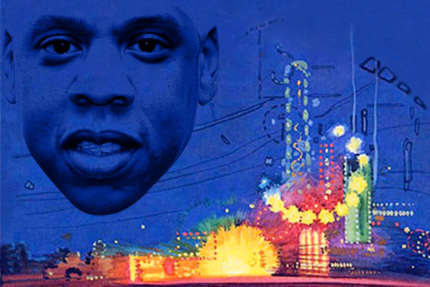
Jay Z and Jay Gatsby: Re-imaging Gatsby for Millennials
Notes:
http://www.vulture.com/2013/01/jay-z-great-gatsby-quiz.html

Slide 47
Learning Targets 12/12
I can collaborate with classmates in a productive, focused, and engaged manner
I can demonstrate an understanding of the great Gatsby by using evidence and analysis

Slide 48
Major themes of hip hop?
Money, status, love, cars (materialism), partying & excess
Major themes of the Jazz Age that Fitzgerald is trying to capture in Gatsby?
Money, status, love, wealth & materialism, partying & excess

Slide 49
Baz Luhrmann (director) draws a parallel between the Jazz-era pop songs that Fitzgerald references and his own soundtrack, ultimately aiming to demonstrate how deeply hip-hop has come to influence rock, pop, and dance music
Jazz used to be lewd and provocative dance music, now seen as refined and sophisticated
The incorporation of hip-hop gives the story a renewed authenticity
Effectively evoked emotion and imagery
More than just entertainment:
Imagine them as messages and images that attempt to transport an old idea to a new audience

Slide 50
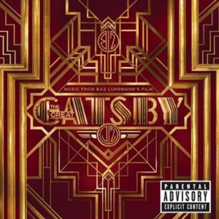
Annotate the lyrics while you listen, paying particular attention to…
Tone
Word Choice
Point of view
Repetition
Metaphor
Allusions
How does this song represent the novel?

Slide 51
To what extent is 2013 hip-hop an appropriate choice for the soundtrack of a story about the 1920s?
Conclude if Jazz is an example of life imitating art or art imitating life?
So, why hip hop?
And why spend time re-imaging an old story like this?

Slide 52
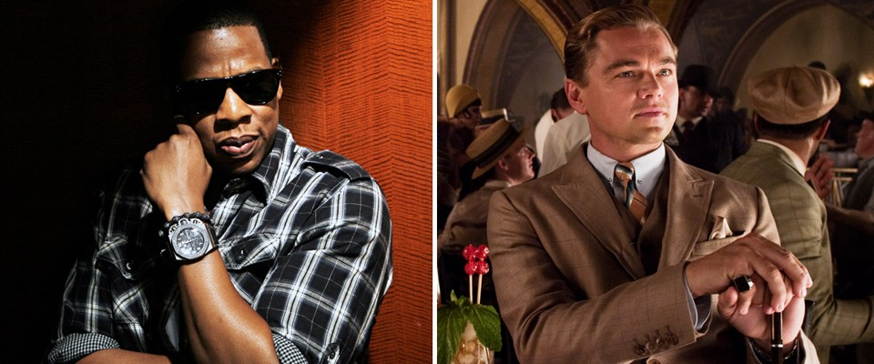
Jay Gatsby & Jay-Z
Pseudonym
Filthy rich
Self-made
School drop-out
Gangster associates
Sports connections
Political connections
Great cars

Slide 53
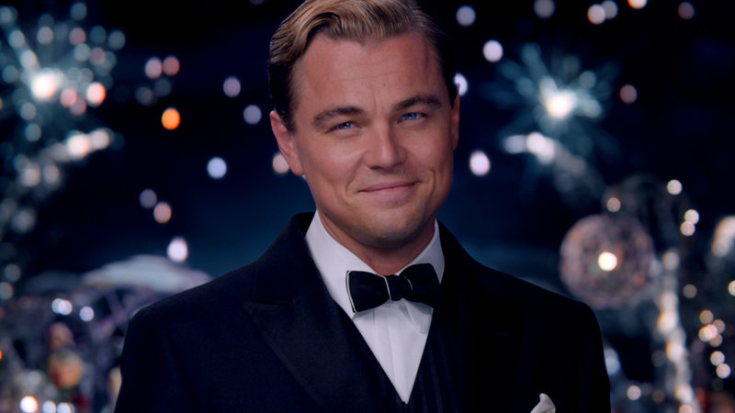
Homework...

Slide 54
Sound Track: Thematic Connections to Gatsby
Find one song that would be appropriate for the soundtrack of your version of The Great Gatsby.
May correlate to any part of the novel
What you turn in: Write out your rationalization for the song, including:
Musician & Song Title
Describe the song’s connection to Fitzgerald’s The Great Gatsby (thematic, pace, characterization, etc.)
Cite specific textual evidence to support your choice

Slide 55
Learning targets
I can demonstrate an understanding of the novel and the 1920s
I can use evidence and analysis to explore Fitzgerald's commentary of the 1920s
I can create a thesis statement supported by evidence and analysis

Slide 56
Timed write/11 sentence essay
Thesis statement sentence
One sentence BTS
One quote/fact (cited)
One sentence analysis
One sentence BTS
One quote/fact (cited)
One sentence analysis
One sentence BTS
One quote/fact (cited)
One sentence analysis
One sentence conclusion
On Monday, December 16th, you will be writing an 11 sentence essay as our integrated assessment for the great Gatsby and the 1920s
Open note, open book
Four potential prompts, you pick one for the assessment
Follow the exact format (this is not an essay or full paragraphs)

Slide 57
Essay Prompts
Conclude if Nick is as careful and honest as he claims to be. Determine his reliability as a narrator. What aspect of 1920s society does Nick represent?
To what extent does Gatsby represent the 1920s American Dream? Does he ever achieve it?
Investigate if the novel is a fair and accurate representation of the 1920s.
Analyze the symbolism in the novel and how Fitzgerald uses symbolism to provide social commentary of the 1920s.

Slide 58
Older files

Slide 59
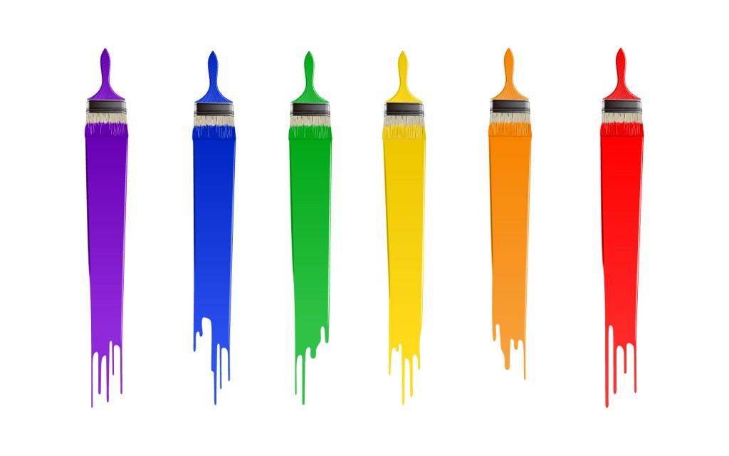
The Great Gatsby
Exploring symbolism through color

Slide 60
Learning Targets
I can collaborate with classmates in a productive, focused, and engaged manner
I can explain the symbolism of colors in the Great Gatsby
I can demonstrate an understanding of the great Gatsby by analyzing the use of color symbolism

Slide 61
Entry Task
I will put up a color, and I want you to write down everything you think of associated with that color
Bullet points are fine

Slide 62
Colors
Red
Yellow
Gold/golden/brass
White
Purple
Blue
Green
Gray/ colorless
Brown
Silver

Slide 63
Red

Slide 64
Yellow

Slide 65
Gold/
golden/
brass

Slide 66
White

Slide 67
Purple

Slide 68
Blue

Slide 69
Green

Slide 70
Gray/ colorless

Slide 71
Brown

Slide 72
Silver

Slide 73
Reflection
What color do you think best represents you, and why?

Slide 74
Fitzgerald’s Colors
Your group’s job is to first find examples of your color in the text, then figure out what your color represents in the novel. What is the significance of your color in the novel so far?
write the quotes you find, what you think the symbolism of your color is, and an image that represents your color

Slide 75
Duality
One symbol can have TWO different meanings, depending on the context
Fitzgerald’s use of color as symbolism uses duality throughout, so you have to pay attention to context!
Why is duality important?

Slide 76
Colors
Red
Yellow
Gold/golden/brass
White
Purple
Blue
Green
Gray/ colorless
Brown
Silver

Slide 77
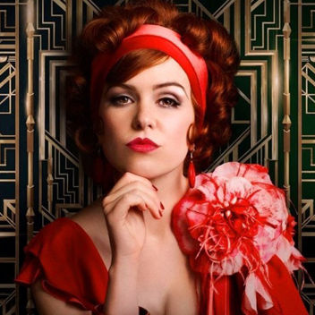
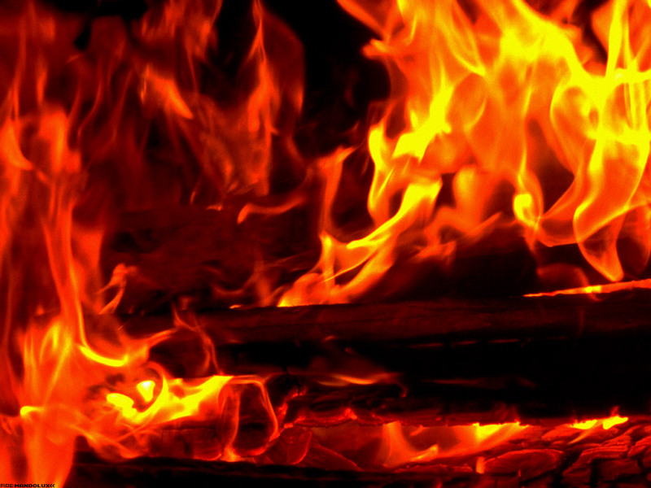
Red
Passion
Love
Excitement
Power
Anger
Violence
Aggression
Wealth
Tom’s carpet
Catherine’s hair
The blood from Myrtle’s nose
The blood on Gatsby’s car
The red falling leaves at the end of the novel by Gatsby’s house
Gatsby’s pink suit… not quite red
Red circles on the water

Slide 78
Quotes
“Then there were bloody towels upon the bathroom floor, and women’s voices scolding and high over the confusion a long broken wail of pain” (41)
“We walked through a high hallway into a bright, rosy-colored space” (13)
“The touch of a cluster of leaves revolved it slowly, tracing, like the leg of a compass, a thin red circle in the water” (170)
“the sister, Catherine, was a slender, worldly girl of about thirty with a solid sticky bob of red hair and a complexion of powdered milky white” (34)

Slide 79
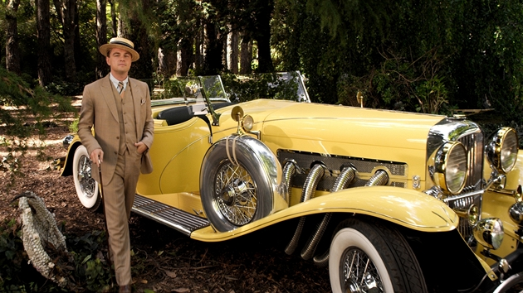
Yellow (mentioned 28 times)
Cowardice
Status/social class
Gets your attention
Corruption: White on the outside, yellow on the inside
Idealism
Joy
Death/Destruction
Enlightenment
Gatsby’s car
Gatsby’s tie
“Yellow cocktail music”
The glasses of T.J. Eckleburg
The yellow dress girls at the party
Tom’s apartment with Myrtle has yellow windows
Think about the color yellow in comparison to gold… not quite the same. Like old money and new money

Slide 80
quotes
“It was a yellow car [that killed myrtle]” (147)
“now the orchestra is playing yellow cocktail music” (40)
“His station wagon scampered like a brisk yellow bag to meet all trains” (39)

Slide 81
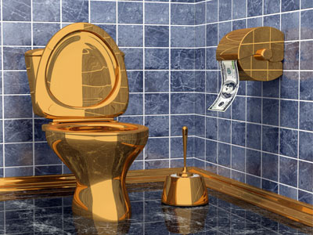
Gold/Golden/Brass (15 times)
Wealth
Status
Money
Greed
Old Money to the yellow new money
Beauty
Precious Metals
Jordan’s arms and shoulders
Daisy “The Golden Girl”
Gold odor
Buchanan house has a “gold sheen”
Gatsby’s toilet gold (dull gold)
Sometimes gold turns to yellow (especially at Gatsby's home) “twin girls in yellow cocktail dresses”

Slide 82
Quotes
“With Jordan’s slender golden arm resting in mine” (44)
“I put my arm around Jordan’s golden shoulder” (77)

Slide 83
White (mentioned 35 times)
Purity
Cleanliness
Innocence
Peace
Honesty
“White collar”
White supremacy… Tom & his “scientific books”
White privilege
Emptiness
Daisy starts out wearing white… Gatsby starts out wearing white… do they end up that way?
Nick’s clothes at the first Gatsby party
Buchanan house is white and red
The idea of white on the outside, yellow on the inside…explore this later

Slide 84
quote
“our white girlhood passed together there out of beautiful white” (24)
“They were both in white and their dresses were rippling and fluttering as if they had just been back in after a short flight around the house” (12)
“The king’s daughter, high in a white palace” (120)

Slide 85
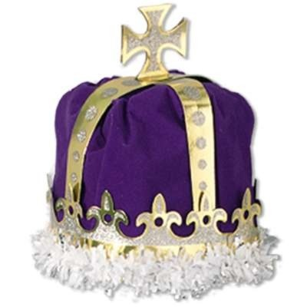
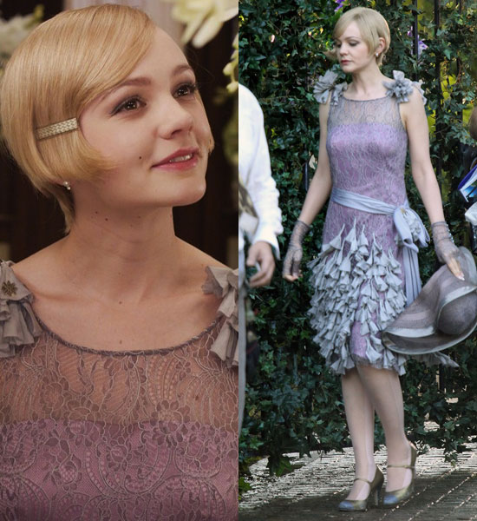
Purple
Royalty
Power
Elegance
Nobility
Arrogance
Cruelty
Luxury
Gatsby’s home decor, & shirts: Lavender
Daisy has lavender dresses and hats
Myrtle wears a lavender dress…why?

Slide 86
Quotes
“daisy’s face, tipped sideways beneath a three cornered lavender hat, looked out at me with a bright ecstatic smile” (54)
“Upstairs, in the solemn echoing drive away before she selected a new one lavender colored with gray upholster…sunshine” (18)

Slide 87
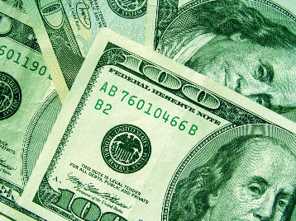
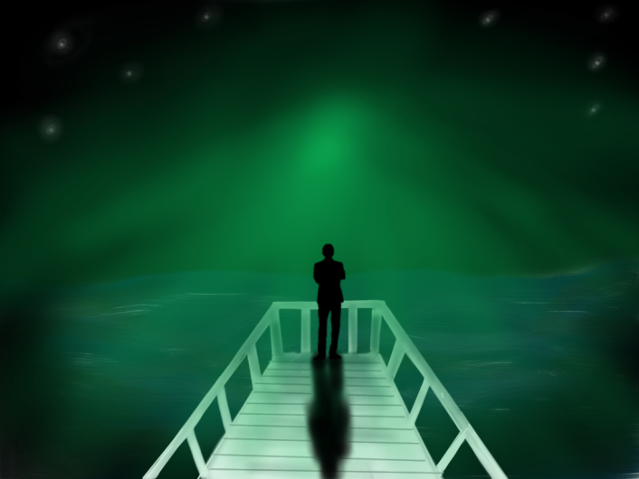
Green
Envy
Energy
Growth
Renewal
Hope
Youth
Vigor
New money
Stability
Green is mentioned 18 times in the novel
The Green light at the end of the dock
The human eye can see more shades of green than any color…
The American Dream… When does the light vanish?
Wilson’s face chapter 7

Slide 88
quotes
“I glanced seaward and distinguished nothing except a single green light, minute and far away, what might have been the end of a dock” (26)
“Sitting down behind many layers of glass in a sort of green leather conservatory we started to town” (68)

Slide 89
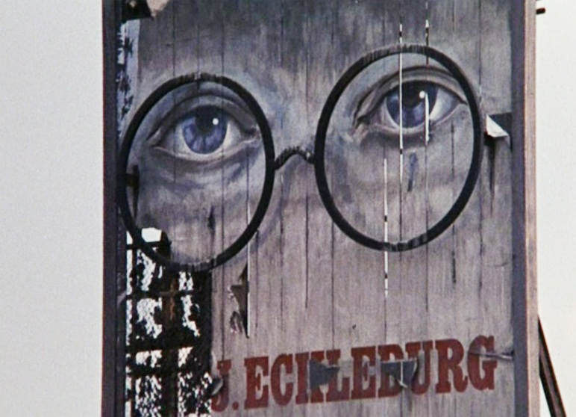
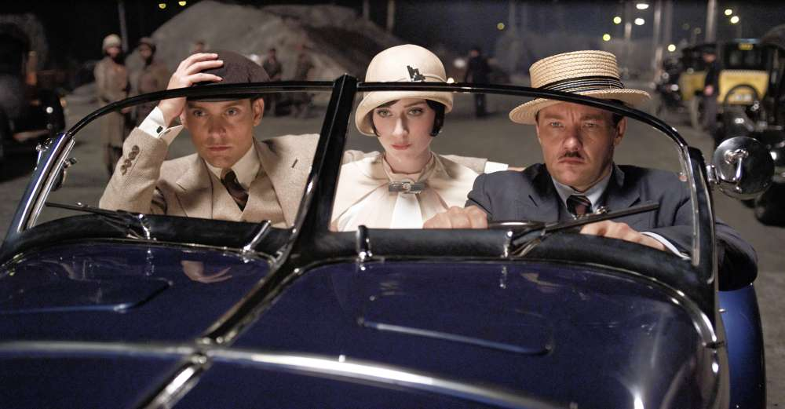
Blue
Wisdom
Cold
Sadness
Serenity
Confidence
Calm
Trust
Order
“Blue Collar”
Coolness/indifference
The eyes of Dr. T.J. Eckleburg
Tom’s car
Wilson’s eyes
Gatsby’s coat from Dan Cody, Gatsby’s lawn
Myrtle's dress when we see her the first time
The ripped party dress
Gatsby’s chauffeur’s uniform… working class

Slide 90
quotes
“the eyes of T.j. Eckleburg are blue and gigantic-their irises are one yard high” (27)
“Her face, above a spotted dress of dark blue crepe-de-chine, contained no facet or gleam of beauty, but there was an immediately perceptible vitality about her as if the nerves in her body were continually smoldering” (25)
“Ghostly birds began to sing among the blue leaves” (144)

Slide 91
Gray/Colorless (7 times)
Separation of the classes
No money
Poverty
Hopelessness
Facelessness
Melancholy
Low class
The Valley of Ashes
Wilson himself (except he has blue eyes)
Working class men and women
The dog seller
Even the air is smoky in the Valley of Ashes
Jordan Baker’s “gray, sun strained eyes”
Gatsby’s father has a gray beard

Slide 92
Quotes
“occasionally a line of gray cars crawls along an invisible track…” (23)
“it was a few days before the fourth of July, and a gray, scrawny, Italian child was setting torpedoes in a row along the rail road track” (26)
“Wilson’s glazed eyes turned out to the ash heaps, where small gray clouds took on fantastic shapes and scurried here and there in the faint dawn wind” (159)
“her grey sun-strained eyes stared straight ahead, but she [Jordan] had deliberately shifted our relations, and for a moment I thought I loved her” (63)

Slide 93
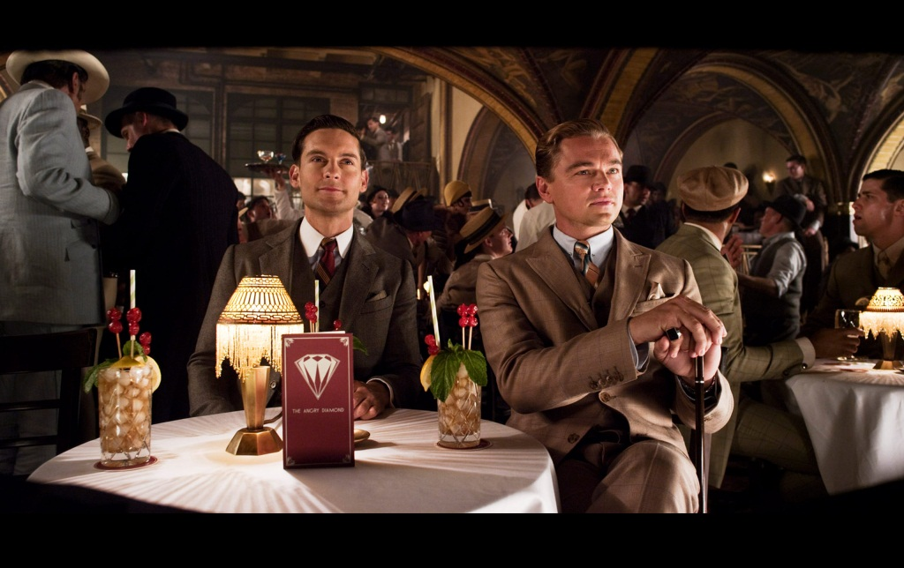
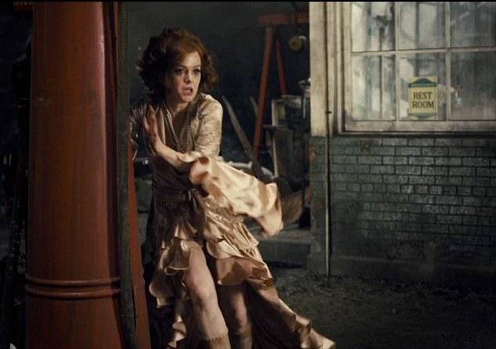
Brown
Earth
Reliability
Comfort
Endurance
Stability
Tainted

Slide 94
quotes
“her [jordan] brown hand waved a jaunty salute as she melted into her party at the door” (52)
“her hair the color of an autumn leaf, [and] her face the same brown tint as the fingerless gloves on her knee” (177)

Slide 95
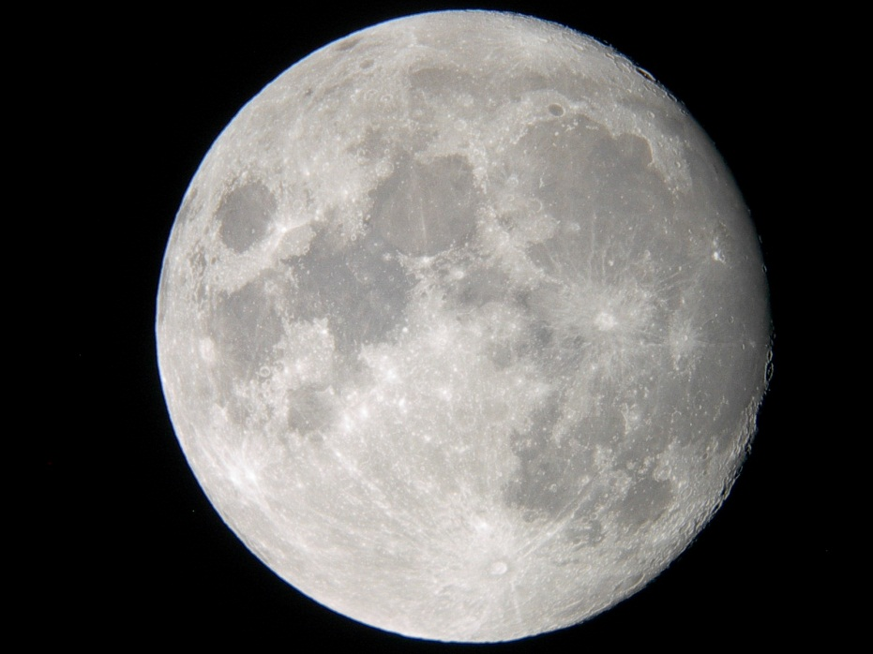
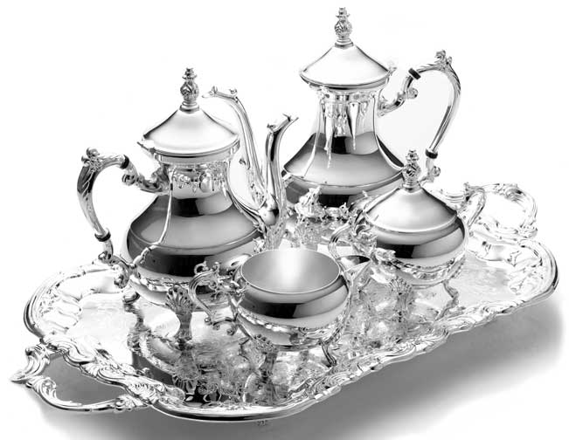
Silver
Moonlight
Jewelry
Wealth
Stars
Luxury
Precious metal

Slide 96
quotes
“the moon had risen higher, and floating in the sound was a triangle of silver scales, trembling a little to the stiff, tinny drip of the banjos on the lawn” (51)
“with his hands in his pockets regarding the silver pepper of the stars” (25)

Slide 97
Langston Hughes and the American Dream
Clearly, African Americans were not included in the American Dream, and not always given the opportunity to attain their American Dream
As a reaction, Langston Hughes created poems critical of America
Learning Target:
I can analyze Hughes poetry to determine his social commentary

Slide 98
Learning Targets
I can a Create a ‘found’ poem – at least 10 lines long – from Fitzgerald’s novel The Great Gatsby. As you do so, pay close attention to Fitzgerald’s use of language.
I can Summarize the story and social commentary of Fitzgerald’s 1920s novel
I can Review the story in preparation for Socratic seminar

Slide 99
Poem by Peter Norman 12/14
Nick Carraway and Gatsby (Jay)
Are next-door neighbours; every day
The enigmatic Gatsby gazes
Towards a distant green light (Daisy’s)
He throws wild parties; round his pond
Collects the New York demi-monde.
They rarely meet their host, who mopes
Indoors, but innocently hopes
That somewhere in this crowd of liggers,
Drunks, bores and Charlestoning gold-diggers,
He’ll spot a girl who drove him crazy
Before the Great War—name of Daisy.
Mrs. Buchanan now, her life
Is wasted as the unloved wife
Of brutish Tom (who has a manic
Mistress, wife of a mechanic)
They meet; it changes both their lives.
Intoxicated, Daisy drives
The rolls from town; sadly they hurtle
Into Tom’s manic mistress, Myrtle...
To shield the guilty loves one’s name,
Impulsive Gatsby takes the blame.
(And that’s how idealistic fools
End up face down in swimming pools)
Notes:
Demi-monde: people who lose favor because of being sexually promiscuous or doing questionable things
Liggers: free-loader, one who hangs on, attends parties

Slide 100
Gatsby Found Poem
Getting started:
Choose ten lines from the novel that you think create a vivid image of the story/theme/social commentary
Copy down Fitzgerald’s words. Then re-arrange the words/lines quotes to create a ‘found’ poem.
Re-order words so that you communicate images or emotions clearly.
Omit words that aren’t necessary.
Change punctuation, capitalization, verb tense, plurals, or possessives, as necessary.
Add up to four words of your own, if you absolutely need to add something to make the poem flow more smoothly or to make sense.

Slide 101
Space or arrange the words so they are poem-like. Pay attention to line breaks, layout, and other elements that will emphasize important words or significant ideas in the poem
Arrange the words so that they make a rhythm you like. You can space words out so that they are all alone or allruntogether.
You can also put key words on lines by themselves (max one time though)
You can shape the entire poem so that it’s wide or tall or shaped like an object
Choose a title.

Slide 102
Symbolism Timed Write 12/8
"You don't write because you want to say something, you write because you have something to say.“-F. Scott Fitzgerald
You will be presented with six questions, and you must respond to at least three in the 25 minutes
Must use specifics (facts, quotes, plot details) with a page number…this is why we annotate!
Grading using junior rubric (focusing on just content/evidence and analysis/thesis)

Slide 103
Learning Targets
I can collaborate with classmates in a productive, focused, and engaged manner
I can demonstrate an understanding of the great Gatsby by summarizing the plot correctly

Slide 104
Chapter Summaries 12/5
At your table groups (15 minutes):
Write a brief summary for your assigned chapters (1-6)
What happened?
Which characters were involved?
Important quotes (at least 3-4)?
Symbols/colors/motifs?
Social commentary being made by Fitzgerald?
We will put these summaries up on a poster paper to display in the class

Slide 105
Class Discussion
Determine if Daisy and Jordan are modern women.
Conclude Who is more to blame for the Myrtle/Tom and Gatsby/Daisy affairs.
Daisy? Tom? Myrtle? George? Nobody? Everybody?
Why the difference in colors, music?
Determine if you think one affair is more justified than another.
What is the difference between the two affairs?

Slide 106
Timeline for chapter 7
At your table group, come up with a timeline of events from chapter 7
Major events, characters involved
Will be going in a homework packet
We will be creating one as a whole class afterwards

Slide 107
The Great Gatsby Socratic seminar

Slide 108
Due Dates
Socratic Seminar: Wednesday 12/20
Prep work is due for a stamp Wednesday, December 20th
Before the seminar starts
Reflections are due Wednesday, January 3rd
Will submit prep and reflection in a 1920s/Gatsby homework packet

Slide 109
Learning Targets
I can demonstrate an understanding of the themes of the novel
I can demonstrate an understanding of the characters
I can demonstrate an understanding of the novel and how it explores major themes of the 1920s

Slide 110
Requirements
Preparation: prepare answers to the questions. Be able to support your ideas by referring to the text and historical information
Understand the grading set up and operation of the seminar: using normal Socratic seminar rubric
Ideas should be based in the text, yet you should be making original connections
You will also be incorporating 1920s slang, politics, culture, beliefs
While in the seminar, you should be referring to your prepared notes for comments

Slide 111
Extra credit!
Using 1920s slang in the appropriate way
Dressing up as a character from the novel

Slide 112
Questions
Must have specifics from the novel (quotes, facts)
Must have connection to history and the culture of the 1920s

Slide 113
Seminar Prep Work
Conclude the most important theme of Gatsby, and how Fitzgerald uses the characters and symbolism to develop the theme.
Fitzgerald wrote, "You don't write because you want to say something, you write because you have something to say." What did he have to say in Gatsby? What was the biggest problem in 1920s society?
The 1920s was the decade of ‘the flapper’, the young woman who exercised unprecedented freedom. Determine if Jordan Baker is a ‘flapper’.
Fitzgerald returns several times to describe a decrepit optical products sign – the eyes of Doctor T. J. Eckleburg -- that hovers over "the valley of ashes." What does that sign represent? What do the faded eyes of Doctor T.J. Eckleburg symbolize? Is there a connection between this billboard and the green light at the end of Daisy's dock?
Perhaps the novel's climax occurs when Gatsby confronts Tom in New York. Did Daisy's ultimate choice surprise you? Is it consistent with her character? Explain.
Nick believes he is an honest, nonjudgmental narrator. Discuss the reliability of Nick Carraway as the narrator of The Great Gatsby. Does Nick want to be with Gatsby or be Gatsby?

Slide 114
Online Discussion Board Directions
Go to turnitin.com (same as the Minorities Socratic seminar)
Click on Discussion tab
Respond to all of the different blog posts in a few sentences.
Requirements:
Must write an original response to at least three questions
Must respond to the comments of at least two classmates (must be a question that you have not responded to yet)

Slide 115
Online Discussion Board
What is a successful person? What is the greatest accomplishment in the 1920s society? Who is the ‘good guy’ in the novel and why?
When is it alright to lie? What is the worst kind of lie? Who is the most worthless/despicable/villainous character, and why?
What part of his past is Gatsby trying to recapture? Is he successful? Is there a person, feeling, or event in your past that you'd want to revisit? Gatsby believes that the past can be repeated. Is he right?
What characteristics make the novel a good representative of America in the 1920s? What is a 1920s “American” in your opinion?
What do you think of Nick as the narrator? Reliable? Gay? Careless?

Slide 116
Reflection
In a paragraph or two:
What is the American Dream? How does one achieve this dream? Can one achieve this dream?
Rate yourself: what score do you think you deserve for Content? Analysis? Discussion? Why?
Due by Wednesday, January 3rd

Slide 117
Reflection
Using the rubric, give yourself a score out of 10 for evidence, and a score out of 10 for analysis/thesis
For evidence: what evidence did you use that supported your thesis? Why did you choose that evidence?
For analysis/thesis: how did you use analysis to support your thesis and evidence?
After: What areas do you see as your strength? Why? What areas do you see as your weakness? Why?
This should be about a paragraph reflection.

Slide 118
Discussion 11/20
How does Fitzgerald describe East Egg?
How does he describe West Egg?
What does Nick say about Gatsby?
What are your impression/questions regarding chapter 1?
Film Version!

Slide 119
Discussion 11/21
How is Myrtle described?
How is the apartment described?
What effect is his ‘friendship’ with Tom having on Nick?
What is the mood of the scene in the apartment? How is this achieved? (textual evidence)
What is the marriage of Daisy and Tom like? The marriage of Myrtle and George?
What happens at the party in chapter 2?
What is Nick’s reaction to the party?
Is Nick gay? Why would this matter to the story and his role as a narrator?

