Slide 1
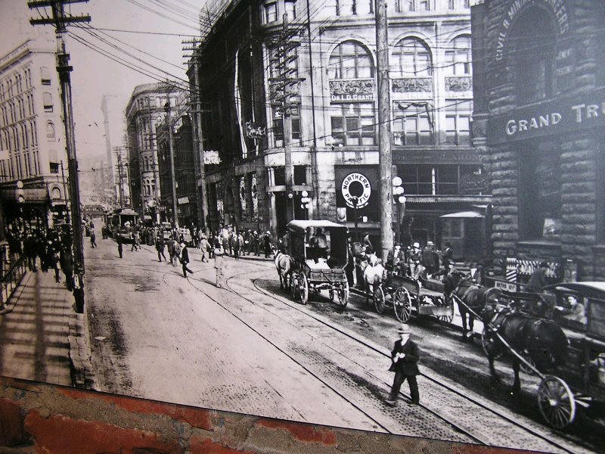
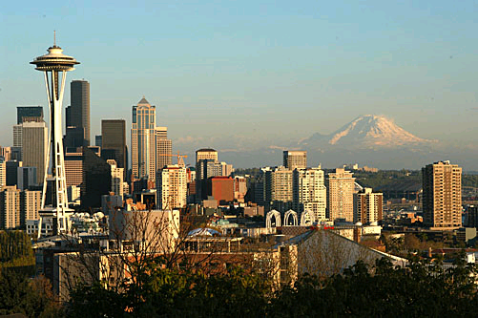
Urbanization of Seattle

Slide 2
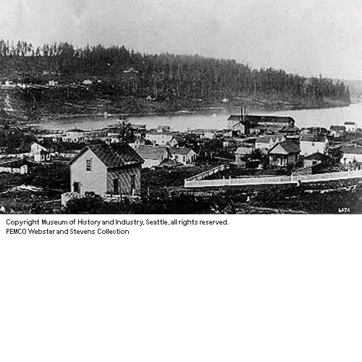
General Geography
Surrounded by low hills
Lake Washington to the West, Cascade Mountains to the East
Located on Elliot Bay
Puget Sound
-Deep water bay
-Trading
Abundant trees
Henry Yesler’s saw mill

Slide 3
The City of Seattle
Denny’s
Cabin
UW Campus
Sewage
Pot holes
Skid Road
Henry Yesler’s Saw Mill
Battle of Seattle
“Seamstresses”
Next

Slide 4
Denny vs. Maynard
Arthur Denny
Believed profit lay in developing harbor (Elliot Bay)
Developed banking and what would become Bank of America
Detested brothels
Doc Maynard
Saw the value of timber
196 of the 208 businesses located in Maynardtown (Pioneer Square)
Brought in Henry Yesler’s steam powered saw mill
Saw brothels as a perk of business

Slide 5
Henry Yesler’s Saw Mill
First steam powered saw mill in Pacific Northwest
Yesler partook in “questionable” business affairs
Rain, ocean and wagon damage combined with a lack of trees caused the land to sink
Yesler suggested dumping sawdust in potholes for “stabilization”
Yesler made mayor

Slide 6
Architectural / Sewage Planning
Originally had outhouses
Modern toilet invented 1851
Seattle created a sewage system which dumped into the sound
High tide caused the sewage to flow back to the houses

Slide 7
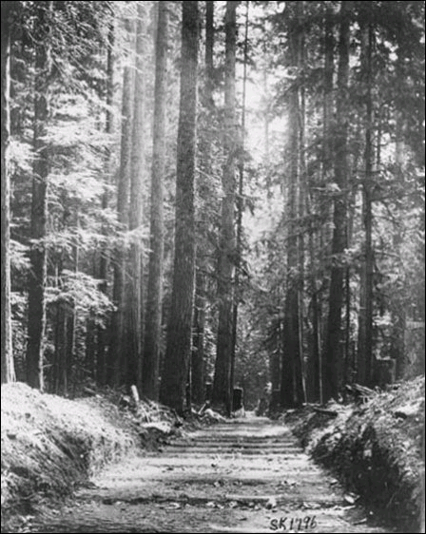
Skid Road
Problem: Hills too steep to transport logs
Solution: Skid Road constructed
Logs “skidded” down hill to Yesler’s saw mill
Efficient because of the severe slope of Seattle’s hills

Slide 8
Question
What is the risk of rapid urbanization?

Slide 9
The Great Fire

Slide 10
The Great Seattle Fire
June 6, 1889
The urban areas were vulnerable to fires
Started in the basement of a woodshop owned by Victor Clairmont
First Avenue and Madison
Started around 2:45 PM

Slide 11
After
The fire destroyed 32 blocks
Fire reached 4th and University
8:00 curfew
The smoke plume was seen in Tacoma

Slide 12
Casualties
No one died
Around 5,000 without jobs
Thousands without homes
City lost more than $8 million

Slide 13
Reconstruction
Martial Law
Plans for rebuilding
Rebuilding
Stone, brick, and iron
Streets raised by 22 ft
465 buildings built
More hydrants
Needed help from other cities

Slide 14
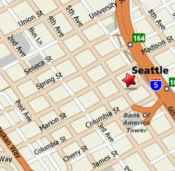
1st and Madison to 4th and University

Slide 15
Regrading
Seattle in between Elliot Bay and Lake Washington
Three major hills (Capitol, First, and Beacon)
Problem: Steepness of hills prevented roads and buildings from being constructed
Solution: Regrade the city

Slide 16
Regrading…thanks Wikipedia
Regrading is the process of grading for raising and/or lowering the levels of land. Such a project can also be referred to as a regrade.
Regrading may be done on a small scale (as in preparation of a house site or on quite a large scale (as in major reconfiguration of the terrain of a city, such as the Denny Regrade in Seattle).
Regrading is typically performed to make land more level (flatter), in which case it is sometimes called levelling.) Levelling can have the consequence of making other nearby slopes steeper, and potentially unstable or prone to erosion.

Slide 17
Leveling the hills of Seattle (1907)

Slide 18
Denny Regrade

Slide 19
Purpose of Regrading
Original motivation
-more available land
-increase land values (waterfront)
Problems
-new land isolated from the city
-eastern half of the hill still intact → west side hard to approach
-people drawn away from moving to west side because they feared another regrade would destroy their homes or businesses

Slide 20
Seattle Fire pictures and article
http://content.lib.washington.edu/extras/seattle-fire.html
Look at the pictures and read the background article
Create a metaphor for pre and post-fire Seattle.
Don’t just draw buildings then burned buildings

Slide 21
Seattle Labor and Industries

Slide 22
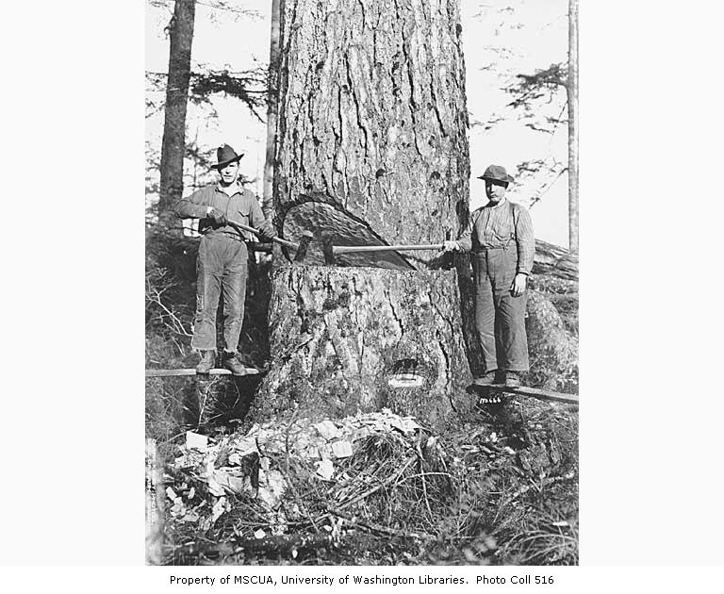
Lumber in the Pacific Northwest
He’s a lumberjack and he’s ok, he sleeps all night and he works all day

Slide 23
In the beginning
Starts as early at 1820 along the Columbia in southern Washington
Only really occurs in BC and WA, never really makes it to OR; (BC & WA are rainforests)
Picks up steam with Henry Yesler’s mill in Seattle in 1853
First major staple industry in Washington since fur
In full force by 1900—mainly because nowhere else has any more trees

Slide 24
The process
Find a forest, chop down a tree—it was this simple to begin with
Then it became a matter of protecting resources, so some forest are harvested on a rotating system
Once the tree is down, roll it (skid row) or float it to the lumber mill
Lumber mill chops it up, most of which is used to build things
Small portion of harvested forests used to make paper

Slide 25
Company towns
In 20th century big-business America, some got powerful enough to control entire town = company towns
Virtually everyone in the town works for the company
Those who don’t are homemakers or run other town services (schools, police, fire)
Good in that everyone knows everyone else
Bad in that everyone knows everyone else and it becomes hard to “get out” of the town

Slide 26
Modern logging
Golden Age of logging ends with 1920s when other materials become more prevalently used
Logging stays relatively strong through today (does not fully die like fur)
Still one of the world’s chief logging areas
Much more environmentally concerned—more protected areas and natural forests, cut down a tree, plant two trees programs, regulation and limits enforced

Slide 27
Other industries
Fishing
Boat making/shipping
Later: Boeing and Microsoft

Slide 28
Seattle General Strike
1919: First city-wide labor action called a general strike

Slide 29
Activity
http://depts.washington.edu/labhist/strike/
Read the background information (newspaper articles, strike memories and oral histories, interactive map, understanding the strike, etc.)
Then, with a partner:
Under Research Reports: pick one of the essays/articles, and become an expert on the topic
Be ready to briefly share information about the strike with the class
Bring in one-two quotes from reading
One pair per report

Slide 30
Research Reports Available
Spying on Labor: The Seattle Minute Men (Hollie)
Loyal Legion of Loggers and Lumbermen (Trenton)
The International Union of Timberworkers 1911-1923
The Seattle Telegraphers Lockout of 1918 (Jai)
The Mooney Congress and the 1919 Seattle General Strike
The IWW, the Newspapers, and the 1913 Seattle Potlatch Riot (Noah)
Where Women Worked During World War I (Ben)
Reds, Labor, and the Great War: Antiwar Activism in the Pacific Northwest
Newspaper Coverage of Washington State’s 1911 Workmen’s Compensation Act
Laundry Workers Struggle for Recognition 1916-17 (Aimee)
Perceptions of Race in the Seattle Union Record (Alex)
The University of Washington, Henry Suzzallo, and the General Strike (Jared)
The Songbird and the Martyr: Katie Phar, Joe Hill, and the Songs of the IWW (Henna)
Manufacturing a Menace: Labor Espionage in Seattle, 1919-1920 (PJ)
The Politics of Gender in the Writings of Anna Louise Strong (Alysha)
The Industrial Workers of the World in the Seattle General Strike (Aaron)
African-Americans and the Seattle Labor Movement (Fernando)
International Shingle Weavers of America (Parinita)
Women and the Seattle Labor Movement (Alex A.)
How the National Press Reported the General Strike (Kyle)
Mayor Ole Hanson: Fifteen Minutes of Fame (Tal)

Slide 31
Class sharing
You will share the following:
Brief summary of your reading
Who was involved? What happened?
What new insight did you gain?
Bring in one-two quotes from the reading to share with the class

Slide 32
Seattle General Strike
The Seattle General Strike of February 1919 was the first city-wide labor action in America to be proclaimed a “general strike.” It led off a tumultuous era of post-World War I labor conflict that saw massive strikes shut down the nation's steel, coal, and meatpacking industries and threaten civil unrest in a dozen cities.
The strike began in shipyards that had expanded rapidly with war production contracts. 35,000 workers expected a post-war pay hike to make up for two years of strict wage controls imposed by the federal government.
When regulators refused, the Metal Trades Council union alliance declared a strike and closed the yards. After an appeal to Seattle’s powerful Central Labor Council for help, most of the city’s 110 local unions voted to join a sympathy walkout. The Seattle General Strike lasted less than a week but the memory of that event has continued to be of interest and importance for more than 80 years.

Slide 33
February 6th
On the morning of February 6, 1919, Seattle, a city of 315,000 people, stopped working. 25,000 union members had joined the 35,000 already on strike. Much of the remaining work force was idled as stores closed and streetcars stopped running. The General Strike Committee, composed of delegates from the key striking unions, tried to coordinate vital services and negotiate with city officials, but events moved quickly beyond their control.

Slide 34
Americanism vs. Bolshevism
Most of the local and national press denounced the strike, while conservatives called for stern measures to suppress what looked to them to be a revolutionary plot. Mayor Ole Hanson, elected the year before with labor support, armed the police and threatened martial law and federal troops. Some of the unions wavered on the strike's third day. Most others had gone back to work by the time the Central Labor Council officially declared an end on February 11. By then police and vigilantes were hard at work rounding up Reds. The IWW hall and Socialist Party headquarters were raided and leaders arrested. Federal agents also closed the Union Record, the labor-owned daily newspaper, and arrested several of its staff. Meanwhile across the country headlines screamed the news that Seattle had been saved, that the revolution had been broken, that, as Mayor Hanson phrased it, “Americanism” had triumphed over “Bolshevism.”
Works Cited: http://depts.washington.edu/labhist/strike/

Slide 35
Timed Write
Using your notes and research about the Seattle General Strike, the race riots, the founding of Seattle, and Washington becoming a state, answer the following prompts for the full 30 minutes
What was the cause of the Seattle General Strike? What were the consequences/impacts/results of the Strike?
What event/person had the biggest impact on the founding of Seattle as an urban center?

