Slide 1
Realism

Slide 2
Learning Targets
I can define the Realist movement
I can analyze art for Realist characteristics
I can determine how Emily Dickinson and Walt Whitman are Realist poets.

Slide 3
The Realists (1860s- 1900)

Slide 4
Romantics Review
Could find “higher truths” in the natural world
City was the site of corruption and moral decay; nature was site of renewal, truth
Feelings/intuition/imagination over reason or logic
Experiences over school education
Poetry thought to be highest form of expression
Use traditional European themes/style to promote American way of writing

Slide 5
Realism vs. Romantics
Real life
Not really interested in lofty ideas of “higher truth”
Nurture (people products of environment)
Satire and irony
American uniqueness
Language how people actually talk
Feelings and intuition
Fascinated with “higher truth”
Nature (Good and Evil.)
Serious and Straightforward
European Traditionalism
Language fancy and European

Slide 6
Romantics and Realists: Similarities
Both felt cities sites of corruption, death, etc.
Both value lived experience over philosophy
Believe that people are improvable, we can be changed
Reject predestination, direct involvement of divine

Slide 7
American Realism
A style in art, music and literature that depicted contemporary social realities and the lives and everyday activities of ordinary people
A rejection of Romanticism
Began as early as the 1830s, but reached real prominence from the end of the Civil War to around the end of the 19th century
The realist concerned himself with the here and now, the socio-political climate of his day

Slide 8
Realism in Literature
A new choice of subjects: far from idealized characters.
Attempt to represent the real environment and manners of everyday life
Rejection of the impractical or visionary
An accurate representation of middle class life & people- the good & bad
Aims to change a specific social problem
The Civil War brings demand for a “truer” type of literature that does not idealize people or places.

Slide 9
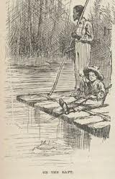
Realist hero
Not focused on “high truth”, instead focusing on life and getting by
Realistic or real portrayal
Often an outcast or a rebel; uneducated, uncultured, powerless, or poor

Slide 10
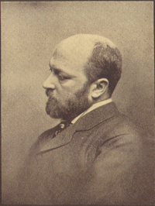
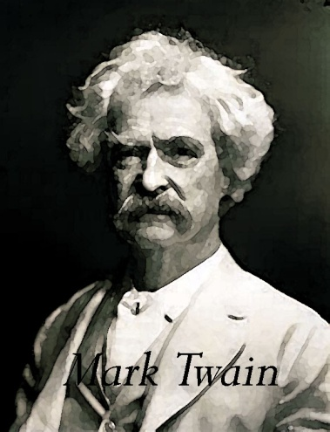
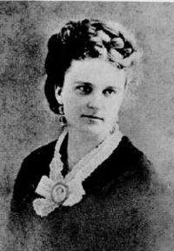
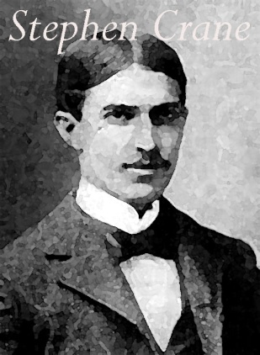
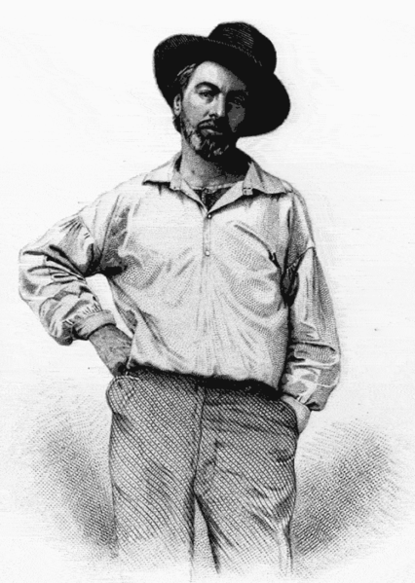
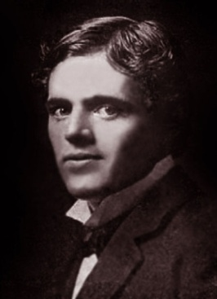
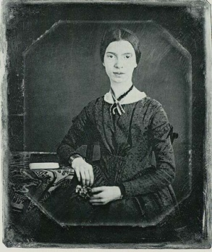
Realism Branches
Psychological
Fiction
Regionalism
“Realist”
Poets
Naturalism
Twain
James, Chopin
Crane, Bierce, London
Whitman,
Dickinson

Slide 11
Regionalism and Naturalism
Naturalism: Showed life as the unavoidable working out of natural forces beyond our power to control.
Regionalism: blended Realism with Romanticism: emphasized place, and the elements that create local “color”: customs, dress, speech, and other local differences.

Slide 12
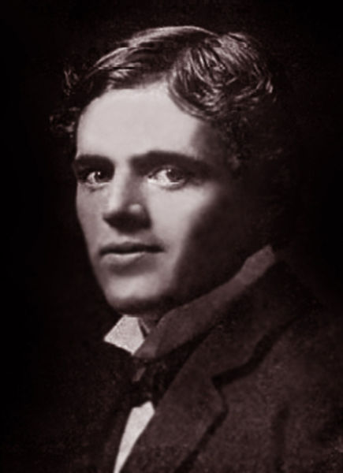
Naturalism
Went Beyond Realism in attempt to describe life as it really was.
Tended to view life as a grim, losing battle where people have few choices and live according to natural laws out of their control.

Slide 13
Regionalism
Realists no longer ashamed of American “provincial” roots
Provincial: the regions outside the capital city of a country; seen as unsophisticated
Portrayed, as accurately as possible: speech patterns, customs, daily life, environment, and music of the region
Goals varied
Showcase unique American character
Expose American flaws in order to bring social change

Slide 14
Psychological Fiction
Henry James, Kate Chopin
Disagreed with Naturalists idea that people driven only by crude instinct or what is natural
Concentrated on detailed studies of characters’ motivations
Emotional/mental reasons for doing things instead of nature impacting one’s actions

Slide 15
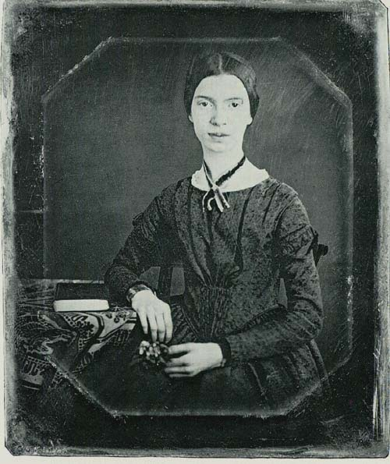
Realist poets
Pioneers of American Poetry
Both abandoned European forms- wrote in “free verse”
Gave two new “jobs” for poetry:
Whitman- celebratory, troublemaking (like Regionalists)
Dickinson- subversive, mental mindset (like psychological fiction)

Slide 16
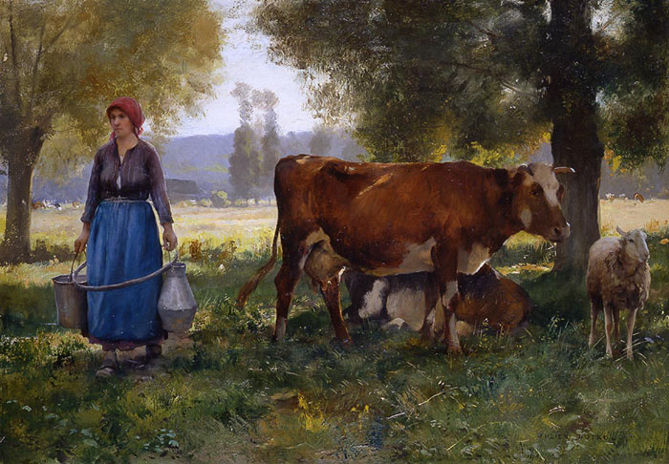
Naturalism

Slide 17
NATURALISM
Social conditions and events are inescapable and not because of the supernatural/God
Portrays things as they actually are
Naturalism literature is a literary movement that seeks to represent an everyday reality
More realistic and believable
Drawing/writing of realistic objects in a natural setting

Slide 18
Your task today
You will be writing about each of the Naturalist paintings presented.
You need to write about what you see, and what you think is happening in the painting.
You will have 1 minute for each painting, and you are expected to write for the full minute.
Painting notes and the overall reflection question will go in the homework packet

Slide 27
Reflection (5 minutes)
What similarities AND difference can you see between Rationalism, Romanticism, Dark Romanticism, Transcendentalism, and Realism (and all of its branches)?

Slide 28
Emily Dickinson Poetry
Realist poetry

Slide 29
Learning Targets
I can define the Realist movement
I can determine how Emily Dickinson and Walt Whitman are Realist poets.

Slide 30
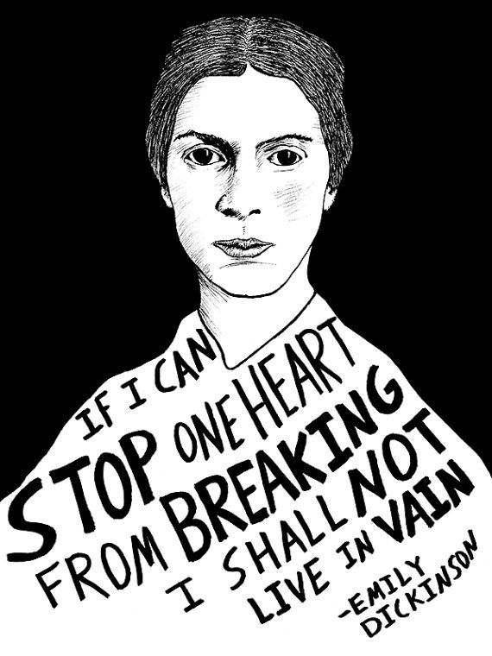
Dickinson Background
Born in Amherst, Massachusetts in 1830
Member of a prominent family really connected to community
Dickinson chose to live most of her life in isolation (she was a recluse)
Most of her 1,800 poems were published after her death in 1886
Died from Bright’s Disease (kidney disease) and her life was filled with much personal loss and turmoil
Family feud over the posthumous publication of her poetry, but eventually, half a century after her death, her poems were published
She is often seen as a feminist icon for her refusal to conform to gender stereotypes and expectations

Slide 31
Determine the role of nature/society in identity formation.
Emily Dickinson poetry
Each table group will be assigned a poem by Dickinson. The groups will then need analyze the poem for
the main ideas or themes presented
the mindset of Dickinson.
You will also write 5 discussion questions for the poem

Slide 32
Discussion Questions
Should not be a yes or no, or one word answer
Ex. What is Emily Dickinson’s name?
Should be questions of evaluation that could lead to further discussion
Ex. Examine the role of nature and society in the poem
Starter words: examine, conclude, determine, explain, investigate, infer, justify, to what extent…
Your questions should demonstrate your understanding of the poem, Dickinson’s mindset, and how this is a realist poem/poet

Slide 33
Groups
1: because I could not stop for death
2: success is counted sweetest
3: much madness is divinest sense
4: my life closed twice before its close
5: the soul selects her own society
6: I heard a fly buzz when I died
7: my life has stood a loaded gun

Slide 34
Walt Whitman Poetry

Slide 35
Learning Targets
I can read and analyze poetry for historical context.
I can collaborate with classmates to analyze literature.
I can demonstrate an understanding of Realism and Transcendentalism.

Slide 36
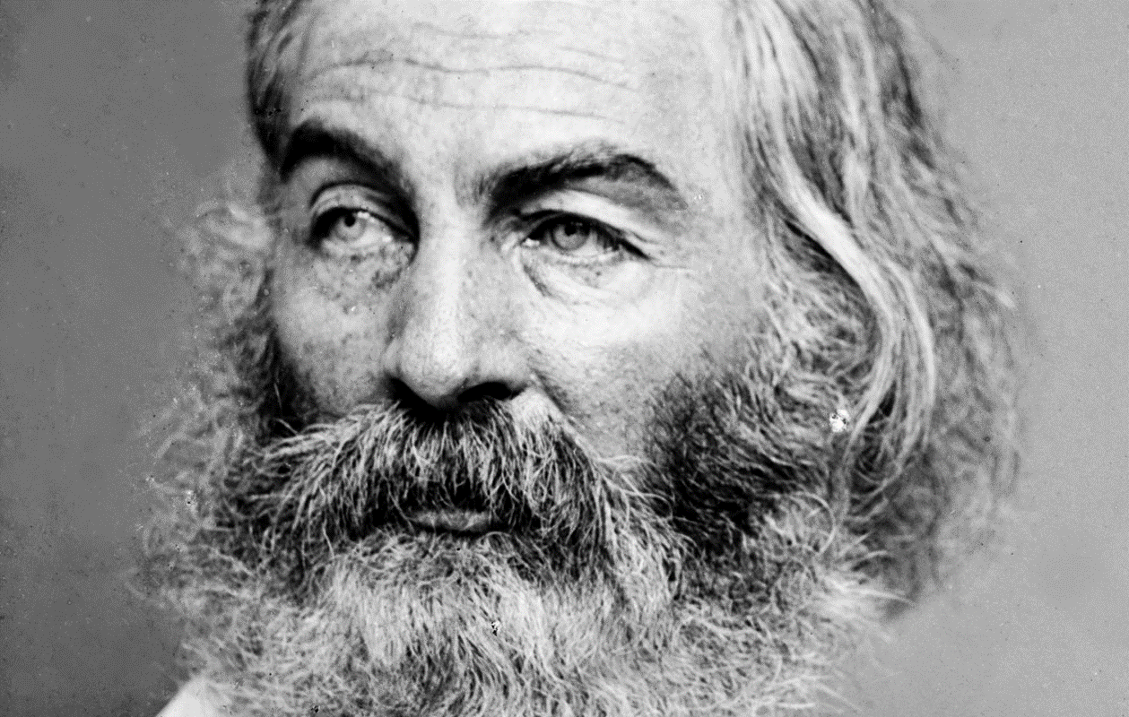
“Do I contradict myself? Very well, then I contradict myself, I am large, I contain multitudes.”
Walt Whitman

Slide 37
Walt Whitman
May 31, 1819 – March 26, 1892
Poet, essayist, journalist
A Humanist, Whitman was part of transition from Transcendentalism to Realism
Concerned with politics
Concluded formal schooling at age 11

Slide 38
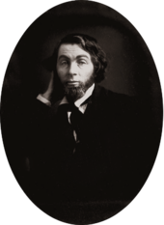
Evolution of a Writer
Early writing career consisted of writing for various East Coast newspapers
Determined to become a poet
Free Verse
An organic form that lacks regular meter and rhyme
Intended to write a distinctly American epic composed of free verse
Leaves of Grass

Slide 39
Leaves of Grass
Paid for its initial publication himself
975 copies
Criticized for being obscene in its nature
Nine editions
Final one published 1892, contained nearly 400 poems
Very well-received by many influential writers
Emerson, Thoreau

Slide 40
His Poetry
Broke boundaries of poetic form
Generally prose-like, free verse
Unusual symbols and imagery
Wrote openly about death and sexuality
Believed there was a vital, symbiotic relationship between poetry and society
Symbiotic: mutually beneficial relationship
America’s first “poet of Democracy”
Vagabond lifestyle was later adopted by Beat Poets

Slide 41
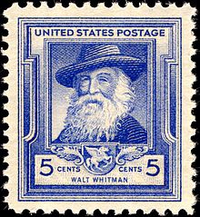
His Beliefs
Did not drink
Embraced all religions equally
Sexual orientation is disputed
Opposed the extension of slavery in the United States

Slide 42
His influence…
“If you are American, then Walt Whitman is your imaginative father and mother, even if, like myself, you have never composed a line of verse. You can nominate a fair number of literary works as candidates for the secular Scripture of the United States. They might include Melville’s Moby Dick, Twain’s Huckleberry Finn, and Emerson’s two series of Essays and The Conduct of Life. None of those are as central as the first edition of Leaves of Grass.”
Harold Bloom, American Literary Critic

Slide 43
“I Hear America Singing” (532)
Published in Whitman’s 1860 edition of Leaves of Grass
What elements of Transcendentalism are present within the poem? What elements of Realism are present?
What is the image of America that Whitman is presenting within the poem? Is this a favorable image? Why or why not?
Individual Thesis! What is the purpose of Whitman’s poem “I Hear America Singing”?

Slide 44
Old files

Slide 45
Determine the role of nature/society in identity formation.
Emily Dickinson poetry
Each table group will be assigned a poem by Dickinson. The groups will then need to illustrate the poem using the main ideas or themes presented, and the mindset of Dickinson.
You will have the rest of the period to illustrate, then we will do a class art walk to view each illustration tomorrow

Slide 46
Requirements
Illustration must contain specific references to the poem (theme, ideas, characters, events)
Illustration must be in color, not black and white or pencil
Illustration must contain the name of the poem, author, and group members
You must get me to check your analysis and theme before you illustrate
Illustration should have one quote from the poem.

