Slide 1
Puritan Life
Morals, values, God, dancing: life of early settlers

Slide 2
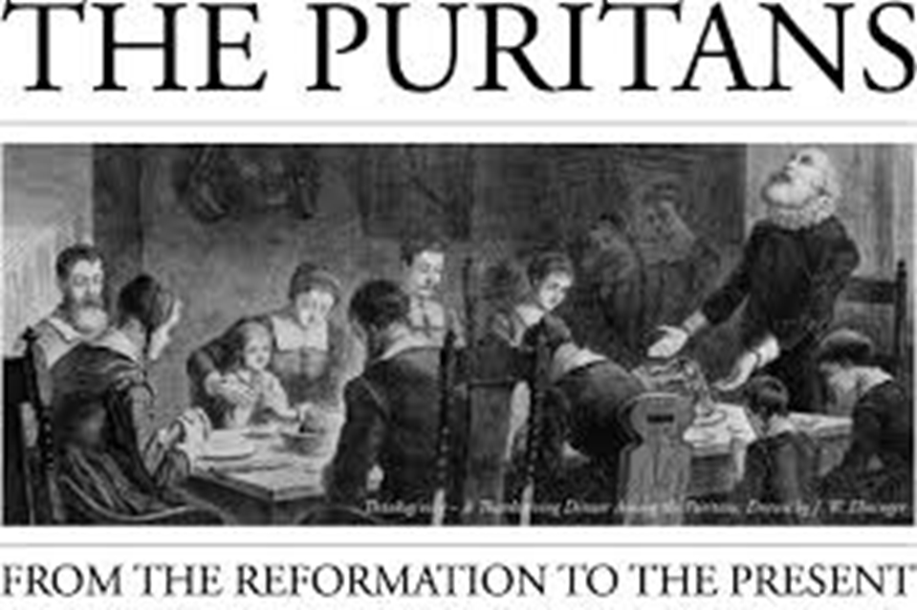
Discuss what you know about…

Slide 3
Puritan Code by Jonathan Edwards
Remember to read over these resolutions once a week:
4. Resolved, never to do any manner of thing, whether in soul or body, less or more, but what tends to the glory of God; nor be, nor suffer it, if I can avoid it.
6. Resolved, to live with all my might, while I do live.
7. Resolved, never to do anything, which I should be afraid to do, if it were the last hour of my life.
9. Resolved, to think much on all occasions of my own dying, and of the common circumstances which attend death.
12. Resolved, if I take delight in it as a gratification of pride, or vanity, or on any such account, immediately to throw it by.
14. Resolved, never to do any thing out of revenge.
15. Resolved, never to suffer the least motions of anger towards irrational beings.
16. Resolved, never to speak evil of anyone, so that it shall tend to his dishonor, more or less, upon no account except for some real good.
17. Resolved, that I will live so, as I shall wish I had done when I come to die.
20. Resolved, to maintain the strictest temperance, in eating and drinking.
21. Resolved, never to do any thing, which if I should see in another, I should count a just occasion to despise him for, or to think any way the more meanly of him. (Resolutions 1 through 21 written in one setting in New Haven in 1722)
22. Resolved, to endeavor to obtain for myself as much happiness, in the other world, as I possibly can, with all the power, might, vigor, and vehemence, yea violence, I am capable of, or can bring myself to exert, in any way that can be thought of.
23. Resolved, frequently to take some deliberate action, which seems most unlikely to be done, for the glory of God, and trace it back to the original intention, designs and ends of it; and if I find it not to be for God' s glory, to repute it as a breach of the 4th Resolution.
25. Resolved, to examine carefully, and constantly, what that one thing in me is, which causes me in the least to doubt of the love of God; and to direct all my forces against it.

Slide 4
Table Activity
Your group will be given one to two of the ‘codes’ to dissect and put in plain English
Put this in your own words!
When you have the modern code, put it on the board
What do these ‘Codes’ tell us about Puritans?

Slide 5
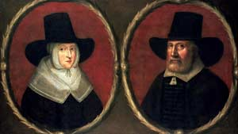
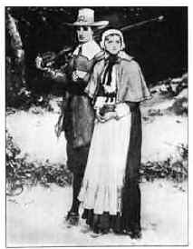
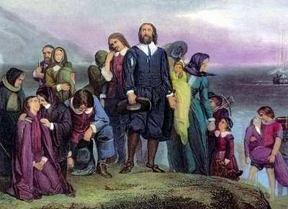

Slide 6
Brief History 1620-1750
Extreme Protestants in the 16th century: English Reformed Protestants
Trying to purify church by eradicating Catholicism
Settled in colonies of New England in 1600’s
Hard work, effort, strong person ran society
Hard work, simple life, and Christianity
Man is inherently evil

Slide 7
Religion and Gender
Religious exclusiveness
Religion informed all community laws and customs. Religion IS society. Theocracy.
Actions spoke louder than words, so actions had to be constantly controlled.
Church infraction = a social one. No margin for error.
All - work together to serve God.
Women - Domestic Sphere. Raise & educate good Puritans. Serve men.
Men - Public Sphere. Govern & protect.
Parents - discipline was mental and physical. Strict in order to save children from hell.
Children - Serve family. “Sent out” for apprenticeships
Elders - greatly respected

Slide 8
Education and the Devil
Education - critical. Read the bible, understand laws, maintain order, get into heaven, or else...
Fear - Devil is behind every evil deed.
Fear - Church ministers persuasively preached words of hellfire and brimstone.
Fear - Codes were written to guide the young and meant to be rigorously applied.
emotional displays = discouraged (devil)
strict dress code = no flourishes (devil)
idle hands = (devil)
Personal pleasure (devil)

Slide 9
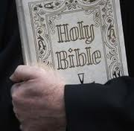
Puritan Belief
Supreme power of God
Prosperity was a gift from God
Moral and ecclesiastical (relating to Church) purity
Fought against developments of traditional Roman Catholics
Trust and faith in God
Private study of the Holy Bible
Education

Slide 10
Puritan Philosophy
Original Sin- Everybody a sinner, since everyone born of “original sin”
Predetermination- God determines all events and actions- all according to plan that God has laid out in advance
Morality- Duty of all people to constantly examine their lives for sin, and live as purely as possible in all of their actions- private and public (“Puritan angst”).
Egalitarianism- People should have direct relationship with God, as opposed to one translated through Pope and priests- also, believed that all people equal under eyes of God.

Slide 11
Puritan Societal Rule
No dancing, drinking, gambling, playing cards, ribaldry, fashionable clothes
Chief duty of man is to glorify God
Ribaldry: vulgar humor or jokes

Slide 12
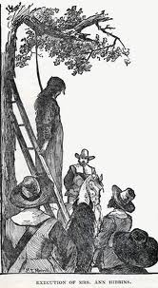
Sinners!
Deviating from religion resulted in:
flogging
pillorying
hanging
banishment
having ears cut off
having tongue bored through with a hot iron

Slide 13
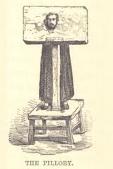
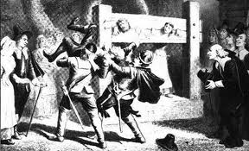
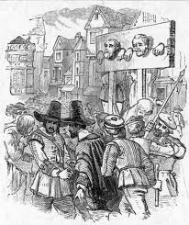
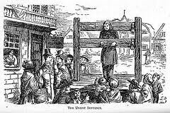

Slide 14
Puritan Remnants Today
Read “Our Inner Puritan” article
Feel free to write on the copy…it is yours!
In yours groups, come up with aspects of today’s society that reflect or still maintain some of the Puritan beliefs or ways of living

Slide 15
Puritan Poetry
Anne Bradstreet

Slide 16
Puritan Female Expectations
Women were to attend church, but remain out of public eye and not speak out.
Women were expected to remain in the domestic sphere:
Cooking sewing Cleaning Caring for and teaching children Serving father, husband, and God Maintaining a strict moral code

Slide 17
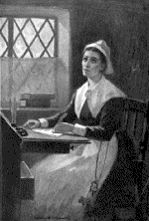
Anne Bradstreet
Born Anne Dudley, in England in 1612.
Emigrated to America in 1630 with husband and parents
Father and husband both governors of Massachusetts
Married Simon at age 16; had 8 children, lived to be 60 years old
Questioned the power of male hierarchy and God
Conflict between love of nature and family in present world vs. religion’s hope for the future

Slide 18
Anne Bradstreet (1612-1672)
She grew up in cultured circumstances and was a well-educated woman for her time, being tutored in history, several languages and literature.
First female poet published in both England and the New World (America)
Wrote about politics, history, medicine, and theology

Slide 19
Poetry Characteristics
Self-effacing "apology" (art claiming artlessness) gradually becomes more authoritative (bold assertion followed by retraction)
Distaste for dualism and hierarchy; preference for balance
Attachment to nature and the body (even questioning God)
Humor and irony which allow her to say the unsayable
Self-exploration through historic and mythic heroines
Dwelling on the domestic as authoritative

Slide 20
Compare and Contrast
Consider the epitaphs on the following slides. To what extent are they similar? Different? Determine what they tell us about Puritan culture?
ep·i·taph
ˈepəˌtaf/
Noun
a phrase or statement written in memory of a person who has died, especially as an inscription on a tombstone.

Slide 21
Epitaph for her mother
Here lies/ A worthy matron of unspotted life,/ A loving mother and obedient wife,/ A friendly neighbor, pitiful to poor,/ Whom oft she fed, and clothed with her store;/ To servants wisely aweful, but yet kind,/ And as they did, so they reward did find:/ A true instructor of her family,/ The which she ordered with dexterity,/ The public meetings ever did frequent,/ And in her closest constant hours she spent;/ Religious in all her words and ways,/ Preparing still for death, till end of days:/ Of all her children, children lived to see,/ Then dying, left a blessed memory.

Slide 22
Epitaph for her father
Within this tomb a patriot lies/ That was both pious, just and wise,/ To truth a shield, to right a wall,/ To sectaries a whip and maul,/ A magazine of history,/ A prizer of good company/ In manners pleasant and severe/ The good him loved, the bad did fear,/ And when his time with years was spent/ In some rejoiced, more did lament./

Slide 23
Connections-Bradstreet
Read the “To My Dear and Loving Husband”
Determine her beliefs about marriage, religion, daily life.
Describe the type of love Bradstreet is describing.
What connections do you see between “To My Dear and Loving Husband” and Puritan ideals/values?
Be specific
To what extent would the Puritan community have considered any aspects of Bradstreet’s poetry praiseworthy. Explain your answer.

Slide 24
If ever two were one, then surely we.
If ever man were loved by wife, then thee;
If ever wife was happy in a man,
Compare with me ye women if you can.
I prize thy love more than whole mines of gold,
Or all the riches that the East doth hold.
My love is such that rivers cannot quench,
Nor ought but love from thee give recompense.
Thy love is such I can no way repay;
The heavens reward thee manifold, I pray.
Then while we live, in love let’s so persever,
That when we live no more we may live ever.

Slide 25
Older files

Slide 26
Edward Taylor (1642-1729)
Born in England, moved to Massachusetts Bay Colony in 1668.
Colonial American poet, pastor and physician
Taylor's poems were an expression of his deeply held religious views, acquired during a strict upbringing and shaped in adulthood by New England Congregationalist Puritans
To become communing participants, "halfway members" were required to relate by testimony some personal experience of God's saving grace leading to conversion, thus affirming that they were, in their own opinion and that of the church, assured of salvation

Slide 27
His poetry
His poems had robust spiritual content
Conveyed by means of homely and vivid imagery derived from everyday Puritan surroundings.
Homely: unattractive, not beautiful
Vivid: strikingly bright; full of life
How do you get the two images?

Slide 28
Connections-Taylor
Read Husewifery: page 120
What is the poem’s message? What point is Taylor trying to make about God?
Explain the extended metaphor of the poem.
To what extent is his religious belief demonstrated in the poem?
Determine how the message of the poem relates to the ideal Puritan?
Be specific

Slide 29
Make me, O Lord, thy Spining Wheele compleate.
Thy Holy Worde my Distaff make for mee.
Make mine Affections thy Swift Flyers neate
And make my Soule thy holy Spoole to bee.
My Conversation make to be thy Reele
And reele the yarn thereon spun of thy Wheele.
Make me thy Loome then, knit therein this Twine:
And make thy Holy Spirit, Lord, winde quills:
Then weave the Web thyselfe. The yarn is fine.
Thine Ordinances make my Fulling Mills.
Then dy the same in Heavenly Colours Choice,
All pinkt with Varnisht Flowers of Paradise.
Then cloath therewith mine Understanding, Will,
Affections, Judgment, Conscience, Memory
My Words, and Actions, that their shine may fill
My wayes with glory and thee glorify.
Then mine apparell shall display before yee
That I am Cloathd in Holy robes for glory.

Slide 30
Puritan remnants today
Read “Our Inner Puritan” article
Feel free to write on the copy…it is yours!
In a group of 3-4, come up with aspects of today’s society that reflect or still maintain some of the Puritan beliefs or ways of living

Slide 31
Homework
Print Sinners in the Hands of an Angry God from The Crucible section of my website
JUST PRINT…don’t read this weekend
Need in class tomorrow

Slide 32
In Class Today
Read Of Plymouth Plantation (pages 104-110)
Make a chart of (this chart will go in a homework packet) what Puritans were like/valued in each of these categories
Lifestyle
Religion
Families
Education
Jobs

Slide 33
Reading Quiz
Who did the Puritans thank, despite the long and treacherous boat trip?
What was the new world like when they first arrived?
How were the Puritans able to “vanquish their enemies and give them deliverance”
What does Providence mean?
What was one of the terms of the peace they made with the Native American?

Slide 34
Reading Quiz
(God)
(desolate, wild, savage)
(God)
(divine care)
(Won’t harm their people, punish offender, restore stolen goods, aid each other in war, boundaries)

Slide 35
Of Plymouth Plantation
Using the details from the story last night, what are some inferences you can make about Puritans?
Lifestyle
Religion
Families
Education
Jobs

