Slide 1
The Pacific Northwest in the first half of the 20th century
AKA: The Forgotten Years

Slide 2
New Business & Urban Life
Boeing
First incorporated in 1916 in Seattle as B&W Sea Planes
Big take off around WWII
Famous for great employee relations
Bogue Plan
Virgil Bogue: Long term plan to give Seattle face lift
Make Belltown central hub, connect it with Denny Regrade, create huge mass transit and lots of park land
First clear vision for Seattle as a city of millions of people
Voted down by far left and far right (for different reasons)

Slide 3
1920s
Women’s suffrage
Starting in 1840s with Seneca Falls Convention
Tabled by Civil War, begins again in 1880s on state-by-state basis
Wyoming 1st to pass it universally and other than school elections
In PNW Idaho follows in 1896, Washington in 1910, Oregon in 1912
Passes nation wide with 19th amendment in 1920
Roaring 20s
Fairly similar to the rest of the country
Finally ends prostitution as a viable/legal business

Slide 4
Major physical changes to the city
Smith Tower is built
Denny Regrade (downtown and lower Capital hill)
Ballard Locks and fish ladder
Montlake and Fremont cuts
Woodland Park (zoo) and almost every other park
Boeing field

Slide 5
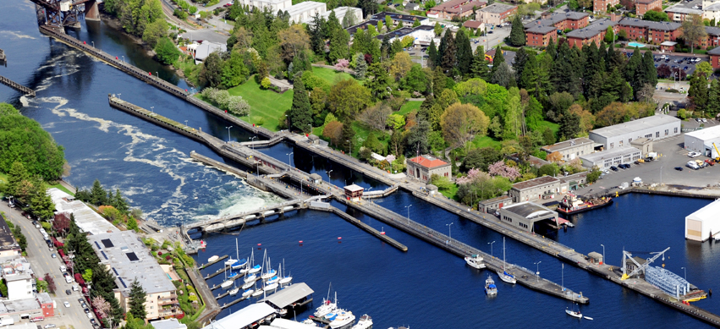

Slide 6
Great Depression
What is the great depression?
Markets crash, increased unemployment, huge economic struggle in america

Slide 7
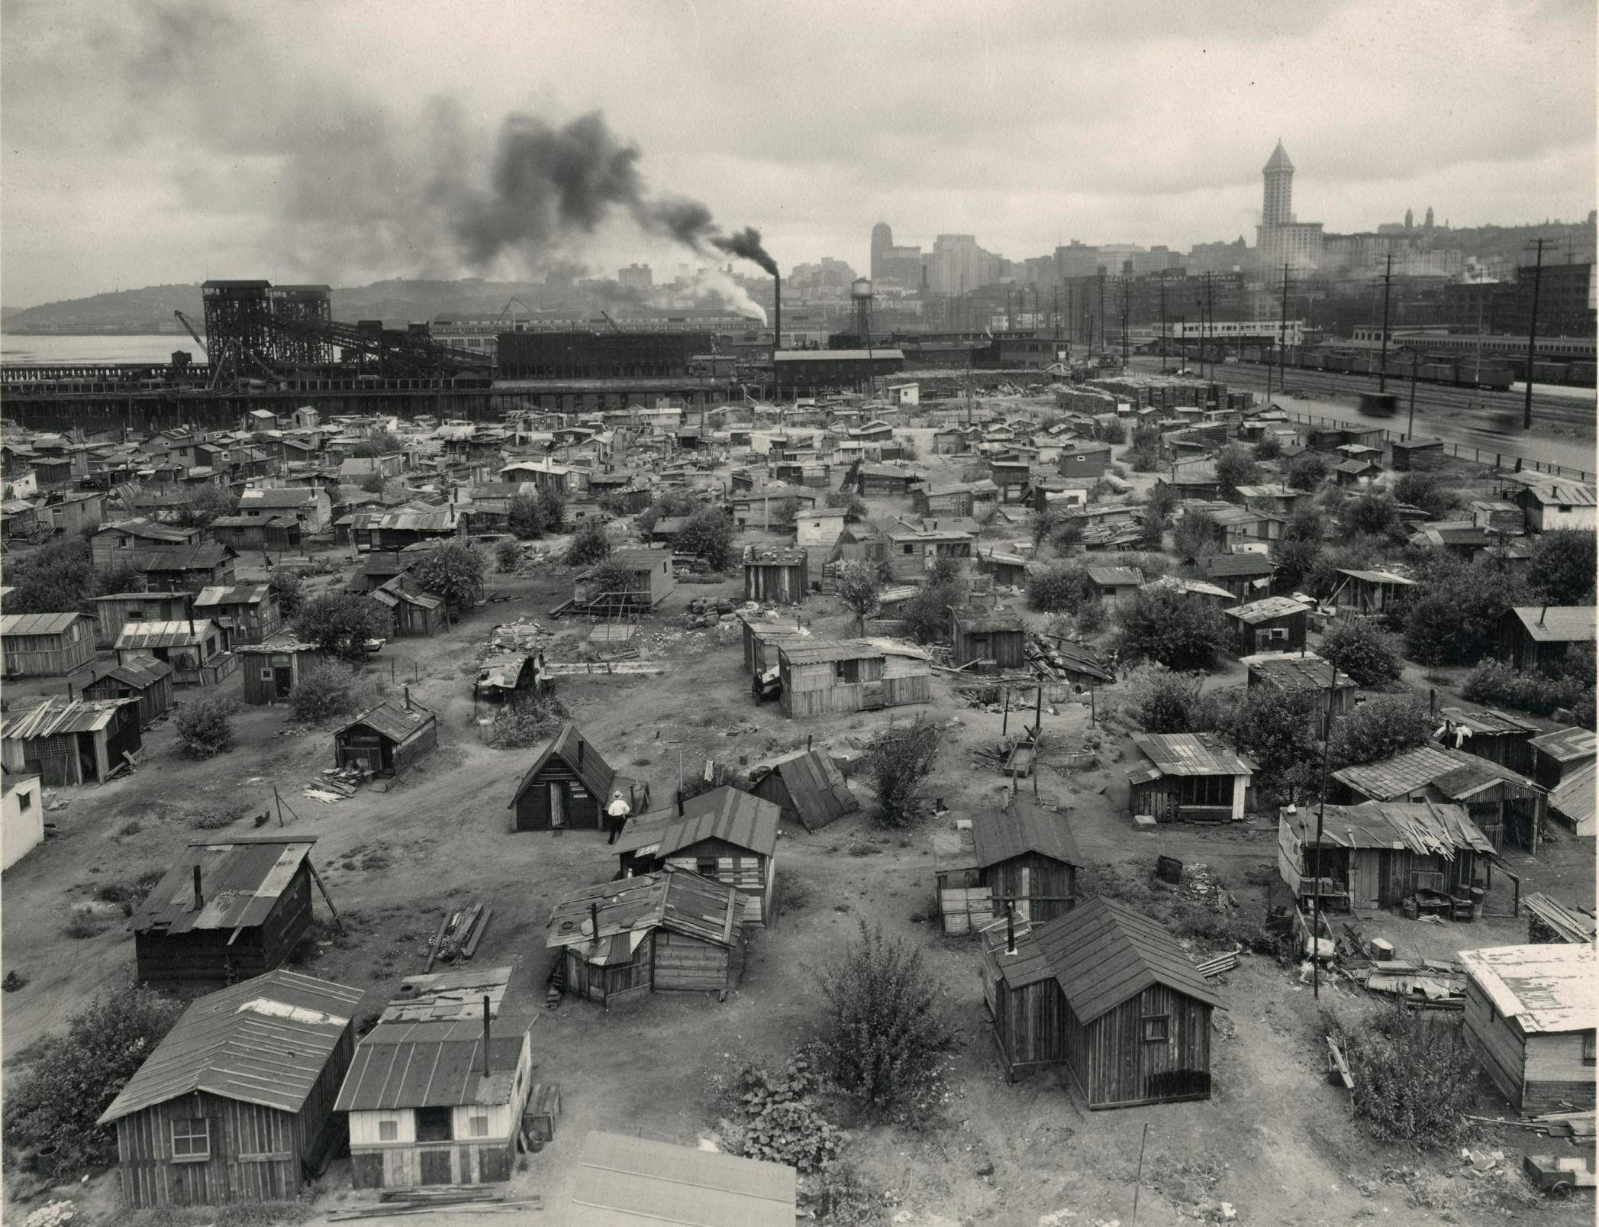

Slide 8
Great Depression in Seattle
The stock market crash in October 1929 helped trigger a devastating depression that dominated the Northwest for nearly a decade.
The economic downturn gradually affected more and more people. Mortgage foreclosures, delinquent taxes, and sharply rising unemployment were the experiences of many.
Between 1929 and 1933, a hundred thousand businesses failed across the nation.
Racial minorities, women, and the unskilled were the first to lose their jobs.
By the time President Hoover left office in 1933, 13 million were unemployed, about 25% of the work force. Some unemployed became transients, searching for jobs and food. In Seattle, unemployment was 11% in April 1930, rising to 26% by January 1935.
Source: http://www.seattle.gov/cityarchives/exhibits-and-education/digital-document-libraries/hoovervilles-in-seattle

Slide 9
Great Depression in Seattle
Lots of strikes in Seattle—most violent city labor wise—fully of commies and fascists
they also built lots of dams out here as part of the New Deal
Past that it actually broke even as far as its citizens income—unheard of during depression
Has been called Americas first suburb

Slide 10
Hoovervilles in Seattle
Families doubled up in apartments, others were evicted and built makeshift houses. Groups of these dwellings for the homeless were called Hoovervilles.
in Seattle, one of the largest cluster of homeless was located on the tide flats on the site of the former Skinner and Eddy Shipyard. Its boundaries were the Port of Seattle, warehouses, and Railroad Avenue.
A city of shacks, dwellings were fashioned from packing boxes and any other discarded materials the residents could find. Hundreds of men lived there. Other large cluster of shacks in Seattle were located in the southern industrial section and in Interbay.
Several attempts were made to get rid of the shack towns during the 1930s. City officials saw them as a health problem and a nuisance. Finally, in 1941, a shack elimination program began and the shack towns were systematically eliminated.
Source: http://www.seattle.gov/cityarchives/exhibits-and-education/digital-document-libraries/hoovervilles-in-seattle

Slide 11
Hoovervilles and Homelessness
You will use a variety of resources to build a photo essay comparing the Hoovervilles in Washington during the Great Depression to homelessness in Seattle today.
You will have today and tomorrow to work on this.

Slide 12
Construction
Must have 8-10 photos with your own captions
Caption: one-two sentences with citation for picture
You will be saving these to the public folder
Woldendorp Folder: NW Studies Photo essay

Slide 13
Japanese Internment

Slide 14
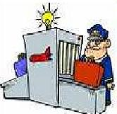
After the terrorist attacks of 9/11, the United States began cracking down on air travel security. One of the methods suggested to help eliminate suspects is racial profiling, or the act of looking at someone’s race and making judgments about them. Some people argue that by doing this security forces could eliminate “obvious non-terrorists” and concentrate on those they see as a threat. While the federal government has never admitted to it, it is widely believe they endorse the practice.
Should the United States continue this practice? Why or why not?

Slide 15
Asian American Relations
Excluded and discriminated against from Chinese exclusion, ends in 1920
Land quotas put into place
Some laws said even US born kids could not become citizens (arguably unconstitutional)
Formed own communities (International District)
Begin Pike Place Market as a food market
Thrive as farmers grow 50% of WA’s food
Going well and making racial strides until Pearl Harbor

Slide 16
Japanese internment
Happened as a result of the attacks on pearl harbor.
Japanese Americans were suspected of remaining loyal to their ancestral land. ANTI-JAPANESE PARANOIA increased because of a large Japanese presence on the West Coast.
Executive Order 9066: “dated February 19, 1942, gave the military broad powers to ban any citizen from a fifty- to sixty-mile-wide coastal area stretching from Washington state to California and extending inland into southern Arizona. The order also authorized transporting these citizens to assembly centers hastily set up and governed by the military in California, Arizona, Washington state, and Oregon”

Slide 17
forced relocation and incarceration in camps in the interior of the country.
between 110,000 and 120,000 people of Japanese ancestry who had lived on the Pacific coast.
Almost two-thirds of the interns were NISEI, or Japanese Americans born in the United States.
Many families sold their homes, their stores, and most of their assets. They could not be certain their homes and livelihoods would still be there upon their return. Because of the mad rush to sell, properties and inventories were often sold at a fraction of their true value.

Slide 18
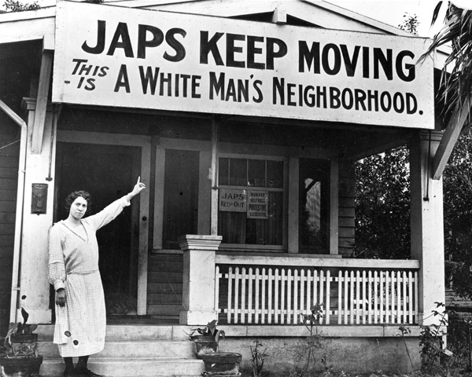

Slide 19
“Racial affinities are not severed by migration and the Japanese race is an enemy race.”
—General John DeWitt, commanding general on the West Coast

Slide 20
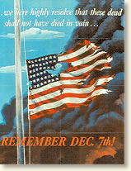

Slide 21
“I’m for catching every Japanese in America, Alaska and Hawaii now and putting them in concentration camps… Damn them! Let’s get rid of them!”
—U.S. Congressman after Pearl Harbor

Slide 22
“The Japanese are dangerous and they must leave. Remember the destruction and sabotage perpetrated at Pearl Harbor. Notice how they have infiltrated into the harbor towns and take our best land.”
—California state senator

Slide 23
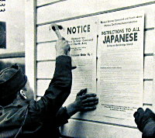

Slide 24
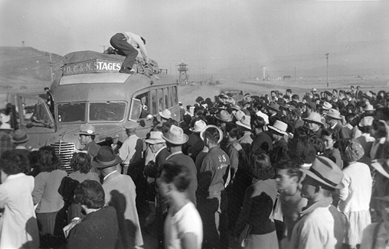

Slide 25
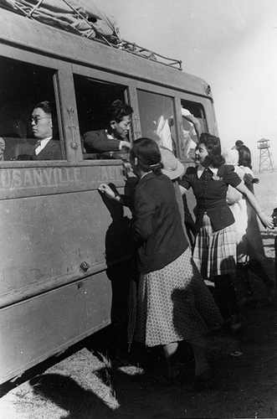

Slide 26
“It is nothing more than the legalization of racism.”
—Justice Murphy, dissenting, on Korematsu v. U.S.

Slide 27
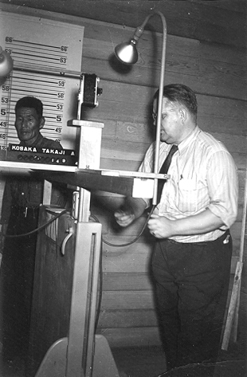

Slide 28
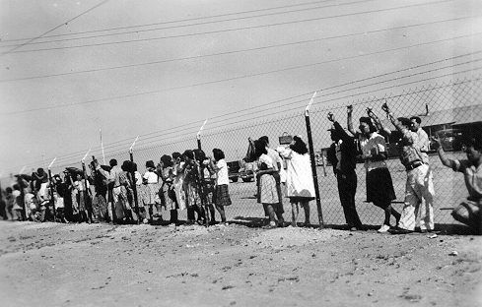

Slide 29
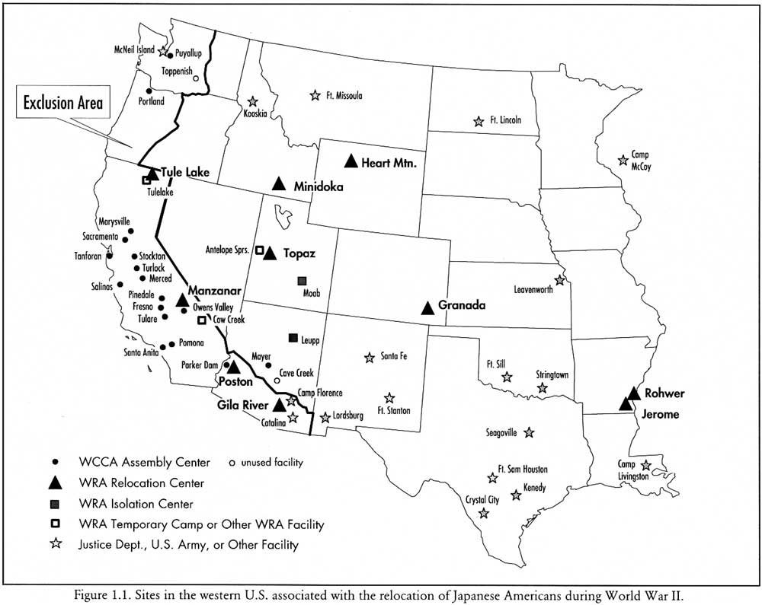
WRA: War Relocation Authority

Slide 30
Rabbit in the Moon
Film: Not all Japanese Americans endured their World War II internment with quiet stoicism. Not all second generation (Nisei) young men welcomed the chance to prove their patriotism by serving in the armed forces of the very government that was holding their families captive. A more complex, turbulent and intimate story of the internment camps is revealed in Emiko Omori’s new film, Rabbit in the Moon
Rabbit in the Moon, uncovers a buried history of political tensions, social and generational divisions, and resistance and collaboration in the camps. With fascinating archival and recently recovered home movies, Omori and her older sister Chizuko, who were children when they went to the camps, also confront their own family secrets –especially the silence surrounding the death of their mother only a year after the family’s release. They correspondingly confront the collective silence among Japanese Americans about the social antagonisms and insecurities that were born in the camps and that still haunt community life 50 years later.
Source: http://www.pbs.org/pov/rabbitinthemoon/film-description/

Slide 31
Found Poem
To present an interpretation of what you have learned about Japanese Internment, you will create a Japanese Internment Memorial. This will consist of a found poem that you will create, an accompanying visual, and a one-paragraph explanation of your project.
What is Found Poetry? In its purest form, found poetry is poetry assembled from non-literary sources – can labels, road signs, clothing tags, picture titles, advertisements, etc. One way to write a found poem is to gather lines and phrases as they leap out at you, then shape/create your poem afterwards by rearranging the lines and phrases.

Slide 32
Directions:
You will find your poem on the online museum www.densho.org and using the film Rabbit in the Moon
While watching Rabbit in the Moon compile quotes that jump out to you as important.
At the online museum, you will visit AT LEAST the following exhibits: “Causes of Incarceration,” and Learning Center: “Sites of Shame” and “In the Shadow of My Country.” (Feel free to visit other parts of the site.)
Take notes (at least a page) as you go through the exhibits.
The lines and phrases from the film and museum that you gather will later become a 20 line found poem expressing what you have learned about Japanese Internment.
Once you have written your poem, create a visual to accompany it. The visual may be hand-drawn, created on the computer, collage, or whatever medium you find suitable. (If you use other people’s images, please cite them on the back of your visual.)
Your memorial should be turned created in a 2-D format (essentially on paper).
Then write a clear, detailed one paragraph explanation of your poem and visual. This paragraph should be on the back of your visual and should be typed.
***You will be graded on creativity, quality of work, thoroughness and clarity of your explanation.***

Slide 33
Create your own public works stimulus package
Directions: You and your group will create three different public works/stimulus packages for the Pacific Northwest in the upcoming year—2017. It will be your job to determine what public works can be fixed, how they can be fixed, and what they will offer to the local community. You should also make sure that each part of plan is feasible—it must work monetarily, it must me timely, and it must be something you can pass through the state, local, and federal government. For each plan consider the following:
The basics: What, where, how and who are involved. Be sure to consider location, feasibility, and about how many people it will employ (10s, 100s, 1,000s, etc.)
The money: Where and how will you get it?
The politics: Considering our current government, is this something most people will support? Why?
The implementation: How will this be done? Will it bother public normalcy?
The final results: What will this look like when it is all done? Sketch a picture.
For each plan, you must answer all these questions and more to be thorough and make complete sense. 5 points process per plan. Be as creative as possible

