Slide 1
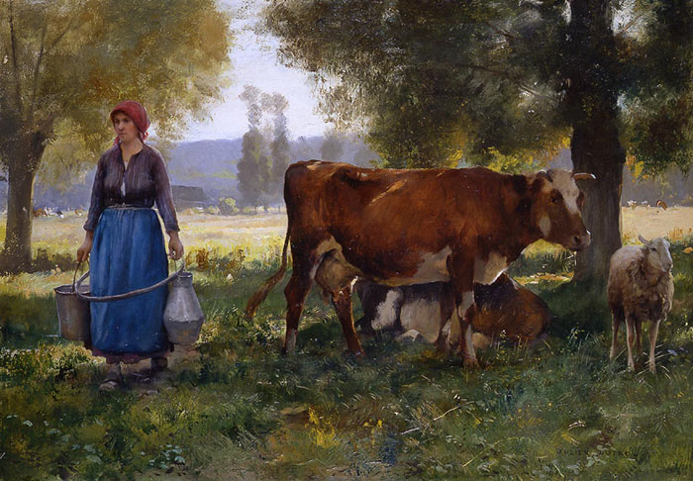
Naturalism

Slide 2
NATURALISM
Social conditions and events are inescapable and not because of the supernatural/God
Portrays things as they actually are
Naturalism literature is a literary movement that seeks to represent an everyday reality
More realistic and believable
Drawing/writing of realistic objects in a natural setting

Slide 3
Your task today
You will be writing about each of the Naturalist paintings presented.
You need to write about what you see, and what you think is happening in the painting.
You will have 1 minute for each painting, and you are expected to write for the full minute.
Painting notes and the overall reflection question will go in the homework packet

Slide 4
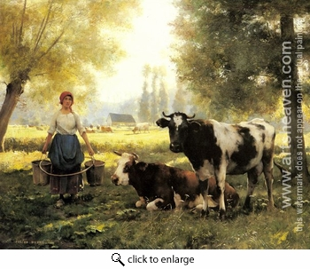

Slide 5
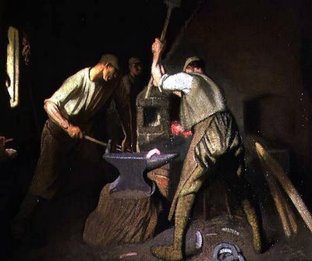

Slide 6
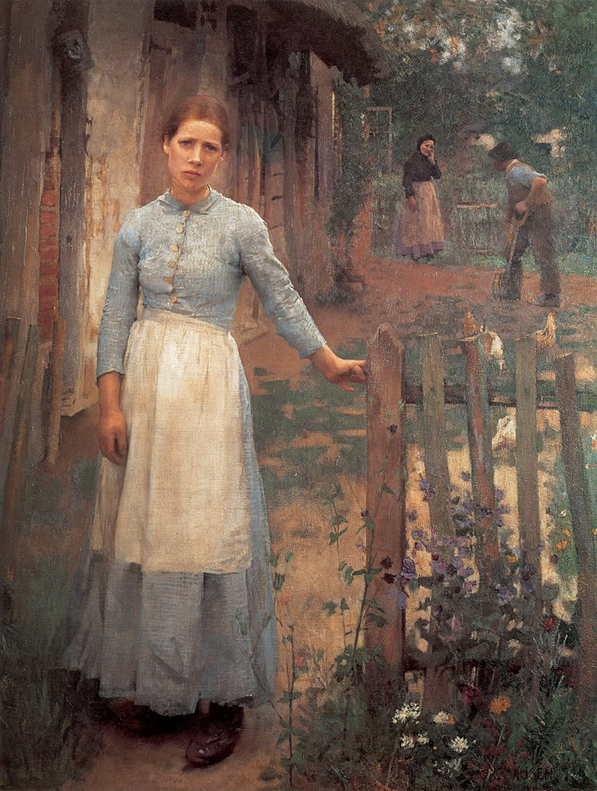

Slide 7
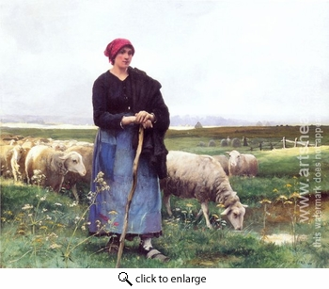

Slide 8
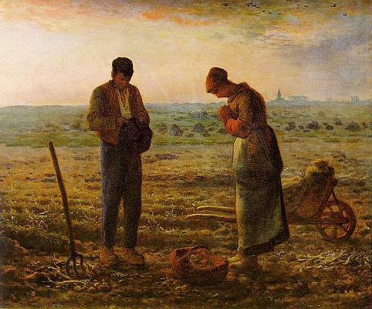

Slide 9
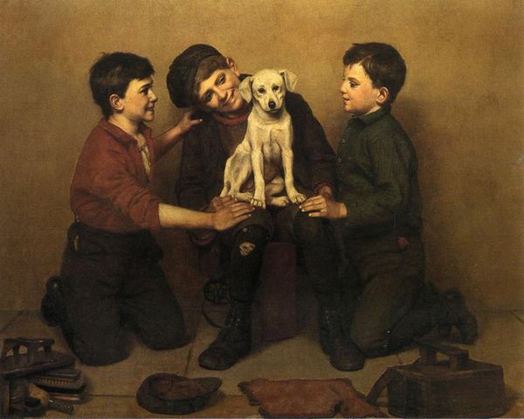

Slide 10
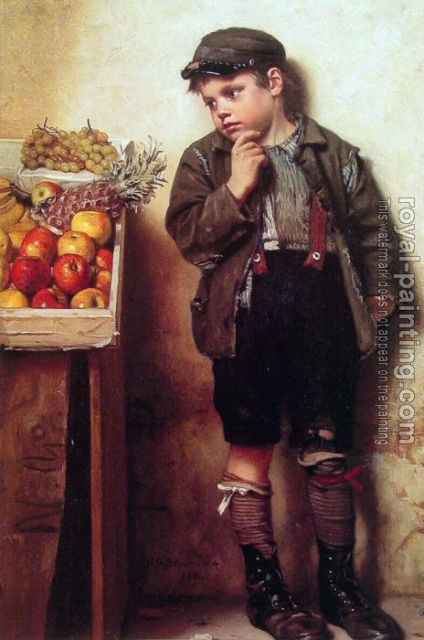

Slide 11
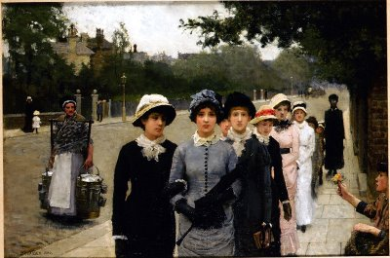

Slide 12
Reflection (5 minutes)
What similarities AND difference can you see between Rationalism, Romanticism, Dark Romanticism, Transcendentalism, and Naturalism?

