Slide 1
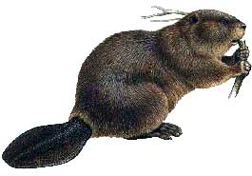
Fur Trading Era

Slide 2
Why Fur?
Fur Trading Era: 1780s-1840s
Furs used by native inhabitants, but were not that valuable. But metal was…
Climate ideal for furry animals- beaver, otter, seals, and foxes
But China, Western Europe, and the Eastern U.S., were cold places where prices for fur were high
Lots of rivers made transporting furs easy in the NW
Lots of cheap labor

Slide 3
The Fur Trade
Get Better Price- Go to China
Sell quicker, go to Eastern U.S. or Europe
Or, go all the way around the world, fur for tea and silk for fur, etc. = lots of money
Everybody (except for beavers) benefited, but the corporate owners and investors made the most cash.

Slide 4
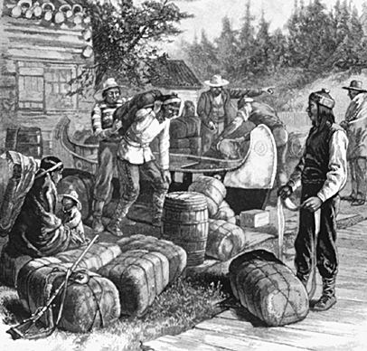
The Four Big Fur Companies
The Hudson’s Bay Company
Founded in 1670, still exists today.
Largest and most successful company
Bought out Northwest Fur Company in 1821
Headquarted at Ft. Vancouver (present-day Vancouver, WA)

Slide 5
The Four Big Fur Companies
The Northwest Fur Company
Formed in 1784
British owned- handled all fur trade west of Rockies
Offshoot of HBC – owned at first by them
Crucial to the exploration of Western Canada
Alexander Mackenzie- In attempts to find NW passage, found several major rivers in Canada
Simon Fraser- Mapped out Fraser River
David Thompson- Mapped most of Canada- discovered headwaters of Colombia in B.C.- solidified British claim for B.C. and made strong case for WA.

Slide 6
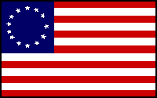
The Four Big Fur Companies
Pacific Fur Company- Disaster by Land and Sea
Founded by John Jacob Astor in early 1800s.
Built a trading port at the mouth of the Colombia River.
1810- Water Expedition Sent his ship Tonquin to mouth of Colombia
1810- Overland Expedition
1813- People who did make it in Astoria set up a few trading posts, but taken over by British in the War of 1812

Slide 7
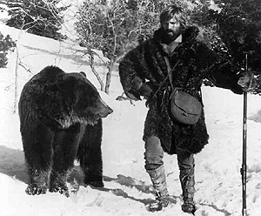
The Four Big Fur Companies
Rocky Mountain Fur Company
1823-26 Smallest and last major fur company
Loosely organized band of mountain men- John Coulter, Jim Bridger, Jebediah Smith, Benjamin Bonneville, and Jeremiah Johnson.
Established early Oregon Trail
Had a big rendezvous every year—beginning of corporate reunions

Slide 8
The Oregon Trail

Slide 9
The Story So Far
Monroe Presidency: Manifest Destiny, westward expansion, fur trapping
Jacksonian Era: Indian Removal, Missionaries led to Whitman Massacre and Indian Wars (more on them later)
James K Polk:
Polk’s 5 promises: Oregon, acquire California from Mexico, lower tariffs, create sub-treasury not dependent on banks, not to run again
Oregon Boundary Dispute: 1816-1846 (not settled by War of 1812), 54-40 or fight! rallying cry
Oregon up to the 54-40 line that marked the southern boundary of Russian Alaska
Ended with joint agreement to settle PNW with boundary line at 49th parallel as it is at the present day – Known as Oregon Treaty

Slide 10
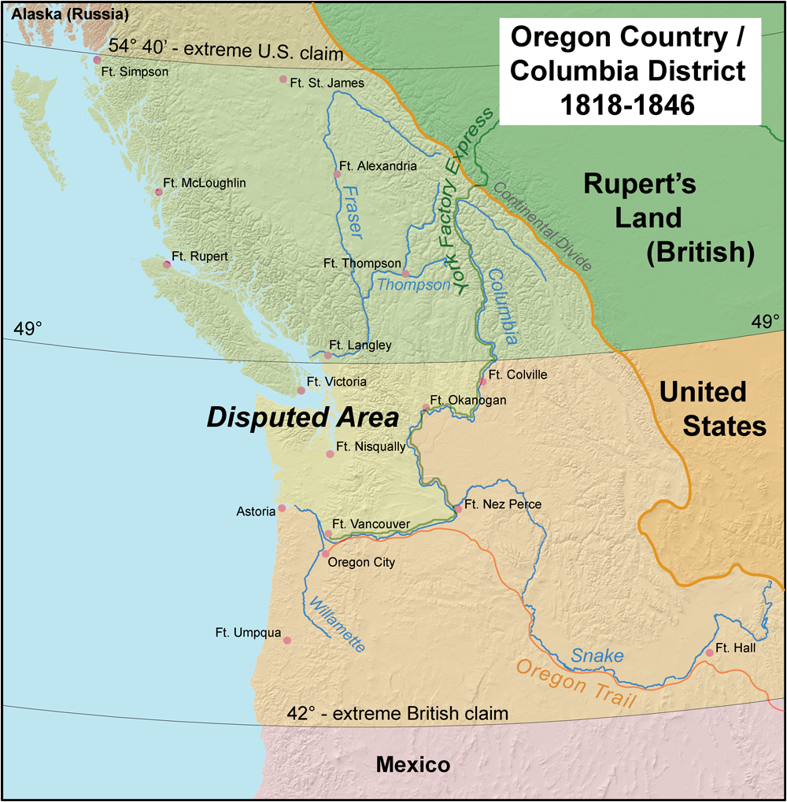

Slide 11
What Prompted Travel?
Lewis and Clark
Fur Traders, Missionaries, Indians
Newspapers, writers, magazines
Speculators- i.e. Hall Jackson Kelley and Nathaniel Wyeth – led groups of pioneers to Oregon.
Speculators: bought real estate in hopes that land value would increase over time.

Slide 12
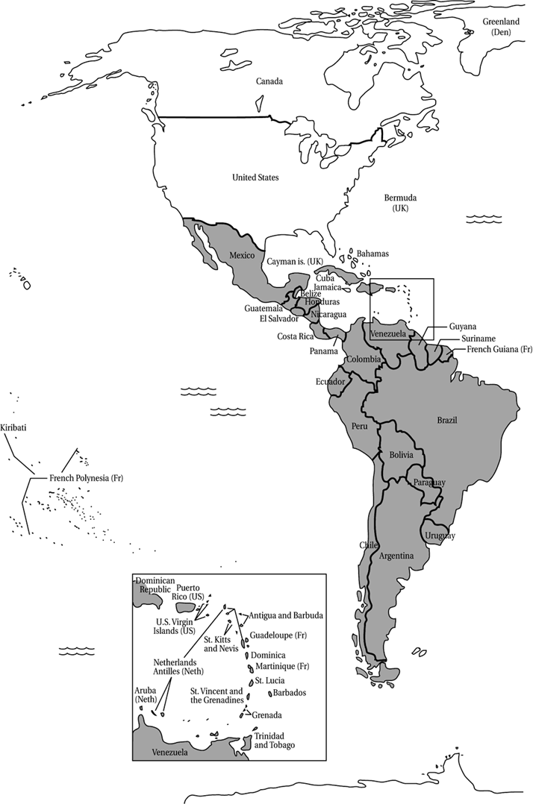
How to Get There?
By Boat: “Around the Horn”
Departed from New York, Boston, Philadelphia, New Orleans, etc.
Very expensive; took three months
Got them to San Francisco
Overland:
At fastest, 2200 mi trip would take 5-6 months.
If longer- very bad news because then had to get over snowy mountain passes of Rockies or Cascades = death
Most people would walk much of the way- were women, children, elderly
Extremely dangerous- many, many people died along way.

Slide 13
The Oregon Pioneers
Why?
After all, this was INCREDIBLY dangerous.
Starting a new life
Personal Adventure
Getting Rich
Getting Powerful
Getting free or inexpensive land
Following husband or father

Slide 14
The Route
Until 1840s- Just small groups of trappers, explorers going different ways in attempts to find Northwest Passage- alternatives to Lewis and Clark’s difficult route
1841- Wagon route finally found through Rockies and Blue Mountains- became “Oregon Trail”
Finally pushed through by missionaries
Became pioneer’s highway from Independence, Missouri to Vancouver, WA

Slide 15
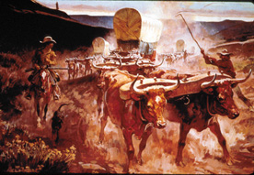
The Vehicle
Emigrants used small farm wagons
Front wheels are smaller than the ones in back--which also helped the wagons to round sharp corners and deal with broken axles.
To keep out the dust and rain, the covers were treated, but most eventually leaked anyway.
Most emigrants loaded them to the brim with food, farm implements and furniture--often over a ton of cargo.
Most wagons had several handy options: a toolbox on the side, a water barrel.

Slide 16
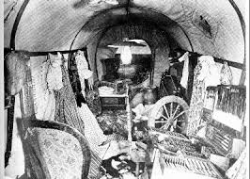
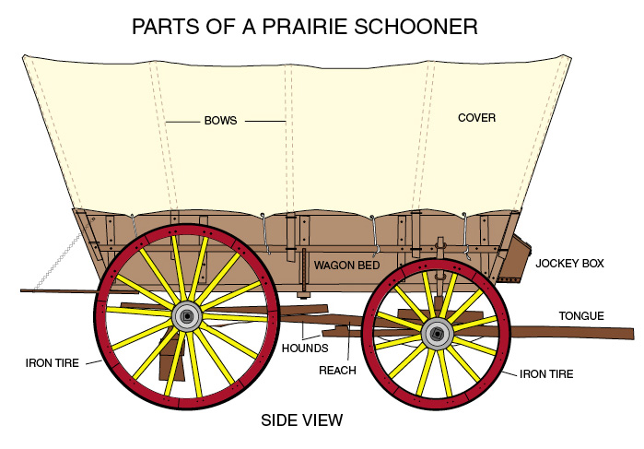

Slide 17
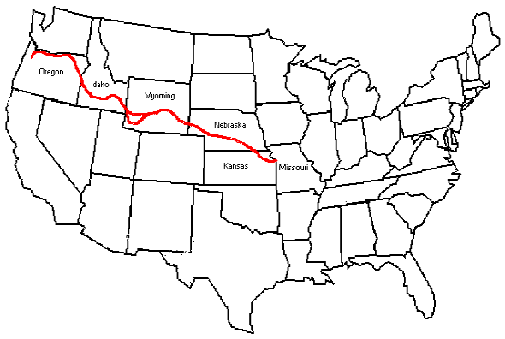
Oregon Trail
Start: Independence, Missouri- on West end of civilization. Place to buy supplies, etc.- Last chance to change mind
First Leg: Great Plains
Relatively easy- food, water, easy terrain, friendly Native Americans
Kansas prairies, followed North Platte, through Nebraska, to Ft. Laramie, Wyoming.

Slide 18
Oregon Trail
Second Leg- Rockies
First big pass at South Pass- starts getting tough.
Split at Fort Bridger- rest stop and critical choice
California?
Through Nevada and American Desert
Over Sierras via Donner Pass near Tahoe
Or, Applegate Trail up to Eugene and Willamette Valley

Slide 19
Oregon Trail
Most Stayed on Oregon trail (until gold found in CA-1849)
Leg 3- Whitman Mission
Safer than American Desert, but still troublesome
Crosses rugged Blue Mountains
Whitman mission pit stop in SE WA (until massacre in 1847)
Leg 4- Ft. Vancouver and Salem
Reached Columbia- Could follow on foot or float
Celilo Falls near The Dalles, OR- required portage
Ft. Vancouver- Met by John McLaughlin- who promptly sent them South to US OR, instead of UK WA

Slide 20
Oregon Trail- Summary
Era had heyday in 1840s, ended in 1867 when railroad made the Oregon Trail obsolete
Tens of thousands of pioneers took the trip– lots died, no idea how many (some guess 1 in 10)
Things could go terribly wrong—like Donner Party, which got stuck in Sierra Nevada’s and resorted to some ‘interesting’ things (you will find out more later).
Farming the Willamette Valley cemented the claim of the U.S. on the PAC NW (Oregon, anyway)
Settlement hit lull during Indian Wars of 1847-1877
Also delayed by California gold rush in 1849
Led to territory organization in 1848 and statehood in 1859 for Oregon.

Slide 21
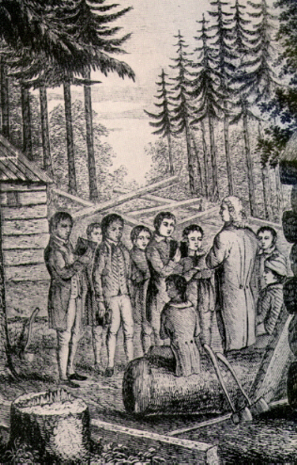
Missionaries

Slide 22
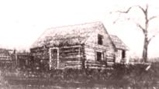
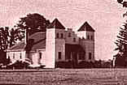
Basics
Short Period of History- 1834-1847 (From time of first mission in Oregon to Whitman Massacre)
Two Main Groups- Protestants and Catholics
Had lasting effect on Native American relations and the later pioneers

Slide 23
Why Missionaries?
Fur trappers? Not really- though Hudson’s Bay Co. provided some priests, the “mountain men” were not particularly religious- but later settlers were
Christianize the Indians
Civilize the Indians according to Victorian norms
Develop economic base for territories
Strengthen claim of U.S. to the territories
Competition between Protestants and Catholics
Provide literacy and education

Slide 24
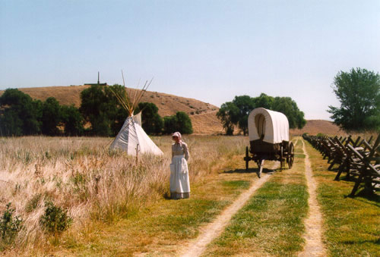
Protestants
Jason Lee- 1st Missionary- 1834
Set up near present-day Salem, Oregon
Successful, since coastal tribes relatively peaceful, and this encouraged settlers to come.
American Board Missionaries-1836
Whitman’s, Spalding’s, and William Gray
Spalding’s and Gray- lived with Nez Perce in North Idaho- successful mission because they spoke language and the Indians were friendly

Slide 25
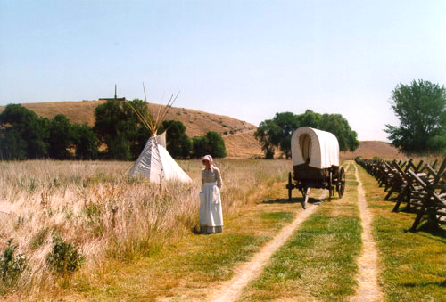
Protestants
Whitman's- Dr. Marcus and Narcissa-1836
Founded Waiilatpu mission-near Walla Walla
This became important stop on Oregon Trail
Worked with less friendly Walla Walla and Cayuse
Dr. Whitman treated Native Americans- gained reputation as shaman- but this is what killed him when he could not stop a measles outbreak- also Narcissa was mean
Both killed in 1847 along with 11 others- started Indian Wars that lasted for 30 more years

Slide 26
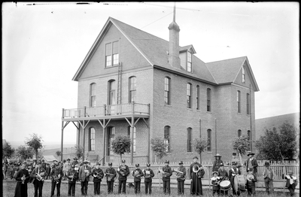
Catholics
Significantly more successful- Why?
Did not encourage more settlers to show up
Rituals in Catholic Church more impressive
Had more missions
Did not emphasize changing Native American way of life
Traveled more
Included Blanchet, DeSmet, Demers

Slide 27
Whitman Massacre
As known as the Walla Walla Massacre/Whitman Incident

Slide 28
Whitman Family
Marcus Whitman: helped lead the first wagon train to cross Oregon's Blue Mountains and reach the Columbia River via the Oregon Trail
Narcissa Whitman: Marcus’ wife and a missionary

Slide 29
Background
The Whitman Massacre was the murder of Oregon missionaries Marcus Whitman and his wife Narcissa, along with eleven others, on November 29, 1847.
The massacre was led by a band of Cayuse Native Americans who accused Marcus of having poisoned 200 Cayuse in his medical care.
Seems to be in retaliation for 1) cultural clashes, and 2) not preventing the spread of measles

Slide 30
Legacy
Began the Cayuse War.
One of the most infamous episodes in the U.S. settlement of the Pacific Northwest.
Climax of several years of tense and complicated interactions between Marcus and Narcissa, and the local Native Americans.
The massacre shocked and horrified Congress into finally establishing the Oregon Territory on August 14, 1848.

Slide 31
Perspectives
The Whitman Massacre is still controversial today. Two sides to the incident:
Whitman’s are pioneer heroes;
Whitman’s are white settlers who attempted to impose their religion on the Native Americans, intrude on their land and culture, and allegedly poisoned the natives.

Slide 32
Why Do We Care?
Furthers the tension amongst white settlers and Native Americans
Continued disputes over land and culture, and the supposed white-washing of Native Americans
Another piece of the Indian Wars

Slide 33
Indian Wars
A brief glance

Slide 34
Important Events
Indian Removal Act
Whitman Massacre
Organic Act for Oregon Territory
Organic Act for Washington Territory
Isaac Stevens as Territorial Governor
Donation Land Claim Act
Walla Walla Treaty Council
Yakama Wars
Spokane Wars
Nez Perce Retreat

Slide 35
Indian Removal Act
The Indian Removal Act was signed into law by President Andrew Jackson on May 28, 1830, authorizing the president to grant unsettled lands west of the Mississippi in exchange for Indian lands within existing state borders. A few tribes went peacefully, but many resisted the relocation policy.
https://www.loc.gov/rr/program/bib/ourdocs/Indian.html

Slide 36
Organic Act
An Organic Act, in United States law, is an Act of the United States Congress that establishes a territory of the United States or an agency to manage certain federal lands.
The "OREGON TERRITORIAL ORGANIC ACT", signed by President James Polk on August 14, 1848 created "The Territory of Oregon": The boundaries were described:
"that part of the Territory of the United States which lies West of the summit of the Rocky Mountains, North of the forty second degree of North latitude, known as the Territory of Oregon".
The “WASHINGTON TERRITORIAL ORGANIC ACT” was signed March 2, 1853
http://www.clackamas.us/surveyor/landcorners.html

Slide 37
Isaac Stevens as Territorial Governor
Isaac Ingalls Stevens (March 25, 1818 – September 1, 1862) was the first Governor of Washington Territory, serving from 1853 to 1857. He also served as a U.S. Congressman, and a Brigadier General in the Union Army during the American Civil War until his death at the Battle of Chantilly.
http://www.historylink.org/File/5314

Slide 38
Donation Land Claim Act
The Donation Land Claim Act of 1850, sometimes known as the Donation Land Act, was a statute enacted in late 1850 by the United States Congress.
It was intended to promote homestead settlements in the Oregon Territory in the Pacific Northwest (comprising the present-day states of Oregon, Washington, Idaho and part of Wyoming).
The law, a forerunner of the later Homestead Act, brought thousands of white settlers into the new territory, swelling the ranks of settlers traveling along the Oregon Trail. 7,437 land patents were issued under the law, which expired in late 1855.
https://en.wikipedia.org/wiki/Donation_Land_Claim_Act

Slide 39
Walla Walla Treaty Council
The treaty council held at Waiilatpu (Place of the Rye Grass) in the Walla Walla Valley in May and June of 1855 forever changed the lives of Native Americans living in north-central and eastern Oregon.
The fate of the Cayuse, Umatilla, and Walla Walla Indians who lived in that part of Oregon became closely tied to that of the Nez Perce, Palouse, and Yakama, who also participated in the treaty council.
None of the tribes requested the council or wanted to surrender their lands, but representatives of the United States government championed the grand council and representatives of the tribes attended to protect their people and tribal interests.
https://oregonencyclopedia.org/articles/walla_walla_treaty_council_1855/#.V-QbOPkrKUk

Slide 40
Yakama Wars
The Yakima War (1855-1858) was a conflict between the United States and the Yakama, a Sahaptian-speaking people of the Northwest Plateau, then part of Washington Territory, and the tribal allies of each.
http://www.historylink.org/File/5311

Slide 41
Spokane Wars
The Coeur d'Alene War of 1858, also known as the Spokane-Coeur d'Alene-Paloos War, was the second phase of the Yakima War, involving a series of encounters between the allied Native American tribes of the Coeur d’Alene, Spokane, Palouse and Northern Paiute against United States Army forces in the Washington and Idaho areas.
In May 1858 a combined force of the tribes attacked and defeated a force of 164 American troops under Colonel Edward Steptoe at the Battle of Pine Creek.
A larger force of 601 men under Colonel George Wright was sent to subdue the tribes. On September 1, 1858 Wright's troops defeated the allied tribes at the Battle of Four Lakes and four days later he defeated another force in the Battle of Spokane Plains.
After the Four Lakes battle, the army hanged seventeen Palouse along Latah Creek (later called Hangman Creek), though the name has reverted to Latah Creek in the State of Washington. In Idaho, the stream is still named Hangman Creek. Among the hanged was a chief named Qualchan of the Yakima.
https://en.wikipedia.org/wiki/Coeur_d%27Alene_War

Slide 42
Nez Perce Retreat
After a period of conflict with US Army…over land
Chief Joseph: “I am tired of fighting. Our chiefs are killed. Looking Glass is dead. Toohoolhoolzoote is dead. The old men are all dead. It is the young men who say, "Yes" or "No." He who led the young men [Ollokot] is dead. It is cold, and we have no blankets. The little children are freezing to death. My people, some of them, have run away to the hills, and have no blankets, no food. No one knows where they are -- perhaps freezing to death. I want to have time to look for my children, and see how many of them I can find. Maybe I shall find them among the dead. Hear me, my chiefs! I am tired. My heart is sick and sad. From where the sun now stands I will fight no more forever.”

Slide 43
Discussion
What is the value of Native Americans in the eyes of the American people and government?

Slide 44
Found Your Own Fur Trade Company

Slide 45
Directions
You and a partner have been appointed by your board of directors back east to run an upstart fur company in the Pacific Northwest in the early 19th century.
While you do not have a limitless budget, you can assume that all money spent justifiably and within reason will be approved. In other words, spend where you need to, but try to cut costs when possible.
To accomplish this task you will need to do several things:

Slide 46
Planning and Creating Your Company (write this information down)
Where do you want to found your main fort? Will the location be to serve as easy access for transportation or easy access as a rendezvous point for trapper? Will you have one fort or a few smaller forts? Will they double as any type of mission, military base or trading post? Who will live there and how will you defend them?, etc.
Who do you want trapping fur for your company? Mountain men? Men of ill-repute like Simpson’s men? Native Americans? Men who can later serve in the financial sphere of your business? Men who have lived here for a while and know the land? Men who can bargain well with the natives?, etc.
How will your company transport its loot? To Asia? The East Coast? Europe? All three? Who will finance this expedition? Will it be continuous or as needed? Where will it ship from and to?, etc.
How will you deal with natives? Will you employ them to help you? Barter with them? Treat them hostilely? How will you make sure they do not get angry and damage your enterprise? What instructions will you give to your men when they run into them out in the field? How will you make sure your men don’t damage native relations as well?, etc.
How would you like to grow and expand you company? What are your ultimate goals? How do you think you can best conquer the fur trade in the Pacific Northwest? How will you keep it viable in the long term?

Slide 47
After the creation document…
Once you’ve written down the details get a white sheet of paper, and create a company sketch, displaying it in a creative manner.
There are no specific guidelines for exactly what needs to go on the final page, it’s up to you.
Pretty simple scoring: 10 Point Scale (judging details and creativity).

Slide 48
Make an eight-page booklet on the Whitman Massacre adhering to the following directions:
Cover Page (must be in color) with title that includes the words Whitman and/or Massacre but not only those words
a picture of the incident—whatever part you want to highlight
your name at the bottom right-hand corner
First two (maybe even three) inside pages (must be in color)
pre-Massacre pages (think, what is going on in Oregon country?) with descriptive picture and sentence/phrase
Next several pages of information…
these pages will be about Massacre
pages must be in chronological order
each page must have a colored picture that corresponds
with the fact about the massacre
there must be a total of 6 facts about the Whitman Massacre itself life. Plan them out accordingly.

