Slide 1
Photojournalism
Pictures AND 1,000 words!

Slide 2
WHAT MAKES A GOOD NEWS PHOTO?
The photo tells a story; it is visual reporting
Captures the attention of the viewer and holds it
They are not posed or staged, unless they are portraits
They illustrate the story
Add additional information
They engage the viewer

Slide 3
BUT WHAT MAKES A GOOD PHOTO?
Good photos use composition and interesting lighting
Good photos capture a moment at peak action
Good photos show the relationships between elements of the story
Good photos are well-cropped and well-toned

Slide 4
HOW DO YOU ACCOMPLISH THAT:
Understand the story or the sport you are covering
Do research and MORE research
Be interested in your subject’s story
Listen to what they say, invest yourself in them
Build a relationship with them
Anticipate the action
“Know” what historically might happen next
Stay with the scene
Just because you’re trying to capture a still shot doesn’t mean that you cannot continue following your subject like you would with a video camera
Be willing to rethink your story
If you are trying to photograph one thing, but you continually get shots that tell another story, FOLLOW THE SHOTS!

Slide 5
CUTLINES
Your picture may be worth 1,000 words, but you should add a few

Slide 6
PHOTO CUTLINES A.K.A. CAPTIONS
TWO PARTS TO A CUTLINE
Who is in the photo and what are they doing?
Why is it important?

Slide 7
WRITING GOOD CUTLINES
Who, what when where and why of what is happening
Names of people shown spelled correctly
What is going on
The date including the day of the week and year
Where it is happening including the city and state
Why the event pictured is going on and why it is important to the story

Slide 8
WRITING A STRONG CUTLINE
PART ONE
Describe the action seen in the photo
Write it in the present tense
The reason is because you are not telling the story of what happened, but you are, AT THE PRESENT TIME, guiding the viewer through the picture.
PART TWO
Explains why the action is important and gives context
Written in the past tense

Slide 9
PHOTOJOURNALISM ETHICS
Photos report facts
Do not set up or recreate an event with the exception of a portrait
With the exception of toning and cropping, you cannot use software to add or remove elements to photos.
Anything else is a lie.

Slide 10
ACTIVITY
On the following slides, you will see some images
As the images are shown, you will write the “story” (caption) of each photo
You may not ask questions
You are simply to look at the images and write the story in one sentence
Label them 1-6

Slide 11
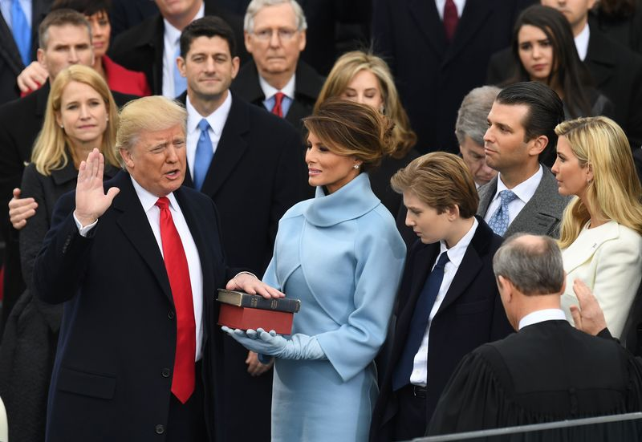
PHOTO 1

Slide 12
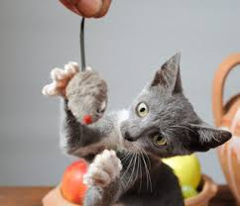
PHOTO 2

Slide 13
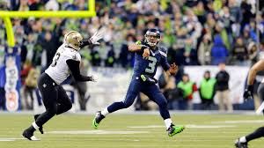
PHOTO 3

Slide 14
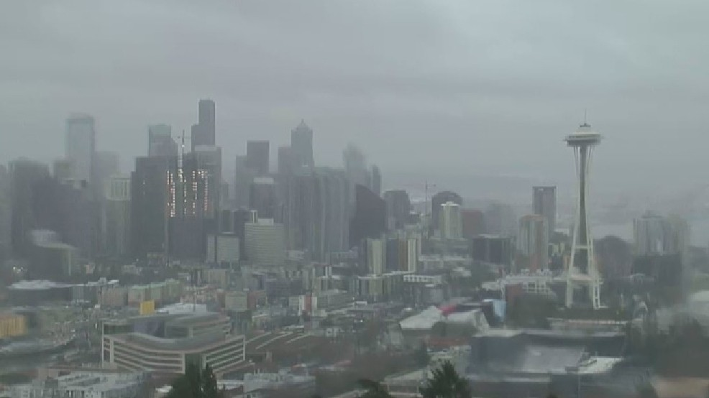
PHOTO 4

Slide 15
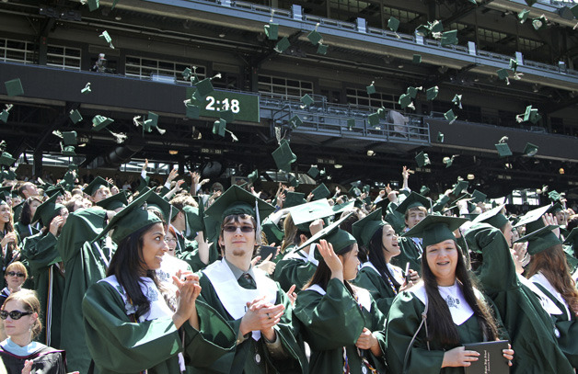
PHOTO 5

Slide 16
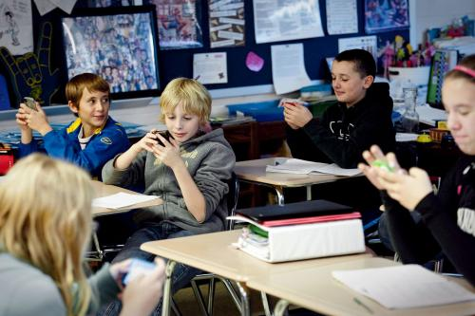
PHOTO 6

Slide 17
WRITING HEADLINES
You have to get their attention somehow!

Slide 18
HEADLINES
On the average, five times as many people read the headline as read the body copy. When you have written your headline, you have spent eighty cents out of your dollar.
- David Ogilvy
l

Slide 19
HEADLINES ARE THE ADVERTISEMENTS OF NEWS
DON’T tell the obvious
DON’T steal the reporter’s first paragraph
DON’T use “to-be” verbs - they tend to be weak
DON’T be clever, unless a story calls for it
DON’T write a “cute” headline for a serious story
DON’T overdo the puns
DO be accurate
DO use active verbs and vibrant words

Slide 20
HOW DO YOU WRITE A HEADLINE?
Use simple structure and declarative sentences
Summarize the news
Explain the story
Lure readers in
Reflect the tone of the story
Reflect the tone of the publication

Slide 21
FORMULA:
SUBJECT + VERB + OBJECT = HEADLINE
President approves education budget
President approves education budget

Slide 22
Your group task
Definition of the section
Important do’s and don'ts's for the section
What types of articles you can put in the section
What wording/writing style/person you use in the section
Visual representation of the section

Slide 23
Editing and Style
Just because you wrote it doesn’t mean you’re finished!

Slide 24
GOALS OF COPY EDITING:
Copy editing is the QUALITY CONTROL function for a publication.
Clarity - copy editors must make sure the story is clear and makes sense
Correctness - copy editors have to double check the facts and the accuracy
Conciseness - copy editors make sure the story is told in the most efficient way possible
Consistency - copy editors make sure the rules, style and other elements of the story are consistent and remain the same throughout.
Coherency - copy editors make sure that the story is well-put together and easily readable.

Slide 25
FACT CHECKING:
Copy editors serve as fact checkers. THEY ENSURE ACCURACY.
Make sure all of the information passes the “who said this” and “how do they know it” test
If you need to fact check:
Use the Internet, but only reliable sources on the Internet
If something seems like a coincidence, like James Jones lives on Jones St., or something just seems off… LOOK IT UP!

Slide 26
HOW DOES A COPY EDITOR ACHIEVE THOSE THINGS?
Correcting writing, usage and fact errors
Rewriting when a sentence is unclear or wordy
Copy editors use a variety of STANDARD PROOFREADING MARKS to indicate errors.

Slide 27
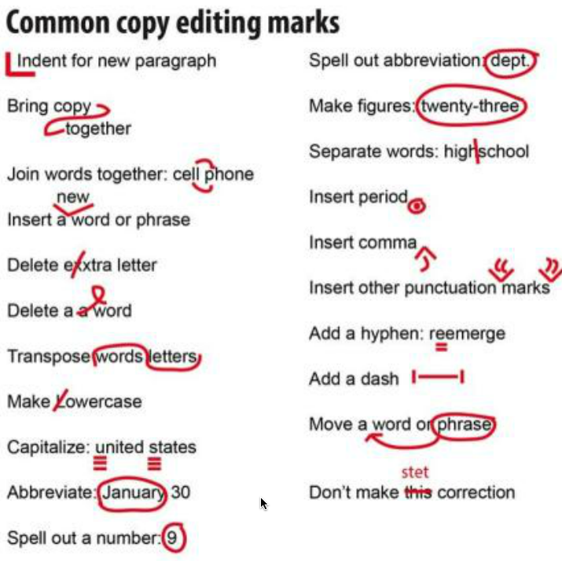
Common
Copy
Editing
Marks

Slide 28
Major Journalistic Style Rules

Slide 29
Punctuation
Punctuation goes inside quotation marks
Semi-colons separate two independent clauses (not commas)
Use commas to separate introductory statements or quote and attribution.
No exclamation points!

Slide 30
Abbreviations
Months are abbreviated when with a number
Months are spelled out when by themselves
Titles are not abbreviated

Slide 31
Capitalization
Capitalize official titles before a name or organizations (Head Custodian, Debate Club)
Do not capitalize titles after a name or unofficial titles such as “teacher” (Jane Doe, assistant coach)
Capitalize names of classes when referring to entire class
Do not capitalize names of classes when referring to a portion of the class or an individual
Capitalize names of individual courses (Honors Biology) but not general subjects (science)
same goes for Journalistic Writing vs. journalism

Slide 32
Style
Don’t refer to reader
Don’t refer to self (unless type of article specifically calls for it, such as in opinion or column)

Slide 33
Usage
Less vs. Fewer
less is for large quantities
I have less self-esteem than she does.
fewer is for countable quantities
I have fewer toys than she does.
Who vs. That
“who” refers to people
“that” refers to things

