Slide 1
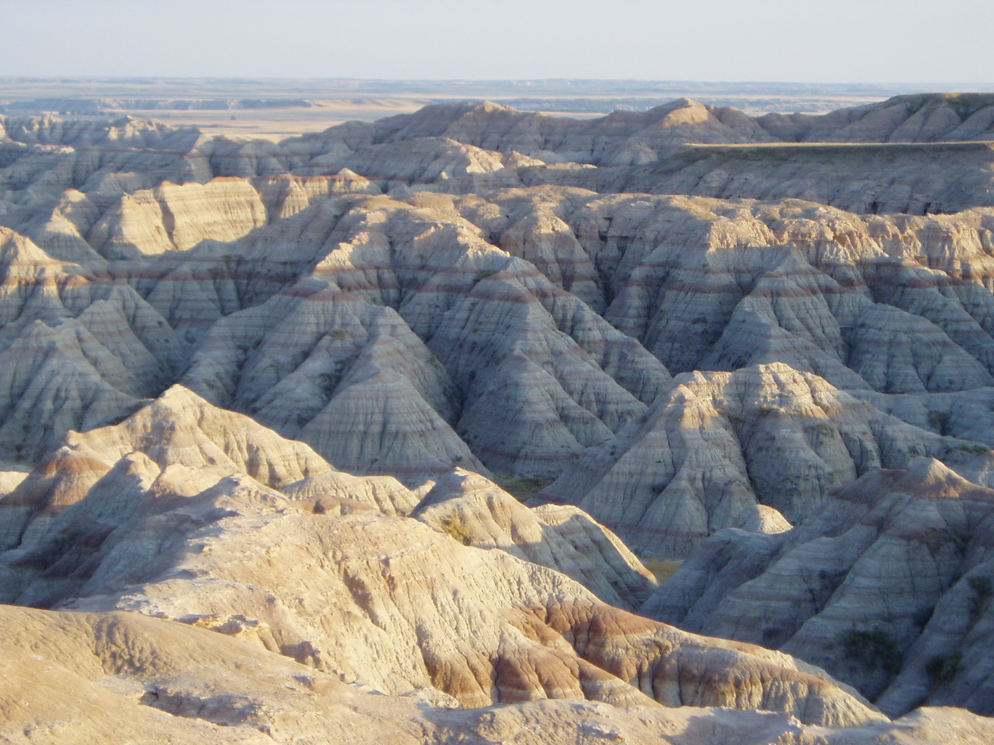
HOW THE WEST WAS WON
(AND WHERE IT GOT US)

Slide 2
Where are we in history?
1800s
America used Manifest Destiny to justify heading West
Lewis and Clark “found” the west, specifically the Pacific Northwest
Oregon and Washington are territories
California becomes a state in 1850
California gold rush
Oregon Trail

Slide 3
American Exceptionalism
American Exceptionalism: refers to the special character of the United States as a uniquely free nation based on democratic ideals and personal liberty.
Idea actually originates from Manifest Destiny and the Monroe Doctrine
Monroe Doctrine: a principle of US policy, originated by President James Monroe in 1823, that any intervention by external powers in the politics of the Americas is a potentially hostile act against the US.
Teddy Roosevelt furthers it with the Roosevelt Corollary (to the Monroe Doctrine)
Roosevelt Corollary: (1904) asserting that the U.S. might intervene in the affairs of an American republic threatened with seizure or intervention by a European country.
Woodrow Wilson names it at the end of WWI (the war to end all wars)
Almost every American believes it on some level
It is the idea that the U.S.’s place in the world is unique and it differs in both its founding and credo with other nations. Therefore it should have more say and is more important than others

Slide 4
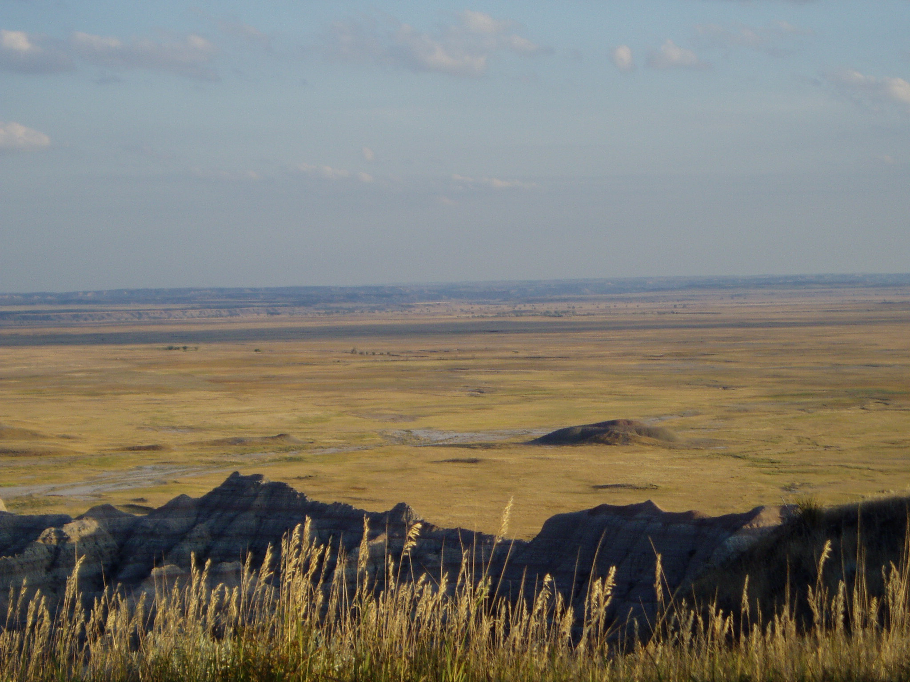
American Exceptionalism
This is a very hot topic in history and politics right now, due in large part to events of the last 50 years.
In 1991the idea was broken down into three broad categories:
Supernatural explanations – potency of God, new Rome, city on the hill ideas (WWII – Vietnam Era belief)
Genetic explanations – dominance of certain races, social Darwinism (Wilson-Depression belief)
Environmental explanations – geography, natural resources, economy, social structure (this is what most believe today)

Slide 5
Current Theory
Walter Russell Meade, in his 2007 book God and Gold: Britain, America and the Making of the Modern World contends that:
It is the continual movement, the progressive step, forward, toward the West, which has given them their unique place in the world.
The term “West,” he says should be seen as relative, with each degree of “West” being more free, more rich, more advanced, more progressive, but also more cold and inhuman (on a large scale).
This culminates in the West Coast of the U.S.

Slide 6
Why Do We Care?
Frontier/Turner Thesis: Idea that the west has the the fountain for American Exceptionalism.
The argument advanced by historian Frederick Jackson Turner in 1893 that American democracy was formed by the American frontier. He stressed the process—the moving frontier line—and the impact it had on pioneers going through the process.
Perpetuated to get people to move West in the 1880s, refuted, somewhat later, still somewhat up for debate today
Was one of the main reasons the West grew as it did. The other was the railroad, the next was the Homesteading Act
Culminated in “Go West” on Horace Greeley’s paper, The New York Tribune.

Slide 7
Land Grabs
The Oklahoma Land Rush of 1889 was the first land rush into the Unassigned Lands. The area that was opened to settlement included all or part of the present-day Canadian, Cleveland, Kingfisher, Logan, Oklahoma, and Payne counties of the US state of Oklahoma.
The land run started at high noon on April 22, 1889, with an estimated 50,000 people lined up for their piece of the available two million acres.
The Unassigned Lands were considered some of the best unoccupied public land in the United States.
The Indian Appropriations Act of 1889 was passed and signed into law with an amendment by Illinois Representative William McKendree Springer, that authorized President Benjamin Harrison to open the two million acres for settlement.
The Homestead Act of 1862, signed by President Abraham Lincoln, allowed legal settlers to claim lots up to 160 acres in size. Provided a settler lived on the land and improved it, the settler could then receive the title to the land.

Slide 8
Film Clip
Far and Away starring Nicole Kidman and Tom Cruise
Just watching the land grab scenes
Question to consider:
Is this the best way to do this?
If you were the president, how would you have organized this expansion?

Slide 9
Why do we care?
All of this led to the founding of Seattle
What do you know about Seattle? How often do you go? Name famous streets/areas/people of old Seattle.

Slide 10
Founding of Seattle
Arthur Denny and Co. landed at Alki Nov. 13, 1851
Relocated to Pioneer Square (Elliott Bay) area six months later.
Henry Yesler then solidified the sights importance in 1852 by building a lumber mill there.
City’s early history a battle of control and corruption between the Denney, Mercer, Boren, Terry and Yesler families:
Pretty much a contest of who could rip people off the most.

Slide 11
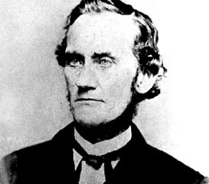
Dennys
Led by Arthur and David Denny
Started with a general merchandise store
Arthur eventually founded a bank (which became part of Bank of America) and served as Speaker of WA’s House and Territorial Rep. to Senate
Very Conservative and some what politically scummy.
Eventually helped found UW (1858) Denny Hall

Slide 12
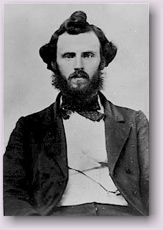
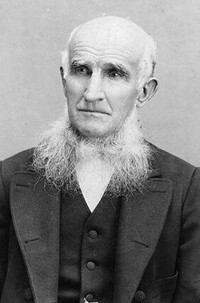
Mercers
Asa and Thomas Mercer, originally from VA
Asa founded UW and the Mercer Girls
Mercer Girls: women ‘imported’ to balance ratio of genders
Thomas is whom after everything is
named (Mercer Street and Mercer Island)
Founded most of West Seattle, served in
politics, named Lake Washington and Lake
Union
One of the few founders who was not
too scummy

Slide 13
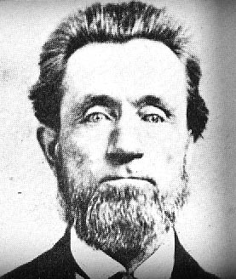
Yeslers
Main family member was Henry Yesler
On one hand he built the sawmill and made jobs for everyone
One the other hand he created Skid Road (Row), and was sued for poor business practice more times that could be counted
Skid Road: (Mill Street, now Yesler Way) in Seattle, an impoverished area, typically urban, inhabited by the poor, the homeless, or others considered disreputable or forgotten by society
He once tried to control and sell the city’s water

Slide 14
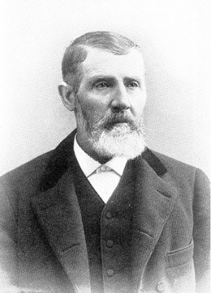
Boren and Terry
Carson Boren was Denny’s brother-in-law
King County’s first sheriff
He was responsible for most of the racist policies towards Indians and Black and Asians.
Lee and Charles Terry
Arrived with Dennys on the first ship
Stayed at Alki when Dennys and Boren
went to Pioneer Square, and faded from
relevance

Slide 15
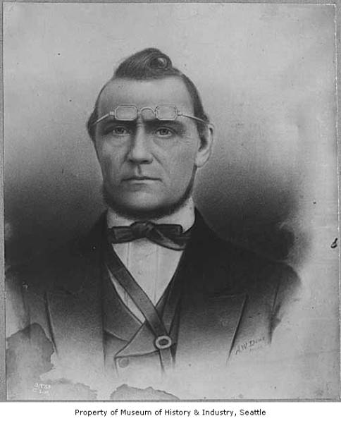
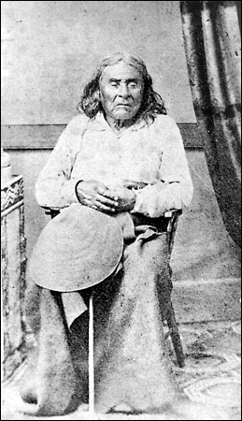
Doc Maynard & Seattle
Doc Maynard: part of Denny party
Good friends with Natives, diffused many early possible problems between the two parties
Friends with Chief Sealth. Maynard talked Sealth into allowing the whites to name the city of Seattle after him.
Sealth was chief of Suquamish and Duwamish Indians tribes of the Puget Sound.

Slide 16
Seattle Founders Project

Slide 17
Seattle Founders Project
Groups of 2 (a few of 3), each founder will need to be covered, and there are 13 total
Directions: Over the course of the next days you will research one (person or group) that was instrumental in the founding of Seattle. You will have to create a PowerPoint, representative model, and short paper (no more than one page) with information about your founder(s).
Finally, you will have to do some of your own research and submit and properly formatted bibliography of at least four sources.
Decide how to tackle each of the following:

Slide 18
Requirements
Create a short PowerPoint explaining the actions surrounding and the importance of your founder. This should be no more than 4 slides of text and should go above and beyond the lecture given in class. You should also including visuals, if possible, of both the person and event. All this should be done in a simple form that will facilitate understanding as well as audience note taking.
Create a 3-D model of an important event within the life of your founder that also relates to the city of Seattle. This can be literal or interpretive, but should be more than just a poster or drawing. These will also be presented to the class along with the PowerPoint presentation. Be sure to include a small, written description so that we know what we are looking at.
Write a brief paper (no more than a double-spaced page) explaining the life of your founder and their significance to Seattle. This should be about two paragraphs long and should include a clear thesis explaining why your founder is important to the city. The first paragraph should give any necessary historical background, ending in a thesis and the second paragraph should explain that founders significance to/importance in the history of Seattle. Since it is only one page long there is no room for introductory and concluding paragraphs, though there should be an introductory and concluding sentence. Finally, your paper should include a few citations, which should be done in proper MLA format
Create a bibliography listing the sources you consulted and cited in proper MLA format. Your paper/model/PowerPoint should consult at least four sources, though more are welcome.

Slide 19
Founders
Arthur Denny (Daya)
David Denny (Jared)
Chief Sealth (Noah)
Doc Maynard (Fernando)
Henry Yesler (Ben)
Asa & Thomas Mercer (Aimee)
Lizzie Ordway (Parinita)
Charles Terry (Evan)
Carson Boren (P.J.)
Dexter Horton (Kyle)
The Van Asselts (Alex)
The Collins (Hugo)
The Maples (Jai)

Slide 20
Washington’s Journey to Statehood
1859-1889

Slide 21
Extra, Extra!
We are going to create a newspaper as a class covering the various enterprises of Washington as it became a state.
This is an individual assignment, but you may want to poll each other for ideas.

Slide 22
You, the Journalist
You need to thoroughly research your topic. Use the databases and other online resources (Remember your timeframe: 1859-1889).
Write a story (500-1000) word covering your topic, but make it creative, as if it is something you are witnessing right now. It’s okay to embellish but be based in fact. Make sure you have a title and your name in the by line.
Be creative in your approach- you can write a criticism, or a feature advertising employment, etc.
Find at least one photograph to accompany your story.
Need a Works Cited Page (must be MLA).
Rest of the article does not need to be MLA format

Slide 23
Topics (1855-1890)
Chinese immigrants
Chinese Exclusion Act
Scandinavian Immigrants
Japanese Immigrants
Washington State Constitutional Convention
Logging
The effect of salmon canning on the environment
California Gold Rush
Mining Towns
Coal Mining
Homestead Act
Anti-Chinese riots
Railroads
Oregon Steam Navigation Company
The Dawes Act
Women’s Suffrage Movement
Desert Land Act
The Railroad Act
What’s more important: economic growth or railroads?
The marginalization of Native Americans
The Great Seattle Fire of 1889
Raising the streets of Seattle
Interview with: Arthur Denny
Interview with Doc Maynard
Interview with Henry Yesler
Interview with Asa Mercer
Interview with Chief Seattle
Competition with Tacoma for railway/port options
The Winter Indian War of 1856
Canning and/or the fishing industry
Education in the Seattle area
Agriculture based in Eastern Washington

Slide 24
Draw Washington’s Journey to Statehood
On a blank piece of paper, draw Washington’s journey to statehood. Think about the Founders Project and the newspaper assignment. Include at least five of the following events (and describe them in detail):
Railroads
Immigrants
Agriculture
Fishing
Mining
Unions
Timber
The Desert Land Act
Omnibus Bill
World’s Fair 1909
(Alaska-Yukon-Pacific Expo)

Slide 25
Constitution Comparison
Task 1:
Critically read both the Washington State and United States Constitution excerpts
Write one discussion question to share with the class for a graded class discussion tomorrow
Task 2:
Graded class discussion about the two Constitutions, weaknesses, merits/strengths, similarities, and differences

Slide 26
Founding of Seattle: Sons of the Profits readings
 | What occurred in the reading? | Who was instrumental in making this occur? | How did it effect the city of Seattle? | Why did the event(s) occur? | How did the event(s) ultimately end?
“Our Father”
“Let Lux Sit”
“Wry and Water”
Some other questions to consider for discussion. Answer these on your own ON A SEPARATE sheet of paper.
Which event seemed to have the single biggest impact on the founding of Seattle? Why?
Which event(s) were detrimental to the city? Why? How would you change them into a positive influence?
Why did Seattle and/or the Pacific Northwest seem to cater to this type of scummy behavior? What allowed in to continue so long?
In the end, do you see the ‘profits’ and a good or bad things for the city? Why?

Slide 27
Founding of Seattle: Sons of the Profits readings
 | What occurred in the reading? | Who was instrumental in making this occur? | How did it effect the city of Seattle? | Why did the event(s) occur? | How did the event(s) ultimately end?
“Yesler gets rich”
“Skid Road”
“Mary Kenworthy and the Railroads”
Some other questions to consider for discussion. Answer these on your own ON A SEPARATE sheet of paper.
Which event seemed to have the single biggest impact on the founding of Seattle? Why?
Which event(s) were detrimental to the city? Why? How would you change them into a positive influence?
Why did Seattle and/or the Pacific Northwest seem to cater to this type of scummy behavior? What allowed in to continue so long?
In the end, do you see the ‘profits’ and a good or bad things for the city? Why?

