Slide 1
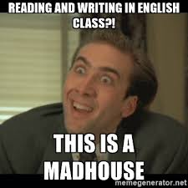
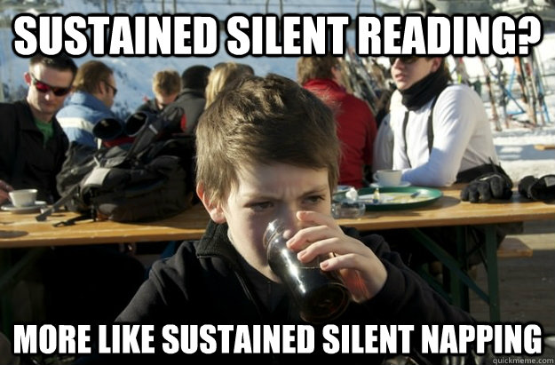
Independent novel
Yes, you have to read in Creative Writing

Slide 2
Your task
Select a novel (novel must be at least the reading level of a 12th grader…no Harry Potter or The Hunger Games) that is at least 200-250 pages.
You will be given class time to read, and can always read when you finish assignments during class work time.
Must have your book by Friday, February 14th (first reading day). I encourage you to start reading NOW though.
The last day to finish the novel will be April 20th.

Slide 3
Literary analysis essay
You will be writing a literary analysis essay on your novel.
Things you can analyze: use of character, setting, conflicts in the novel, theme, symbolism, use of point of view.
Think about how these things impact the story or storytelling.

Slide 4
Caution…
This is done independently, so make sure you are reading! There will be no reading quizzes or anything like that.
I expect you to read, and budget your time.
If you need help managing the reading, ask me!

Slide 5
What can’t you read?
If you have read one of these novels in previous classes at Skyline or will read them at Skyline, you may not read them for Creative Writing this semester.

Slide 6
Your tasks and responsibilities
Reading conferences during Friday reading periods
Fill out my “Weekly Reading Recording Sheet” each Friday to help me keep track of your reading schedule
Keep a novel journal (can be done on a sheet of paper) where I will ask questions every week for you to answer
Annotate the novel to help with the Literary Analysis Essay
You will be writing about: author craft, symbolism, characterization, character development, social commentary.

Slide 7
Week 10/11 prompt
What are your initial thoughts about the novel? (Writing style, characters, plot, etc.)

Slide 8
Week 3/13 Prompt
Pick one character to analyze. How do they contribute to the novel? Why are they an important character? Describe them as a character.

Slide 9
Week 3/20 prompt
What is the major theme of your novel and how is it being developed so far?

Slide 10
Week 11/7
Give me a brief plot summary of your novel (what you have read so far).

Slide 11
Week 3/28
What do you think about the novel so far? What parts do you like or not like? Would you recommend the book, and why/why not?

Slide 12
Week 4/18 Prompt
How would you compare the two novels? Similarities and differences? Positives and negatives?

Slide 13
Older files

Slide 14
Second reading task
You will also read a second novel over the course of the semester, but this time a novel you really want to read (think: reading for fun!)
Any genre, style, topic, but must be at least 200-250 pages and a reading level of an 11th grader or above
You will do a short review presentation (a book talk) at the end of the semester
Must get approval for your book
Must finish the book by May 16th.

Slide 15
Choice novel assignment
You are going to prepare a book talk poster presentation
You need to include (in your own words): summary of novel, setting, characters, critique of authors style, two quotes that are good examples of the authors writing style
You will create a visually appealing poster to present to small groups

