Slide 1
Daily Lessons
The Adventures of Huckleberry Finn

Slide 2
Huck Finn presentations

Slide 3
Requirements
43 chapters total: read 2 per school night; read 4 over the weekends
Use an audiobook version
Reading schedule posted weekly: plan ahead
Present chapters of the text to practice public speaking and review main ideas
Reading pop-quizzes
Major assessment: first semester paper

Slide 4
Chapter Presentations
You will work with a partner to create a very brief chapter presentation on the chapters we read the previous night: in your own words!
You need a chapter summary, a quote (that best represents the plot, characters, satire, social commentary of the chapter), and a discussion question to share with the class
Every student will be reading all the chapters, but you are just going to be the experts for your chapters

Slide 5
Day Of
You and your partner will present your chapters in front of the class
Keep your presentation to under 5 minutes
Must be done on a PowerPoint presentation, and emailed to me before class starts each day
MAY NOT BE COPIED FROM SPARKNOTES
MAY NOT BE COPIED FROM SPARKNOTES
MAY NOT BE COPIED FROM SPARKNOTES

Slide 6
Chapter 1
Plot: Huck and Tom getting the money they find in the cave, Widow Douglas takes guardianship of Huck and tries to civilize him, they are trying to give him a religious education (praying, thanking/listening to God)
Quote: “…allowed she would sivilize me, but it was rough living in the house all the time” (1)

Slide 7
Chapter 2
Plot: Huck and Tom play a trick on Jim. Jim is a celebrity amongst the slaves. The “Tom Sawyer Gang” forms. They are going to be a gang that robs and murders people (keep women prisoners)
Quote: “Jim was most ruined for a servant, because he got stuck up on account of having seen the devil and been rode by witches” (6)

Slide 8
Chapter 3
Plot: Miss Watson tries to explain prayers to Huck. Rumor that Huck’s Pa has been found dead, but it later turns out to be a woman dressed as a man. The gang disbands after no robbing or murdering actually happens. Huck tells the reader about game they play where they raid picnics and pretend they are raiding a caravan of Arabs and Spaniards.
Quote: “I went and told the widow about it, and she said the thing a body could get by praying for it was “spiritual gifts”. This was too many for me…” (11)

Slide 9
Chapter 4
Plot: Huck going to school and accepting his religious and school education. He sees the boot with the cross in the snow, gets Judge Thatcher to take control of the money he has. Jim has the oracle ox hairball and tells Huck that there are two angels surrounding Pa (one good, one bad), but that Huck is safe for right now. Pa is in Huck’s room.
Quote: “I liked the old ways best, but I was getting so I liked the new ones too, a little bit” (15).

Slide 10
Emily Dickinson Poetry
Realist poetry

Slide 11
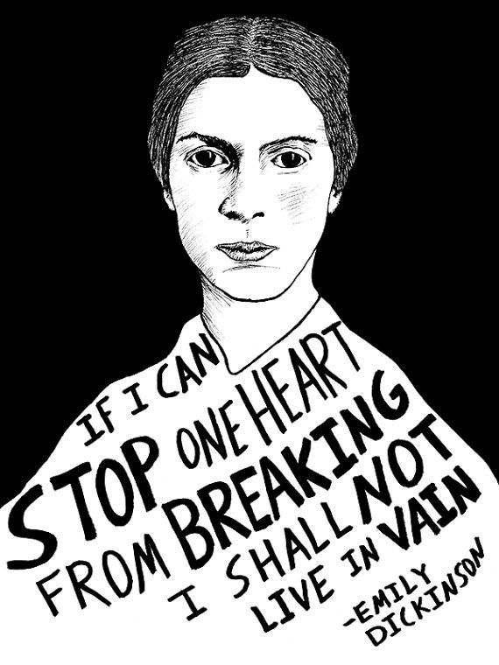
Dickinson Background
Born in Amherst, Massachusetts in 1830
Member of a prominent family really connected to community
Dickinson chose to live most of her life in isolation (she was a recluse)
Most of her 1,800 poems were published after her death in 1886
Died from Bright’s Disease (kidney disease) and her life was filled with much personal loss and turmoil
Family feud over the posthumous publication of her poetry, but eventually, half a century after her death, her poems were published
She is often seen as a feminist icon for her refusal to conform to gender stereotypes and expectations

Slide 12
Determine the role of nature/society in identity formation.
Emily Dickinson poetry
Each table group will be assigned a poem by Dickinson. The groups will then need to illustrate the poem using the main ideas or themes presented, and the mindset of Dickinson.
You will have the rest of the period to illustrate, then we will do a class art walk to view each illustration tomorrow

Slide 13
Requirements
Illustration must contain specific references to the poem (theme, ideas, characters, events)
Illustration must be in color, not black and white or pencil
Illustration must contain the name of the poem, author, and group members
You must get me to check your analysis and theme before you illustrate
Illustration should have one quote from the poem.

Slide 14
Groups
1: because I could not stop for death (548)
2: success is counted sweetest (550)
3: much madness is divinest sense (551)
4: my life closed twice before its close (551)
5: the soul selects her own society (552)
6: I heard a fly buzz when I died (553)
7: my life has stood a loaded gun (554)

Slide 15
Slave Narratives
What is freedom?

Slide 16
Learning Targets
I can read and analyze informational and historical text.
I can juxtapose slave narrative and Huck Finn.
I can collaborate with classmates to analyze literature.

Slide 17
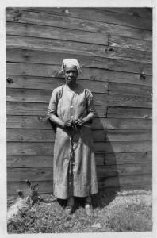
Genre: Slave Narrative
A diverse and wide ranging genre, including oral & written histories as well as songs and spirituals
Most slave narratives came with a preface written by an established white author
Why do you think these texts would need these?
What purpose do you think these narratives served?
Most slave narratives climax with the arrival in the north – what do you suppose happened after this?

Slide 18
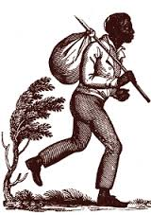
Style & Purpose
Author’s word choice, imagery, setting (the importance of place)
“I was broken in the body, soul, and spirit” – Douglass
“beast-like stupor”
Transformation
Or lack thereof…

Slide 19
Frederick Douglass
Slave for 21 years before he escaped to freedom
His former owner, Mrs. Auld, taught him to read. He also educated himself by reading a textbook on public speaking (The Columbian Orator)
Illegal for slave owners to educate slaves
Lectured for the Massachusetts Anti-Slavery Society
Wrote Narrative of the Life of Frederick Douglass
Traveled to Britain to avoid being recaptured, friends raised money to buy his freedom when he returned
Founded anti-slavery newspaper, North Star.
Advised Lincoln about slavery and black soldiers serving in the Union Army during the Civil War.
Goal was to achieve civil rights for all African Americans.

Slide 20
Harriet Jacobs
Born into slavery. First owner was kind, but then was willed to a 5-year old child of Dr. James Norcom (Dr. Flint). Norcom began to sexually abuse her.
She finally decided to run away
She hid in a tiny space in her grandmother’s attic for seven years.
Finally escaped to New York, where she worked as a nanny for a white family.
Became involved in the abolitionist movement; published “Incidents of a Slave Girl”
Always worried that she would be caught, a worry most runaway slaves had.

Slide 21
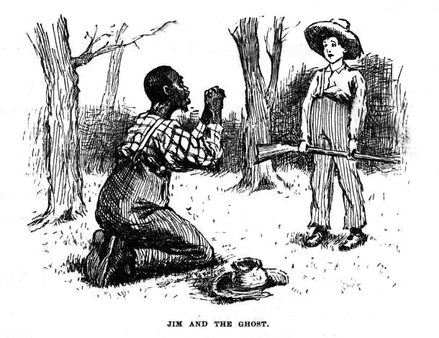
Relation to Huck Finn
1845 – Douglass published his narrative
1875 – Twain published Huck Finn
As you read:
If Twain was well aware of these slave narratives and their power and purpose, as he certainly was, why do you think he wrote this novel? And particularly in the way that he chose to write it?
How does Twain’s writing style reveal his purpose?

Slide 22
Slave Narrative Jigsaw
We will be having a jigsaw in class on Friday, based on two essays.
Narrative of the Life of Frederick Douglass (560-569)
“Incidents in the Life of a Slave Girl” (574-579)
Read the story, then answer the reading questions.
Also provide quotes/facts to support answers

Slide 23
Reading Questions
Summary of your reading, including the effects of slavery
Conclude which conflicts the author struggles with. Internal? Emotional? Explain…
Determine the effect of the authors writing style on the reader. (are they convincing, making their argument)
Determine the price of freedom. Explain.
To what extent is it possible to set yourself free? Explain.
How does reading this impact your understanding of Jim and his desires?
How does reading this impact your understanding of Huck and his concern with being an Abolitionist?

Slide 24
Slave Narrative Jigsaw
Step 1: You will have 10 minutes to summarize the reading and share your question responses with the person who read the same essay as you
Step 2: Mixed group discussion with whole table
Step 3: Group assignment: write a letter to President Lincoln from Jim, highlighting why slavery should be abolished in America.
Use evidence from the two essays to support your argument
About one-two paragraphs

Slide 25
Walt Whitman Poetry

Slide 26
Learning Targets
I can read and analyze poetry for historical context.
I can collaborate with classmates to analyze literature.
I can demonstrate an understanding of Realism and Transcendentalism.

Slide 27
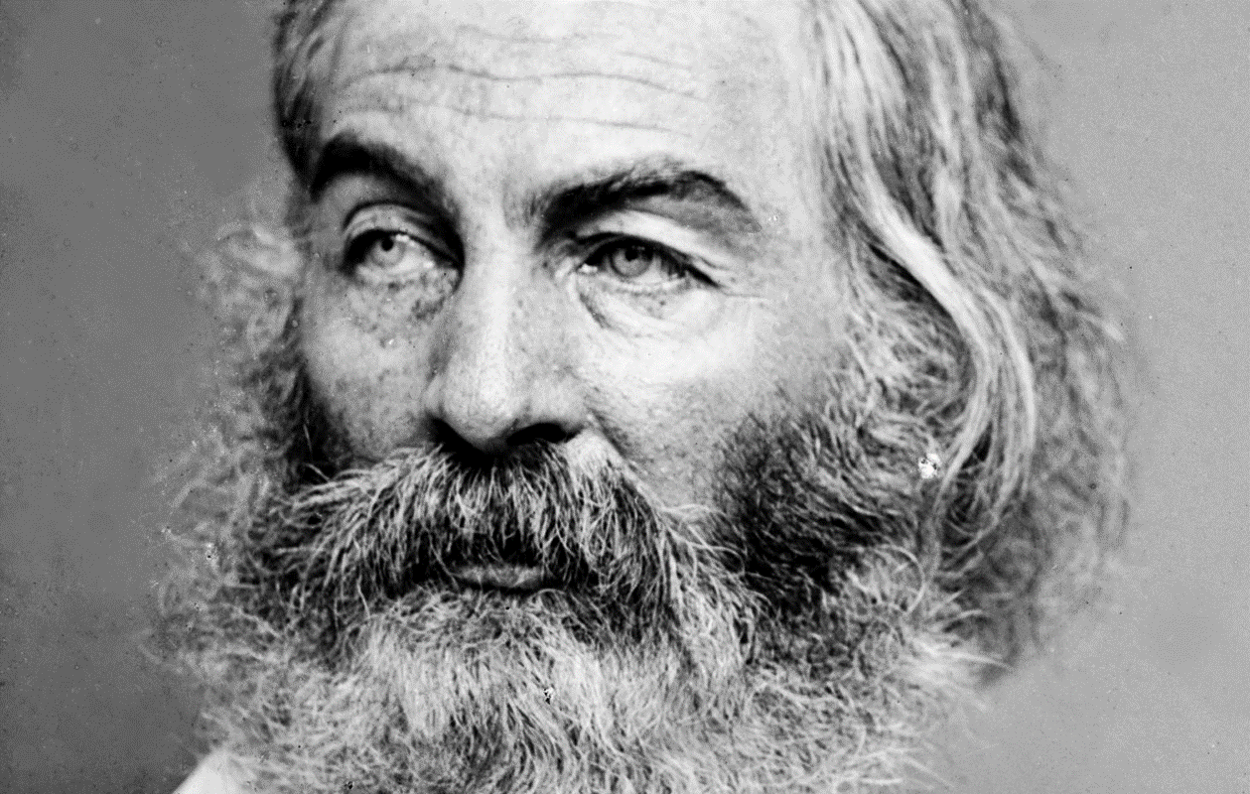
“Do I contradict myself? Very well, then I contradict myself, I am large, I contain multitudes.”
Walt Whitman

Slide 28
Walt Whitman
May 31, 1819 – March 26, 1892
Poet, essayist, journalist
A Humanist, Whitman was part of transition from Transcendentalism to Realism
Concerned with politics
Concluded formal schooling at age 11

Slide 29
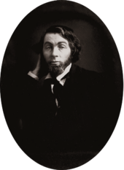
Evolution of a Writer
Early writing career consisted of writing for various East Coast newspapers
Determined to become a poet
Free Verse
An organic form that lacks regular meter and rhyme
Intended to write a distinctly American epic composed of free verse
Leaves of Grass

Slide 30
Leaves of Grass
Paid for its initial publication himself
975 copies
Criticized for being obscene in its nature
Nine editions
Final one published 1892, contained nearly 400 poems
Very well-received by many influential writers
Emerson, Thoreau

Slide 31
His Poetry
Broke boundaries of poetic form
Generally prose-like, free verse
Unusual symbols and imagery
Wrote openly about death and sexuality
Believed there was a vital, symbiotic relationship between poetry and society
Symbiotic: mutually beneficial relationship
America’s first “poet of Democracy”
Vagabond lifestyle was later adopted by Beat Poets

Slide 32
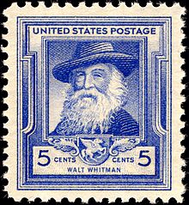
His Beliefs
Did not drink
Embraced all religions equally
Sexual orientation is disputed
Opposed the extension of slavery in the United States

Slide 33
His influence…
“If you are American, then Walt Whitman is your imaginative father and mother, even if, like myself, you have never composed a line of verse. You can nominate a fair number of literary works as candidates for the secular Scripture of the United States. They might include Melville’s Moby Dick, Twain’s Huckleberry Finn, and Emerson’s two series of Essays and The Conduct of Life. None of those are as central as the first edition of Leaves of Grass.”
Harold Bloom, American Literary Critic

Slide 34
“I Hear America Singing” (532)
Published in Whitman’s 1860 edition of Leaves of Grass
What elements of Transcendentalism are present within the poem? What elements of Realism are present?
What is the image of America that Whitman is presenting within the poem? Is this a favorable image? Why or why not?
Individual Thesis! What is the purpose of Whitman’s poem “I Hear America Singing”?

Slide 35
Modernism and Huck Finn

Slide 36
Learning Targets
I can define the term modernism.
I can explain why Huck Finn is a modern novel.
I can collaborate with classmates to evaluate early feminism in America.

Slide 37
Ernest Hemingway said:
"The good writers are Henry James, Stephen Crane, and Mark Twain. That's not the order they're good in. There is no order for good writers.... All modern American literature comes from one book by Mark Twain called Huckleberry Finn. … it's the best book we've had. All American writing comes from that. There was nothing before. There has been nothing as good since." -- from Ernest Hemingway, "The Green Hills of Africa" (1934)

Slide 38
The first modern novel
Huck: “I liked the old ways best, but I was getting so I liked the new ones, too, a little bit.”
Novel is written in 1884 (post-Reconstruction) but set in 1830s and 1840s (pre-Civil War).

Slide 39
Literary Periods We Study
Puritans/New Nation
Rationalism
Romanticism
Dark Romanticism
Transcendentalism
Realism
Regionalism
Modernism
Post Modernism
We will be in modernism through second semester (until the 1950s)

Slide 40
Review of writing techniques
REALISM
REGIONALISM
SATIRE
Adding … modernism & stream of consciousness

Slide 41
Modernism: A new type of literature
Grows out of three things:
Realism
A reaction to Industrialism & the Victorian Age
The death and destruction of WWI
Written using stream of consciousness —authors write down all the thoughts in a characters head
The story will jump around and is hard to follow but rewarding because you know the character better

Slide 42
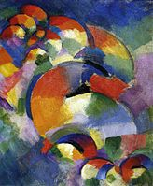
Genres
Visual art, literature, music, film, design, architecture, and lifestyle
Jazz Age and Roaring Twenties
Modernist art
New age of gender roles, feminism and sexuality
Charlie Chaplin and film
Model-T Ford
Food and culture (M&M’s, boxed cakes, deep dish pizza)

Slide 43
Modernist Literature
Focus on inner world of reality, not outer
Experimentation
Fragmentation, juxtaposition of events, narrators, etc.
“Open” endings; lack of resolution
Intensive use of allegory, metaphor, allusion, symbolism
Determine if this applies to Huck Finn (so far).
Notes:
With language
With structure and form (impressions, perspectives)

Slide 44
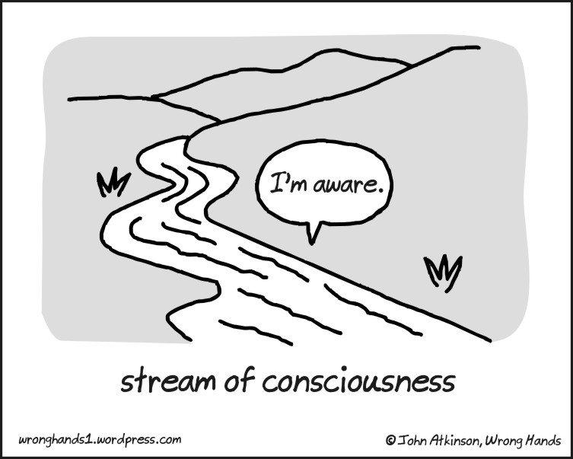
Modernist Technique: Stream of Consciousness
Gives the reader the impression of listening to the running flow of a character’s thoughts and commentary
Water imagery!
“Stream of Consciousness”
Phrase first used
in 1890
Notes:
Phrase first used by William James in 1890

Slide 45
Quote analysis
Huck: “I liked the old ways best, but I was getting so I liked the new ones, too, a little bit.”
What ‘old ways’ does Huck like? What ‘new ways’ does he like? Use specific examples from the text for each.
How does Huck represent a progressive point of view for his era?

Slide 46
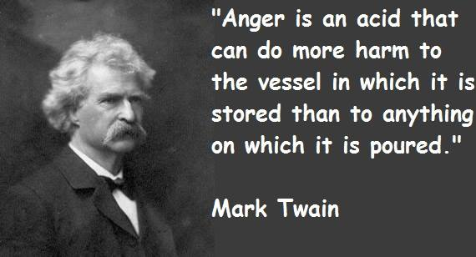
Huck is a Progressive novel, too
Twain’s use of modernism
Literary modernism as an era took place generally between 1900-1960.
Huck Finn was published in 1884 but is a modern novel
Twain’s attitudes towards abolitionism and equality
Twain’s use of a youthful, realistic, flawed, poor, evolving protagonist

Slide 47
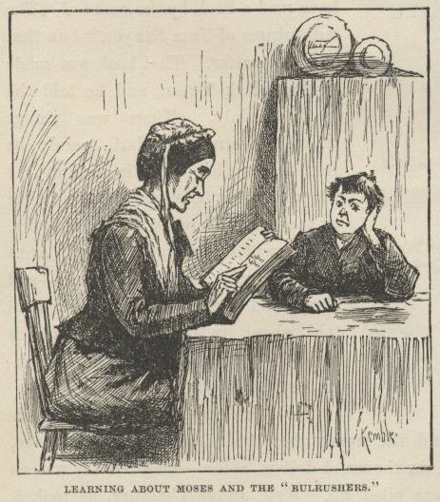
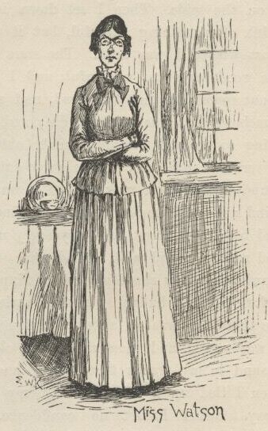
Early American Feminism
How progressive is the novel, really?

Slide 48
Four Stereotypes of Females
Using this lens, analyze the female characters in Huck Finn as being a feminist or stereotypical portrait.
Characters:
Miss Watson
Widow Douglas
Judith Loftus
The virgin
The wife, mother, replacement mother
The temptress or seductress
The old maid
Notes:
Aunt Sally
The Wilks sisters

Slide 49
Table Discussion
Determine Twain’s views on women.
Determine if the novel could be considered a feminist novel.

Slide 50
Brainstorming
So why did I teach you this?
At this time, was it ‘good’ enough to write a novel, or did a novel need to advocate for change?
Huck Finn is full of Twain’s opinions on social reform and social issues
At your table groups:
What social reform or ideas has Twain presented in the novel so far?
Make a list on the board (do not repeat something already up there)

Slide 51
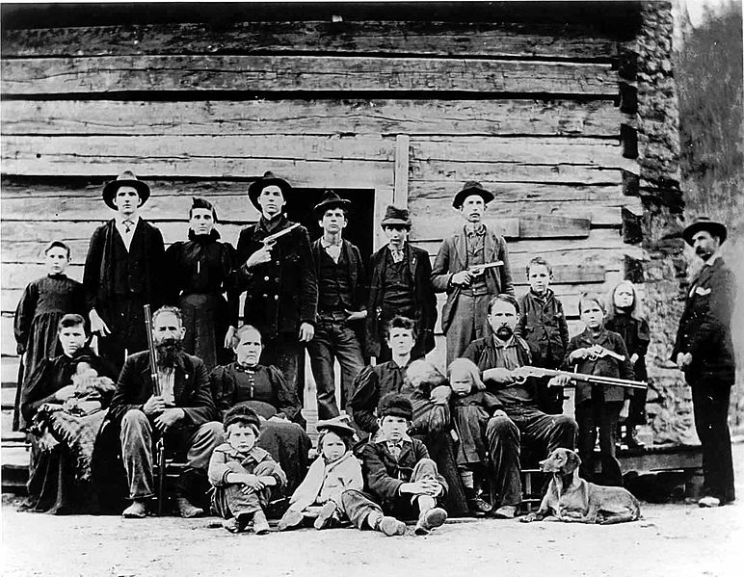
Hatfields vs. McCoys and the Grangerfords vs. Shepherdsons

Slide 52
Learning Targets
I can identify the satirical manner in which Twain presents the feuds
I can determine the purpose of including the feud in Huck Finn

Slide 53
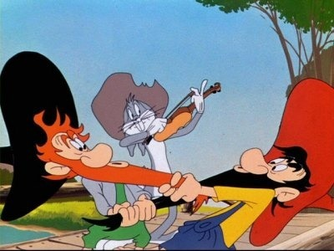
Feud /fyo͞od/ (n)
A state of prolonged mutual hostility, typically between two families or communities, characterized by violent assaults in revenge for previous injuries

Slide 54
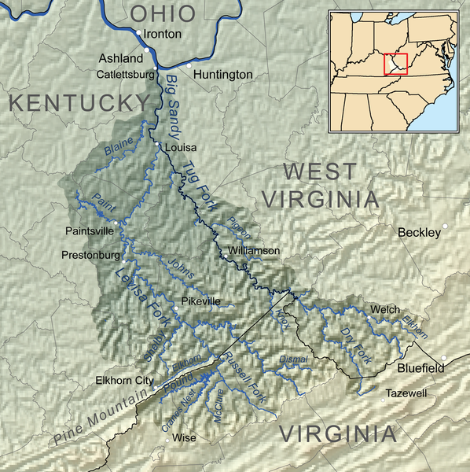
The Feud…
1863-1891
West Virginia-Kentucky
Along the Tug Fork of the Big Sandy River
‘Devil Anse’ Hatfield vs. ‘Ole Ran’l’ McCoy
Synonymous with the perils of family honor, justice, revenge

Slide 55
Almost all of them fought for the Confederacy, with the exception of Asa Hatfield, who fought for the Union
Asa was murdered and Uncle Jim Vance (McCoy) was widely suspected of the murder
13 years later, Hog theft
Roseanna McCoy & Johnse Hatfield

Slide 56
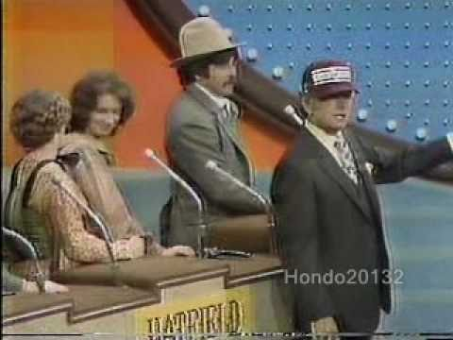
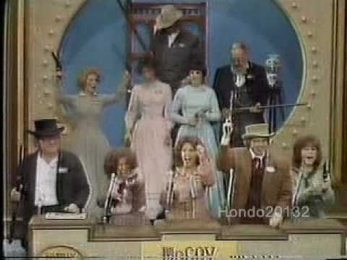
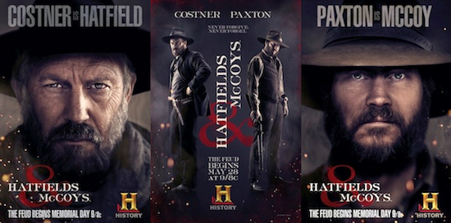
Legacy…
Family Feud
1979
TV shows and film

Slide 57
Yellow Journalism
Journalism that is based on exaggeration, sensationalism
Little or no legitimate well-researched news
Uses eye-catching headlines to sell more newspapers
“Woman gives birth to half cat, half human baby!”
“The president wants to move all immigrants out of the U.S.”

Slide 58
Hatfield’s and McCoy’s
With your group, research the Hatfield’s and McCoy’s feud
Who was involved? Major events? Why did the feud start?
Get a general overview of the history of this feud.
Next:
You are journalists investigating the feud:
Create a headline with 3 details about the event (from the feud)

Slide 59
The Feud Reflection
Summarize the Grangerford/Shepherdson feud (reasons, participants, consequences)
Connections to Hatfields and McCoys?
Determine why Twain would include this feud.
Conclude the comments he is making about society.
How does he use satire with the feud?
So far, determine which characters are ‘civilized’ and which characters are ‘fools/uncivilized’? Explain why.
Provide specific evidence from the text

Slide 60
Huck Finn Timed Write

Slide 61
Learning Target
I can answer a prompt in a specific time frame.
I can use evidence and analysis to fully answer a prompt.

Slide 62
Timed Write Directions
You will have exactly 30 minutes to respond to one of the following prompts.
You may use your books and any notes you have taken.
You must have a thesis, use cited evidence, and provide analysis that is not just a restatement of the evidence.
You will not get any extra time.
Grading using Humanities rubric.

Slide 63
Timed Write Prompts
Determine the social commentary presented by Twain in Huck Finn. Use both historical and literary references in your response.
Twain examines the idea of humanity and inhumanity. How is this examination depicted in the novel?

Slide 64
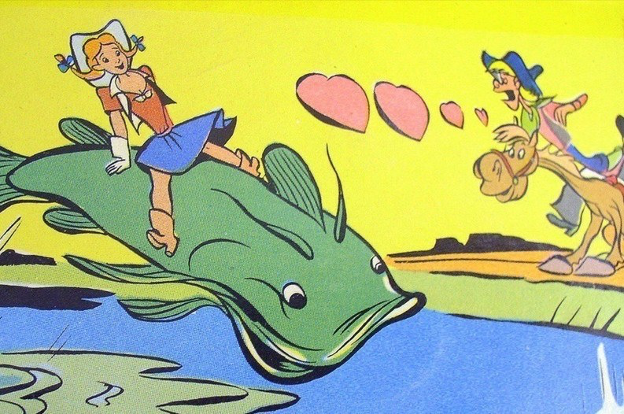
American Folklore & Tall Tales

Slide 65
Learning Targets
I can evaluate the value of tall tales.
I can collaborate to create a visual representation of a tall tale

Slide 66
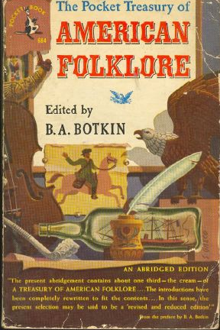
Origin of Tall Tales
One of the forms of literature that came about as a result of this new imaginative way of thinking was the American folklore and tall tales.
By the Romantic time period, the pilgrims landed almost 200 years before.
Americans began to long for some of their own “origins” and stories that taught moral lessons
The Romantic authors embraced this need and, using the ideals of romanticism (the American forms of chivalry), developed some of the best folk stories of American literature.

Slide 67
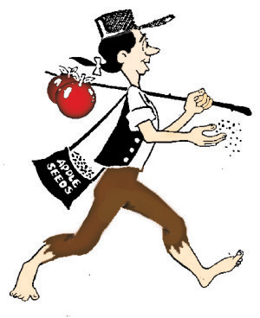
Style of the story
In America, tall tales were first told by settlers who made their homes in the American wilderness. In those days, before TV and movies, people depended on storytelling for entertainment.
After a long day’s work, people gathered to tell each other funny tales.
Each group of workers (cowboys, loggers, and railroad and steel workers) had its own tall-tale hero.
Having a superhuman hero with the same job somehow made their lives easier; perhaps it gave them strength or courage to do their difficult and dangerous work.

Slide 68
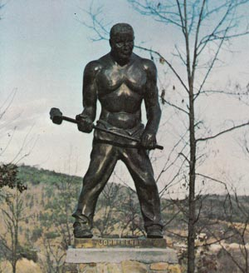
Style of the Story
Tall Tales and Folklore were more than just stories.
They take the normal story:
“John met Mary at her house. They said hello, and started to walk to school. When they turned the corner, they saw a dog…”
and turn it in to a fantastical story:
“John met Mary at her twelve-story mansion. The house, which was bigger than a football stadium, had solid gold walls that shone as bright as the sun on a summer day. John and Mary greeted each other with a jubilant hello and started to skip to school. When they turned the corner, they saw a ferocious hell hound with giant globs of saliva dripping from his teeth.”

Slide 69
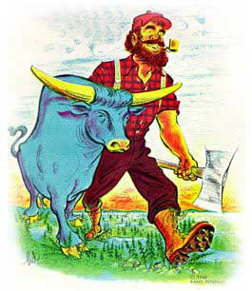
Conventions of a Tall Tale:
Characters: a larger-than-life, or superhuman, main character with a specific job who (attempts) to do impossible things.
Humor: a problem that is solved in a funny way.
Exaggeration: exaggerated details that describe things as greater than they really are.
Use of Colorful Idioms: characters that use everyday language.
Literary Devices: the use of similes and metaphor.

Slide 70
Historical Motivations
Westward migration/exploration
Introspection and debate over issues and ideals surrounding Civil War (sectionalism, slavery)
Pain/death/ destruction resulting from Civil War itself
Religious/philosophical ideals

Slide 71
Working with Tall Tales
As a table group, read the tall tale or summary of the tall tale
Create a children’s book cover for your tall tale
Front:
Symbolic illustration
Title
Idiom that captures the spirit of the story
Back:
Identify the elements that make this a tall tale
What is the moral of this tale?
What are the historical connections?
(Look these up if you are stumped! Research!)

Slide 72
Tall Tale Options
Paul Bunyan
Johnny Appleseed
John Henry
Pecos Bill
Davy Crockett
“The Notorious Jumping Frog of Calaveras County”

Slide 73
Individual Reflection
This will be going in a homework packet, so please make sure you answer these two questions on something you can submit.
To what extent can we use tall tales as a way to understand American culture and history?
Determine the value of tall tales in American history and culture.

Slide 74
Is Huck Finn a racist novel?

Slide 75
Learning Targets
I can critically read the article highlighting important evidence and analysis
I can come to a conclusion about whether Huck Finn is a racist novel
I can use evidence from the reading to prove my argument

Slide 76
Assignment
Critically read the article “Is Huck Finn a Racist Book?” by Peter Salwen
Answer the questions on the back of the reading
Be prepared to have a class discussion using evidence from the reading and your own analysis

Slide 77
Satire and Huck Finn

Slide 78
Learning Targets
I can correctly identify a statement as satire or not
I can determine what Mark Twain was satirizing when he wrote Huck Finn
I can determine why Twain use satire to describe the plight of his characters
I can create an assignment showcasing Twain’s satire

Slide 79
Reminder
Satire: Used to ridicule or make fun of human vice or weakness, often with the intent of correcting, or changing
Twain does not necessarily use humor in the novel
Presents events as serious, but meant to seem ridiculous
This is his use of satire
Feud: presented as this honorable fight between these aristocratic families
Reality: look how stupid rich white people are. They fight for no reason, kill children

Slide 80
How Twain Uses Satire
Pap’s complaints about not getting any justice from the government when he has had “all the anxiety and expense” raising a child.
Pap berates a government that allows a black professor to vote right along with a white man like Pap.

Slide 81
The Grangerfords
“Everybody was sorry [Emmeline Grangerford] died…but I reckon, that with her disposition, she was having a better time in the graveyard.”
Huck is naïve and means this statement literally: Emmeline doted on death and therefore would presumably be happiest among the dead.
Twain, in contrast, is clearly laughing at the poetic justice of Emmeline’s early death.

Slide 82
Epic Poetry
“Buck said [Emmeline] could rattle off poetry like nothing. She didn’t ever have to stop to think.”
Huck’s tone is one of admiration for Emmeline’s ability.
Twain knows that one cannot “rattle off” good poetry and that “stopping to think” is necessary; he is laughing at Emmeline’s verse-writing abilities.

Slide 83
Religion
“Next Sunday we all went to church…The men took their guns along…It was pretty ornery preaching – all about brotherly love, and such-like tiresomeness; but everybody said it was a good sermon, and they all talked it over going home, and had such a powerful lot to say about faith, and good works…”

Slide 84
Religion
Huck is simply telling what happened, his reaction to it, and the reactions of the Grangerfords.
Twain is conscious of many ironies:
The men took their guns to church to hear a sermon about brotherly love.
Although Huck found the sermon tiresome and ornery, he was the most civilized and religious person in the audience.
The butt of the criticism here is not only the Grangerfords but also the church, for it is implied that the church is lacking in true vitality.

Slide 85
Religion
“…There weren’t anybody at the church, except maybe a hog or two…If you notice, most folks don’t go to church only when they’ve got to; but a hog is different.”
Again, Huck mainly reports the facts as he observes them.
Twain, however, is clearly implying that so far as going to church is concerned, hogs are more faithful than human beings.

Slide 86
Practice
Satire or not satire:
“Next Sunday we all went to church…the Shepherdsons done the same” (speaking of Grangerfords and Shepherdsons)
Satire! Aristocracy, Christianity
“I fell in the river, we got five catfish off the lines and went home” (Huck)
Not satire
“She qwyne to sell me down to Orleans” (Jim, about Miss Watson)
Satire! Christianity

Slide 87
Practice
Satire or not satire:
“Why don’t your juries hang murderers? Because they’re afraid the man’s best friend will shoot them in the back” (Colonel Sherburn)
Satire! Men are sheep and cowards
“…and better for a while if people treated him according to his rights, and got down on one knee…always call him ‘Your Majesty’” (Huck on the duke and dauphin)
Satire! Educated white people are fools, easily tricked
“Oh no. The list with tearful eye, whilst his fate do tell. His soul did from this world fly by calling down a well” (Emmeline and her poetry)
Satire! Mocking Romantics/poetry (odes)

Slide 88
Practice
Satire or not satire:
“We got six thousand dollars a piece…Judge Thatcher he took it and put it at interest and fetched us a dollar a day a piece”
Not satire
“The men took their own guns along…and kept them between their knees” (Shepherdsons and Grangerfords in church)
Satire! Religion, white aristocracy, civilized men
“It didn’t take me long to make up my mind that these liars warn’t no kings or dukes at all” (Huck on duke and dauphin)
Not satire

Slide 89
Satire through irony
“Pretty soon I wanted to smoke, and asked the widow to let me. But she wouldn't. She said it was a mean practice and wasn't clean, and I must try to not do it any more. And she took snuff, too; of course that was all right, because she done it herself.”
“They talked it over, and they was going to rule me out, because they said every boy must have a family or somebody to kill, or else it wouldn't be fair and square for the others.”
Your turn: Find another quotation that is satirical, ironic or humorous from the Twain we’ve read thus far.

Slide 90
Questions
Anything you are still unsure about (in terms of Huck and satire)?

Slide 91
Satire Poster
Create a satirical cover for Huck Finn,
On the back, write a satirical novel description
Remember: Satire is used to ridicule or make fun of human vice or weakness, often with the intent of correcting, or changing

Slide 92
Social Reform and Mark Twain

Slide 93
Learning Targets
I can determine and explain how Mark Twain feels about issues in society
I can use evidence from Huck Finn to support my analysis
I can collaborate with classmates to determine Twain’s social commentary

Slide 94
Your assignment
This can be done in collaboration with your group…not divided and conquered.
For each issue listed, come to a conclusion about how Mark Twain felt about the stated issue and give cited examples from the book that support your conclusion.
Issues:
Temperance
Women’s Rights
Abolition of Slavery
Education Reform
Prison Reform
Revivals

Slide 95
Socratic Seminar

Slide 96
Socratic Seminar
Having a graded Socratic seminar on Thursday 10/25
Complete the prep work questions
Prep work goes in participation (10 points)
Seminar grade in Culminating (30 points)
Use quotes and direct evidence in your prep work

Slide 97
Format of Socratic seminar
Split class in half (A and B’s)
Each half will then be split again
Will be two small groups (the inner circle and the outer circle)
Inner circle: only people talking
Outer circle: participating in a silent board discussion
Will switch after 20 minutes

Slide 98
Questions to Answer
Huck begins and ends the novel by resisting being "sivilized." What do you think Huck means by this? Do you think he means the same thing in the beginning of the novel as he does in the end?
Describe the relationship between Huck and Jim. Does their relationship truly change over time? In what way? If you believe it changes, is it a lasting change?
What did freedom mean to Huck? What did it mean to Jim? To what extent do their means reflect pre and post-Civil War Americans?
Determine the social commentary presented by Twain in Huck Finn. Use both historical and literary references in your response.
Twain examines the idea of humanity and inhumanity. How is this examination depicted in the novel?
Investigate how Huck Finn is a reaction to the Civil War and Reconstruction. Conclude the message Twain wants the reader to understand. What are his thoughts of this time period?

Slide 99
Outside Group Discussion
Social criticism
Reconstruction
Random Musings
Lost Cause
Commentary on Racism

Slide 100
Huck Finn and Reconstruction

Slide 101
Learning Targets
I can identify ways in which Huck Finn is an allegory for Reconstruction
I can collaborate to determine the allegory

Slide 102
Huck Finn and Reconstruction
Many say Huck Finn is used as an allegory for Reconstruction
With you group, create a visual representation that tracks the Civil War through Reconstruction using Huck Finn and the story/characters
Analysis: what is Mark Twain saying about Reconstruction?

Slide 103
Things that must be included
How characters represent certain people/groups
How plot points represent the Civil War and Reconstruction
How Twain feels about Reconstruction
You can be creative with this visual, as long as you can clearly explain how Huck Finn is an allegory for Reconstruction

Slide 104
Symbols
Tom: white Southerners (scalawags: cooperate for own benefit)
Tom’s plan to torture Jim: violence use by whites to control African Americans
Aunt Sally’s neighbors: KKK members who use lynching to control
Huck fails to respect Jim, just as America failed to respect African Americans post Civil War
Huck and Jim represent two groups most hurt by Civil War: poor people and African Americans
Huck learns from Jim, but then rich white people influence him to be racist
Duke and Dauphin: white people are not better than African Americans (common perception at the time)
Huck and the state of Tennessee: started as racist (part of Confederacy), then became less racist (captured by Union), but still had some racist tendencies (citizens)

Slide 105
Older Files

Slide 106
In groups
Find a section of “Stream of Consciousness”
Think “inner thoughts”, rambling, flow, one thought to the next without much pause.
What is Twain’s purpose in using stream of consciousness?

Slide 107
Tasks
Read the article, and complete the Hatfields and McCoys chart with the events of the feud and the reactions of the two families (you will have Monday in class to do this)
Create a headline with 3 details about the event (from the feud)
Put this on group assignment sheet
Answer the feud reflection questions (on the next slide)
Put this on group assignment sheet

Slide 108
Tall tales
Story with unbelievable facts that are told as if they are the truth or factual
Exaggerations
Narrator as part of the story
Local color
Part of American folk literature

Slide 109
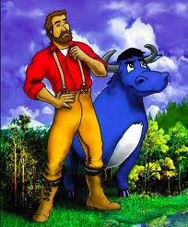

Slide 110
Mark Twain and Tall Tales
You will be reading The Notorious Jumping Frog of Calaveras County (684-690)

Slide 111
Mark Twain and Tall Tales
Looking for the characteristics of tall tales, find specific examples of:
Exaggeration/Hyperbole (1)
Understatement (1)
Local color (2)
Narrator as character in the story

Slide 112
Purpose of tall tales?
Determine why Twain (and other authors) write tall tales.
Investigate the role tall tales play in American history.
Compare Jumping Frog to Huck Finn.

Slide 113
Satire
Create a social media page for Mark Twain
Each satirical entry should be his thoughts and comments on the following
Victorian lifestyle
Wealth
Aristocracy/Southern Hospitality
Romantics/Romantic Adventure
Christianity
Justice
Still use the feuds and the Colonel Sherburn incident as evidence
Must have at least six entries/posts
Can be “retweets” from other people (characters from novel)
Can have hashtags as sort of an explanation of posts
Make this like evidence from the novel

Slide 114
Questions to Answer
Huck begins and ends the novel by resisting being "sivilized." What do you think Huck means by this? Do you think he means the same thing in the beginning of the novel as he does in the end?
Describe the relationship between Huck and Jim. Does their relationship truly change over time? In what way? If you believe it changes, is it a lasting change?
What is the role of the Mississippi River in this book?
What is the purpose of including the feud between Shepherdsons and Grangerfords? What is the purpose of including the duke and dauphin?
What did freedom mean to Huck? What did it mean to Jim?
Compare and contrast society in Twain's time to today's society. Does time change the "message" of the book?
Ernest Hemingway has said that all modern American literature comes from The Adventures of Huckleberry Finn. What features make this book modern? What features make this book American?

Slide 115
What role does nature/society play in shaping our identity and who we are?
Walt Whitman poetry
Today you will be reading the poetry of American Realist Walt Whitman.
While you read the poems, keep in mind the realist depictions of life
Dialect, customs, daily life, environment
Things are everyday life
Write down the meaning of the poem on the printer paper I provided (on just one side)
Keep in mind: he liked Lincoln, written around Civil War time

Slide 116
Poems
Group 1: I Hear America Singing (532)
Group 1: A Noiseless Patient Spider (538)
Group 2: Beat! Beat! Drums! (539)
Group 3: O Captain! My Captain! (handout)

Slide 117
Metaphor
You will create a metaphor for the poem (a before and after metaphor) on the one side of the paper
What is life like before/after a major historical event (these poems: Civil War, death of Lincoln)
Use specific evidence (events, quotes) from the poem as your evidence
Need at least 5 quotes from poem
Put the quotes on the metaphor images
Image cannot be a picture from the text, instead should be a metaphor
Explanation of the poem’s meaning (on other side of paper)

Slide 118
Rubric
Creativity and Neatness | 5 Points Very creative, original metaphor. Multi-colored with lots of details | 4 Points Shows some originality, but doesn’t go beyond what is required. Somewhat detailed | 3 Points Average. Monotone, one dimensional, with sloppy work or no effort | 1-2 Points Little to no creativity. Drew a picture from the novel. No color
Information (X2) | Uses a lot of supporting facts from poem (5) | Uses some supporting facts from poem (4) | Uses little factual information from poem (3) | Little to no facts from poem (2 or less)

Slide 119
Turn in
Written explanation of the poem’s meaning (that you did before you started the metaphor) on one side of paper
Put all contributing group members names on this side
Metaphor with quotes from the text on the other side

Slide 120
Local Color Revisited
With the continued lens of satire

Slide 121
Huck Finn
Conventions: Our assessment of them depends on how we choose to express individuality.
A student who expresses individuality through unconventional dress might regard high school standards of dress as a restriction of freedom.
A student who expresses individuality in some other way might not object to such standards at all.
Which conventions are socially necessary? Which are merely an attempt by some dominant social group to impose its standards on everyone?

Slide 122
Huck Finn
In the mistaken belief that the superficial societal conventions of his day are synonymous with the values of civilization, Huck never realizes that his basic integrity and his compassion reveal him as a truly civilized human being.

Slide 123
Chapter the last
Tom decides that he is going to repay Jim and make sure he is known as a hero.
Tom gives him $40, and Jim says that the omen of a hairy chest bringing riches is true.
Tom wears the bullet around his neck.
Huck thinks that his Pa has taken/spent all the money by know, but Jim tells him that is not possible because the dead body they found in the first house (the one that Jim would not let Huck see the face of), was actually the dead body of Pa.
Huck says that he has nothing more to write about, and that he is “rotten glad”, because writing a book is hard. He decides to head out west because Aunt Sally is trying to civilize him, and he does not want that.
Quote: “she’s going to adopt me and sivilize me, and I can’t stand it. I been there before”.

Slide 124
Last chapters reflection
Conclude if this is really two books in one? Why or why not?
Determine if this is a racist novel.
To what extent have you seen a change have you seen in Huck? In Jim? In Tom?
Conclude Mark Twain’s overall opinion of man. How do you know?

Slide 125
Huck Finn chapters 22-31 Discussion
Through the actions of the King and Duke, who all is being satirized? How?
In these chapters, Huck is very conflicted internally. What different conflicts does he face?
Twain examines the idea of humanity and inhumanity. How is this examination depicted in these chapters?
Explain with some details the events that occur when the “real” Harvey and William arrive? How does mob mentality again come into play here?
Chapter 31 contains the lines, “‘All right, then I’ll go to hell’ – and tore it up.” Explain the complex irony in those lines using detail on who said it and why.

Slide 126
Chapter 5
Plot: Pa returns to see Huck, and is not very impressed by his clothes, and education. Pa goes to the Judge to get the money back, after Huck tells him he is not really rich (even though he technically is, but Thatcher has control of the money). Pa says he is trying to change, so the new judge takes him in and helps him. Pa then later gets drunk and goes back to normal. Thatcher claims the only real way Pa will be reformed is with a shotgun.
Quote: “I’ll learn people to bring up a boy to put on airs over his own father and let on to be better’n what he is” (19).

Slide 127
Timed Write
Huck says: “Well, he was right; he was most always right; he had an uncommon level head for a n****r” (chapter 14).
How does this statement and the following conversations show us more about how Huck views Jim?
Determine why Twain use satire to describe Jim and his escape from slavery.

Slide 128
Outside Groups
Determine Twain’s social criticism using Huck and Jim’s journey. Determine Mark Twain’s overall opinion of man.
Justify if Huck is a character who changes throughout the novel.
Examine the use of the “n-” word and whether it is needed or just racist.
Random Musings
Determine how the novel is an allegory for Reconstruction.

Slide 129
Huck Finn review

Slide 130
River Illustration
Introduction
Jackson’s Island
Huck dressing as a girl (with Judith Loftus)
Raft crash and robbers boat
Grangerfords vs. Shepherdsons
Duke and dauphin and all their nonesuch
Wilks family
Phelps farm and the selling of Jim
Breaking Jim out of the shack, Tom’s return
Conclusion….
Some of the major plot points that need to be included (these are the minimum, you are encouraged and expected to add other events, and give specific details of what happened):

