Slide 1
Hemingway and Fitzgerald

Slide 2
Essential Questions
Determine the major differences between Fitzgerald and Hemingway.
Conclude what type of writing style was valued more by the people of the 1920s.
Conclude which writing style would be best for conveying social commentary or criticism.

Slide 3
Hemingway & Style

Slide 4
Learning Target/Task
I can critically read the short Hemingway story “Three Shots”
As partners, try to answer: What do you think Hemingway is trying to do with this story?
Answer discussion questions on back of critical reading sheet

Slide 5
Discussion Questions
How is this story an example of modernism?
What differences and similarities do you see between Hemingway and Fitzgerald (think about their writing styles)?
What do you think Hemingway thinks about Masculinity?
Independence?
Women?

Slide 6
Style
Contributing Factors:
Types of adjectives and adverbs (simple or complex)
Clause length
Sentence length
Paragraph length
Use of dialogue
Use of vernacular
Choice of punctuation
Why does style matter?
How does Hemingway’s style affect the mood of “Three Shots”?
How does Hemingway’s style shape the character development of Nick Adams?

Slide 7
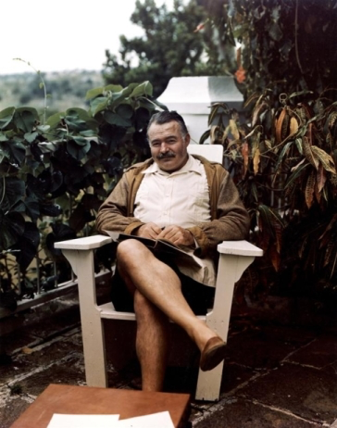
Hemingway
Served in WWI
Moved to Paris
Known for his style of writing: a break in traditional narrative
Sparse, deliberate choices to break from flowery language of the past
Left out essential information of the story in the belief that omission can sometimes strengthen the plot of the novel
Major Themes: Love, war, wilderness, loss

Slide 8
Hemingway’s Style: Iceberg Theory
The Iceberg Theory (Theory of Omission) is the characteristic writing style of Ernest Hemingway.
Hemingway chooses to give very little context or interpretation in his stories. His style is minimalistic and focuses on surface elements without specifically explaining underlying themes.
Hemingway believed the deeper meaning of a story should not be evident on the surface, but should shine through implicitly.
You start with the tip of the iceberg, but there is much more complexity and meaning beneath the surface.
Critics argue that this Iceberg writing style functioned to distance Hemingway from his characters.

Slide 9
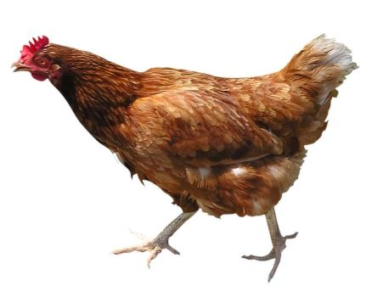
What would Hemingway say?
Why did the chicken cross the road?
To die. In the rain.

Slide 10
Six Word Stories
For sale: baby shoes, never worn.
What does this story reveal to the reader?
How does Hemingway manage to tell us an entire story in just a few words?
Notes:
https://www.youtube.com/watch?v=nc5VbZ2RnTg

Slide 11
Homework:
Create your own six word story!
In the spirit of Hemingway, you are going to create your very own six word story.
Be creative & have fun!
Due tomorrow, 15 points
10 pts for your six word story
5 pts for creativity and presentation (Make it pretty! They will be on display!)

Slide 12
Hemingway and Fitzgerald

Slide 13
Ernest Hemingway (1899-1961)

Slide 14
Started his career as a writer in a newspaper office in Kansas City
Hemingway became a member of the group of expatriate Americans in Paris
The Sun Also Rises (1926), A Farewell to Arms (1929), For Whom the Bell Tolls (1940), The Old Man and the Sea (1952)
Many had autobiographical elements (war experience, life abroad)

Slide 15
Today
In Another Country (1010)
Look at first paragraph
What do you notice about his writing?

Slide 16
Hemingway Piece
“In the fall the war was always there, but we did not go to it any more. It was cold in the fall in Milan and dark came very early. Then the electric lights came on, and it was pleasant along the streets looking into the windows. There was much game hanging outside the shops, and the snow powdered in the fur of the foxes and the wind blew their tails. The deer hung stiff and heavy and empty, and small birds blew in the wind and the wind turned their feathers. It was a cold fall and the wind came down from the mountains.”

Slide 17
Fitzgerald
Look at chapter 1 in Gatsby, third paragraph
What do you notice about his writing?

Slide 18
Compare
What differences and similarities do you see between Hemingway and Fitzgerald?

Slide 19
Task
Translate Hemingway’s passage into Fitzgerald-eque style (keeping in mind the style, format)
Translate Fitzgerald’s passage into Hemingway-esque style (keeping in mind the style, format)
Due in 20 minutes!

Slide 20
Hemingway Piece
“In the fall the war was always there, but we did not go to it any more. It was cold in the fall in Milan and dark came very early. Then the electric lights came on, and it was pleasant along the streets looking into the windows. There was much game hanging outside the shops, and the snow powdered in the fur of the foxes and the wind blew their tails. The deer hung stiff and heavy and empty, and small birds blew in the wind and the wind turned their feathers. It was a cold fall and the wind came down from the mountains.”

Slide 21
Fitzgerald Piece
“He didn’t say any more but we’ve always been unusually communicative in a reserved way and I understood that he meant a great deal more than that. In consequence I’m inclined to reserve all judgments, a habit that has opened up many curious natures to me and also made me the victim of not a few veteran bores. The abnormal mind is quick to detect and attach itself to this quality when it appears in a normal person, and so it came about that in college I was unjustly accused of being a politician, because I was privy to the secret grief’s of wild, unknown men. Most of the confidences were unsought—frequently I feigned sleep, preoccupation or a hostile levity when I realized by some unmistakable sign that an intimate revelation was quivering on the horizon—for the intimate revelations of young men or at least the terms in which they express them are usually plagiaristic and marred by obvious suppressions. Reserving judgments is a matter of infinite hope. I am still a little afraid of missing something if I forget that, as my father snobbishly suggested and I snobbishly repeat, a sense of the fundamental decencies is parceled out unequally at birth.”

