Slide 1
The great depression

Slide 2
Learning targets
I can demonstrate an understanding of the 1930s experience and life
I can demonstrate an understanding of how the excess of the 1920s lead to the Great Depression
I can determine how literature can be used to create social change and awareness

Slide 3
The Great Depression
On Tuesday, October 29th, 1929 the stock market plummeted. Investors dumped a record 16 million shares that day, known as Black Tuesday. Additional millions of shares could not even find buyers. By mid-November, investors had lost $30 billion, an amount equal to American spending in World War I. This exacerbated an already desperate time for industries and farmers. Many believe the United States remained in the midst of The Great Depression until the start of World War II.
The Dust Bowl
New farming techniques and overproduction exhausted the land and when the drought and winds began in the early 1930s, little grass and few trees were left on the plains to hold the soil down. Plagued by dust storms, thousands of farmers and sharecroppers left their land behind. They packed up their families and few belongings and headed west, following route 66 to California.

Slide 4
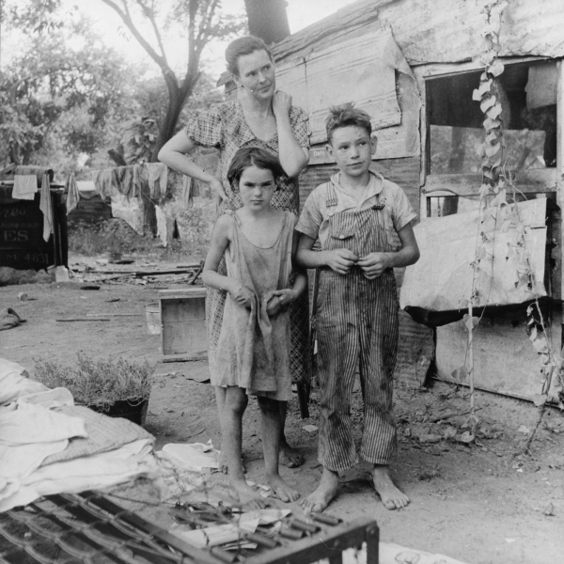
Surviving the Depression: Art, Music & Literature in 1930s America

Slide 5
Overview
Over the next two weeks we will be looking at various forms of literature from the 1930s & 1940s to determine how what it means to be an American shifts in the years after the Roaring 20s
You will turn in a short homework packet with your process work at the end of the unit

Slide 6
Free Write
If you knew that you had to leave your home, you wouldn’t be able to return, and you weren’t going to be in a new home anytime soon, what four items would you take with you and why?

Slide 7
Escapism
The tendency to seek distraction and relief from unpleasant realities especially by seeking entertainment or engaging in fantasy
Popular culture and literature grew as citizens sought diversion from their troubles

Slide 8
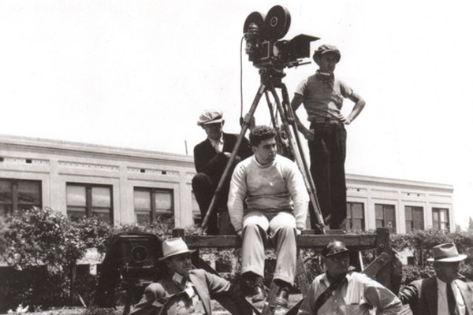
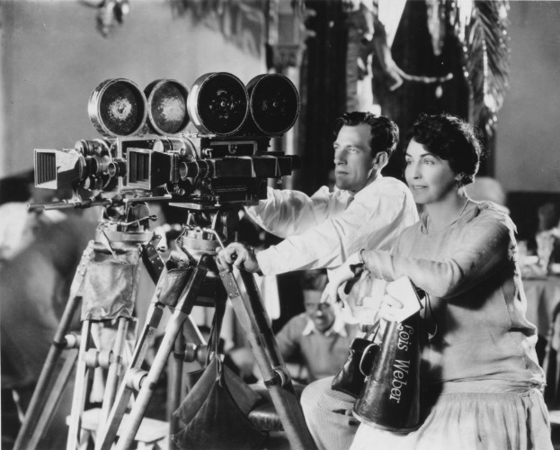
Camera Technology: 1930s
Start to see more of an emergence of actual footage being used in documentary films in the 1930s, as this technology becomes more widely available.
However, this was still very expensive and very difficult, and thus not available to the public at large.
Today, anybody can make a documentary, and almost anybody can make a good documentary, but back then there was a push/drive towards film that was cheap and entertaining, rather than things that dwelled on the awful realities of what was going on around them
(Unlike Twain, they did NOT want to be reminded of what was actually happening)

Slide 9
Fun Fact! ☺
During the 1930s mass-produced, die-cut, cardboard jigsaw puzzles came into huge demand
The jigsaw puzzle became a positive (and relatively cheap) source of family entertainment
A form of escape!
Wooden puzzles were popular among the rich, and cardboard pieces among the poor

Slide 10
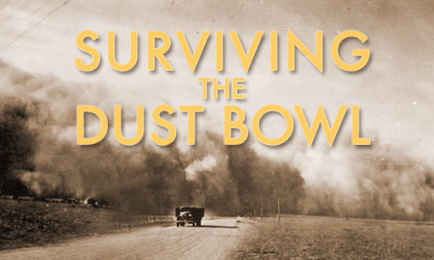
The Role of Personal Narrative
In order to truly understand WHY people relied so heavily on Escapism, we must clearly understand WHAT they were turning away from.
“Surviving the Dust Bowl” : captures the personal narratives of the farmers who came to the Southern Plains of Texas, Oklahoma and Kansas dreaming of prosperity, and lived through ten years of drought, dust, disease and death.

Slide 11
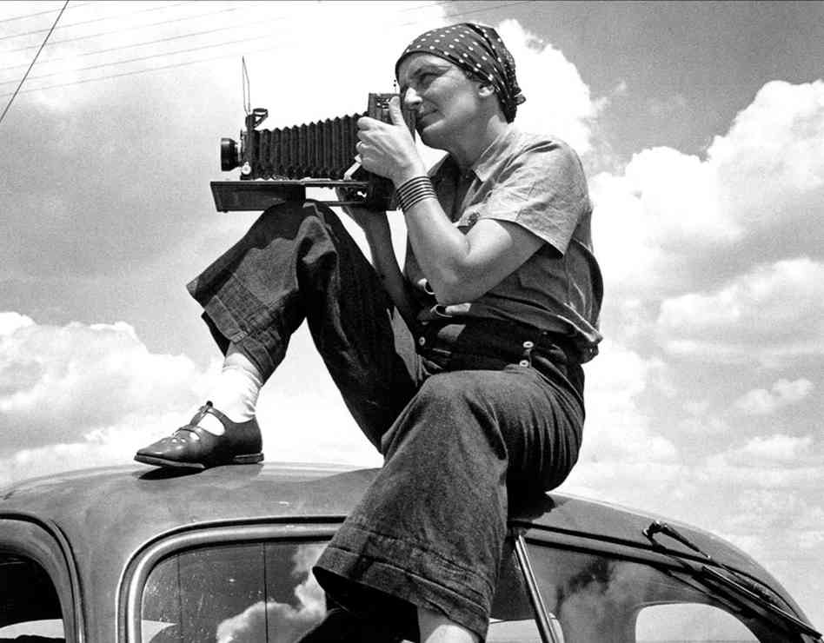
DorotheA Lange
"You put your camera around your neck along with putting on your shoes, and there it is, an appendage of the body that shares your life with you. The camera is an instrument that teaches people how to see without a camera." - Dorothea Lange

Slide 12
About Lange (May 26, 1895 – October 11, 1965)
Documentary photographer and photojournalist
Worked for the Farm Security Administration (FSA)
an effort during the Depression to combat American rural poverty
Rehabilitate farms, improve lifestyles, purchased bad farms
Farmers work on government owned farms

Slide 14
To what extent do these photographs represent the 1930s?
Determine what themes these photographs explore or emotions they evoke.
Conclude how these photographs might have impacted the 1930s and its aftermath.

Slide 15
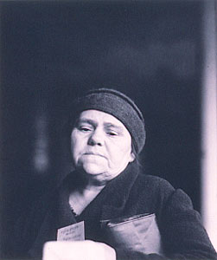
First Food Line Distribution, San Francisco, 1933

Slide 16
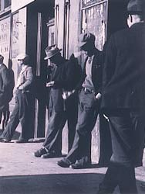
San Francisco, California, 1934 "Thirteen million unemployed fill the cities in the early thirties."

Slide 17
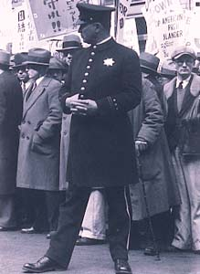
Street Demonstration, San Francisco, 1933

Slide 18
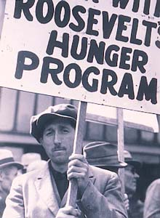
Demonstration Sign, San Francisco, 1934

Slide 19
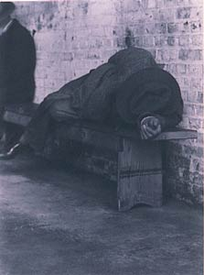
Howard Street, San Francisco, 1934

Slide 20
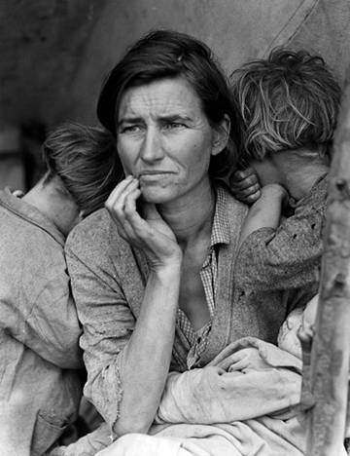
Migrant Mother
Nipoma, CA 1936

Slide 21
To what extent do these photographs represent the 1930s?
Determine what themes these photographs explore or emotions they evoke.
Conclude how these photographs might have impacted the 1930s and its aftermath.

Slide 22
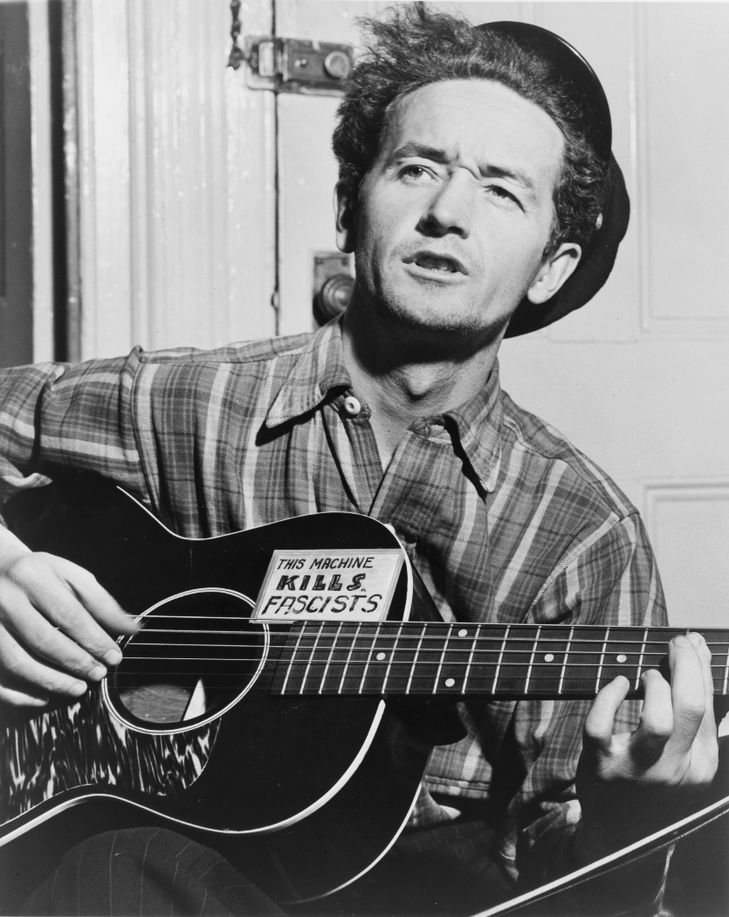
Woody Guthrie
American singer-songwriter and folk musician
“This Land is Your Land”
Songs were about his experiences in the Dust Bowl era during the Great Depression
Traveled with migrant workers to California

Slide 23
“This Land is Your Land”
What qualities in the lyrics of Guthrie’s song convey his life experiences?
Why do you think he wrote the song and performed it?
What does the song tell you about life and experiences during this period?

Slide 24
“Dust Bowl Ballads”
How does the song or the style of music exemplify the era?
What emotions and themes do you hear in the music and the lyrics?
How would you define this era, according to the music?

Slide 25
Why do we need the arts?
Job creation & economic stimulus
But also…
Boosted morale
Restored confidence
Cultural equivalent of the New Deal
Psychological stimulus package

Slide 26
1930s Hollywood
Sound and color revolutions
First color film debuted in 1932, an animated Disney short
1934 saw the first live-action full-color film, La Cucaracha
The advance of the “talkies”
Expanse of genres
First drive-in theatre opened in 1933
Despite the serious effects the Depression had on the film industry theatre attendance remained between 60-75 million a week, even in the worst days of the Depression
Provided a balancing act between cynicism & realism of the Depression and escapism of the arts

Slide 27
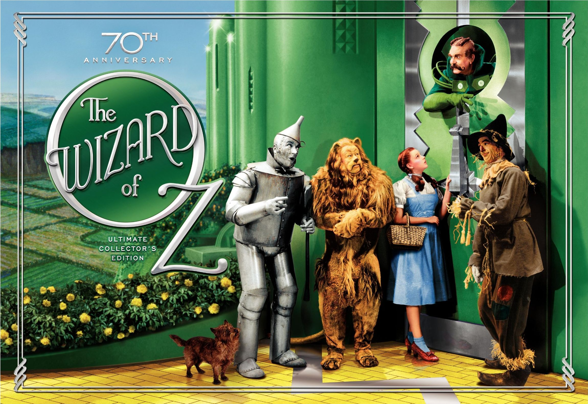

Slide 28
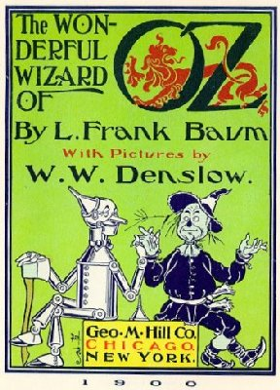
Cultural Significance
Based off of the children’s novel written by Frank L. Baum in 1900
Film made in 1939
Lost Best Picture to Gone with the Wind
Dorothy Gale, swept away from Kansas in a cyclone
Technicolor
Ushering us out of the Depression and into the renewed prosperity of war time!

Slide 29
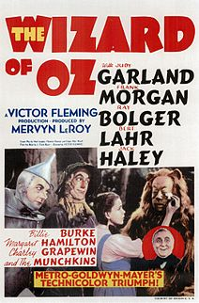
Cultural Significance (cont’d)
Twister: Stock Market Crash, Dust Bowl
Wizard: Roosevelt & his New Deal

Slide 30
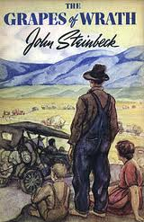
The Grapes of Wrath (1939)
John Steinbeck
“I want to put a tag of shame on the greedy bastards who are responsible for this [the Great Depression and its effects]."

Slide 31
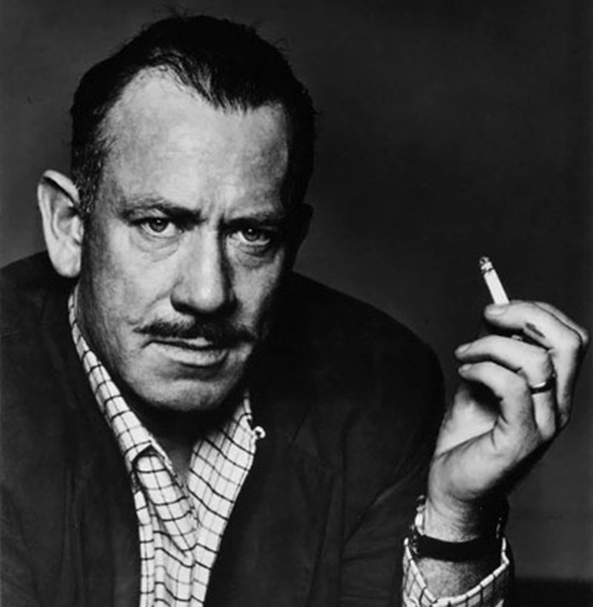
Who is John Steinbeck?
American author
Winner of the 1962 Nobel Prize in Literature
Most of his work is set in southern and central California (the Salinas Valley in particular)
Explored themes of fate and injustice, particularly as applied to the everyman
Publically critical about the government
Notes:
http://www.biography.com/people/john-steinbeck-9493358/videos/john-steinbeck-mini-biography-2174100661

Slide 32
Poetry of Place
Close your eyes and think of your favorite place on earth. Now, take the next 5 minutes and write in as much detail as you possibly can about that place.
Steinbeck = Poetry of Place
Captured the Salinas Valley and the rolling hills and valleys of California like no one had before or has since

Slide 33
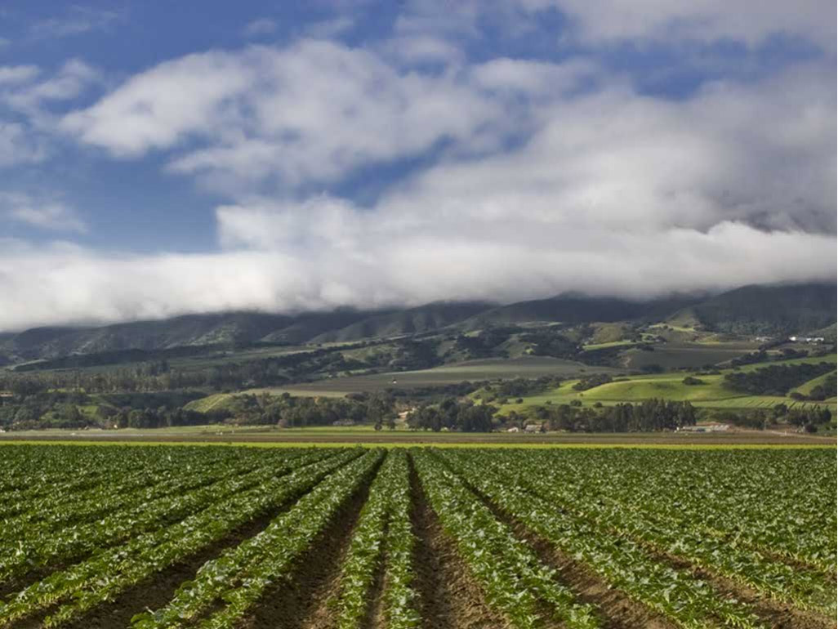

Slide 34
The Grapes of Wrath
Follows the Joad family as they travel from Oklahoma to California
Developed from “The Harvest Gypsies”, a series of seven articles about the plight of migrant workers

Slide 35
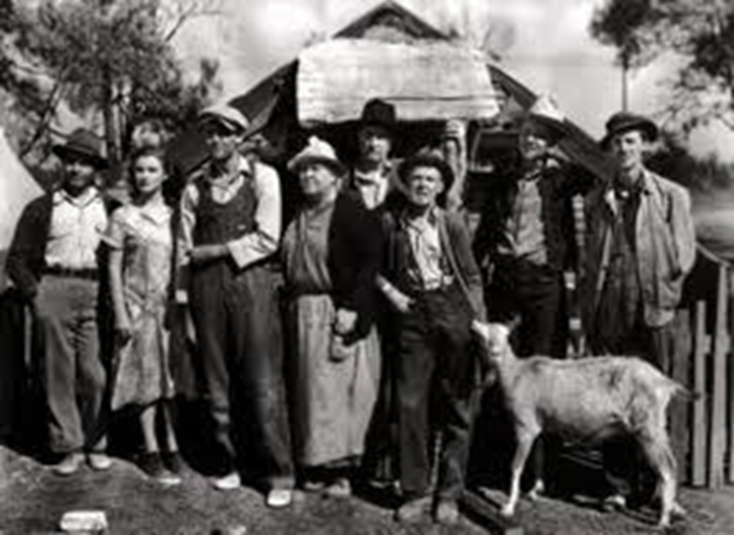
Migrant Worker
A person who moves from place to place to get work, especially farm work
The migrant worker pool is filled with marginalized peoples: the poor, immigrants, racial minorities
Estimated 2 million migrant workers in the US in the 1930s

Slide 36
Why do we still read it today?
Many families making the same journey
False hope and promises out West
Big corporate farmers, bankers, big business=evil, sucking the blood from the land
Try to organize unions, fight for the oppressed

Slide 37
Chapter 19
Read chapter 19, taking note of what life was like for the migrant workers, why they migrated West.
What were the living conditions in the migrant camps?

Slide 38
What does the title mean?
Oppression/wrath will come from the Dust Bowl
But…
Through cooperation and hard work, the workers will be delivered/saved

Slide 39
OLD STUFF

Slide 40
Visual representation
Think about the music, readings, film, and photographs
Visually represent the authors purpose/intent
Why would they create these pieces? What are they trying to achieve? What are they saying to the American public? How would you define the 1930s?
Due: tomorrow for a gallery walk

Slide 41
Escapism in the depression
Your table group will be writing a movie to help people in the 30s escape the Great Depression
You must incorporate events from the Depression, struggles of the people, and villains/heroes of the Depression in your film
Any genre, any type of characters (animals, people)
You will be writing:
Character descriptions
Setting
Brief outline of the film
Creating a film poster

Slide 42
The Grapes of Wrath film
Clip 1 (36-46:15)
What do you notice about their journey?
Who was affected? Why?
Clip 2 (1:05-1:11)
Were conditions in the migrant camps better than back in Oklahoma?
What is the ‘agitator’ trying to do? Why?

Slide 43
Board talk
Using specifics from the novel/film:
What did you notice about life for migrant workers?
Why are they migrant and not immigrant workers?
What is the attitude of these workers?

Slide 44
Characteristics
Come up with five characteristics of Depression era art (music, literature, etc.)
Find one example from what we have seen, heard, and read
Poetry
Dorothea Lange
Woody Guthrie
Create a visual representation of these characteristics (on printer paper)

Slide 45
Reflection Question
Is it fair/right for American people to blame the president and government for the problems of the Great Depression and/or the situation America is in today?

Slide 46
Found Poem
With your table groups, you will write a Found Poem
Research some Great Depression songs, poems, stories (and you can use what we have read/listened to in class)
MUST BE PRIMARY SOURCES
Must have 16 lines
Prompt: what was the Great Depression like for the people of America?

Slide 47
resources
Federal Writers Project
Poetry, stories, first person accounts from the Great Depression
http://www.loc.gov/collection/federal-writers-project/about-this-collection/

Slide 48
Great Depression Found Poem
Getting started:
Choose sixteen lines from your research that you think create a vivid image of The Great Depression and the experience of the people
Copy down the primary source words. Then re-arrange the words/lines quotes to create a ‘found’ poem.
Re-order words so that you communicate images or emotions clearly.
Omit words that aren’t necessary.
Change punctuation, capitalization, verb tense, plurals, or possessives, as necessary.
Add up to four words of your own, if you absolutely need to add something to make the poem flow more smoothly or to make sense.

Slide 49
Space or arrange the words so they are poem-like. Pay attention to line breaks, layout, and other elements that will emphasize important words or significant ideas in the poem
Arrange the words so that they make a rhythm you like. You can space words out so that they are all alone or allruntogether.
You can also put key words on lines by themselves (max one time though)
You can shape the entire poem so that it’s wide or tall or shaped like an object
Choose a title.

