Slide 1
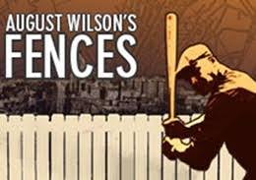
Fences
August Wilson

Slide 2
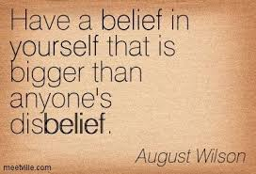
Essential questions
To what extent does the past shape ones identity?
Investigate the title Fences and determine the appropriateness using the themes, literary devices, characters, and commentary of the play as evidence.
Investigate the experience of African Americans in 1950s and 1960s America.

Slide 3
Fences by August Wilson
“Troy Maxson is a survivor—a black man who has remained proud despite pressure that could crush a man. As things begin to change and the 1960s take hold, Troy finds that he has become a stranger in his own family and community. After so many years of fighting adversity, he becomes angry and afraid as he tries to face the new world and a wife and son he barely understands.”

Slide 4
Background
Play written in 1985 by August Wilson
Play is set in the 1950s
Part of a ten-part “Pittsburgh Cycle” collection (Fences is number 6).
Most of his plays, including Fences, analyze and explore the experiences of African Americans in America, as well as race relations.
1987 Pulitzer Prize for Drama and 1987 Tony Award for Best Play.
Movie adaptation starring Denzel Washington and Viola Davis (2016)

Slide 5
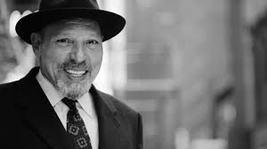
August Wilson
Born on April 27, 1945, in Pittsburgh, Pennsylvania.
Based many plays in the city
His mother Daisy Wilson, was of African-American heritage. His father Frederick Kittle was a German immigrant.
When his parents divorced, he, his mother and his siblings moved from the poor Bedford Avenue area of Pittsburgh to the mostly white neighborhood of Oakland.
Faced bigotry through high school, so instead at 15 years old, Wilson pursued an independent education at Carnegie Library of Pittsburgh, and earned his high school diploma.
Wrote his first play, Jitney, in 1979.
Winner of numerous Pulitzer Prizes and a Tony
Wilson died of liver cancer on October 2, 2005, in Seattle, Washington.

Slide 6
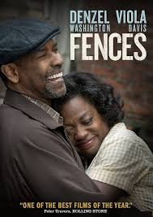
Characters
Troy: main character, skilled baseball player (Negro League as color barrier was not broken yet), went to prison for accidental murder that happened during robbery; works as trash collector
Rose: Troy’s wife; independent, strong
Cory: Rose and Troy’s high school son; aspiring football player with good prospect for college
Raynell: Troy’s daughter
Lyons: Troy’s son from previous marriage; aspiring musician
Gabriel: Troy’s brother. Injured during WWII, and received $3000 as a result. Troy used the money to buy a house
Bono: Troy’s friend and co-worker. Friday payday drinking

Slide 7
setting
“The yard which fronts the only entrance to the Maxson household, an ancient two-story brick house set back off a small alley in a big-city neighborhood. The entrance to the house is gained by two or three steps leading to a wooden porch badly in need of paint”
“The yard is a small dirt yard, partially fenced”
“Opposite is a tree from which hangs a ball made of rags. A baseball bat leans against the tree”
Source: Wilson, August. Fences

Slide 8
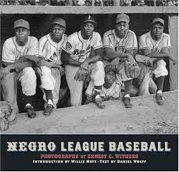
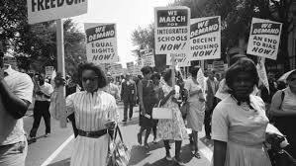
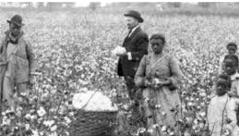
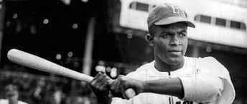
Historical background information
Sharecropping
Baseball and the Negro League
Jackie Robinson
Civil Rights Movement

Slide 9
Themes
The creation of order
The reality of the American Dream for African Americans (opportunities vs. limitations)
Freedom vs. protection
The burden of responsibility, especially in family life

Slide 10
Use of the n-word
Read the “The Meanings of a Word” by Gloria Naylor
Naylor writes that, “I don’t agree with the argument that the word n- at this social stratum of the black community was an internalization of racism”. Evaluate her statement and the use of the n- word in the black community.

Slide 11
Unit overview
Participation and Process:
Will read play as a whole class
Reading guide with analysis questions
Each Act: short answer
Film analysis
Culminating:
Assessment: short writing assignment

